Slide 1
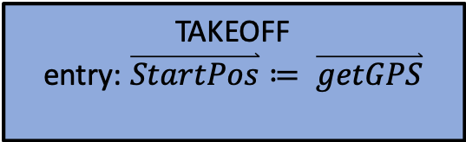
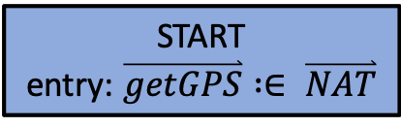
on
START
entry: $\overset{⃑}{getGPS} :∈ \overset{⃑}{NAT}$
toTakeoff
SHUTDOWN
OFF
off
OPERATIONAL
TAKEOFF
entry: $\overset{⃑}{StartPos}≔ \overset{⃑}{getGPS}$
toFly
toLand
landed
FLY
DESCEND
LANDED
toTakeoff

Slide 2

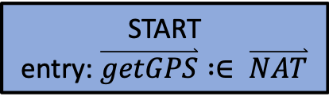

on
START
entry: $\overset{⃑}{getGPS} :∈ \overset{⃑}{NAT}$
toTakeoff
SHUTDOWN
OFF
off
OPERATIONAL
TAKEOFF
entry: $\overset{⃑}{StartPos}≔ \overset{⃑}{getGPS}$
toLand
landed
FLY
DESCEND
LANDED
$getGPS \overset{⃑}{y}>minimum$ / toFly
CLIMB
toFly
HOVER
toTakeoff

Slide 3
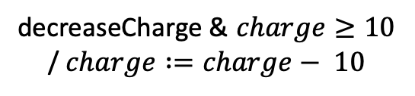







on
START
entry: $\overset{⃑}{getGPS} :∈ \overset{⃑}{NAT}$
toTakeoff $\& charge≤50$
SHUTDOWN
OFF
off
OPERATIONAL
FLYOP
TAKEOFF
entry: $\overset{⃑}{StartPos}≔ \overset{⃑}{getGPS}$
toLand
landed
FLY
DESCEND
LANDED
$getGPS \overset{⃑}{y}>minimum$ / toFly
CLIMB
toFly $\& charge≤40$
HOVER
BATTERYOP
BATTERY
decreaseCharge & $charge≥10$
/ $charge :=charge− 10$
BATTERYOK
BATTERYLOW
$charge≤20$ / toLand
toTakeoff $\& charge≤50$

Slide 4
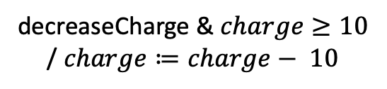


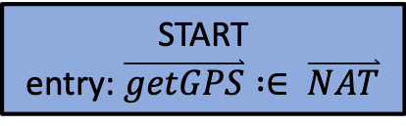




on
START
entry: $\overset{⃑}{getGPS} :∈ \overset{⃑}{NAT}$
toTakeoff $\& charge≤50$
SHUTDOWN
OFF
off
OPERATIONAL
FLYOP
TAKEOFF
entry: $\overset{⃑}{StartPos}≔ \overset{⃑}{getGPS}$
toLand
landed
FLY
DESCEND
LANDED
$getGPS \overset{⃑}{y}>minimum$/ toFly
CLIMB
CLIMB2
toFly $\& charge≤40$
HOVER
ABORT
cancel / toLand
toLand
BATTERYOP
BATTERY
decreaseCharge & $charge≥10$
/ $charge≔charge− 10$
BATTERYOK
BATTERYLOW
$charge≤20$ / toLand
toTakeoff $\& charge≤50$

Slide 5
on
START
entry: $\overset{⃑}{getGPS} :∈ \overset{⃑}{NAT}$
toTakeoff $\& charge≤50$
SHUTDOWN
OFF
off
OPERATIONAL
FLYOP
TAKEOFF
entry: $\overset{⃑}{StartPos}≔ \overset{⃑}{getGPS}$
toLand
landed
FLY
DESCEND
LANDED
$getGPS \overset{⃑}{y}>minimum$/ toFly
CLIMB
CLIMB2
toFly $\& charge≤40$
HOVER
ABORT
cancel / toLand
toLand
BATTERYOP
BATTERY
decreaseCharge & $charge≥10$
/ $charge≔charge− 10$
BATTERYOK
BATTERYLOW
$charge≤20$ / toLand
toTakeoff $\& charge≤50$

Slide 6
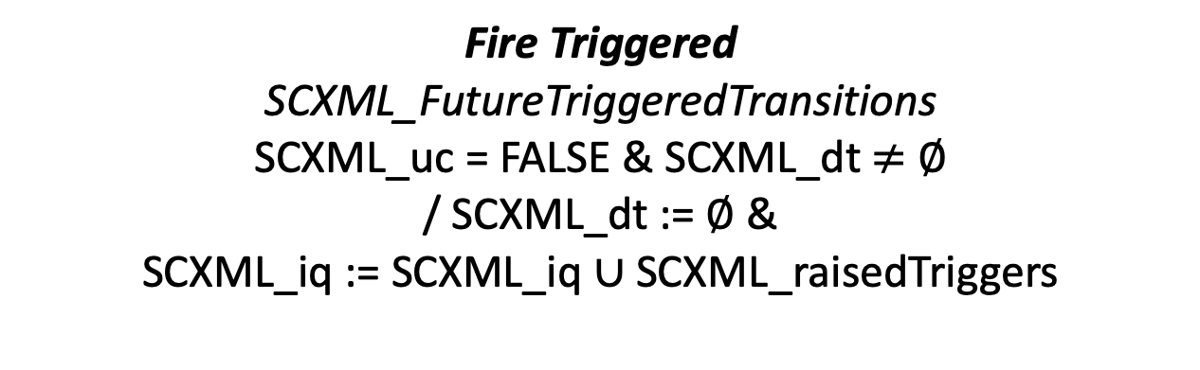
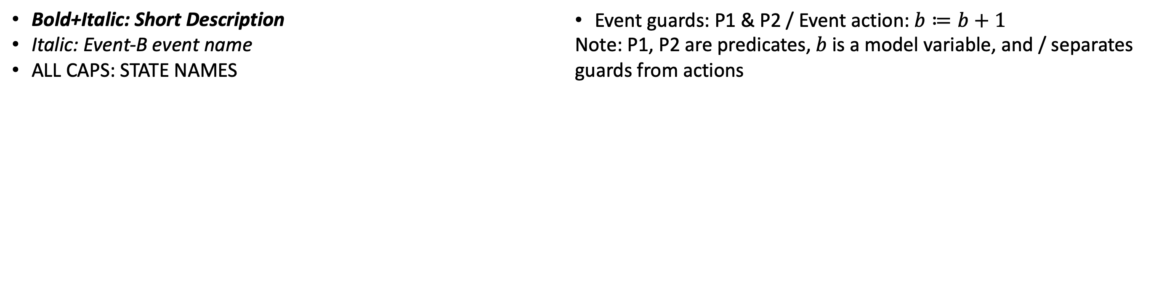
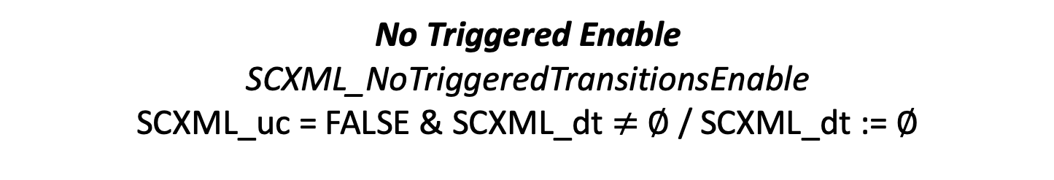
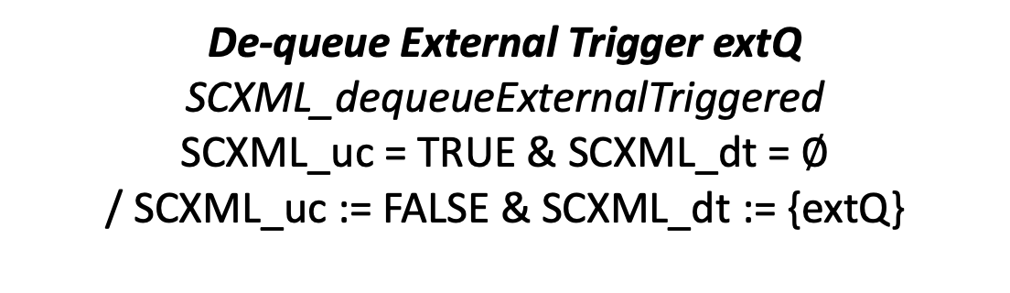
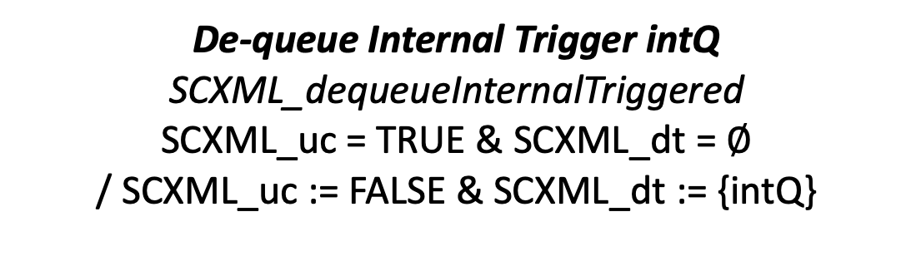
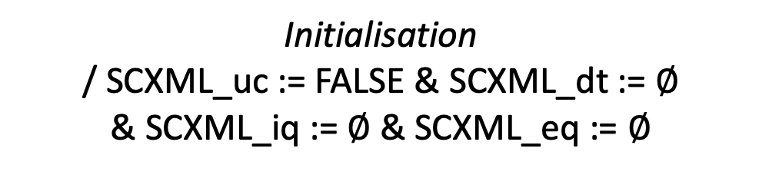
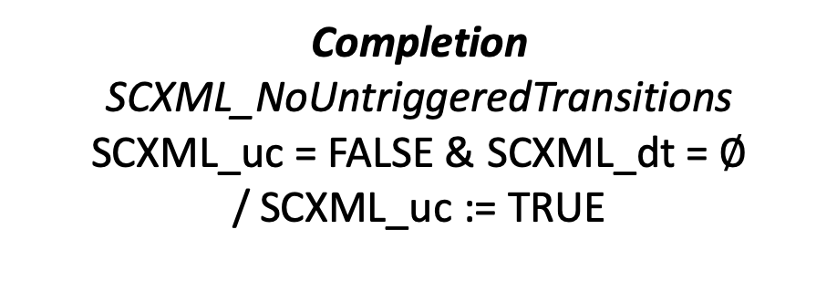
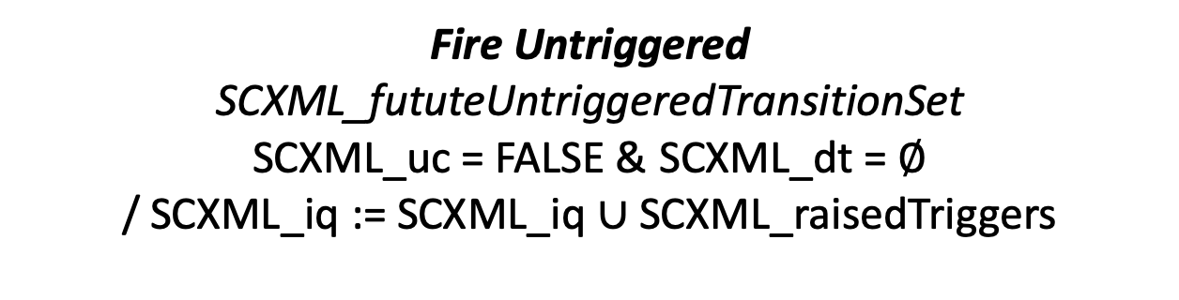
Firing Transitions
Fire Triggered
SCXML_FutureTriggeredTransitions
SCXML_uc = FALSE & SCXML_dt $≠$ $∅$
/ SCXML_dt := $∅$ &
SCXML_iq := SCXML_iq $∪$SCXML_raisedTriggers
Initialisation
/ SCXML_uc := FALSE & SCXML_dt := $∅$
& SCXML_iq := $∅$ & SCXML_eq := $∅$
FIRING
TRIGGERED
FIRING
UN-TRIGGERED
Fire Untriggered
SCXML_fututeUntriggeredTransitionSet
SCXML_uc = FALSE & SCXML_dt = $∅$
/ SCXML_iq := SCXML_iq $∪$SCXML_raisedTriggers
No Triggered Enable
SCXML_NoTriggeredTransitionsEnable
SCXML_uc = FALSE & SCXML_dt $≠$ $∅$/ SCXML_dt := $∅$
De-queue External Trigger extQ
SCXML_dequeueExternalTriggered
SCXML_uc = TRUE & SCXML_dt = $∅$
/ SCXML_uc := FALSE & SCXML_dt := {extQ}
De-queue Internal Trigger intQ
SCXML_dequeueInternalTriggered
SCXML_uc = TRUE & SCXML_dt = $∅$
/ SCXML_uc := FALSE & SCXML_dt := {intQ}
Completion
SCXML_NoUntriggeredTransitions
SCXML_uc = FALSE & SCXML_dt = $∅$
/ SCXML_uc := TRUE
READY TO DE-QUEUE
Bold+Italic: Short Description
Italic: Event-B event name
ALL CAPS: STATE NAMES
Event guards: P1 & P2 / Event action: $b≔b+1$
Note: P1, P2 are predicates, $b$is a model variable, and / separates guards from actions

Slide 7
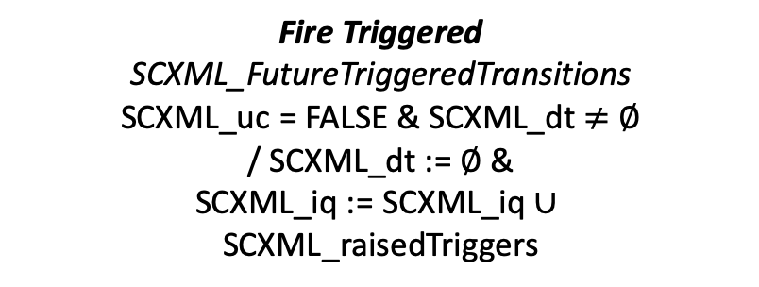
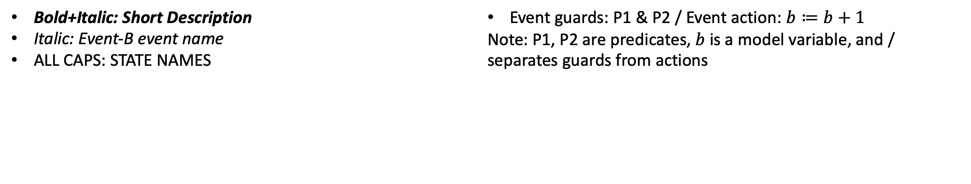
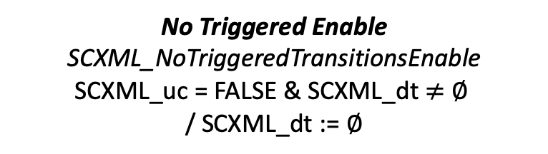
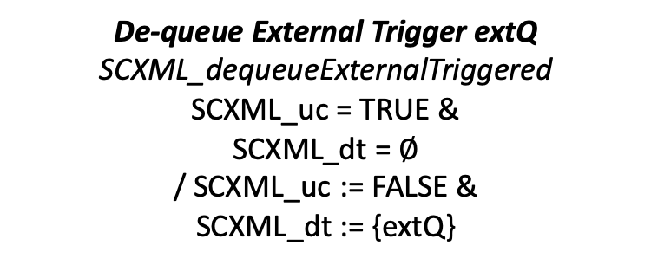
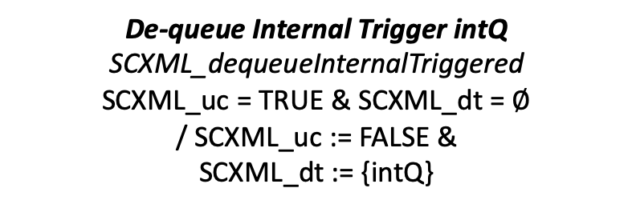
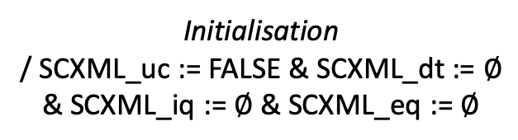
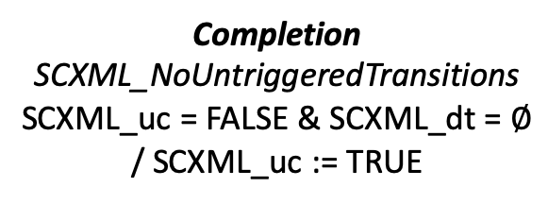
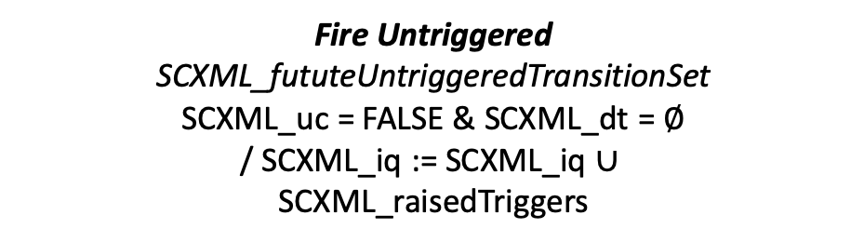
Firing Transitions
Fire Triggered
SCXML_FutureTriggeredTransitions
SCXML_uc = FALSE & SCXML_dt $≠$ $∅$
/ SCXML_dt := $∅$ &
SCXML_iq := SCXML_iq $∪$
SCXML_raisedTriggers
Initialisation
/ SCXML_uc := FALSE & SCXML_dt := $∅$
& SCXML_iq := $∅$ & SCXML_eq := $∅$
FIRING
TRIGGERED
FIRING
UN-TRIGGERED
No Triggered Enable
SCXML_NoTriggeredTransitionsEnable
SCXML_uc = FALSE & SCXML_dt $≠$ $∅$
/ SCXML_dt := $∅$
Fire Untriggered
SCXML_fututeUntriggeredTransitionSet
SCXML_uc = FALSE & SCXML_dt = $∅$
/ SCXML_iq := SCXML_iq $∪$
SCXML_raisedTriggers
De-queue External Trigger extQ
SCXML_dequeueExternalTriggered
SCXML_uc = TRUE &
SCXML_dt = $∅$
/ SCXML_uc := FALSE &
SCXML_dt := {extQ}
De-queue Internal Trigger intQ
SCXML_dequeueInternalTriggered
SCXML_uc = TRUE & SCXML_dt = $∅$
/ SCXML_uc := FALSE &
SCXML_dt := {intQ}
Completion
SCXML_NoUntriggeredTransitions
SCXML_uc = FALSE & SCXML_dt = $∅$
/ SCXML_uc := TRUE
READY TO DE-QUEUE
Bold+Italic: Short Description
Italic: Event-B event name
ALL CAPS: STATE NAMES
Event guards: P1 & P2 / Event action: $b≔b+1$
Note: P1, P2 are predicates, $b$is a model variable, and / separates guards from actions

Slide 8
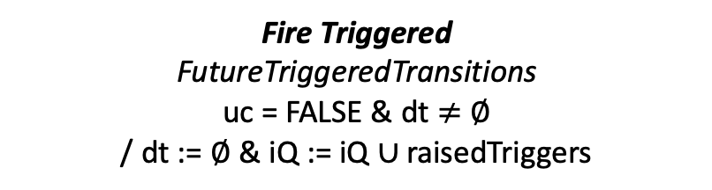
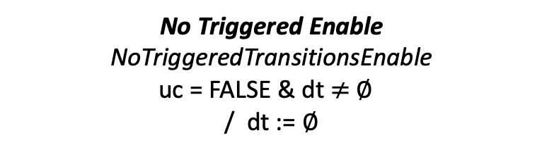
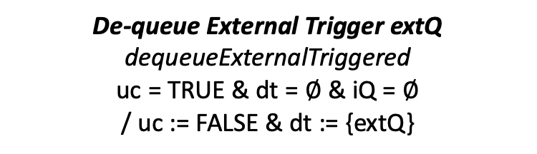
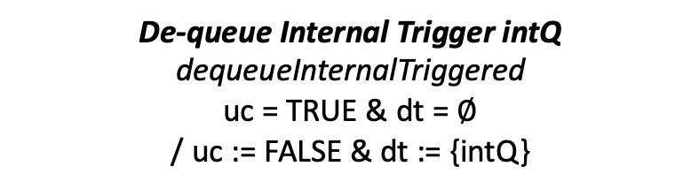
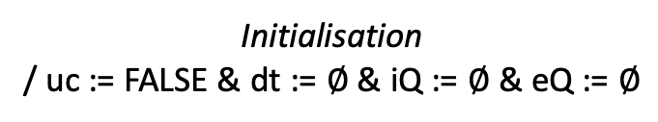
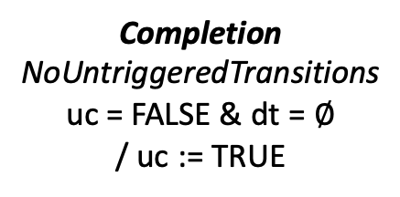

Firing Transitions
Fire Triggered
FutureTriggeredTransitions
uc = FALSE & dt $≠$ $∅$
/ dt := $∅$ & iQ := iQ $∪$raisedTriggers
Initialisation
/ uc := FALSE & dt := $∅$& iQ := $∅$ & eQ := $∅$
FIRING
TRIGGERED
FIRING
UN-TRIGGERED
No Triggered Enable
NoTriggeredTransitionsEnable
uc = FALSE & dt $≠$ $∅$
/ dt := $∅$
Fire Untriggered
fututeUntriggeredTransitionSet
uc = FALSE & dt = $∅$
/ iQ := iQ $∪$raisedTriggers
De-queue External Trigger extQ
dequeueExternalTriggered
uc = TRUE & dt = $∅$ & iQ = $∅$
/ uc := FALSE & dt := {extQ}
De-queue Internal Trigger intQ
dequeueInternalTriggered
uc = TRUE & dt = $∅$
/ uc := FALSE & dt := {intQ}
Completion
NoUntriggeredTransitions
uc = FALSE & dt = $∅$
/ uc := TRUE
READY TO DE-QUEUE
Bold+Italic: Short Description
Italic: Event-B event name
ALL CAPS: STATE NAMES
Event guards: P1 & P2 / Event action: $b≔b+1$
Note: P1, P2 are predicates, $b$is a model variable, and / separates guards from actions

