Slide 2
Formal Language Semantics for Triggered Enable Statecharts with a Run-to-Completion Scheduling
Karla Venessa Morris Wright, Thai Son Hoang, Colin Snook and Michael Butler
7 December 2023

Slide 3
Outline
Motivation
Background
Turnstile Exemplar
Language Semantics Structure
Relevant Proofs
Results
Future Work

Slide 4
Motivation
Graphical languages are attractive to engineers (e.g. statecharts generalization of statemachines)
Rodin/Event-B support abstraction and refinement and enable the use of formal proofs in earlier stages of the design
We have shown case studies of models developed and verified using the proposed semantics, which used a refinement that preserves safety properties from one refinement level to the next
We focus now on the formalization of the language semantics such that we can ensure that models developed with such language will by correct-by-construction with respect to the language semantics

Slide 5
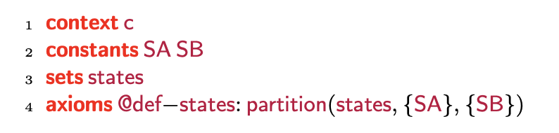
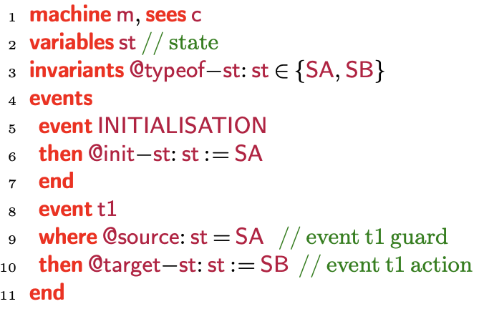
Background Event-B
Context: Static aspects of the model
Used to design and model software systems
Enable proofs of model correctness with respect to specification
Event-B models have two parts:
Contexts: Contain sets, constants and axioms
Machines: Variables, events, and invariants
Machines are refined to add more details to the model
Superposition refinement: including additional variables
Data refinement: replacing abstract variables with new concrete variables
New events: Refines implicit abstract event that does nothing “skip”
Machine: Dynamic aspects of the model

Slide 6
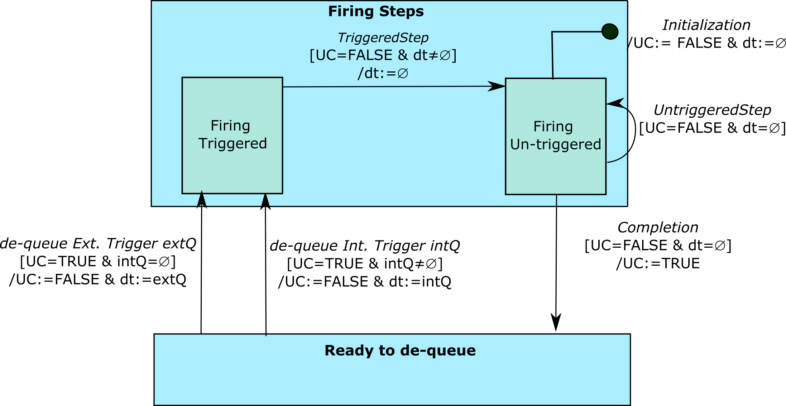
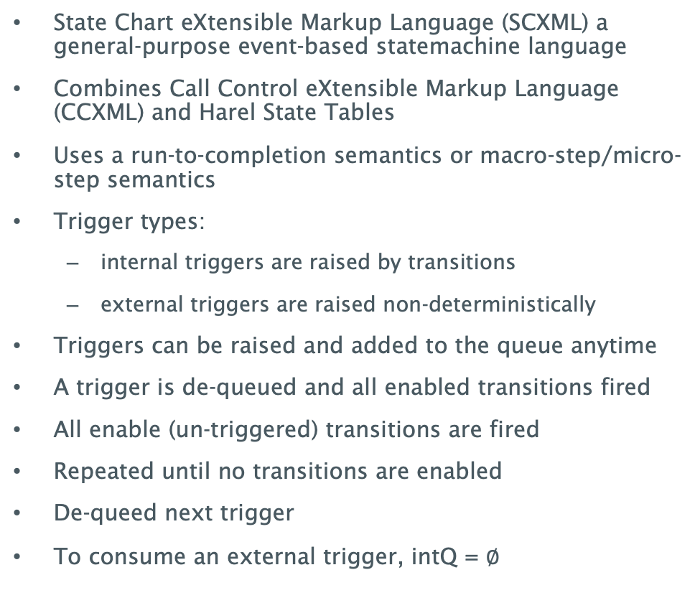
Background SCXML Run-to-Completion
State Chart eXtensible Markup Language (SCXML) a general-purpose event-based statemachine language
Combines Call Control eXtensible Markup Language (CCXML) and Harel State Tables
Uses a run-to-completion semantics or macro-step/micro-step semantics
Trigger types:
internal triggers are raised by transitions
external triggers are raised non-deterministically
Triggers can be raised and added to the queue anytime
A trigger is de-queued and all enabled transitions fired
All enable (un-triggered) transitions are fired
Repeated until no transitions are enabled
De-queed next trigger
To consume an external trigger, intQ = $∅$

Slide 7
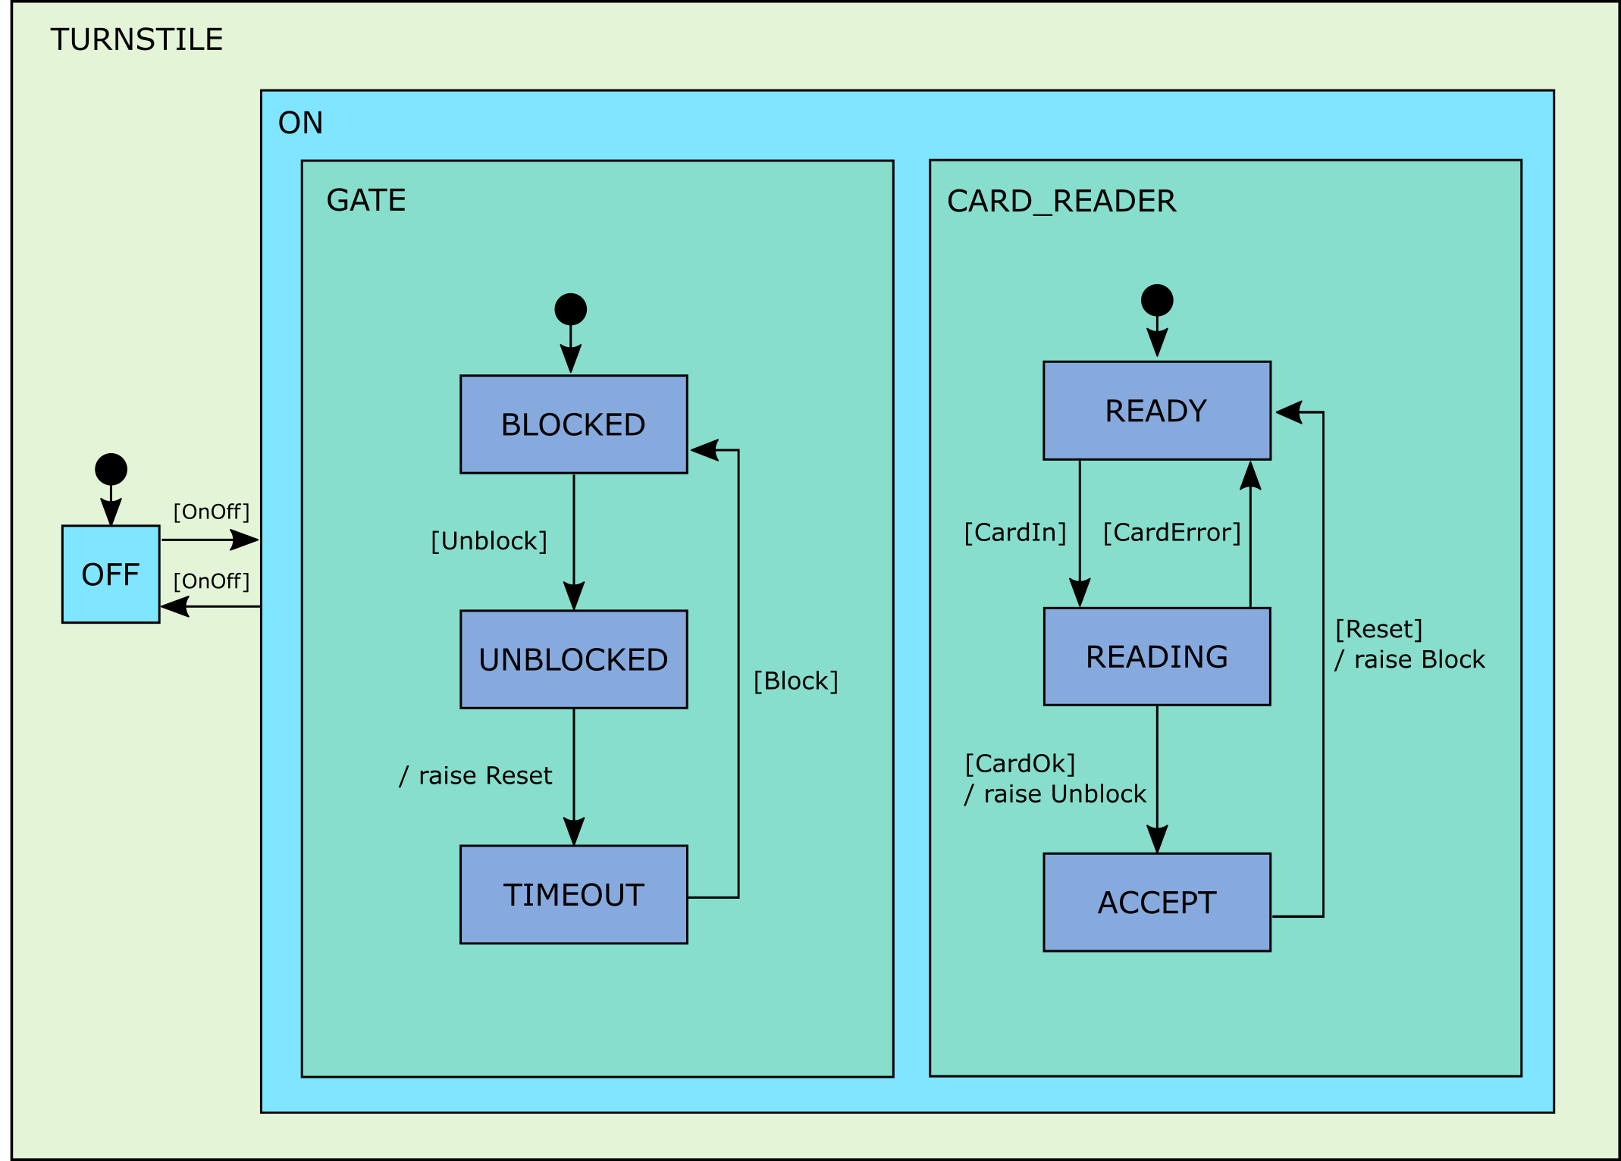
Turnstile Exemplar
Statechart tree structure
states ↦ root ↦ container ↦ leaves ∈ Tree
States of the turnstile example
partition(states, {root}, {OFF}, {ON}, {BLOCKED}, {UNBLOCKED}, {TIMEOUT}, {READY}, {READING}, {ACCEPT})
Container relationship between states
container = {OFF ↦ root, ON ↦ root, BLOCKED ↦ ON, UNBLOCKED ↦ ON, TIMEOUT ↦ ON, READY ↦ ON, READING ↦ ON, ACCEPT ↦ ON}
Leaf states
leaves = {BLOCKED, UNBLOCKED, TIMEOUT, READY, READING, ACCEPT, OFF}

Slide 8
Turnstile Exemplar (cont.)
regions = { {ON, OFF}, // TURNSTILE
{BLOCKED, UNBLOCKED, TIMEOUT}, // GATE
{READY, READING, ACCEPT} // CARD_READER }

Slide 9
Language Semantics Structure Untriggered Statecharts
Model the tree-structure of the states
Model the parallel regions
Model the transformations between states
Transformations: hierarchical view of the set of all simultaneously enabled transitions of the system, from one enabling state configuration to the next configuration.
enabling ∈ transformations → P1(states)
exiting ∈ transformations → P(states)
entering ∈ transformations → P(states)

Slide 10
Language Semantics Structure Untriggered Statecharts (cont.)
ON_2_OFF: transformation from ON to OFF
enabling(ON_2_OFF) = {ON}
exiting(ON_2_OFF) = {ON, BLOCKED, UNBLOCKED, TIMEOUT, READY, READING, ACCEPT}
entering(ON_2_OFF) = {OFF}
OFF_2_ON: transformation from OFF to ON
enabling(OFF_2_ON) = {OFF}
exiting(OFF_2_ON) = {OFF}
entering(OFF_2_ON) = {ON, BLOCKED, READY}

Slide 11
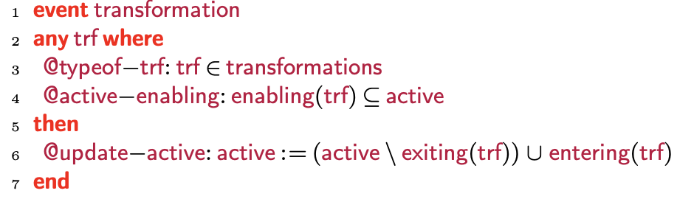
Language Semantics Structure Untriggered Statecharts (cont.)
Machine: Dynamic aspects of the untriggered statechart language model

Slide 12
Language Semantics Structure Run-to-Completion Schedule
Invariants on run-to-completion schedule
internal_queue ∈ Seq(InternalTriggers)
external_queue ∈ Seq(ExternalTriggers)
dequeue_trigger ∈ DeQueueType
dequeue_trigger ⊆ InternalTriggers ∪ ExternalTriggers
completed ∈ BOOL
dequeue_trigger ≠ ∅ ⇒ completed=FALSE
completed=TRUE ⇒ dequeue_trigger = ∅

Slide 13
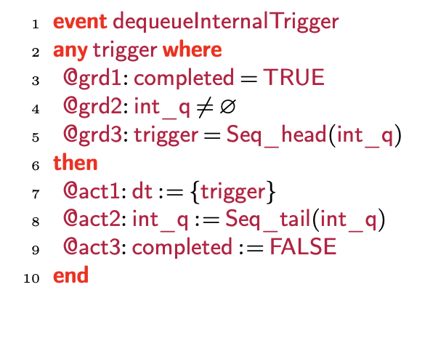
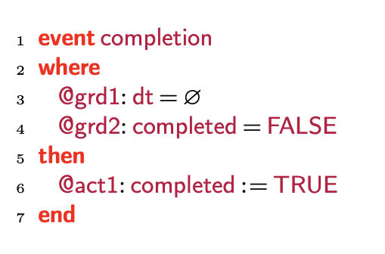
Language Semantics Structure Run-to-Completion Schedule

Slide 14
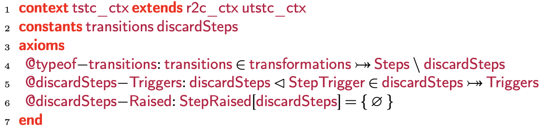
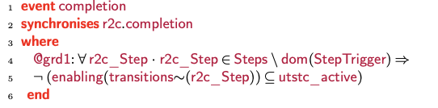
Language Semantics Structure Triggered Statecharts
Context composition
Machine: Event composition

Slide 15
Relevant Proofs (Son’s Content)
What are the conditions we needed to prove?

Slide 16
Results
Language semantics formalization for SCXML run-to-completion statecharts using Event-B
The semantics supports typical statechart features such as transitions, hierarchical structure, clustering, concurrency, start and stop states
The untriggered statechart semantics formalization is common to most statechart notations
SCXML is based on the widely used Harel statechart semantics, so our run-to-completion semantics can also be used for such notations and where notations deviate in run semantics
Proofs of well-defines conditions ensure the consistency of the semantic and can be used by a tool to guarantee a model is corrected by construction

Slide 17
Future Work
Extend formalization to include refinement rules such as those used by Event-B

Slide 19
root
OFF
ON
TURNSTILE region
BLOCKED
UNBLOCKED
TIMEOUT
READY
READING
ACCEPT
GATE region
CARD_READER region

Slide 20
Language Semantics Structure
Triggered Statecharts
Untriggered Statecharts
Run-to-Completion Schedule

