Slide 1
Formal Language Semantics for Triggered Enable Statecharts with a Run-to-Completion Scheduling
Karla Venessa Morris Wright, Thai Son Hoang, Colin Snook and Michael Butler

Slide 2
Outline
Motivation
Background
Turnstile Exemplar
Language Semantics Structure
Relevant Proofs
Results
Future Work

Slide 3
Motivation
Graphical languages are attractive to engineers (e.g. statecharts generalization of statemachines)
Rodin/Event-B support abstraction and refinement and enable the use of formal proofs in earlier stages of the design
We have shown case studies of models developed and verified using the proposed semantics, which used a refinement that preserves safety properties from one refinement level to the next
We focus now on the formalization of the language semantics such that we can ensure that models developed with such language will by correct-by-construction with respect to the language semantics

Slide 4
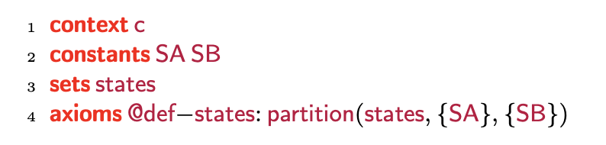
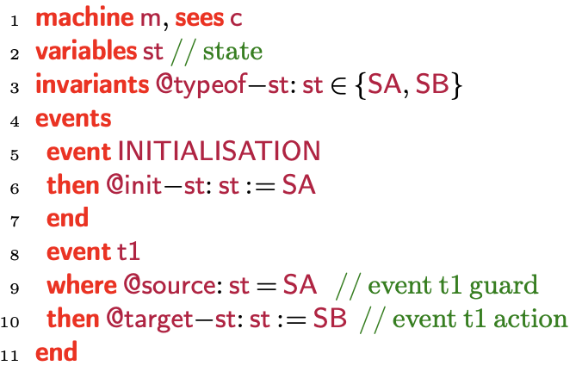
Background Event-B
Context: Static aspects of the model
Used to design and model software systems
Enable proofs of model correctness with respect to specification
Event-B models have two parts:
Contexts: Contain sets, constants and axioms
Machines: Variables, events, and invariants
Machines are refined to add more details to the model
Superposition refinement: including additional variables
Data refinement: replacing abstract variables with new concrete variables
New events: Refines implicit abstract event that does nothing “skip”
Machine: Dynamic aspects of the model

Slide 5
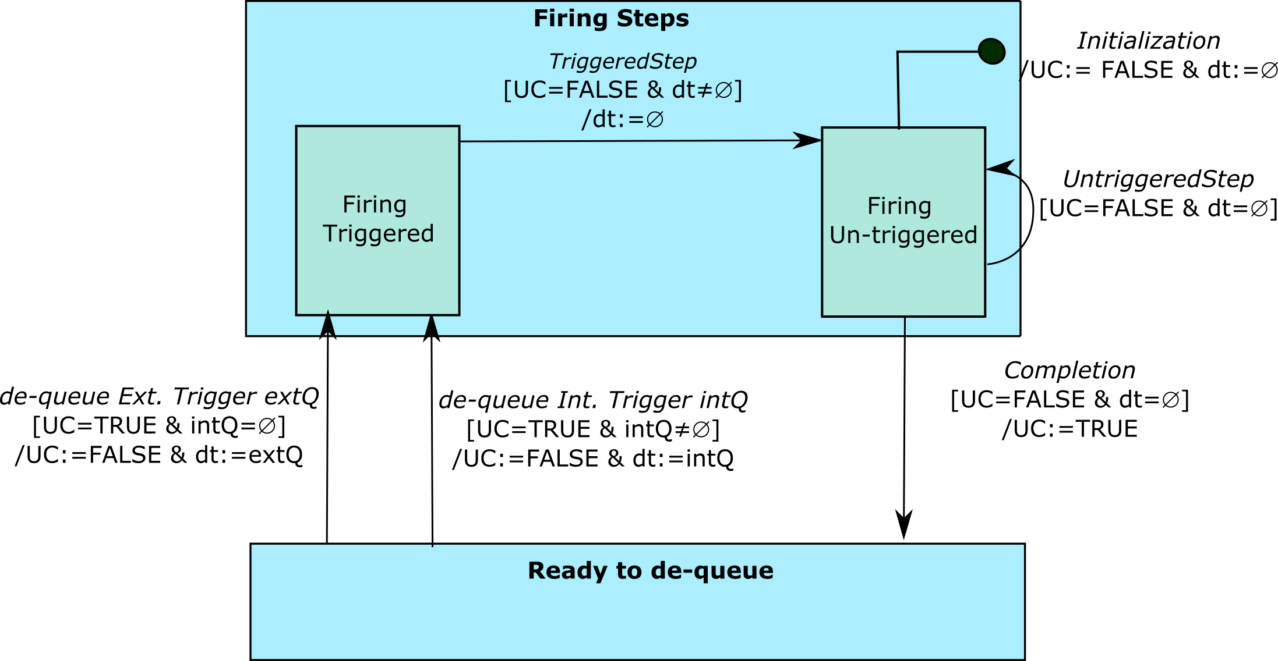
Background SCXML Run-to-Completion

Slide 6
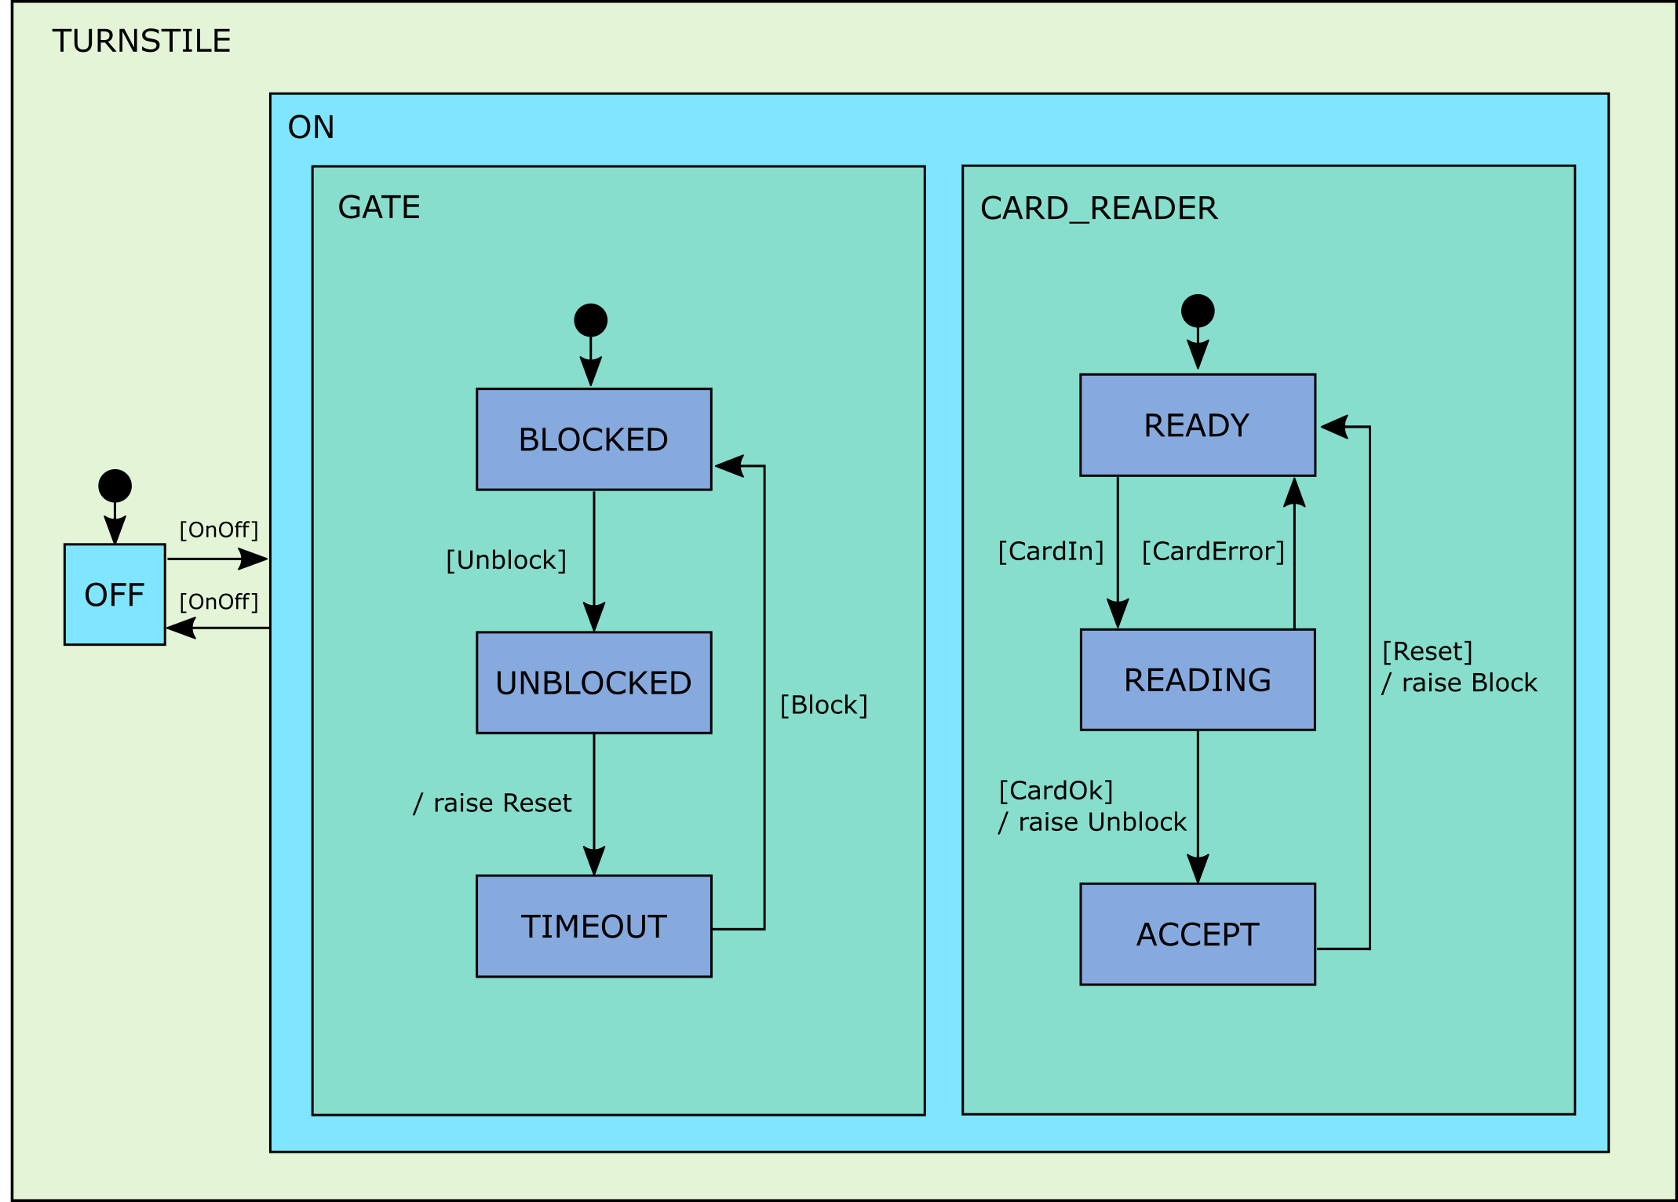

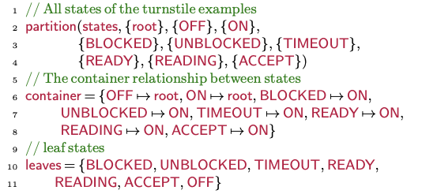
Turnstile Exemplar

Slide 7

Turnstile Exemplar (cont.)

Slide 8
Language Semantics Structure

Slide 9
Language Semantics Structure
Triggered Statecharts
Run-to-Completion Schedule
Untriggered Statecharts

Slide 10
Language Semantics Structure (cont.)

Slide 11
Relevant Proofs (Son’s Content)
What are the conditions we needed to prove?

Slide 12
Results
Language semantics formalization for SCXML run-to-completion statecharts using Event- B.
The semantics supports the typical statechart features such as transitions, hierarchical structure, clustering, concurrency, start and stop states.
The untriggered statechart semantics formalization is common to most statechart notations
SCXML is based on the widely used Harel statechart semantics, so our run to completion semantics can also be used for such notations and where notations deviate in run semantics
Proofs of well-defines conditions ensure the consistency of the semantic and can be used by a tool to guarantee a model is corrected by construction

Slide 13
Future Work
Extend formalization to include refinement rules

