Slide 1
6
Functions

Slide 2
6.1 Introduction
6.2 Program Components in C++
6.3 Math Library Functions
6.4 Function Definitions with Multiple Parameters
6.5 Function Prototypes and Argument Coercion
6.6 C++ Standard Library Header Files
6.7 Case Study: Random Number Generation
6.8 Case Study: Game of Chance and Introducing enum
6.9 Storage Classes
6.10 Scope Rules
6.11 Function Call Stack and Activation Records
6.12 Functions with Empty Parameter Lists

Slide 3
6.13 Inline Functions
6.14 References and Reference Parameters
6.15 Default Arguments
6.16 Unary Scope Resolution Operator
6.17 Function Overloading
6.18 Function Templates
6.19 Recursion
6.20 Example Using Recursion: Fibonacci Series
6.21 Recursion vs. Iteration
6.22 (Optional) Software Engineering Case Study: Identifying Class Operations in the ATM System
6.23 Wrap-Up

Slide 4
6.1 Introduction
Divide and conquer technique
  Construct a large program from small, simple pieces (e.g., components)
Functions
  Facilitate the design, implementation, operation and maintenance of large programs

Slide 5
6.2 Program Components in C++
C++ Standard Library
  Rich collection of functions for performing common operations, such as:
    Mathematical calculations
    String manipulations
    Character manipulations
    Input/Output
    Error checking
  Provided as part of the C++ programming environment

Slide 6
Software Engineering Observation
To promote software reusability, every function should be limited to performing a single, well-defined task, and the name of the function should express that task effectively. Such functions make programs easier to write, test, debug and maintain.
Error-Prevention Tip
A small function that performs one task is easier to test and debug than a larger function that performs many tasks.

Slide 7
Global Functions
Global functions
  Do not belong to a particular class
  Example: sqrt in <cmath> header file
    sqrt( 900.0 )
    All functions in <cmath> are global functions
    Have function prototypes placed in header files
      Can be reused in any program that includes the header file and that can link to the function’s object code

Slide 8
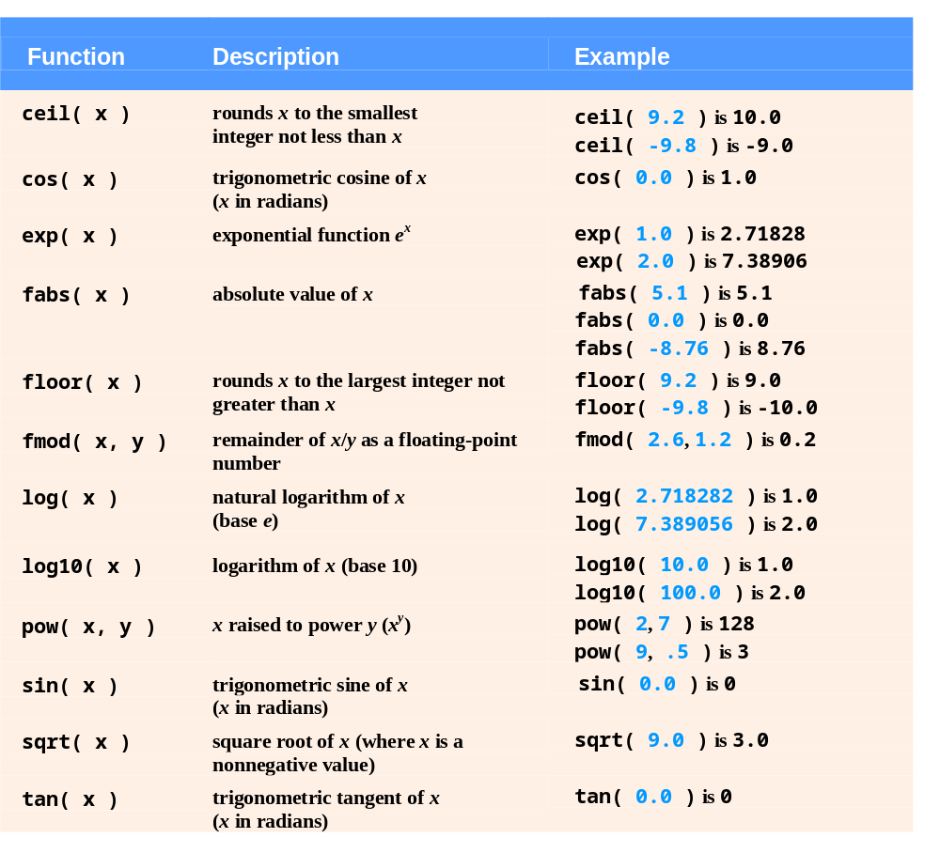
Fig. 6.2 | Math library functions.

Slide 9
Software Engineering Observation
The order of evaluation of a function’s arguments is not specified by the C++ standard. Thus, different compilers can evaluate function arguments in different orders.
The C++ standard does guarantee that all arguments in a function call are evaluated before the called function executes.

Slide 10
6.5 Function Prototypes and Argument Coercion
Function prototype
  Also called a function declaration
  Indicates to the compiler:
    Name of the function
    Type of data returned by the function
    Parameters the function expects to receive
      Number of parameters
      Types of those parameters
      Order of those parameters

Slide 11
6.5 Function Prototypes and Argument Coercion (Cont.)
Function signature (or simply signature)
  The portion of a function prototype that includes the name of the function and the types of its arguments
    Does not specify the function’s return type
  Functions in the same scope must have unique signatures
    The scope of a function is the region of a program in which the function is known and accessible

Slide 12
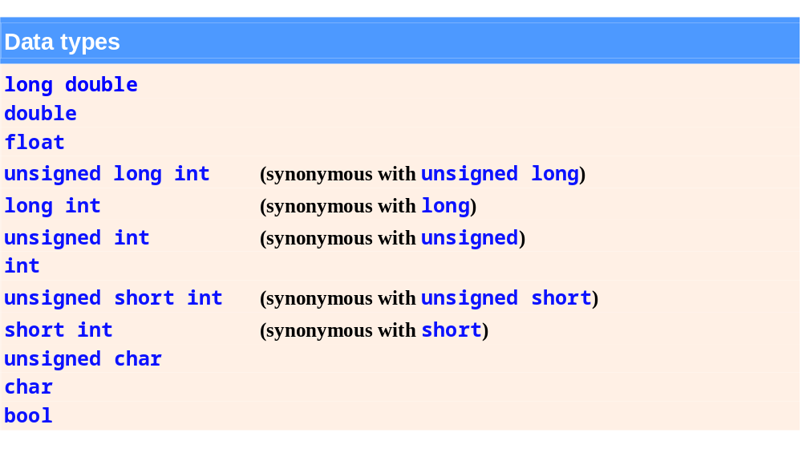
Fig. 6.6 | Promotion hierarchy for fundamental data types.

Slide 13
Introducing enum
Enumeration
  A set of integer constants represented by identifiers
    The values of enumeration constants start at 0, unless specified otherwise, and increment by 1
    The identifiers in an enum must be unique, but separate enumeration constants can have the same integer value
  Defining an enumeration
    Keyword enum
    A type name
    Comma-separated list of identifier names enclosed in braces
    Example
      enum Months { JAN = 1, FEB, MAR, APR };
  Assigning the integer equivalent of an enumeration constant to a variable of the enumeration type is a compilation error.

Slide 14
6.6 C++ Standard Library Header Files
C++ Standard Library header files
  Each contains a portion of the Standard Library
    Function prototypes for the related functions
    Definitions of various class types and functions
    Constants needed by those functions
  “Instruct” the compiler on how to interface with library and user-written components

Slide 15
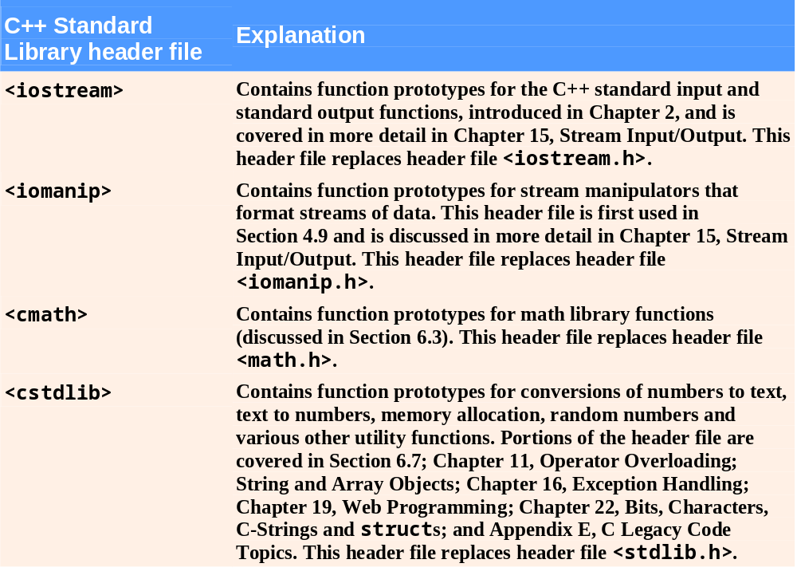
Fig. 6.7 | C++ Standard Library header files. (Part 1 of 4)

Slide 16
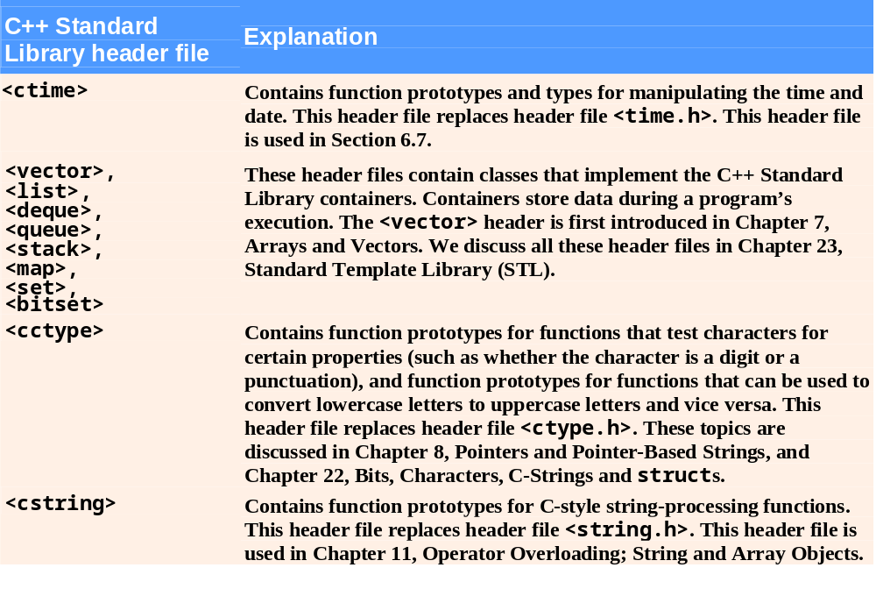
Fig. 6.7 | C++ Standard Library header files. (Part 2 of 4)

Slide 17
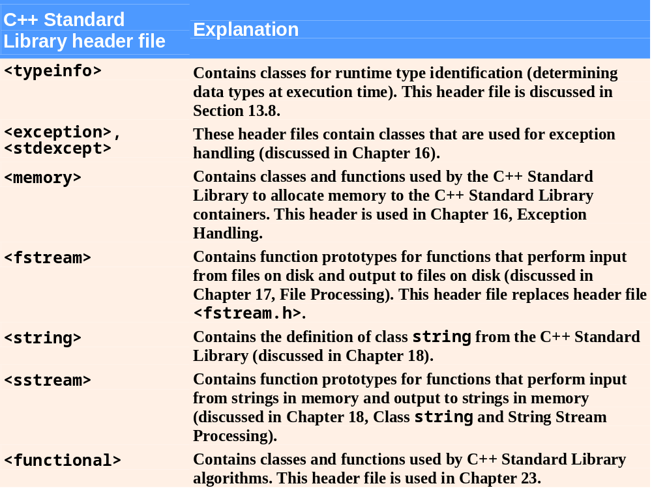
Fig. 6.7 | C++ Standard Library header files. (Part 3 of 4)

Slide 18
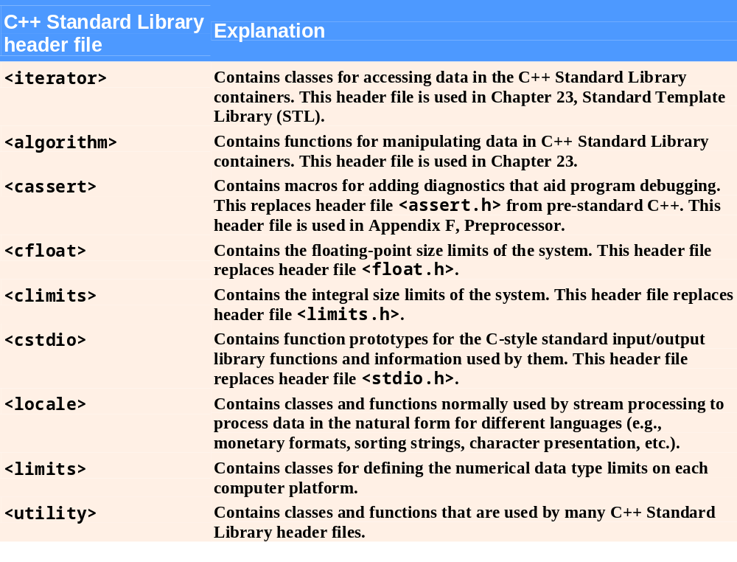
Fig. 6.7 | C++ Standard Library header files. (Part 4 of 4)

Slide 19
6.9 Storage Classes
Each identifier has several attributes
  Name, type, size and value
  Also storage class, scope and linkage
C++ provides five storage-class specifiers:
  auto, register, extern, mutable and static
Identifier’s storage class
  Determines the period during which that identifier exists in memory
Identifier’s scope
  Determines where the identifier can be referenced in a program

Slide 20
6.9 Storage Classes (Cont.)
Identifier’s linkage
  Determines whether an identifier is known only in the source file where it is declared or across multiple files that are compiled, then linked together
An identifier’s storage-class specifier helps determine its storage class and linkage

Slide 21
6.9 Storage Classes (Cont.)
Automatic storage class
  Declared with keyword auto
  Automatic variables
    Created when program execution enters block in which they are defined
    Exist while the block is active
    Destroyed when the program exits the block
  Only local variables and parameters can be of automatic storage class
    Such variables normally are of automatic storage class

Slide 22
6.9 Storage Classes (Cont.)
Static storage class
  Declared with keyword static
  Static-storage-class variables
    Exist from the point at which the program begins execution
    Initialized once when their declarations are encountered
    Last for the duration of the program
  Static-storage-class functions
    The name of the function exists when the program begins execution, just as for all other functions
  However, even though the variables and the function names exist from the start of program execution, this does not mean that these identifiers can be used throughout the program.

Slide 23
6.9 Storage Classes (Cont.)
Two types of identifiers with static storage class
Global variables
  Created by placing variable declarations outside any class or function definition
  Retain their values throughout the execution of the program
  Can be referenced by any function that follows their declarations or definitions in the source file
Local variables declared with keyword static
  Known only in the function in which they are declared
  Retain their values when the function returns to its caller
    Next time the function is called, the static local variables contain the values they had when the function last completed

Slide 24
6.10 Scope Rules
Scope
  Portion of the program where an identifier can be used
  Four scopes for an identifier
    Function scope
    File scope
    Block scope
    Function-prototype scope

Slide 25
6.10 Scope Rules (Cont.)
File scope
  For an identifier declared outside any function or class
    Such an identifier is “known” in all functions from the point at which it is declared until the end of the file
  Global variables, function definitions and function prototypes placed outside a function all have file scope

Slide 26
6.10 Scope Rules (Cont.)
Block scope
  Identifiers declared inside a block have block scope
    Block scope begins at the identifier’s declaration
    Block scope ends at the terminating right brace (}) of the block in which the identifier is declared
  Local variables and function parameters have block scope
    The function body is their block
  Any block can contain variable declarations
  Identifiers in an outer block can be “hidden” when a nested block has a local identifier with the same name
  Local variables declared static still have block scope, even though they exist from the time the program begins execution
    Storage duration does not affect the scope of an identifier

Slide 27
Common Programming Error
Accidentally using the same name for an identifier in an inner block that is used for an identifier in an outer block, when in fact the programmer wants the identifier in the outer block to be active for the duration of the inner block, is normally a logic error.
Good Programming Practice
Avoid variable names that hide names in outer scopes. This can be accomplished by avoiding the use of duplicate identifiers in a program.

Slide 28
6.11 Function Call Stack and Activation Records
Function Call Stack
  Sometimes called the program execution stack
  Supports the function call/return mechanism
    Each time a function calls another function, a stack frame (also known as an activation record) is pushed onto the stack
      Maintains the return address that the called function needs to return to the calling function
      Contains automatic variables—parameters and any local variables the function declares

Slide 29
6.11 Function Call Stack and Activation Records (Cont.)
Function Call Stack (Cont.)
  When the called function returns
    Stack frame for the function call is popped
    Control transfers to the return address in the popped stack frame
  If a function makes a call to another function
    Stack frame for the new function call is simply pushed onto the call stack
    Return address required by the newly called function to return to its caller is now located at the top of the stack.
Stack overflow
  Error that occurs when more function calls occur than can have their activation records stored on the function call stack (due to memory limitations)

Slide 30
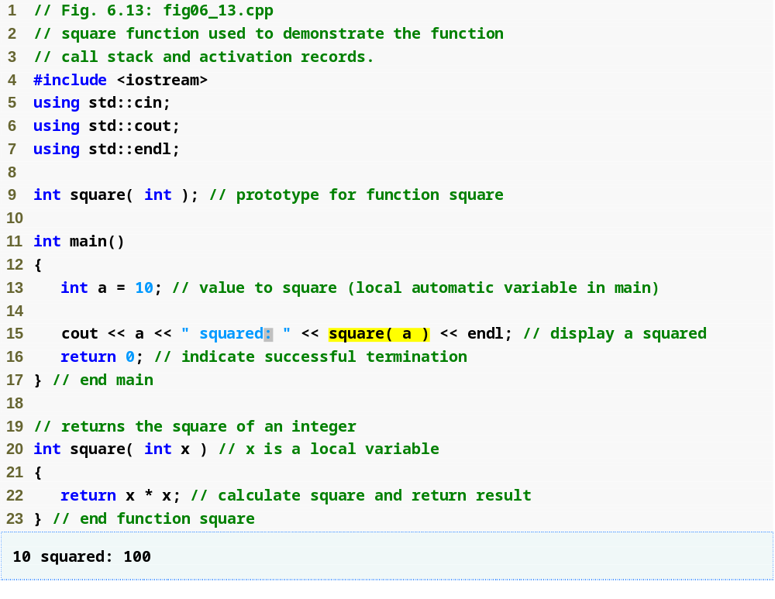
Outline
fig06_13.cpp
(1 of 1)

Slide 31
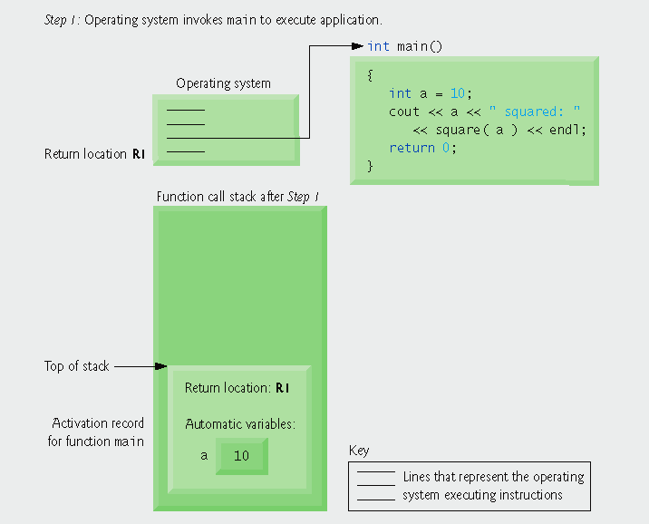
Fig. 6.14 | Function call stack after the operating system invokes main to execute the application.

Slide 32
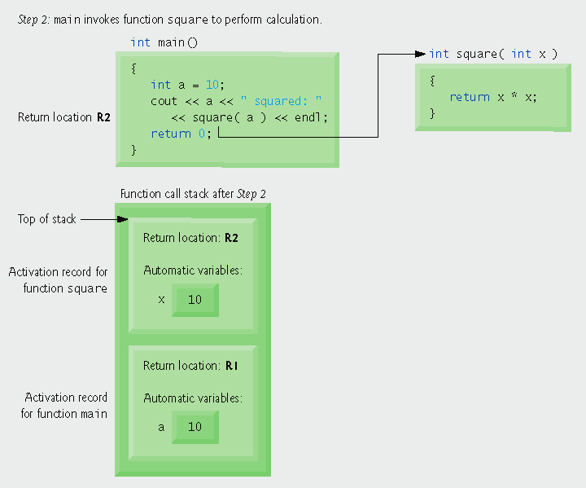
Fig. 6.15 | Function call stack after main invokes function square to perform the calculation.

Slide 33
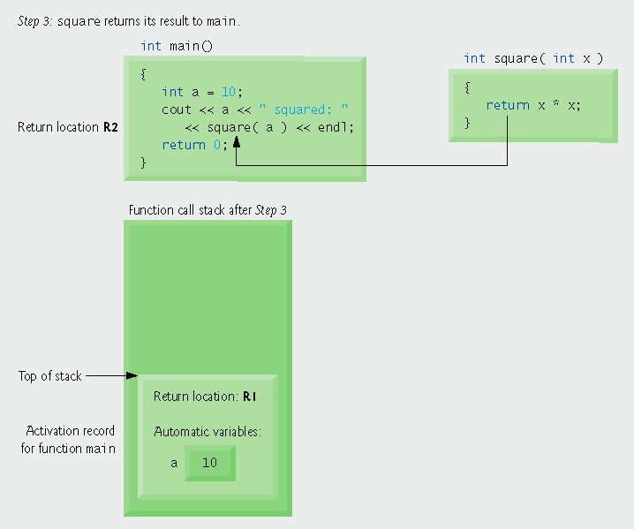
Fig. 6.16 | Function call stack after function square returns to main.

Slide 34
6.14 References and Reference Parameters
Two ways to pass arguments to functions
  Pass-by-value
    A copy of the argument’s value is passed to the called function
    Changes to the copy do not affect the original variable’s value in the caller
      Prevents accidental side effects of functions
  Pass-by-reference
    Gives called function the ability to access and modify the caller’s argument data directly

Slide 35
6.14 References and Reference Parameters (Cont.)
Reference Parameter
  An alias for its corresponding argument in a function call
  & placed after the parameter type in the function prototype and function header
  Example
    int &count in a function header
      Pronounced as “count is a reference to an int”
  Parameter name in the body of the called function actually refers to the original variable in the calling function

Slide 36
Software Engineering Observations
One disadvantage of pass-by-value is that, if a large data item is being passed, copying that data can take a considerable amount of execution time and memory space.
Pass-by-reference is good for performance reasons, because it can eliminate the pass-by-value overhead of copying large amounts of data.
Pass-by-reference can weaken security, because the called function can corrupt the caller’s data.

Slide 37
Software Engineering Observation
The const qualifier should be used to enforce the principle of least privilege. Using the principle of least privilege to properly design software can greatly reduce debugging time and improper side effects and can make a program easier to modify and maintain.
For passing large objects, use a constant reference parameter to simulate the appearance and security of pass-by-value and avoid the overhead of passing a copy of the large object.

Slide 38
6.15 Default Arguments
Default argument
  A default value to be passed to a parameter
    Used when the function call does not specify an argument for that parameter
  Must be the rightmost argument(s) in a function’s parameter list
  Should be specified with the first occurrence of the function name
    Typically the function prototype

Slide 39
6.17 Function Overloading
Overloaded functions
  Overloaded functions have
    Same name
    Different sets of parameters
  Compiler selects proper function to execute based on number, types and order of arguments in the function call
  Commonly used to create several functions of the same name that perform similar tasks, but on different data types
  Overloaded functions are distinguished by their signatures

Slide 40
6.18 Function Templates
Function templates
  More compact and convenient form of overloading
    Identical program logic and operations for each data type
  Function template definition
    Written by programmer once
    Essentially defines a whole family of overloaded functions
    Begins with the template keyword
    Contains template parameter list of formal type parameters for the function template enclosed in angle brackets (<>)
    Formal type parameters
      Preceded by keyword typename or keyword class
      Placeholders for fundamental types or user-defined types

Slide 41
6.18 Function Templates (Cont.)
Function-template specializations
  Generated automatically by the compiler to handle each type of call to the function template
  Example for function template max with type parameter T called with int arguments
    Compiler detects a max invocation in the program code
    int is substituted for T throughout the template definition
    This produces function-template specialization max< int >

