Slide 1
1.1 Computer Organization
Chapter 1 – Introduction to Computers and C++ Programming
Six logical units of computer
  Input unit
    “Receiving” section
    Obtains information from input devices
      Keyboard, mouse, microphone, scanner, networks, …
  Output unit
    “Shipping” section
    Takes information processed by computer
    Places information on output devices
      Screen, printer, networks, …
      Information used to control other devices

Slide 2
1.1 Computer Organization
Six logical units of computer
  Memory unit
    Rapid access, relatively low capacity “warehouse” section
    Retains information from input unit
      Immediately available for processing
    Retains processed information
      Until placed on output devices
    Memory, primary memory
  Arithmetic and logic unit (ALU)
    “Manufacturing” section
    Performs arithmetic calculations and logic decisions

Slide 3
1.1 Computer Organization
Six logical units of computer
  Central processing unit (CPU)
    “Administrative” section
    Supervises and coordinates other sections of computer
  Secondary storage unit
    Long-term, high-capacity “warehouse” section
    Storage
      Inactive programs or data
    Secondary storage devices
      Disks
    Longer to access than primary memory
    Less expensive per unit than primary memory

Slide 4
1.2 Machine Languages, Assembly Languages, and High-level Languages
Three types of computer languages
  Machine language
    Only language computer directly understands
    “Natural language” of computer
    Defined by hardware design
      Machine-dependent
    Generally consist of strings of numbers
      Ultimately 0s and 1s
    Instruct computers to perform elementary operations
      One at a time
    Cumbersome for humans
    Example:
      +1300042774
      +1400593419
      +1200274027

Slide 5
1.2 Machine Languages, Assembly Languages, and High-level Languages
Three types of computer languages
  Assembly language
    English-like abbreviations representing elementary computer operations
    Clearer to humans
    Incomprehensible to computers
      Translator programs (assemblers)
        Convert to machine language
    Example:
      LOAD BASEPAY
      ADD OVERPAY
      STORE GROSSPAY

Slide 6
1.2 Machine Languages, Assembly Languages, and High-level Languages
Three types of computer languages
  High-level languages
    Similar to everyday English, use common mathematical notations
    Single statements accomplish substantial tasks
      Assembly language requires many instructions to accomplish simple tasks
    Translator programs (compilers)
      Convert to machine language
    Interpreter programs
      Directly execute high-level language programs
    Example:
      grossPay = basePay + overTimePay

Slide 7
1.3 History of C and C++
History of C
  Evolved from two other programming languages
    BCPL and B
      “Typeless” languages
  Dennis Ritchie (Bell Laboratories)
    Added data typing, other features
  Development language of UNIX
  Hardware independent
    Portable programs
  1989: ANSI standard
  1990: ANSI and ISO standard published
    ANSI/ISO 9899: 1990

Slide 8
1.3 History of C and C++
History of C++
  Extension of C
  Early 1980s: Bjarne Stroustrup (Bell Laboratories)
  “Spruces up” C
  Provides capabilities for object-oriented programming
    Objects: reusable software components
      Model items in real world
    Object-oriented programs
      Easy to understand, correct and modify
  Hybrid language
    C-like style
    Object-oriented style
    Both

Slide 9
1.4 C++ Standard Library
C++ programs
  Built from pieces called classes and functions
C++ standard library
  Rich collections of existing classes and functions
“Building block approach” to creating programs
  “Software reuse”

Slide 10
1.5 Basics of a Typical C++ Environment
C++ systems
  Program-development environment
  Language
  C++ Standard Library

Slide 11
1.5 Basics of a Typical C++ Environment
Phases of C++ Programs:
  Edit
  Preprocess
  Compile
  Link
  Load
  Execute
Program is created in
the editor and stored
on disk.
Editor
Disk
Preprocessor
Disk
Preprocessor program
processes the code.
Compiler creates
object code and stores
it on disk.
Compiler
Disk
Linker links the object
code with the libraries,
creates a.out and
stores it on disk
Linker
Disk
Primary
Memory
Loader
Loader puts program
in memory.
Disk
.
.
.
.
.
.
Primary
Memory
CPU
CPU takes each
instruction and
executes it, possibly
storing new data
values as the program
executes.
.
.
.
.
.
.

Slide 12
1.5 Basics of a Typical C++ Environment
Input/output
  cin
    Standard input stream
    Normally keyboard
  cout
    Standard output stream
    Normally computer screen
  cerr
    Standard error stream
    Display error messages

Slide 13
1.6 Flowchart
It is a graphical way to describe the solution of the problem.
Flow Chart Symbols
Start and End
Selection
Data Flow
Input / output
Calculation

Slide 14
Problem : Compute and print the summation of two numbers.
Input a,b
S = a + b
Output s

Slide 15
Problem : Compute and print the average of three numbers.
Input n1,n2,n3
S = n1+n2+n3
Average = s / 3
Output average

Slide 16
Problem : Compute the area of the circle. Where area = 3.14 x R2
Input r
A = 3.14 * R *R
Output A

Slide 17
Problem : Read any number from the user, then print positive if it is positive.
Input Num
True
Num>0
Output “Positive”
False

Slide 18
Problem : Read any number from the user, then print positive if it is positive and print negative otherwise.
Input Num
False
True
Num>0
Output “Negative”
Output “Positive”

Slide 19
Problem : Read Two numbers from the user, then print the greatest one.
Input x, y
False
True
X>y
Output
y
Output
x

Slide 20
Problem : Read three numbers to print the smallest one.
Input a, b, c
a<b
and
a<c
True
output a
b<a
and
b<c
True
output b
c<a
and
c<b
True
output c

Slide 21
Input a, b, c
True
False
a<b
b<c
a<c
Output c
Output b
Output c
Output a

Slide 22
Problem : Print the word “Amman” five times.
Count = 1
True
Count<=5
Output “Amman”
False
Count = Count + 1

Slide 23
Problem : Print the following numbers.
1 3 5 7 9 11
I = 1
True
I<=11
Output I
False
I = I + 2

Slide 24
Problem : Print the following numbers.
20 17 14 11 8 5 2
I = 20
True
I>=2
Output I
False
I = I - 3

Slide 25
Problem : Compute and print S, Where
S = 1+ 2+ 3+ 4+ 5
S = 0
I = 1
True
I<=5
S = S + I
False
Output S
I = I + 1

Slide 26
Problem : Compute and print summation of any 10 numbers entered by the user.
S = 0
I = 1
True
I<=10
INPUT Num
False
S = S + Num
Output S
I = I + 1

Slide 27
Problem : Compute and Print the factorial of the number 5.
(Fact = 5 * 4 * 3 * 2 * 1)
Fact = 1
I = 5
True
I>=1
Fact = Fact * I
False
Output Fact
I = I - 1

Slide 28
Problem : Compute and Print the value of M where M = 2 * 4 * 6 * … * n
M = 1
INPUT n
I = 2
True
I<=n
M = M * I
False
Output M
I = I + 2

Slide 29
1.7 Introduction to C++ Programming
C++ language
  Facilitates structured and disciplined approach to computer program design
Following several examples
  Illustrate many important features of C++
  Each analyzed one statement at a time
Structured programming
Object-oriented programming

Slide 30
1.8 A Simple Program:
Printing a Line of Text
Comments
  Document programs
  Improve program readability
  Ignored by compiler
  Single-line comment
    Begin with //
Preprocessor directives
  Processed by preprocessor before compiling
  Begin with #

Slide 31
fig01_02.cpp
(1 of 1) fig01_02.cpp output (1 of 1)
1 // Fig. 1.2: fig01_02.cpp
2 // A first program in C++.
3 #include <iostream>
4
5 // function main begins program execution
6 int main()
7 {
8 std::cout << "Welcome to C++!\n";
9
10 return 0; // indicate that program ended successfully
11
12 } // end function main
Single-line comments.
Function main returns an integer value.
Left brace { begins function body.
Preprocessor directive to include input/output stream header file <iostream>.
Function main appears exactly once in every C++ program..
Statements end with a semicolon ;.
Corresponding right brace } ends function body.
Stream insertion operator.
Name cout belongs to namespace std.
Keyword return is one of several means to exit function; value 0 indicates program terminated successfully.
Welcome to C++!

Slide 32
1.8 A Simple Program:
Printing a Line of Text
Standard output stream object
  std::cout
  “Connected” to screen
  <<
    Stream insertion operator
    Value to right (right operand) inserted into output stream
Namespace
  std:: specifies using name that belongs to “namespace” std
  std:: removed through use of using statements
Escape characters
  \
  Indicates “special” character output

Slide 33
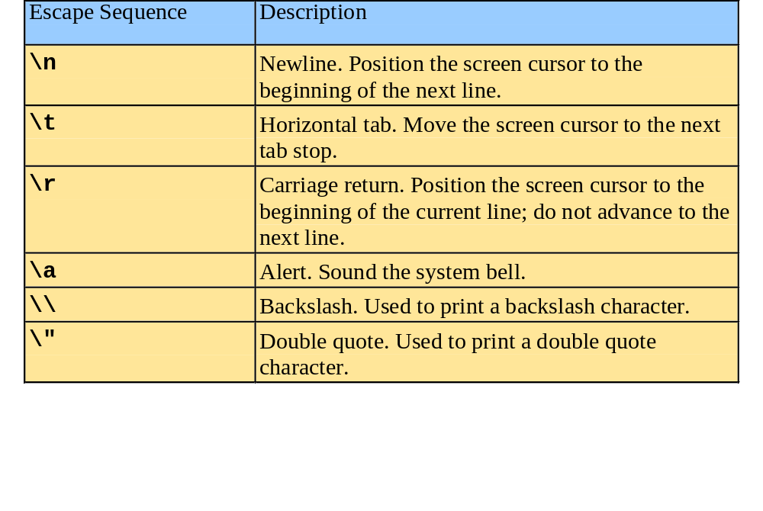
1.8 A Simple Program:
Printing a Line of Text

Slide 34
fig01_04.cpp
(1 of 1) fig01_04.cpp output (1 of 1)
1 // Fig. 1.4: fig01_04.cpp
2 // Printing a line with multiple statements.
3 #include <iostream>
4
5 // function main begins program execution
6 int main()
7 {
8 std::cout << "Welcome ";
9 std::cout << "to C++!\n";
10
11 return 0; // indicate that program ended successfully
12
13 } // end function main
Multiple stream insertion statements produce one line of output.
Welcome to C++!

Slide 35
fig01_05.cpp
(1 of 1) fig01_05.cpp output (1 of 1)
1 // Fig. 1.5: fig01_05.cpp
2 // Printing multiple lines with a single statement
3 #include <iostream>
4
5 // function main begins program execution
6 int main()
7 {
8 std::cout << "Welcome\nto\n\nC++!\n";
9
10 return 0; // indicate that program ended successfully
11
12 } // end function main
Using newline characters to print on multiple lines.
Welcome
to
C++!

Slide 36
1.9 Another Simple Program:
Adding Two Integers
Variables
  Location in memory where value can be stored
  Common data types
    int - integer numbers
    char - characters
    double - floating point numbers
  Declare variables with name and data type before use
    int integer1;
    int integer2;
    int sum;
  Can declare several variables of same type in one declaration
    Comma-separated list
    int integer1, integer2, sum;

Slide 37
1.10 Another Simple Program:
Adding Two Integers
Variables
  Variable names
    Valid identifier
      Series of characters (letters, digits, underscores)
      Cannot begin with digit
      Case sensitive

Slide 38
1.10 Another Simple Program:
Adding Two Integers
Input stream object
  >> (stream extraction operator)
    Used with std::cin
    Waits for user to input value, then press Enter (Return) key
    Stores value in variable to right of operator
      Converts value to variable data type
= (assignment operator)
  Assigns value to variable
  Binary operator (two operands)
  Example:
      sum = variable1 + variable2;

Slide 39
fig01_06.cpp
(1 of 1)
1 // Fig. 1.6: fig01_06.cpp
2 // Addition program.
3 #include <iostream>
4
5 // function main begins program execution
6 int main()
7 {
8 int integer1; // first number to be input by user
9 int integer2; // second number to be input by user
10 int sum; // variable in which sum will be stored
11
12 std::cout << "Enter first integer\n"; // prompt
13 std::cin >> integer1; // read an integer
14
15 std::cout << "Enter second integer\n"; // prompt
16 std::cin >> integer2; // read an integer
17
18 sum = integer1 + integer2; // assign result to sum
19
20 std::cout << "Sum is " << sum << std::endl; // print sum
21
22 return 0; // indicate that program ended successfully
23
24 } // end function main
Declare integer variables.
Use stream extraction operator with standard input stream to obtain user input.
Calculations can be performed in output statements: alternative for lines 18 and 20:
std::cout << "Sum is " << integer1 + integer2 << std::endl;
Stream manipulator std::endl outputs a newline, then “flushes output buffer.”
Concatenating, chaining or cascading stream insertion operations.

Slide 40
fig01_06.cpp output (1 of 1)
Enter first integer
45
Enter second integer
72
Sum is 117

Slide 41
1.11 Memory Concepts
Variable names
  Correspond to actual locations in computer's memory
  Every variable has name, type, size and value
  When new value placed into variable, overwrites previous value
  Reading variables from memory nondestructive

Slide 42
1.11 Memory Concepts
std::cin >> integer1;
  Assume user entered 45
std::cin >> integer2;
  Assume user entered 72
sum = integer1 + integer2;
integer1
45
integer1
45
integer2
72
integer1
45
integer2
72
sum
117

Slide 43
1.12 Arithmetic
Arithmetic calculations
  *
    Multiplication
  /
    Division
    Integer division truncates remainder
      7 / 5 evaluates to 1
  %
    Modulus operator returns remainder
      7 % 5 evaluates to 2

Slide 44
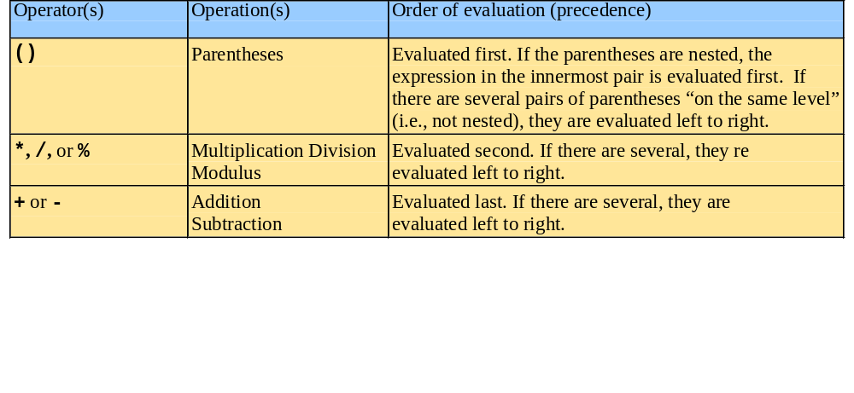
1.12 Arithmetic
Rules of operator precedence
  Operators in parentheses evaluated first
    Nested/embedded parentheses
      Operators in innermost pair first
  Multiplication, division, modulus applied next
    Operators applied from left to right
  Addition, subtraction applied last
    Operators applied from left to right

Slide 45
1.13 Decision Making: Equality and Relational Operators
if structure
  Make decision based on truth or falsity of condition
    If condition met, body executed
    Else, body not executed
Equality and relational operators
  Equality operators
    Same level of precedence
  Relational operators
    Same level of precedence
  Associate left to right

Slide 46
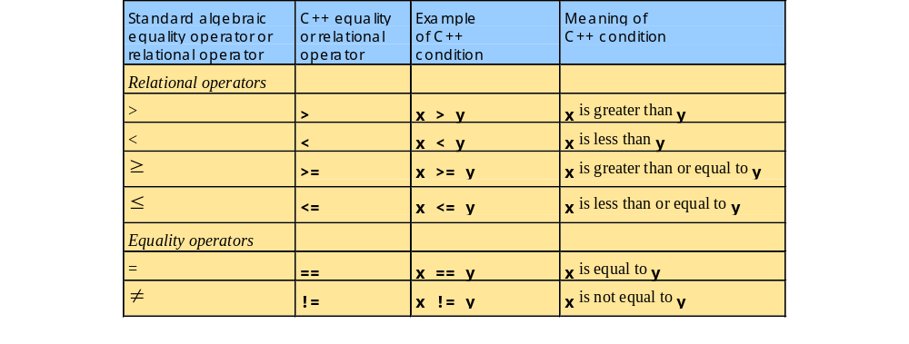
1.13 Decision Making: Equality and Relational Operators

Slide 47
1.13 Decision Making: Equality and Relational Operators
using statements
  Eliminate use of std:: prefix
  Write cout instead of std::cout

Slide 48
fig01_14.cpp
(1 of 2)
1 // Fig. 1.14: fig01_14.cpp
2 // Using if statements, relational
3 // operators, and equality operators.
4 #include <iostream>
5
6 using std::cout; // program uses cout
7 using std::cin; // program uses cin
8 using std::endl; // program uses endl
9
10 // function main begins program execution
11 int main()
12 {
13 int num1; // first number to be read from user
14 int num2; // second number to be read from user
15
16 cout << "Enter two integers, and I will tell you\n"
17 << "the relationships they satisfy: ";
18 cin >> num1 >> num2; // read two integers
19
20 if ( num1 == num2 )
21 cout << num1 << " is equal to " << num2 << endl;
22
23 if ( num1 != num2 )
24 cout << num1 << " is not equal to " << num2 << endl;
25
using statements eliminate need for std:: prefix.
Declare variables.
Can write cout and cin without std:: prefix.
if structure compares values of num1 and num2 to test for equality.
If condition is true (i.e., values are equal), execute this statement.
if structure compares values of num1 and num2 to test for inequality.
If condition is true (i.e., values are not equal), execute this statement.

Slide 49
fig01_14.cpp
(2 of 2) fig01_14.cpp output (1 of 2)
26 if ( num1 < num2 )
27 cout << num1 << " is less than " << num2 << endl;
28
29 if ( num1 > num2 )
30 cout << num1 << " is greater than " << num2 << endl;
31
32 if ( num1 <= num2 )
33 cout << num1 << " is less than or equal to "
34 << num2 << endl;
35
36 if ( num1 >= num2 )
37 cout << num1 << " is greater than or equal to "
38 << num2 << endl;
39
40 return 0; // indicate that program ended successfully
41
42 } // end function main
Statements may be split over several lines.
Enter two integers, and I will tell you
the relationships they satisfy: 22 12
22 is not equal to 12
22 is greater than 12
22 is greater than or equal to 12

Slide 50
fig01_14.cpp output (2 of 2)
Enter two integers, and I will tell you
the relationships they satisfy: 7 7
7 is equal to 7
7 is less than or equal to 7
7 is greater than or equal to 7

