Slide 1
Linked Lists

Slide 2
Linked Lists
Types:
One-way
Double-Linked
Circular
We will talk about one-way linked lists

Slide 3
What is a Linked List?
Data Structure
Each element dynamically allocated
These elements point to each other to define a linear relationship

Slide 4
Common Implementations
“Things to Do” lists
Grocery list
Stacks and queues

Slide 5
Common Operations
createList()
displayList()
addNode()
searchNode()
…and others…

Slide 6
Simple Linked List
Linked Lists are made from nodes
Each node has two elements: value (data) and a pointer (to next node).
Let’s Practice!
Define a struct with two data members: int data and node *next

Slide 7
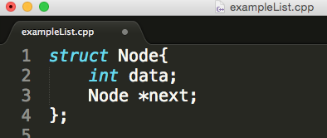
Simple Linked List

Slide 8
Simple Linked List
To create the first node, we need to create an object of the struct and initialize the first node.
Set the first member to some data that is coming in
Set the second member to NULL, indicating end of list

Slide 9
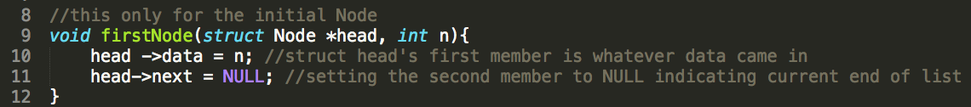
Simple Linked List

Slide 10
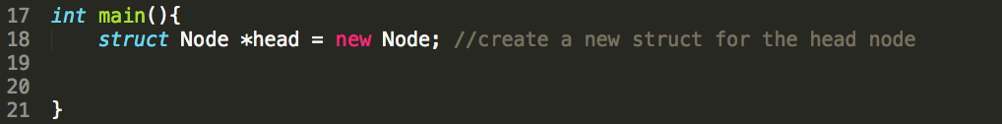
Simple Linked List
Let’s make sure we can create the list and display it’s contents.
First create an object of our struct (create the list)

Slide 11
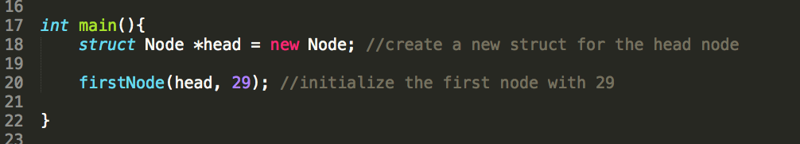
Simple Linked List
Initialize the list

Slide 12
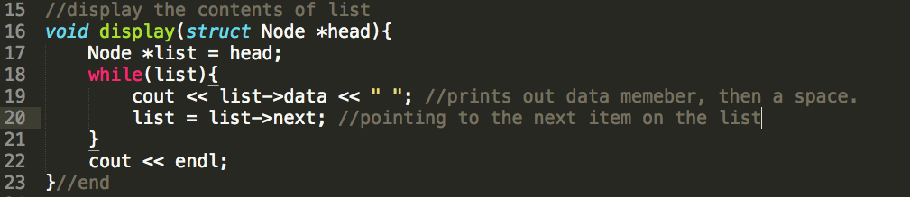
Simple Linked List
display contents

Slide 13
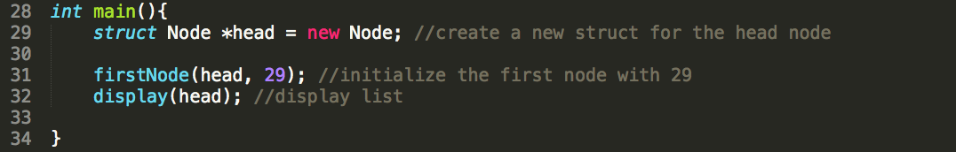
Simple Linked List
Call display function passing head as argument

Slide 14
Simple Linked List
This is what we have so far
Let’s add another number to our list– to do this we must add another node.
data (29)
next (NULL)

Slide 15
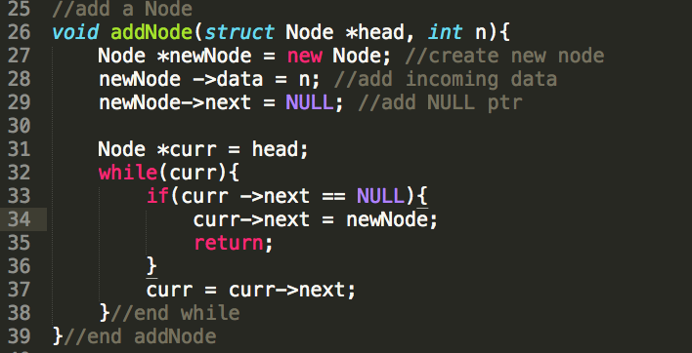
Simple Linked List

Slide 16

Simple Linked List
Call addNode passing head and 33
Also display the updated contents of the list (notice it’s added to the end):

Slide 17
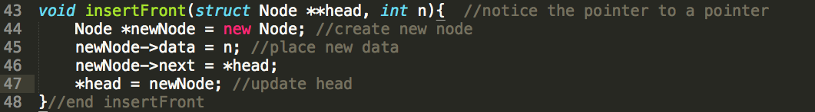
Simple Linked List
What if we want to insert the Node at the front of the list?

Slide 18
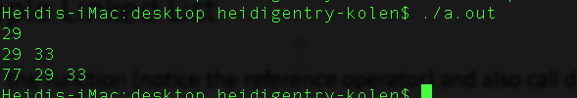
Simple Linked List
Call the function (notice the reference operator) and also call display to see results:
Output

Slide 19
Simple Linked List
What if we want to delete a Node?
We will need to write two functions: One for searching the list for the Node and the second for deleting the Node.

Slide 20
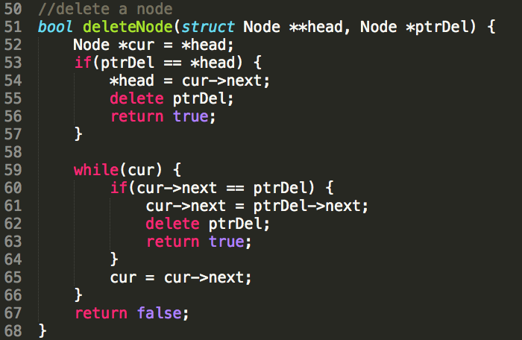
Simple Linked List
First write the deleteNode function

Slide 21
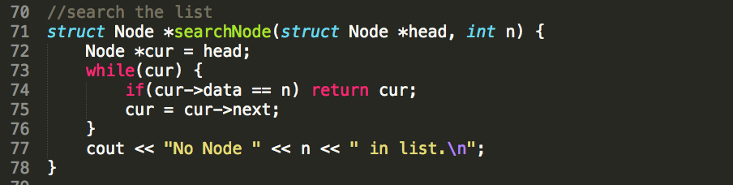
Simple Linked List
Next, write the function to search the list for the Node the user wants to delete.

Slide 22
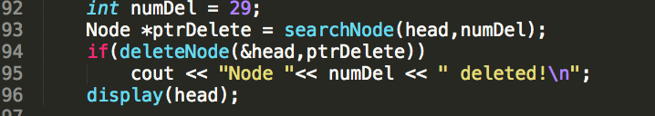
Simple Linked List
Write an algorithm to search and delete Node (for this example, let’s say user wants to delete the second Node (which stores the value 29):

Slide 23
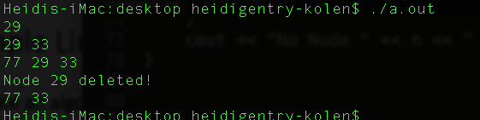
Simple Linked List

Slide 24
Arrays vs Linked Lists
Linked lists are more complex to code and manage than arrays, but they have some distinct advantages.
Dynamic: a linked list can easily grow and shrink in size.
We don’t need to know how many nodes will be in the list. They are created in memory as needed.
In contrast, the size of a C++ array is fixed at compilation time.
Easy and fast insertions and deletions
To insert or delete an element in an array, we need to copy to temporary variables to make room for new elements or close the gap caused by deleted elements.
With a linked list, no need to move other nodes. Only need to reset some pointers.

Slide 25

Arrays vs Linked Lists
Scenarios To Consider

Slide 26
Arrays vs Linked Lists
You are writing a program that will store 97 salespeople salaries and determine the operational cost of keeping each employee.

Slide 27
Arrays vs Linked Lists
You are writing a program that will store an unknown amount of salespeople salaries and determine the operational cost of keeping each employee.

Slide 28
Arrays vs Linked Lists
You are writing a grocery list program that can hold 100 grocery items. The user will not have the option of inserting new items or deleting items from the list.

Slide 29
Arrays vs Linked Lists
You are writing a grocery list program that can hold unlimited grocery items. The user has the option of inserting new items or deleting items from the list.

Slide 30
Arrays vs Linked Lists
You are writing a program that will store 100 student names. Your program will randomly produce a unique student name each time the instructor presses the enter key.

Slide 31
Arrays vs Linked Lists
You are writing a social trick-or-treat program where there is an unlimited number of houses that can be input (representing the optimal trick or treat experience). Users can insert and delete houses from the program as desired.

Slide 32

Implementation (today’s lab)
Imagine you are writing an application for your cousins (they are four, six and eight years old). They want to socialize trick-or-treating this year! They live on Barrow’s Street, which is known as the best street in the city for trick-or-treating!

Slide 33
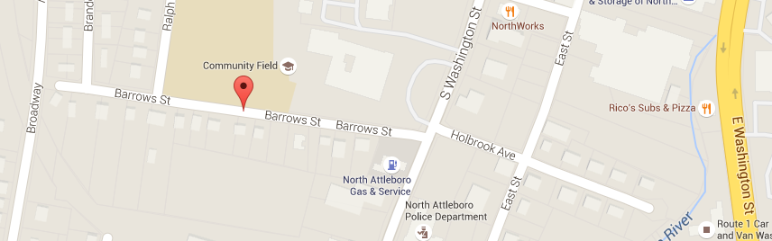
Barrows Street

Slide 34

Lab Specifications
Overall, the application will allow the users ( envision this as an app that many trick-or-treaters on Barrows Street download ) to enter in, display and modify the addresses of the “best” houses to visit for the most lucrative treat experience! Of course, for this example/lab, we will only be implementing the linked list. At the very least, you should implement the following functions:
displayAllStreetNumbers();
addStreetNumber();
deleteStreetNumber();
searchStreetNumber();

