Slide 1


Movie Recommender System Based On Fuzzy Logic

Slide 2
MOVIE RECOMMENDER SYSTEM BASED ON FUZZY LOGIC
A Recommender System is an application that is used to provide insightful recommendations to users that align with their interests.
Based on their preferences and viewing history.
Recommender systems plays an essential role in our real life they simplify decision-making , they assists users for finding relevant and personalized content in various domains, such as e-commerce ,social networking, job portals, travel and entertainment etc.
The system will consider various factors such as past purchases, search history, demographic information, and other factors to the user.
By incorporating the fuzzy membership functions for representing user-item interactions, the system can assign degrees of relevance or the preferences.

Slide 3
PROBLEM STATEMENT
There are various ways of implementing these recommender systems. Traditional recommender systems often depend on explicit user-item features for generating recommendations
Whereas our project uses a new approach for recommending systems that is fuzzy logic ,which is used to model and accommodate user-generated uncertainty and imprecision.
It has been observed that most of the users do not give any ratings. So, a research problem arises that how to know whether they are satisfied with the product and how much.
Fuzzy logic allows for handling uncertainty and imprecision in data, making it a valuable tool for recommendation systems when dealing with uncertain user preferences and item characteristics It also involves the application of fuzzy logic and fuzzy inference techniques to create a personalized recommendation engine.

Slide 4
MOTIVATION
It is difficult for the customers to find the products they want in the existing recommendation systems.
Due to Limited resource situation, data valid time and cold start problems are some of the issues that have not been very well considered in existing recommendation systems.
Due to which no personalized recommendation are provided to users., unable to solve cold start problem, limited resource situation not properly handled, data valid time not handled properly and less efficient.
This is where fuzzy recommender systems step in. They can handle the in-between stuff.

Slide 5
Overview Of Various Methods
There are several approaches to building recommendation systems, and they can be categorized into two main types: collaborative filtering, content-based filtering.
Collaborative Filtering: This technique relies on user-item interaction data to identify patterns and make recommendations.
It recommends items based on the behavior and interest of similar users.
For example: In a music recommendation , if you and another user have same interest and share a lot of common favorite songs and artists. If that user listens to a new album, the system may suggest same album to you, assuming that you'll likely enjoy it too.

Slide 6
Overview Of Various Methods
Content Based Filtering: This recommends items to users based on the characteristics or features of the items and the user's preferences.
In a movie recommendation system, it might consider features like genre, actors, director, and user's past preferences. This uses Clustering approaches k-means etc.
For example: If a user browses for a product on an online shopping platform, the platform will analyze the item attributes of the users purchase history and based this information, the system will recommend the similar items to the user.

Slide 7
Application Of Fuzzy Logic
In this project involves the application of fuzzy logic and fuzzy Inference techniques to create a personalized recommendation engine. Fuzzy logic allows for handling uncertainty and imprecision in data, making it a valuable tool for recommendation systems.
Fuzzy logic is a process generalizing the standard logic, in standard logic which all statements have a truth value of 0 or 1.
In fuzzy logic, statements can have a value of partial truth, such as 0.95 or 0.25 .

Slide 8
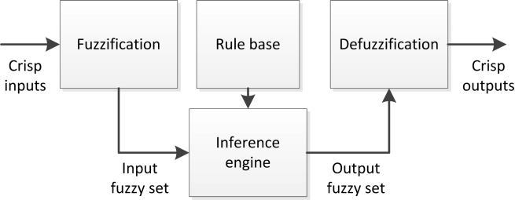

Slide 9
Advantages Of Fuzzy Logic
Handling Uncertainty: Uncertainty refers to a lack of complete information about a data, when there are errors, incomplete information uncertainty occurs.
Fuzzy Systems are well-suited for situations where user preferences or item characteristics are not clear.
Fuzzy systems use membership functions to represent the degree of truth.

Slide 10
Advantages Of Fuzzy Logic
Sparse Data: When a large part of the data-set contains missing values or empty values it leads to data sparsity..
Fuzzy systems can handle sparse data, it creates fuzzy user profiles instead of relying only on crisp ratings.
Fuzzy profiles represent the degree of preference or membership of a user to various item characteristics or genres.

Slide 11
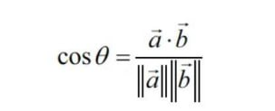
Proposed Models
Cosine Similarity : It is a distance metric used to measure the similarity between two vectors that represent user preferences or item characteristics.
It measures the similarity between two items, such as movies, by calculating the cosine of the angle between their feature vectors

Slide 12
Proposed Models
Fuzzy Systems : Fuzzy means unclear ,distinct or precise .Fuzzy logic is a form of multi-value logic.
A = (x, μA(x)); x, μA(x)[0, 1])
In fuzzy sets ,each elements is mapped with [0,1] by the membership function.

Slide 13
Data Set
The data we were working is taken from Kaggle Dataset
i.e.,TMDB 5000 Movie Dataset, where this contains 2 dataset:
1. Tmdb-5000-c redits.csv
2. Tmdb-5000-movies.csv
This CSV file contains a total of 4802 movies and 24 columns: index, budget, genres, keywords, rating, original-language, homepage, id,
original title, overview, popularity, production-companies, production-countries, release-date, revenue, etc…

Slide 14
Code Implementation
Using the concept of fuzzy membership functions, the project uses two snippets of code.
The first snippet contains one is in Python programming language using the packages like scikit-learn, pandas , and numpy arrays.
And the second snippet of code is in the HTML, JavaScript programming language which is used to create interactive web pages.

Slide 15
Code Implementation
The first part of the code is used to load the data from excel file using pandas libraries " pd.read_csv " this extracts user details like gender, age ,occupation and movie details like movie id ,title, genre.
The next part of the code creates fuzzy sets that is based on the user’s ratings .
A class is created that measures the users interest on a particular movie based on genre that returns good ,bad, very bad, average etc values.
Here, feature extraction methods and distance metrics are utilized to generate recommendations. Feature extraction method is used for calculating similarity between each item available..

Slide 16
Code Implementation
The output generated is sent to a python code called 'app.py’ which will generate a list of movie recommendations provided by the system, when user enters a valid movie name.
The system will check the data against all existing movie names to find the most similar movie and it will generate the recommendations accordingly.

Slide 17
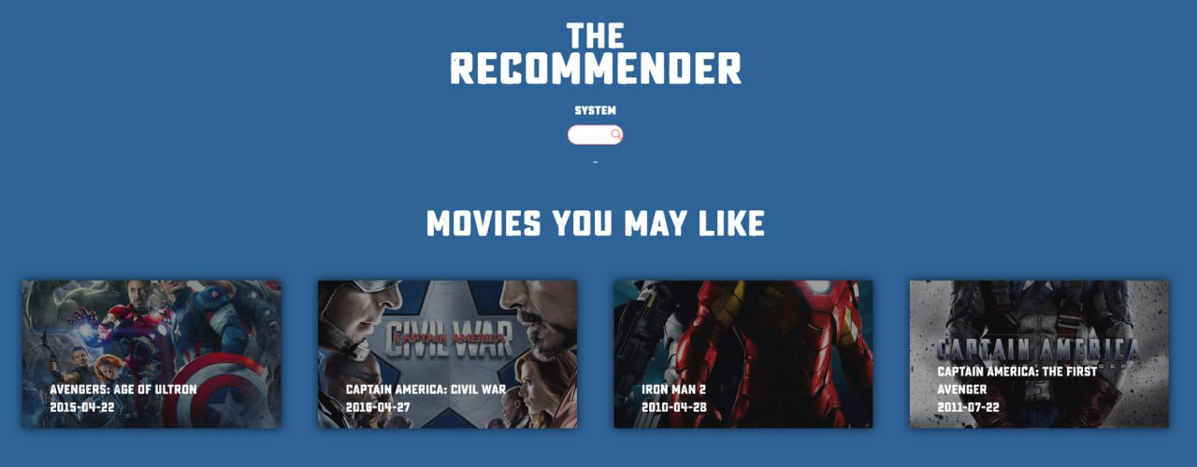

Slide 18
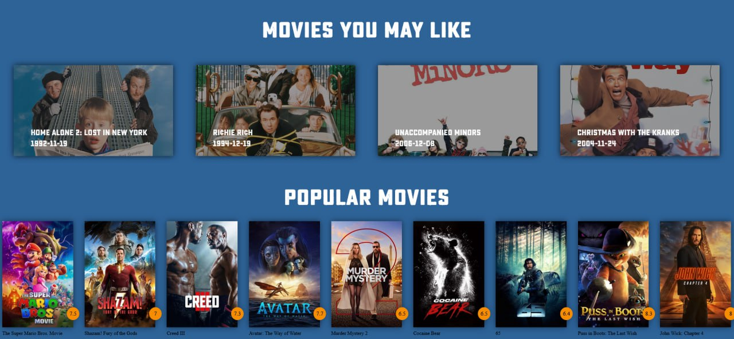

Slide 19
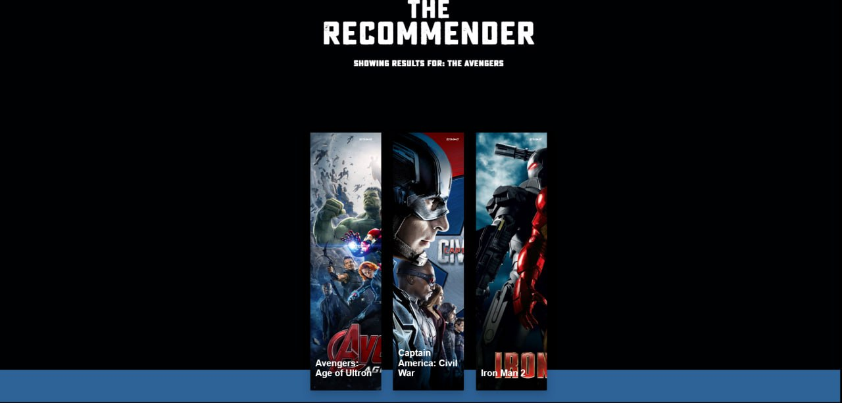

Slide 20
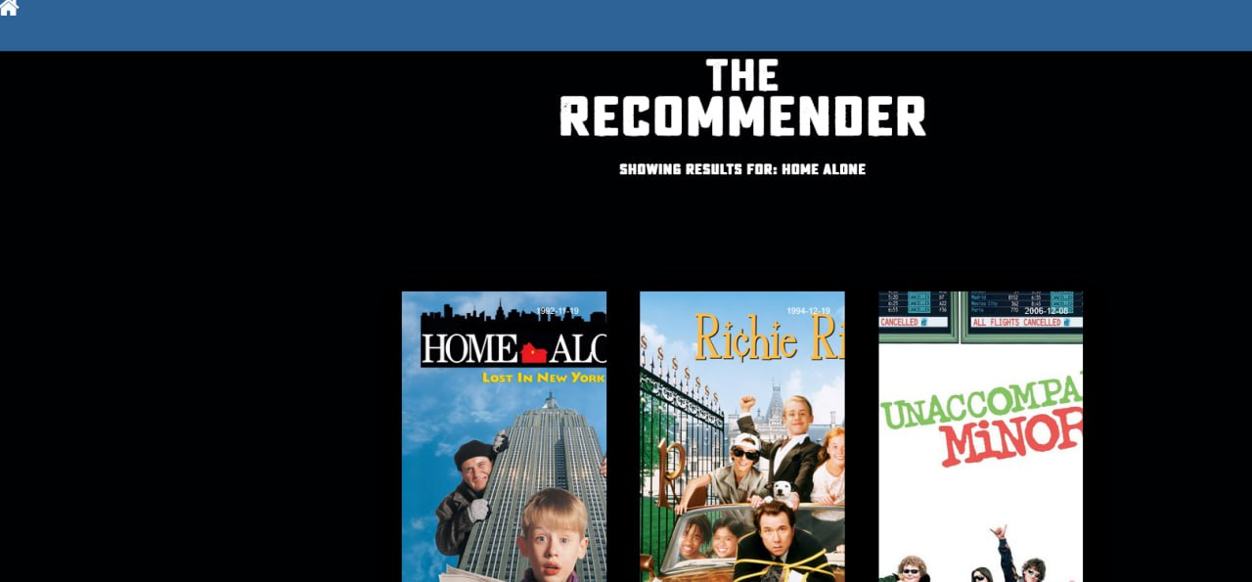

Slide 21
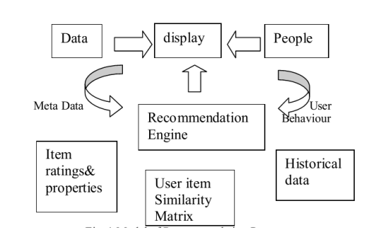
BLOCK DIAGRAM

Slide 22
LITERATURE SURVEY
We reviewed some of the articles and we found that more than half of the recommendation approaches applied content-based filtering (55 %).
Collaborative filtering was applied by only 18 % of the reviewed approaches, and graph-based recommendations by 16 %.
Other recommendation concepts included stereotyping, fuzzy recommenders, item-centric recommendations, and hybrid recommendations.
In addition, most approaches neglected the user-modeling process and did not infer information automatically but let users provide keywords, text snippets, or a single paper as input.

Slide 23
REFERENCES
G. Adomavicius and A. Tuzhilin, “Toward the next generation of recommender systems: A survey of the state-of-the-art and possible extensions,” IEEE transactions on knowledge and data engineering, vol. 17, no. 6, pp. 734–749, 2005
M. Papagelis, D. Plexousakis, and T. Kutsuras, “Alleviating the sparsity problem of collaborative filtering using trust inferences,” in Trust management, pp. 224–239, Springer, 2005.
Abbasi, A., & Hossain, L. (2009). Fuzzy-based hybrid collaborative and content-based recommendation system. In Proceedings of the 2009 IEEE/WIC/ACM International Conference on Web Intelligence and Intelligent Agent Technology (Vol. 3, pp. 329-332).
Y. Fang and Y. Guo, ‘‘A context-aware matrix factorization recommender algorithm, in Proc. IEEE Int. Conf. Softw. Eng. Service Sci., May 2013, pp. 914–918.
M. Gan and R. Jiang, ‘‘Constructing a user similarity network to remove adverse influence of popular objects for personalized recommendation, Expert Syst. Appl., vol. 40, no. 10, pp. 4044–4053, 2013.

Slide 24
APPLICATION AND END USERS
The application of recommender systems is wide ranging with them being used by companies to recommend various products like:
Movies:
A movie recommendation system is an application that suggests movies to users based on their preferences and viewing history such as Netflix, Amazon PrimeVideo.
Music:
Music recommendation predicts songs users might like to hear based on their previous listening history.
Books:
Book recommendation system is a type of recommendation system where we have to recommend similar books to the reader based on his interest.
E-Commerce:
E-commerce sites suggest products to their customers. The products can be recommended based on the top overall sellers on a site.

Slide 25
THANK YOU

