Slide 1

Floating-Point Numbers
Marc Andrysco

Slide 2
Overview
Floating-Point Numbers
  Scientific-notation
  IEEE-754 representation
Denormal Number Timing Attack
  SVG transforms
  Timing channels
  Stealing pixels

Slide 3
Floating-Point Format
Integers
Fixed-point numbers
Floating-point numbers
Precision and rounding

Slide 4
On Spelling
From grade school grammar:
'i' before 'e' *
* except after 'c' ✢
✢ or when sounded as 'a' ❊
as in neighbor or weigh
❊ still sometimes wrong
like 'species' or 'caffeine'

Slide 5
Integers
-2
-1
1
2
3
4
5
0
Take up whole number spots on the number line
Space between each is always 1
32-bit integers have 2^32 unique points
  Signed range [-2147483648, 2147483647]
The number line can wrap around the globe

Slide 6
Fixed-Point Numbers
-0.01
0
0.01
0.02
0.03
Integers scaled by a constant factor
Space between points is always constant
Useful for fixed decimal values like currency
32-bit numbers have 2^32 unique points
  Example range [-21474836.48, 21474836.47]

Slide 7
Scientific Notation
Contains a “floating” decimal point
  1.2 × 10⁻² same as 0.012 × 10⁰
Easy to represent large and small values
  1.6162 × 10⁻³⁵, 6.02 × 10²³
Made up of two pieces
1.2 10⁻²
  Significand/mantissa/fraction
  Exponent

Slide 8
Normal Form
0.01616 × 10⁻³³ 1.616 × 10⁻³⁵ 1616.0 × 10⁻³⁸
Non-zero, single digit left of the decimal
  Called normal or normalized
Non-conforming forms are “denomalized”
  All denormalized numbers can be made normal ✢
  ✢ Except zero, infinity...

Slide 9
Fixed Precision
Fix the number of of digits
  Always use normal form
Ex: 3 significand digits, 2 exponent digits
  Maximum number 9.99×10⁹⁹
  Minimum (non-zero) 1.00×10⁻⁹⁹
Missing zero!
  It has no normal form

Slide 10
Floating-Point Range
0
1.0
2.0
4.0
Space between floats vary
Allows for an enormous range
  Max value of 9.99×10⁹⁹
    Times larger than the observable universe
    Next smaller value, 9.98×10⁹⁹ is a difference of 0.01×10⁹⁹
  Min value of 1.00×10⁻⁹⁹
    1.6×10⁶⁴ times smaller than Planck length

Slide 11
Rounding
Not all numbers have finite representations
  The fraction 1/3 cannot be written in decimal
Round to the nearest representation
  1/3 would be 3.33×10⁻¹
  Round to even if directly in between representations
Other rounding modes
  Round toward zero, infinity, -infinity

Slide 12
IEEE-754 Floats
IEEE-754 standard
Special values
Denormalized numbers

Slide 13
IEEE-754 Standard
IEEE-754 specifies standard formats for floats
  Binary32: “single-precision” ; float in C
  Binary64: “double-precision” ; double in C
Like scientific-notation, uses binary
  1.0101110001b×2^{101b}
  Normal forms, first digit must be 1

Slide 14
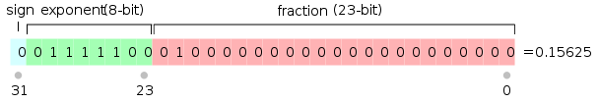
Single-Precision Float
1-bit sign, 8-bit exponent, 23-bit fraction ✢
Maximum: 3.402823466×10³⁸
Minimum: 1.175494351×10^{−38 ❊}
✢ Special forms for other numbers (zero, infinity...)
❊ That's sometimes lie

Slide 15
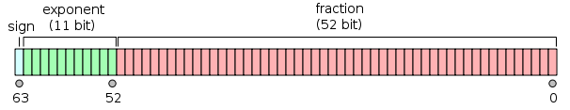
Double-Precision Float
1-bit sign, 11-bit exponent, 52-bit fraction ✢
Maximum: 1.7976931348623157×10³⁰⁸
Minimum: 2.2250738585072014×10⁻³⁰⁸
✢ Same exceptions apply

Slide 16
Float Representation
Fraction starts with 1 (ex: 1.0100...)
Exponent is biased by 127
  Example as above: 0111100b – 127 = 124 – 127 = -3
  Makes floats better ordered

Slide 17
Special Values
Zero – all exponent and fraction bits are zero
  Sign bit can be negative for -0.0
Infinity – all exponent and fraction bits are one
  Sign bit can be negative for -Infinity
NaN – exponent is ones, fraction is not all ones
  Have many NaN representations including -NaN

Slide 18
Denormalized Numbers
Occurs when all exponent bits are zero
  No longer given that the first fraction bit is one
  Takes the form 0.000110b×2⁻¹²⁶
Larger representable range
Extreme loss of precision
Can have an extreme loss of performance
Frequently omitted (e.g. GPUs)

Slide 19
Denormalized Range
Numbers smaller than the “minimum”
Single-precision floats
  1.175494351×10⁻³⁸ to 1.4012985×10⁻⁴⁵
Double-precision floats
  2.2250738585072014×10⁻³⁰⁸ to 5×10⁻³²⁴

Slide 20
Firefox Timing Attack
Attack Overview
Timing Channel
Pixel Extraction

Slide 21
Attack Overview
Create a legitimate website
In the page, hide an <iframe> to a target website that contains private data (i.e. chase.com)
Use a timing channel to create an image copy of the <iframe> contents
Extract private information from the image

Slide 22
Timing Channel
Hiding an <iframe> in a website is easy
Apply image transformation that vary based on the <iframe> contents
Quick transformation = the <iframe> is white
Slow transformation = the <iframe> is black

Slide 23
SVG Transforms
SVG standard defines transformations on SVG elements
HTML5 allows transformations as a CSS style
  applies to any HTML element
Ex: gaussian blur, greyscale, sepia, specular and diffuse lighting, image composition, ...

Slide 24





Example Transforms

Slide 25
SVG Computation
Transform act on input image to an output image
  Applying to HTML elements are flattened to images
Images are RGBA pixmaps
  Each color channel is an 8-bit unsigned integer
Some transforms internally compute using floating-point arithmetic
These computation give us our timing channel

Slide 26
Denormalized Performance
Many operations on denormalized numbers are ~75 times slower!
The operation a∗b=c is slow if
  a, b, or c is denormalized
  And no values are zero

Slide 27
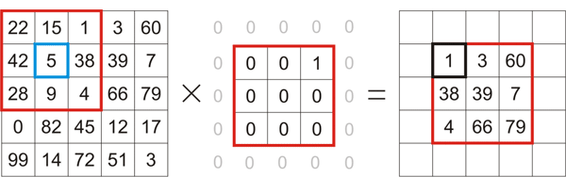
Convolution Filter
Inputs a kernel matrix M
The kernel matrix is multiplied against every input coordinate to produce the output pixel

Slide 28
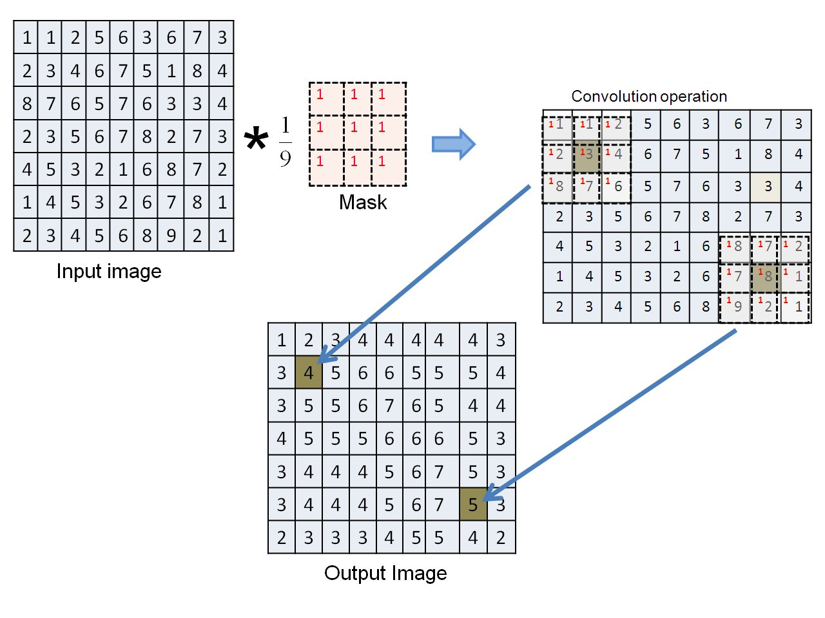
Convolution Filter

Slide 29

SVG Convolution
Includes an arbitrary divisor
Using a 1x1 kernel, each pixel is computed as
  y is the output pixel
  x is the input pixel
  k is the kernel matrix
  d is the divisor

Slide 30
Denormal Convolution
Uses single-precision floats
No constant can be smaller than 0.001
  k = 0.001
  d = 1.0×10³⁸
If x = 0, then y = 0
If x = 255, then y = 2.55×10⁻³⁹
  y is denormal!
Computed for every color channel of every pixel

Slide 31
Denormal Timing Signal
Apply malicious convolution filter to <iframe>
If the filter is applied quickly, <iframe> is black
If the filter is applied slowly, <iframe> is white
Measure timing with requestAnimationFrame
  Executes callback once finished rendering
  Tied to the refresh rate of the monitor (60 Hz)

Slide 32
Denormal Pixel Extraction
Use SVG transforms to isolate a single pixel
Apply timing attack to a single pixel
Iterate over all pixels of the target iframe
Very slow at ~20ms per pixel
  2.7 hours to read an 800x600 iframe

Slide 33
Full Attack
Create a legitimate website (flash game)
Hide an <iframe> to a target website (chase.com)
Apply an convolution filter on the <iframe>
  White pixels = slow
  Black pixels = fast
Use the timing data to read individual pixels
Extract private information from the image (bank info)

Slide 34
Current Work
Pixel Isolation
Apply to Webkit
  Webkit is accelerated using OpenCL
  No denorms on GPUs
Improve Attack Speed
  Convolution transforms can perform letter detection
  Test target for an entire letter at once
  Should read a few characters per second

Slide 35
Questions

Slide 36
Pre-defined Shapes
Here are some pre-defined shapes for your convenience: copy the shapes, copy their formatting, or use the LibO styles.
Green Dark
Green Bright
You may add your code examples, XML statements, or debug output here ;-)
Blue Dark
Blue Bright
Orange Dark
Orange Bright
Purple Dark
Purple Bright
Yellow Dark
Yellow Bright

Slide 37
Section Header Example
You may add additional text here ...

Slide 38
Thank you …
… for using this template!
… for supporting LibreOffice!

Slide 39
Normalized Math
Multiplication is easy
  y×2^{z} = a×2^{b} × c×2^{d}
  y = a×c
  z = b+d
  3.1×2⁴ × 2.6×2⁻²
  3.1 × 2.6 = 8.06
  4 + -2 = 4
  8.06×2²

Slide 40
Normalized Math
Addition is harder
  y×2^{z} = a×2^{b} + c×2^{d}
  y×2^{z} = a×2^{b} + c'×2^{b}
  y = a + c'
  z = b
  3.1×2⁴ + 2.6×2³
  3.1×2⁴ + 0.26×2⁴
  3.1 + 0.26 = 3.36
  4 = 4
  3.36×2⁴

Slide 41
Denormalized Math
All operations are harder
  Results may be outside representable range
  Multiplication yields wildly denormalized results
  Much slower on modern CPUs (Intel, AMD)
Frequently omitted
  GPUs round denormals to zero

