Slide 1
Cross Validation

Slide 2
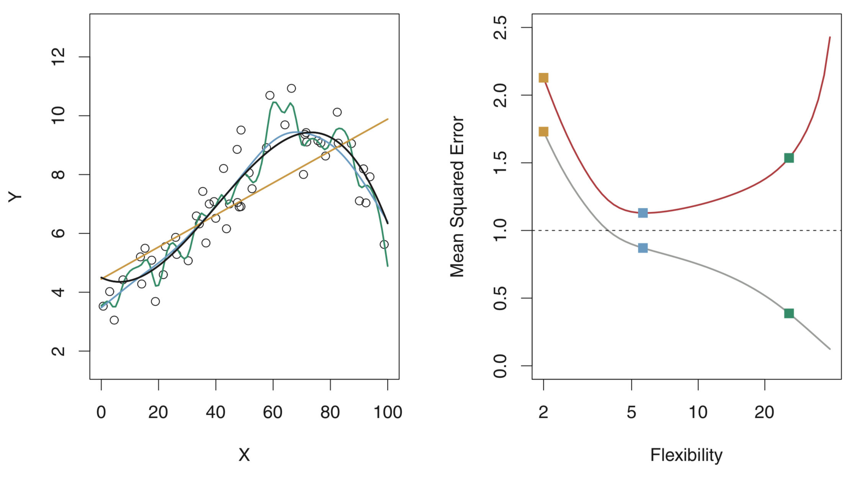
True simulated relationship
test error
Linear fit
Smooth fit
Rough fit
training error
Images from “An Introduction to Statistical Learning”

Slide 3
True simulated relationship
test error
Linear fit
Smooth fit
Rough fit
training error
Images from “An Introduction to Statistical Learning”

Slide 4
True simulated relationship
under fitting
(high bias)
test error
Linear fit
Smooth fit
Rough fit
best
over fitting
(high variance)
training error
Images from “An Introduction to Statistical Learning”

Slide 5
data set
training set
test set

Slide 6
data set
training set
test set
How you split the data is up to you. Although it may matter, there is no a priori single right way to do it.
training set
test set
training set
test set

Slide 7
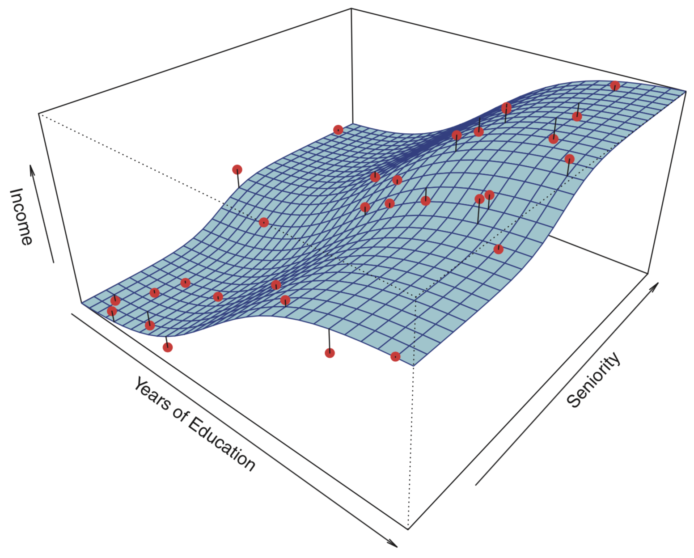
Surface is true simulated model.
Points are randomly simulated data plus noise.
Images from “An Introduction to Statistical Learning”

Slide 8
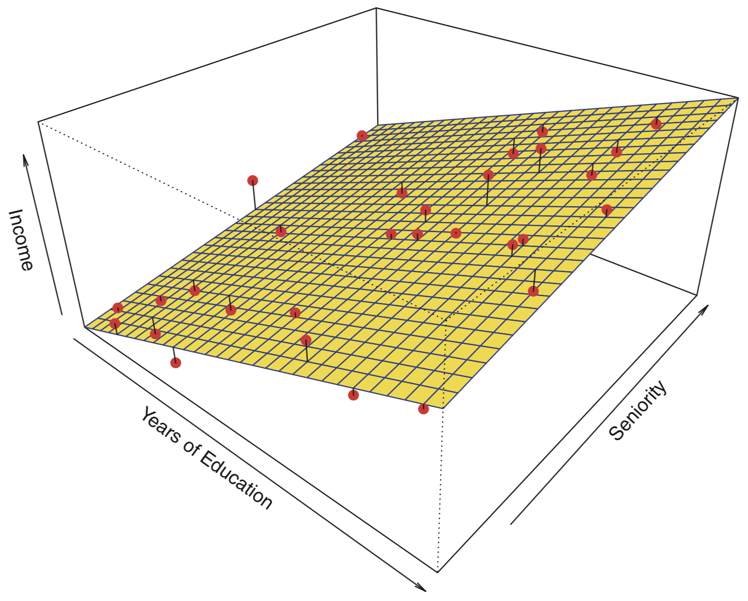
Surface is true simulated model.
Points are randomly simulated data plus noise.
Linear model fit.
Images from “An Introduction to Statistical Learning”

Slide 9
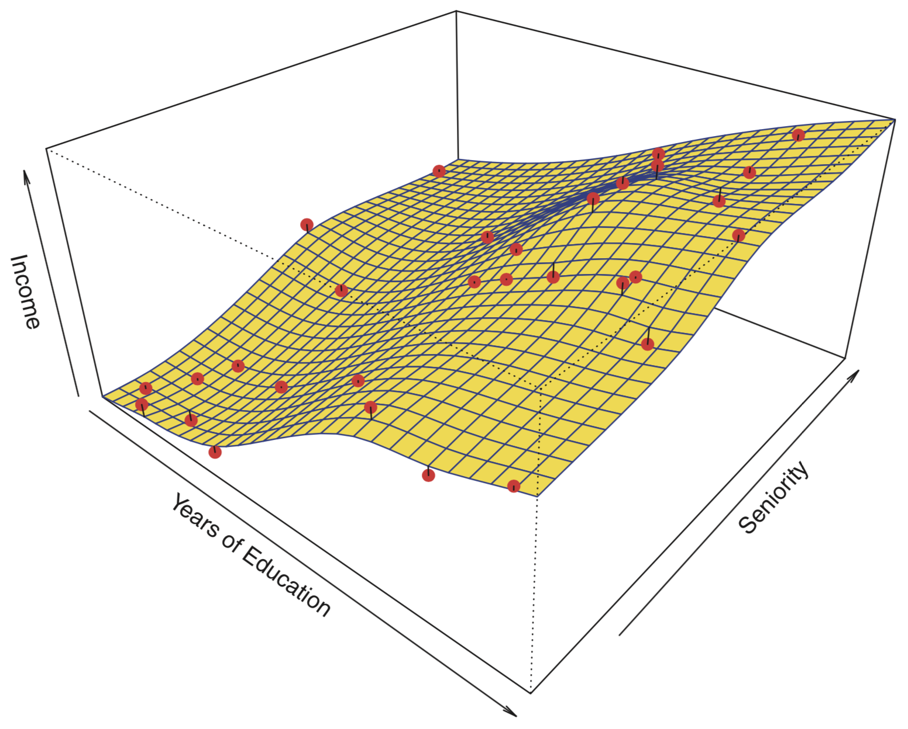
Surface is true simulated model.
Points are randomly simulated data plus noise.
Smooth spline model fit.
Images from “An Introduction to Statistical Learning”

Slide 10
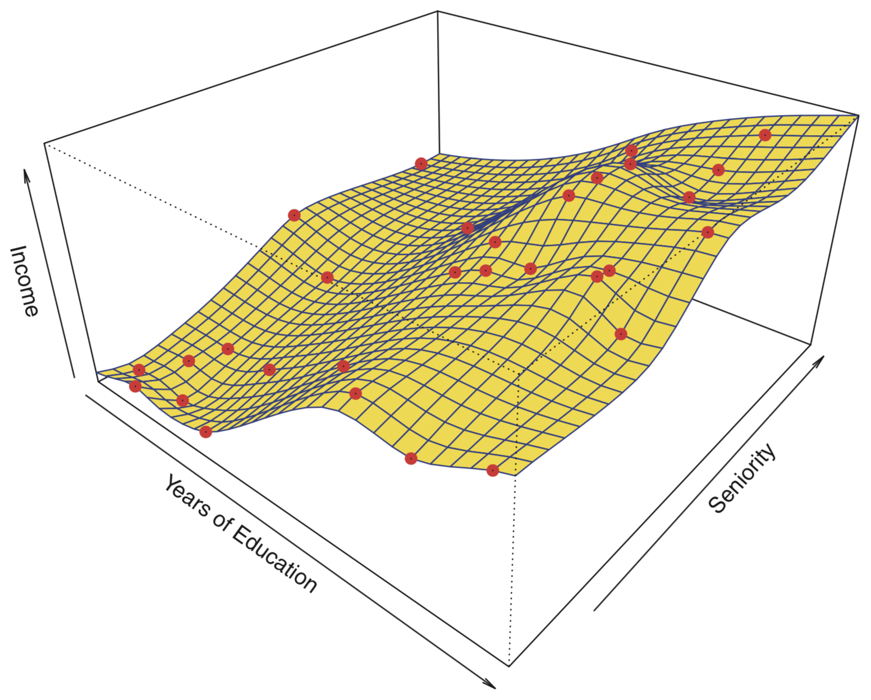
Surface is true simulated model.
Points are randomly simulated data plus noise.
Rough spline model fits data perfectly!
Images from “An Introduction to Statistical Learning”

Slide 11
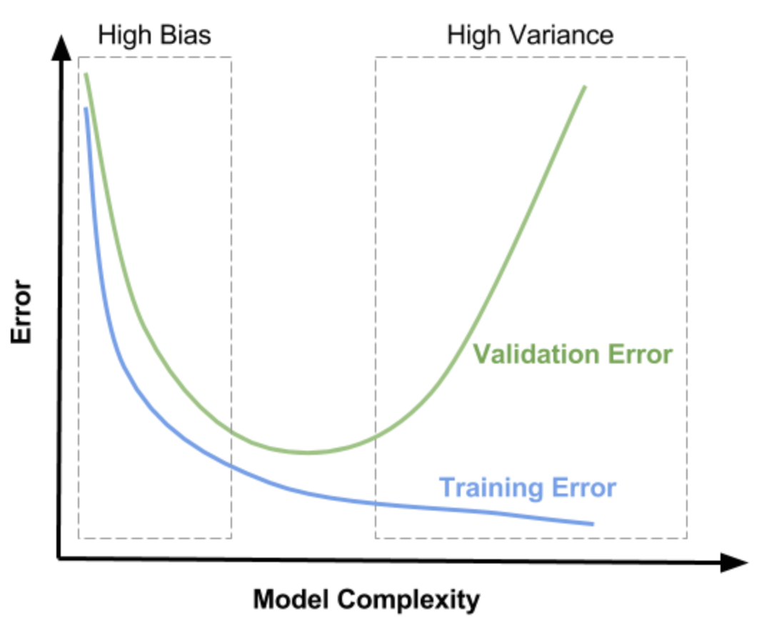
underfitting
just right
overfitting
Goldilocks Zone
https://dziganto.github.io/cross-validation/data%20science/machine%20learning/model%20tuning/python/Model-Tuning-with-Validation-and-Cross-Validation/

Slide 12
data set
Especially for small to medium sized data sets, how you split your data can make a difference in your model results.
For example, small training/test sets may contain outliers/corner cases or otherwise not reflect the larger population.
training set
test set
training set
test set
training set
test set

Slide 13
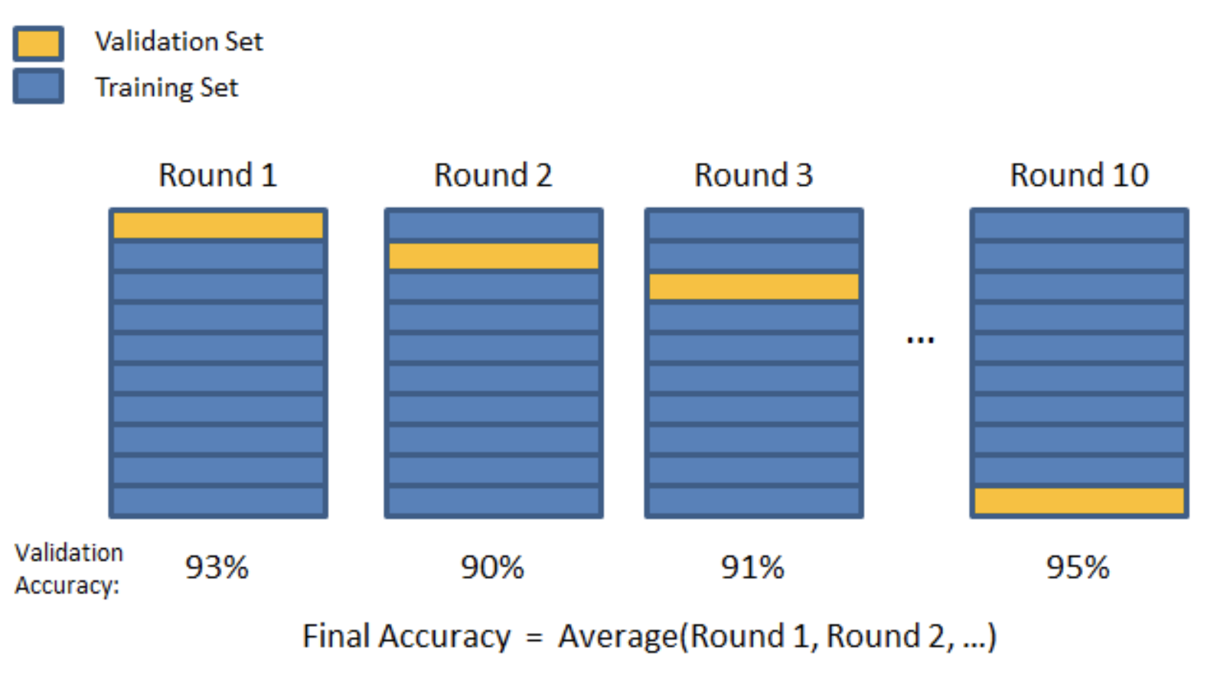
K-fold Cross Validation
10-fold CV
https://dziganto.github.io/cross-validation/data%20science/machine%20learning/model%20tuning/python/Model-Tuning-with-Validation-and-Cross-Validation/

Slide 14
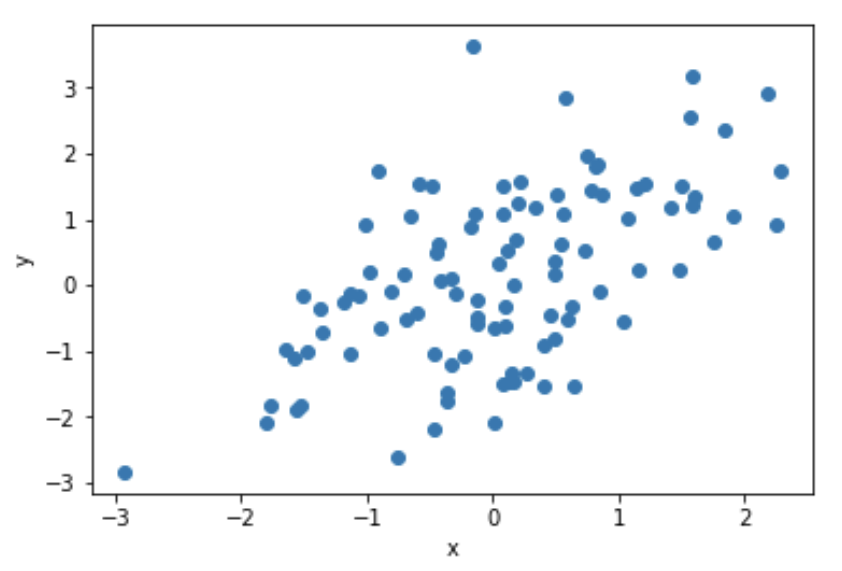















Simple Linear Regression
Goal is to estimate $β_{0}$ and $β_{1}$ given the data (x, y).
$$y=β_{0}+β_{1} x+ε$$
residuals
$$y_{0}$$
$$1$$
$$x_{0}$$
$$ε_{0}$$
$$y_{1}$$
$$1$$
$$x_{1}$$
$$ε_{1}$$
.
.
.
.
.
.
.
.
.
.
.
.
$$=β_{0} +β_{1}$$
$$+$$
$$y_{n}$$
$$1$$
$$x_{n}$$
$$ε_{n}$$
One way to get best estimate is to minimize the sum of squared residuals (SSE).
This is ordinary least squares (OLS) linear regression.

Slide 15
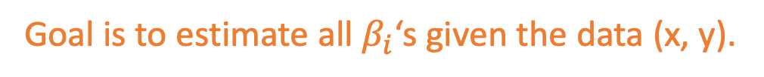
Multiple Linear Regression
Goal is to estimate all $β_{i}$‘s given the data (x, y).
target
variable
noise
$$y =β_{0} 1 +β_{1} x_{1} +β_{2}{ x}_{2} +… +β_{n} x_{n} + ε$$
constant offset
columns of X are feature variables
One way to get best estimate is to minimize the sum of squared residuals (SSE).
This is ordinary least squares (OLS) linear regression.

Slide 16
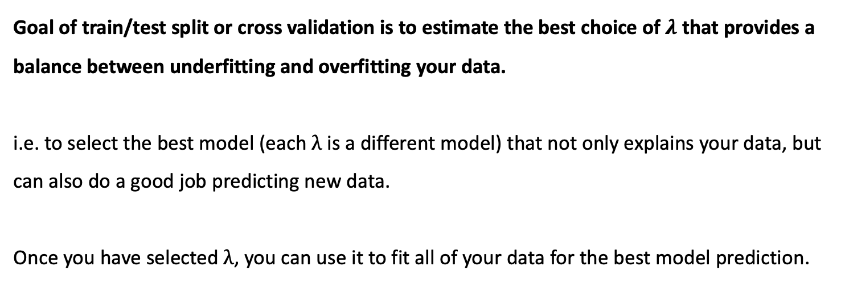
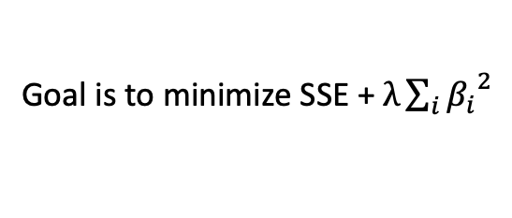
Ridge Regression
Goal is to minimize SSE + $λ\sum_{i}{{β_{i}}^{2}}$
Goal of train/test split or cross validation is to estimate the best choice of $λ$ that provides a balance between underfitting and overfitting your data.
i.e. to select the best model (each $λ$ is a different model) that not only explains your data, but can also do a good job predicting new data.
Once you have selected $λ$, you can use it to fit all of your data for the best model prediction.

