Slide 1
Review
Hypothesis Testing
p-value
t-test
power
bootstrap

Slide 2
data set A
data set B
x
x
x
x
x
x
x
x
x
x
x
x
x
x
x
x
x
x
x
x
x
x
x
x
x
x
x
x
x
x
x
x
x
x
x
x
x
x
x
x
x
x
x
x

Slide 3


data set A
data set B
x
x
x
x
x
x
x
x
x
x
x
x
x
x
x
x
x
x
x
x
x
x
x
x
Compare means of two data sets
x
x
x
x
x
x
x
x
x
x
x
x
x
x
x
x
x
x
x
x
$${\overline{x}}_{A}$$
$${\overline{x}}_{B}$$
mean

Slide 4


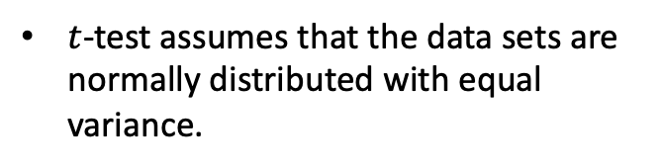
data set A
data set B
x
x
x
x
x
x
x
x
x
x
x
x
x
x
x
x
x
x
x
x
x
x
x
x
Compare means of two normally distributed data sets
x
x
x
x
x
x
x
x
x
x
x
x
x
x
x
x
x
x
x
x
$$x$$
$$x$$
$t$-test assumes that the data sets are normally distributed with equal variance.
$${\overline{x}}_{A}$$
$${\overline{x}}_{B}$$
mean

Slide 5


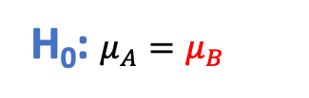
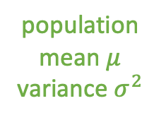
data set A
data set B
population
mean $μ$
variance $σ^{2}$
x
x
x
x
x
x
x
x
x
x
x
x
x
x
x
x
x
x
x
x
x
x
x
x
x
x
x
x
x
x
x
x
x
H₀: data sets A and B came from the same population, differences due entirely to random variation
x
x
x
x
x
x
x
x
x
x
x
H₀: $μ_{A}=μ_{B}$
$$\frac{σ}{\sqrt{n}}$$
$${\overline{x}}_{A}$$
$$μ$$
$${\overline{x}}_{B}$$
mean

Slide 6


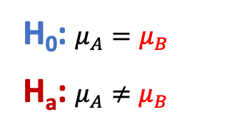
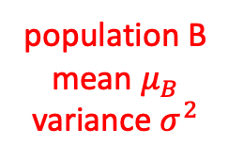

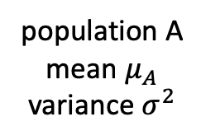

data set A
data set B
population A
mean $μ_{A}$
variance $σ^{2}$
population B
mean $μ_{B}$
variance $σ^{2}$
x
x
x
x
x
H_{a}: data sets A and B did NOT come from the same population, differences unlikely to be due entirely to random variation
x
x
x
x
x
x
x
x
x
x
x
x
x
x
x
x
x
x
x
x
x
x
x
x
x
x
x
x
x
x
x
x
x
x
x
x
x
x
x
H₀: $μ_{A}=μ_{B}$
H_{a}: $μ_{A}≠μ_{B}$
$$\frac{σ}{\sqrt{n_{A}}}$$
$$\frac{σ}{\sqrt{n_{B}}}$$
$${\overline{x}}_{A}$$
$${\overline{x}}_{B}$$
mean
$$μ_{A}$$
$$μ_{B}$$

Slide 7
data set A
data set B
x
x
x
x
x
x
x
x
x
x
x
x
x
x
x
x
x
x
x
x
x
x
x
x
Compare means of two normally distributed data sets
x
x
x
x
x
x
x
x
x
x
x
x
x
x
x
x
x
x
x
x
Formulate H₀ and H_{a}.
H₀: $μ_{A}=μ_{B}$
H_{a}: $μ_{A}≠μ_{B}$
$${\overline{x}}_{A}$$
$${\overline{x}}_{B}$$
mean

Slide 8
data set A
data set B
x
x
x
x
x
x
x
x
x
x
x
x
x
x
x
x
x
x
x
x
x
x
x
x
Compare means of two normally distributed data sets
x
x
x
x
x
x
x
x
x
x
x
x
x
x
x
x
x
x
x
x
Formulate H₀ and H_{a}.
Assume H₀ is true.
H₀: $μ_{A}=μ_{B}$
H_{a}: $μ_{A}≠μ_{B}$
$${\overline{x}}_{A}$$
$${\overline{x}}_{B}$$
mean

Slide 9
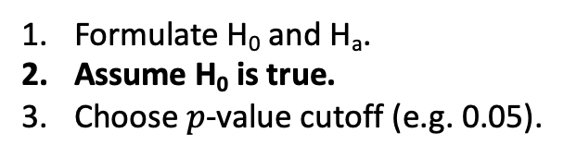
data set A
data set B
x
x
x
x
x
x
x
x
x
x
x
x
x
x
x
x
x
x
x
x
x
x
x
x
Compare means of two normally distributed data sets
x
x
x
x
x
x
x
x
x
x
x
x
x
x
x
x
x
x
x
x
Formulate H₀ and H_{a}.
Assume H₀ is true.
Choose $p$-value cutoff (e.g. 0.05).
H₀: $μ_{A}=μ_{B}$
H_{a}: $μ_{A}≠μ_{B}$
$${\overline{x}}_{A}$$
$${\overline{x}}_{B}$$
mean

Slide 10
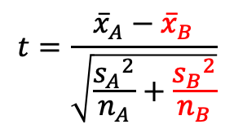
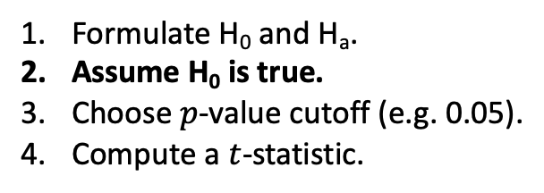
data set A
data set B
x
x
x
x
x
x
x
x
x
x
x
x
x
x
x
x
x
x
x
x
x
x
x
x
Compare means of two normally distributed data sets
x
x
x
x
x
x
x
x
x
x
x
x
x
x
x
x
x
x
x
x
$$t=\frac{{\overline{x}}_{A}−{\overline{x}}_{B}}{\sqrt{\frac{{s_{A}}^{2}}{n_{A}}+\frac{{s_{B}}^{2}}{n_{B}}}}$$
Formulate H₀ and H_{a}.
Assume H₀ is true.
Choose $p$-value cutoff (e.g. 0.05).
Compute a $t$-statistic.
(independent samples A and B)
H₀: $μ_{A}=μ_{B}$
H_{a}: $μ_{A}≠μ_{B}$
$${\overline{x}}_{A}$$
$${\overline{x}}_{B}$$
mean

Slide 11

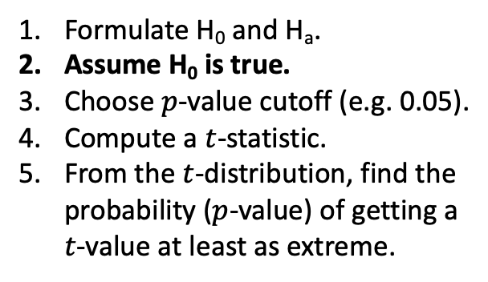
data set A
data set B
x
x
x
x
x
x
x
x
x
x
x
x
x
x
x
x
x
x
x
x
x
x
x
x
Compare means of two normally distributed data sets
x
x
x
x
x
x
x
x
x
x
x
x
x
x
x
x
x
x
x
x
$$t=\frac{{\overline{x}}_{A}−{\overline{x}}_{B}}{\sqrt{\frac{{s_{A}}^{2}}{n_{A}}+\frac{{s_{B}}^{2}}{n_{B}}}}$$
Formulate H₀ and H_{a}.
Assume H₀ is true.
Choose $p$-value cutoff (e.g. 0.05).
Compute a $t$-statistic.
From the $t$-distribution, find the probability ($p$-value) of getting a $t$-value at least as extreme.
H₀: $μ_{A}=μ_{B}$
H_{a}: $μ_{A}≠μ_{B}$
0
$$t$$

Slide 12

data set A
data set B
x
x
x
x
x
x
x
x
x
x
x
x
x
x
x
x
x
x
x
x
x
x
x
x
Compare means of two normally distributed data sets
x
x
x
x
x
x
x
x
x
x
x
x
x
x
x
x
x
x
x
x
$$t=\frac{{\overline{x}}_{A}−{\overline{x}}_{B}}{\sqrt{\frac{{s_{A}}^{2}}{n_{A}}+\frac{{s_{B}}^{2}}{n_{B}}}}$$
Formulate H₀ and H_{a}.
Assume H₀ is true.
Choose $p$-value cutoff (e.g. 0.05).
Compute a $t$-statistic.
From the $t$-distribution, find the probability ($p$-value) of getting a $t$-value at least as extreme.
$t$-distribution assuming H₀ is true
H₀: $μ_{A}=μ_{B}$
H_{a}: $μ_{A}≠μ_{B}$
0
$$t$$

Slide 13
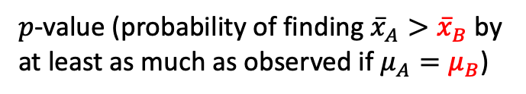
data set A
data set B
x
x
x
x
x
x
x
x
x
x
x
x
x
x
x
x
x
x
x
x
x
x
x
x
Compare means of two normally distributed data sets
x
x
x
x
x
x
x
x
x
x
x
x
x
x
x
x
x
x
x
x
$$t=\frac{{\overline{x}}_{A}−{\overline{x}}_{B}}{\sqrt{\frac{{s_{A}}^{2}}{n_{A}}+\frac{{s_{B}}^{2}}{n_{B}}}}$$
Formulate H₀ and H_{a}.
Assume H₀ is true.
Choose $p$-value cutoff (e.g. 0.05).
Compute a $t$-statistic.
From the $t$-distribution, find the probability ($p$-value) of getting a $t$-value at least as extreme.
$t$-distribution assuming H₀ is true
H₀: $μ_{A}=μ_{B}$
H_{a}: $μ_{A}≠μ_{B}$
$p$-value (probability of finding ${\overline{x}}_{A}>{\overline{x}}_{B}$ by at least as much as observed if $μ_{A}=μ_{B}$)
0
$$t$$

Slide 14

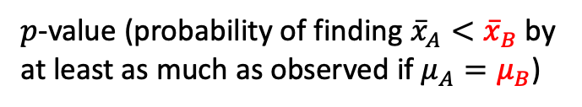
data set A
data set B
x
x
x
x
x
x
x
x
x
x
x
x
x
x
x
x
x
x
x
x
x
x
x
x
Compare means of two normally distributed data sets
x
x
x
x
x
x
x
x
x
x
x
x
x
x
x
x
x
x
x
x
$$t=\frac{{\overline{x}}_{A}−{\overline{x}}_{B}}{\sqrt{\frac{{s_{A}}^{2}}{n_{A}}+\frac{{s_{B}}^{2}}{n_{B}}}}$$
Formulate H₀ and H_{a}.
Assume H₀ is true.
Choose $p$-value cutoff (e.g. 0.05).
Compute a $t$-statistic.
From the $t$-distribution, find the probability ($p$-value) of getting a $t$-value at least as extreme.
$t$-distribution assuming H₀ is true
H₀: $μ_{A}=μ_{B}$
H_{a}: $μ_{A}≠μ_{B}$
$p$-value (probability of finding ${\overline{x}}_{A}>{\overline{x}}_{B}$ by at least as much as observed if $μ_{A}=μ_{B}$)
$$−t$$
0
$$t$$
$p$-value (probability of finding ${\overline{x}}_{A}<{\overline{x}}_{B}$ by at least as much as observed if $μ_{A}=μ_{B}$)

Slide 15
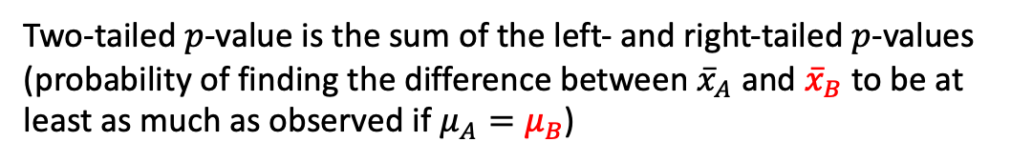
data set A
data set B
x
x
x
x
x
x
x
x
x
x
x
x
x
x
x
x
x
x
x
x
x
x
x
x
Compare means of two normally distributed data sets
x
x
x
x
x
x
x
x
x
x
x
x
x
x
x
x
x
x
x
x
$$t=\frac{{\overline{x}}_{A}−{\overline{x}}_{B}}{\sqrt{\frac{{s_{A}}^{2}}{n_{A}}+\frac{{s_{B}}^{2}}{n_{B}}}}$$
Formulate H₀ and H_{a}.
Assume H₀ is true.
Choose $p$-value cutoff (e.g. 0.05).
Compute a $t$-statistic.
From the $t$-distribution, find the probability ($p$-value) of getting a $t$-value at least as extreme.
$t$-distribution assuming H₀ is true
H₀: $μ_{A}=μ_{B}$
H_{a}: $μ_{A}≠μ_{B}$
$p$-value (probability of finding ${\overline{x}}_{A}>{\overline{x}}_{B}$ by at least as much as observed if $μ_{A}=μ_{B}$)
$$−t$$
0
$$t$$
$p$-value (probability of finding ${\overline{x}}_{A}<{\overline{x}}_{B}$ by at least as much as observed if $μ_{A}=μ_{B}$)
Two-tailed $p$-value is the sum of the left- and right-tailed $p$-values (probability of finding the difference between ${\overline{x}}_{A}$ and ${\overline{x}}_{B}$ to be at least as much as observed if $μ_{A}=μ_{B}$)

Slide 16
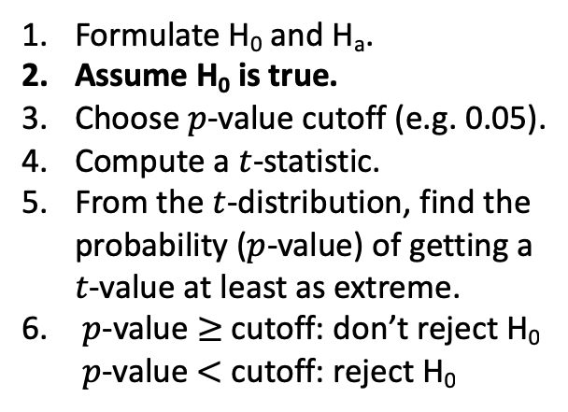
data set A
data set B
x
x
x
x
x
x
x
x
x
x
x
x
x
x
x
x
x
x
x
x
x
x
x
x
Compare means of two normally distributed data sets
x
x
x
x
x
x
x
x
x
x
x
x
x
x
x
x
x
x
x
x
$$t=\frac{{\overline{x}}_{A}−{\overline{x}}_{B}}{\sqrt{\frac{{s_{A}}^{2}}{n_{A}}+\frac{{s_{B}}^{2}}{n_{B}}}}$$
Formulate H₀ and H_{a}.
Assume H₀ is true.
Choose $p$-value cutoff (e.g. 0.05).
Compute a $t$-statistic.
From the $t$-distribution, find the probability ($p$-value) of getting a $t$-value at least as extreme.
$p$-value $≥$ cutoff: don’t reject H₀ $p$-value $<$ cutoff: reject H₀
$t$-distribution assuming H₀ is true
H₀: $μ_{A}=μ_{B}$
H_{a}: $μ_{A}≠μ_{B}$
$p$-value (probability of finding ${\overline{x}}_{A}>{\overline{x}}_{B}$ by at least as much as observed if $μ_{A}=μ_{B}$)
$$−t$$
0
$$t$$
$p$-value (probability of finding ${\overline{x}}_{A}<{\overline{x}}_{B}$ by at least as much as observed if $μ_{A}=μ_{B}$)
Two-tailed $p$-value is the sum of the left- and right-tailed $p$-values (probability of finding the difference between ${\overline{x}}_{A}$ and ${\overline{x}}_{B}$ to be at least as much as observed if $μ_{A}=μ_{B}$)

Slide 17
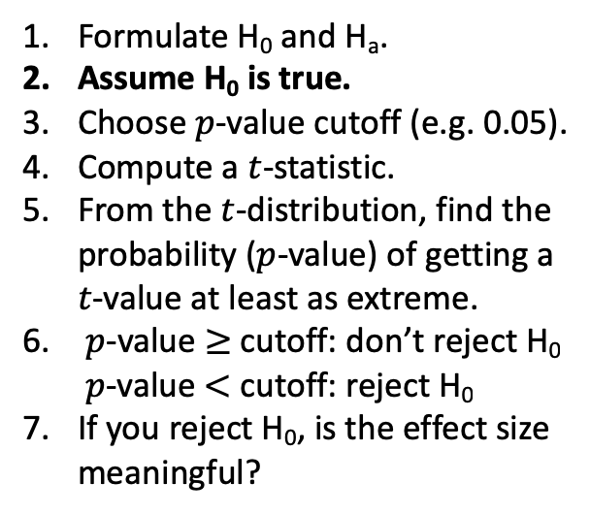
data set A
data set B
x
x
x
x
x
x
x
x
x
x
x
x
x
x
x
x
x
x
x
x
x
x
x
x
Compare means of two normally distributed data sets
x
x
x
x
x
x
x
x
x
x
x
x
x
x
x
x
x
x
x
x
$$t=\frac{{\overline{x}}_{A}−{\overline{x}}_{B}}{\sqrt{\frac{{s_{A}}^{2}}{n_{A}}+\frac{{s_{B}}^{2}}{n_{B}}}}$$
Formulate H₀ and H_{a}.
Assume H₀ is true.
Choose $p$-value cutoff (e.g. 0.05).
Compute a $t$-statistic.
From the $t$-distribution, find the probability ($p$-value) of getting a $t$-value at least as extreme.
$p$-value $≥$ cutoff: don’t reject H₀ $p$-value $<$ cutoff: reject H₀
If you reject H₀, is the effect size meaningful?
$t$-distribution assuming H₀ is true
H₀: $μ_{A}=μ_{B}$
H_{a}: $μ_{A}≠μ_{B}$
$p$-value (probability of finding ${\overline{x}}_{A}>{\overline{x}}_{B}$ by at least as much as observed if $μ_{A}=μ_{B}$)
$$−t$$
0
$$t$$
$p$-value (probability of finding ${\overline{x}}_{A}<{\overline{x}}_{B}$ by at least as much as observed if $μ_{A}=μ_{B}$)
Two-tailed $p$-value is the sum of the left- and right-tailed $p$-values (probability of finding the difference between ${\overline{x}}_{A}$ and ${\overline{x}}_{B}$ to be at least as much as observed if $μ_{A}=μ_{B}$)

Slide 18
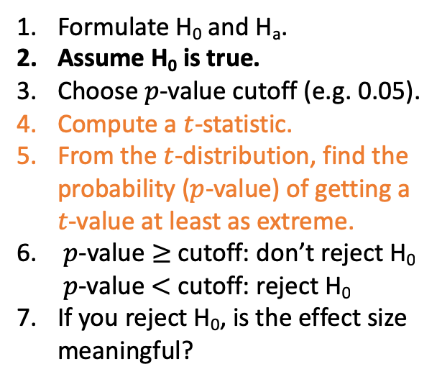
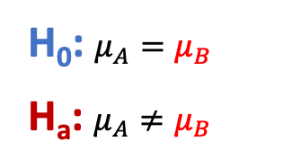

data set A
data set B
x
x
x
x
x
x
x
x
x
x
x
x
x
x
x
x
x
x
x
x
x
x
x
x
Compare means of two normally distributed data sets
x
x
x
x
x
x
x
x
x
x
x
x
x
x
x
x
x
x
x
x
Formulate H₀ and H_{a}.
Assume H₀ is true.
Choose $p$-value cutoff (e.g. 0.05).
Compute a $t$-statistic.
From the $t$-distribution, find the probability ($p$-value) of getting a $t$-value at least as extreme.
$p$-value $≥$ cutoff: don’t reject H₀ $p$-value $<$ cutoff: reject H₀
If you reject H₀, is the effect size meaningful?
independent data sets
t, p = scipy.stats.ttest_ind(dataA, dataB)
H₀: $μ_{A}=μ_{B}$
H_{a}: $μ_{A}≠μ_{B}$
p is a two-tailed $p$-value

Slide 19
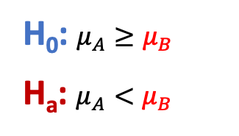
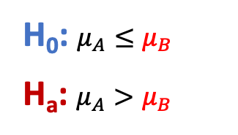

data set A
data set B
x
x
x
x
x
x
x
x
x
x
x
x
x
x
x
x
x
x
x
x
x
x
x
x
Compare means of two normally distributed data sets
x
x
x
x
x
x
x
x
x
x
x
x
x
x
x
x
x
x
x
x
Formulate H₀ and H_{a}.
Assume H₀ is true.
Choose $p$-value cutoff (e.g. 0.05).
Compute a $t$-statistic.
From the $t$-distribution, find the probability ($p$-value) of getting a $t$-value at least as extreme.
$p$-value $≥$ cutoff: don’t reject H₀ $p$-value $<$ cutoff: reject H₀
If you reject H₀, is the effect size meaningful?
independent data sets
t, p = scipy.stats.ttest_ind(dataA, dataB)
H₀: $μ_{A}=μ_{B}$
H_{a}: $μ_{A}≠μ_{B}$
p is a two-tailed $p$-value
H₀: $μ_{A}≤μ_{B}$
H_{a}: $μ_{A}>μ_{B}$
H₀: $μ_{A}≥μ_{B}$
H_{a}: $μ_{A}<μ_{B}$
p/2 is a one-tailed $p$-value

Slide 20
data set A
data set B
x
x
x
x
x
x
x
x
x
x
x
x
x
x
x
x
x
x
x
x
x
x
x
x
Compare means of two normally distributed data sets
x
x
x
x
x
x
x
x
x
x
x
x
x
x
x
x
x
x
x
x
Formulate H₀ and H_{a}.
Assume H₀ is true.
Choose $p$-value cutoff (e.g. 0.05).
Compute a $t$-statistic.
From the $t$-distribution, find the probability ($p$-value) of getting a $t$-value at least as extreme.
$p$-value $≥$ cutoff: don’t reject H₀ $p$-value $<$ cutoff: reject H₀
If you reject H₀, is the effect size meaningful?
paired data sets
dataA[i] ←→ dataB[i]
t, p = scipy.stats.ttest_rel(dataA, dataB)
H₀: $μ_{A}=μ_{B}$
H_{a}: $μ_{A}≠μ_{B}$
p is a two-tailed $p$-value
H₀: $μ_{A}≤μ_{B}$
H_{a}: $μ_{A}>μ_{B}$
H₀: $μ_{A}≥μ_{B}$
H_{a}: $μ_{A}<μ_{B}$
p/2 is a one-tailed $p$-value

Slide 21

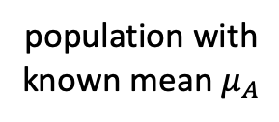
data set B
population with
known mean $μ_{A}$
x
x
x
x
x
x
x
x
x
x
x
Did data set come from population with known mean $μ_{A}$?
x
x
x
x
x
x
x
x
x
x
x
Formulate H₀ and H_{a}.
Assume H₀ is true.
Choose $p$-value cutoff (e.g. 0.05).
Compute a $t$-statistic.
From the $t$-distribution, find the probability ($p$-value) of getting a $t$-value at least as extreme.
$p$-value $≥$ cutoff: don’t reject H₀ $p$-value $<$ cutoff: reject H₀
If you reject H₀, is the effect size meaningful?
t, p = scipy.stats.ttest_1samp(dataB, $μ_{A}$)
H₀: $μ_{A}=μ_{B}$
H_{a}: $μ_{A}≠μ_{B}$
p is a two-tailed $p$-value
H₀: $μ_{A}≤μ_{B}$
H_{a}: $μ_{A}>μ_{B}$
H₀: $μ_{A}≥μ_{B}$
H_{a}: $μ_{A}<μ_{B}$
p/2 is a one-tailed $p$-value

Slide 22
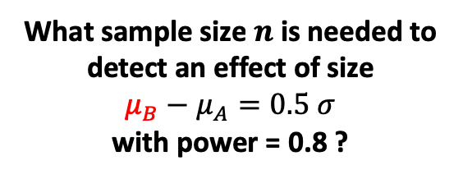
data set A
data set B
population A
mean $μ_{A}$
variance $σ^{2}$
population B
mean $μ_{B}$
variance $σ^{2}$
x
x
x
x
x
What sample size $n$ is needed to detect an effect of size
$μ_{B}−μ_{A}=0.5 σ$
with power = 0.8 ?
x
x
x
x
x
x
x
x
x
x
x
x
x
x
x
x
x
x
x
x
x
x
x
x
x
x
x
x
x
x
x
x
x
x
x
x
x
x
x

Slide 23



data set A
data set B
population A
mean $μ_{A}$
variance $σ^{2}$
population B
mean $μ_{B}$
variance $σ^{2}$
x
x
x
x
x
What sample size $n$ is needed to detect an effect of size
$μ_{B}−μ_{A}=0.5 σ$
with power = 0.8 ?
x
x
x
x
x
x
x
x
x
x
x
x
x
x
x
x
x
x
x
x
x
x
x
x
x
x
x
x
x
x
x
x
x
x
x
x
x
x
x
Central Limit Theorem
$$\frac{σ}{\sqrt{n}}$$
$$\frac{σ}{\sqrt{n}}$$
$${\overline{x}}_{A}$$
$${\overline{x}}_{B}$$
mean
$$μ_{A}$$
$$0.5 σ$$
$$μ_{B}$$

Slide 24
data set A
data set B
population A
mean $μ_{A}$
variance $σ^{2}$
population B
mean $μ_{B}$
variance $σ^{2}$
x
x
x
x
x
What sample size $n$ is needed to detect an effect of size
$μ_{B}−μ_{A}=0.5 σ$
with power = 0.8 ?
x
x
x
x
x
x
x
x
x
x
x
x
x
x
x
x
x
x
x
x
x
x
x
x
x
x
x
x
x
x
x
x
x
x
x
x
x
x
x
$$\frac{σ}{\sqrt{n}}$$
$$\frac{σ}{\sqrt{n}}$$
power
$${\overline{x}}_{A}$$
$${\overline{x}}_{B}$$
mean
$$μ_{A}$$
$$0.5 σ$$
$$μ_{B}$$

Slide 25
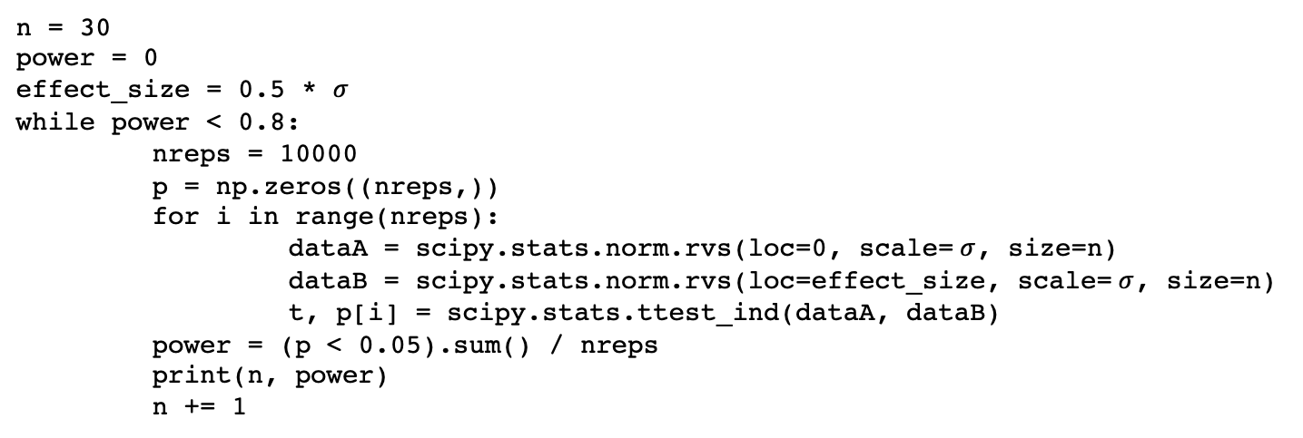
data set A
data set B
population A
mean $μ_{A}$
variance $σ^{2}$
population B
mean $μ_{B}$
variance $σ^{2}$
x
x
x
x
x
What sample size $n$ is needed to detect an effect of size
$μ_{B}−μ_{A}=0.5 σ$
with power = 0.8 ?
x
x
x
x
x
x
x
x
x
x
x
x
x
x
x
x
x
x
x
x
x
x
x
x
x
x
x
x
x
x
x
x
x
x
x
x
x
x
x
n = 30
power = 0
effect_size = 0.5 * $σ$
while power < 0.8:
nreps = 10000
p = np.zeros((nreps,))
for i in range(nreps):
dataA = scipy.stats.norm.rvs(loc=0, scale= $σ$, size=n)
dataB = scipy.stats.norm.rvs(loc=effect_size, scale= $σ$, size=n)
t, p[i] = scipy.stats.ttest_ind(dataA, dataB)
power = (p < 0.05).sum() / nreps
print(n, power)
n += 1

Slide 26


data set A
data set B
x
x
x
x
x
x
x
x
x
x
x
x
x
x
x
x
x
x
x
x
x
x
x
x
Compare some statistic of two data sets
x
x
x
x
x
x
x
x
x
x
x
x
x
x
x
x
x
x
x
x
$${stat}_{A}$$
$${stat}_{B}$$
statistic

Slide 27
data set A
data set B
x
x
x
x
x
x
x
x
x
x
x
x
x
x
x
x
x
x
x
x
x
x
x
x
Compare some statistic of two data sets
x
x
x
x
x
x
x
x
x
x
x
x
x
x
x
x
x
x
x
x
Bootstrap distributions for statistics of A and B.
$${stat}_{A}$$
$${stat}_{B}$$
statistic

Slide 28
data set A
data set B
x
x
x
x
x
x
x
x
x
x
x
x
x
x
x
x
x
x
x
x
x
x
x
x
Compare some statistic of two data sets
x
x
x
x
x
x
x
x
x
x
x
x
x
x
x
x
x
x
x
x
Bootstrap distributions for statistics of A and B.
power
$${stat}_{A}$$
$${stat}_{B}$$
statistic
confidence interval

