Slide 1
Simple Linear Regression

Slide 2
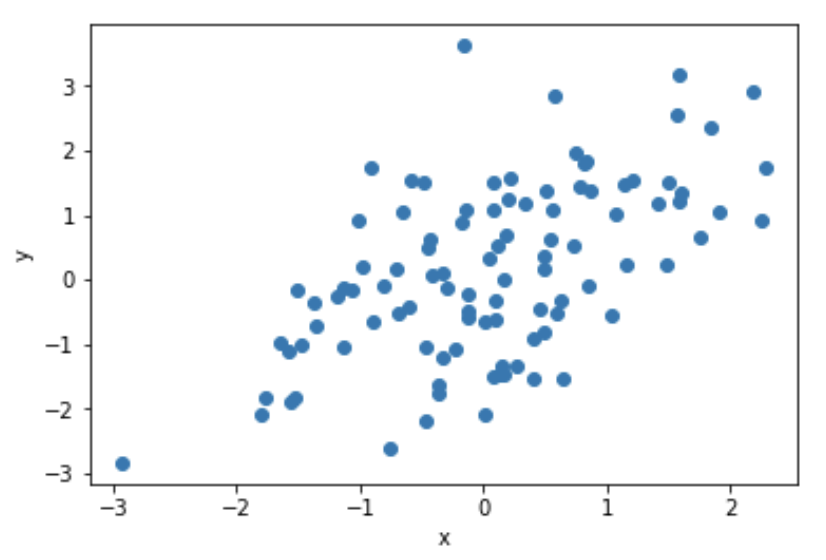
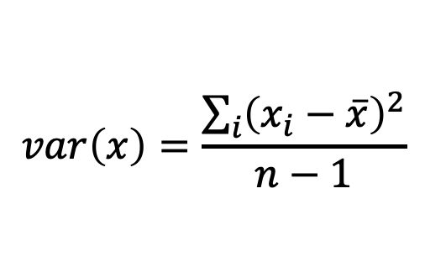
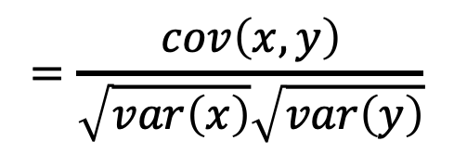
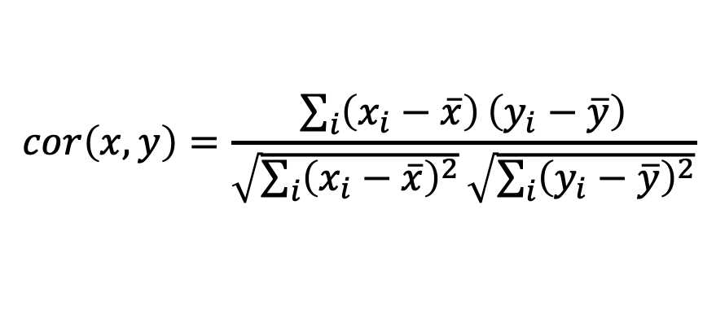
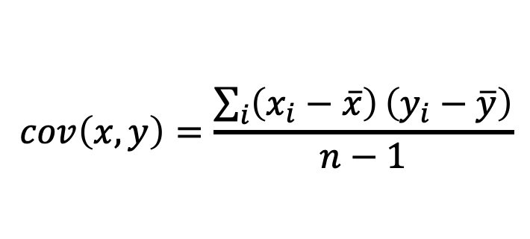
$$var\left(x\right)=\frac{\sum_{i}{{\left(x_{i}−\overline{x}\right)}^{2}}}{n−1}$$
$$cov\left(x,y\right)=\frac{\sum_{i}{\left(x_{i}−\overline{x}\right)}\left(y_{i}−\overline{y}\right)}{n−1}$$
$$cor\left(x,y\right)=\frac{\sum_{i}{\left(x_{i}−\overline{x}\right)}\left(y_{i}−\overline{y}\right)}{\sqrt{\sum_{i}{{\left(x_{i}−\overline{x}\right)}^{2}}}\sqrt{\sum_{i}{{\left(y_{i}−\overline{y}\right)}^{2}}}}$$
$$=\frac{cov\left(x,y\right)}{\sqrt{var\left(x\right)}\sqrt{var\left(y\right)}}$$

Slide 3
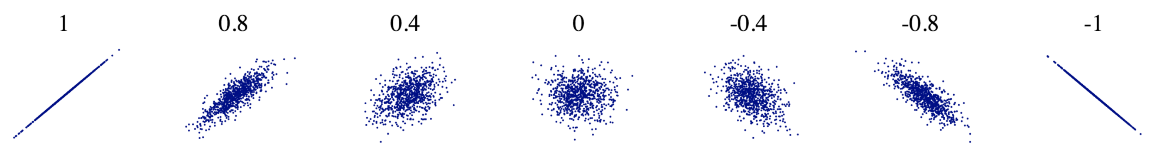

$$cor\left(x,y\right)$$

Slide 4
$$cor\left(x,y\right)$$
Python exercises.

Slide 5

Simple Linear Regression
$$y\left(x\right)=m x+b$$

Slide 6

Simple Linear Regression
$$y\left(x\right)=m x+b+noise$$

Slide 7
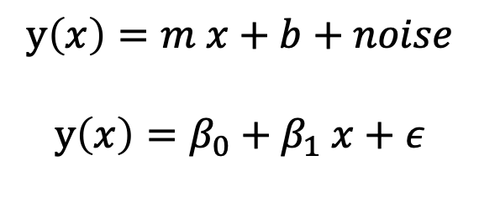
Simple Linear Regression
$$y\left(x\right)=m x+b+noise$$
$$y\left(x\right)=β_{0}+β_{1} x+ε$$

Slide 8











Simple Linear Regression
$$y\left(x\right)=m x+b+noise$$
$$y\left(x\right)=β_{0}+β_{1} x+ε$$
$$y_{0}$$
$$x_{0}$$
$$ε_{0}$$
$$y_{1}$$
$$x_{1}$$
$$ε_{1}$$
.
.
.
.
.
.
.
.
.
$$=β_{0}+β_{1}$$
$$+$$
$$y_{n}$$
$$x_{n}$$
$$ε_{n}$$

Slide 9




Simple Linear Regression
$$y\left(x\right)=m x+b+noise$$
$$y\left(x\right)=β_{0}+β_{1} x+ε$$
$$y_{0}$$
$$β_{0}$$
$$x_{0}$$
$$ε_{0}$$
$$y_{1}$$
$$β_{0}$$
$$x_{1}$$
$$ε_{1}$$
.
.
.
.
.
.
.
.
.
.
.
.
$$= +β_{1}$$
$$+$$
$$y_{n}$$
$$β_{0}$$
$$x_{n}$$
$$ε_{n}$$

Slide 10
Simple Linear Regression
$$y\left(x\right)=m x+b+noise$$
$$y\left(x\right)=β_{0}+β_{1} x+ε$$
Goal is to estimate $β_{0}$ and $β_{1}$ given the data (x, y).
$$y_{0}$$
$$β_{0}$$
$$x_{0}$$
$$ε_{0}$$
$$y_{1}$$
$$β_{0}$$
$$x_{1}$$
$$ε_{1}$$
.
.
.
.
.
.
.
.
.
.
.
.
$$= +β_{1}$$
$$+$$
$$y_{n}$$
$$β_{0}$$
$$x_{n}$$
$$ε_{n}$$

Slide 11
Simple Linear Regression
$$y\left(x\right)=m x+b+noise$$
$$y\left(x\right)=β_{0}+β_{1} x+ε$$
Goal is to estimate $β_{0}$ and $β_{1}$ given the data (x, y).
$$y_{0}$$
$$β_{0}$$
$$x_{0}$$
$$ε_{0}$$
$$y_{1}$$
$$β_{0}$$
$$x_{1}$$
$$ε_{1}$$
.
.
.
.
.
.
.
.
.
.
.
.
$$= +β_{1}$$
$$+$$
$$y_{n}$$
$$β_{0}$$
$$x_{n}$$
$$ε_{n}$$

Slide 12
Simple Linear Regression
$$y\left(x\right)=m x+b+noise$$
$$y\left(x\right)=β_{0}+β_{1} x+ε$$
Goal is to estimate $β_{0}$ and $β_{1}$ given the data (x, y).
residuals
$$y_{0}$$
$$β_{0}$$
$$x_{0}$$
$$ε_{0}$$
$$y_{1}$$
$$β_{0}$$
$$x_{1}$$
$$ε_{1}$$
.
.
.
.
.
.
.
.
.
.
.
.
$$= +β_{1}$$
$$+$$
$$y_{n}$$
$$β_{0}$$
$$x_{n}$$
$$ε_{n}$$

Slide 13
Simple Linear Regression
$$y\left(x\right)=m x+b+noise$$
$$y\left(x\right)=β_{0}+β_{1} x+ε$$
Goal is to estimate $β_{0}$ and $β_{1}$ given the data (x, y).
residuals
$$y_{0}$$
$$β_{0}$$
$$x_{0}$$
$$ε_{0}$$
$$y_{1}$$
$$β_{0}$$
$$x_{1}$$
$$ε_{1}$$
.
.
.
.
.
.
.
.
.
.
.
.
$$= +β_{1}$$
$$+$$
$$y_{n}$$
$$β_{0}$$
$$x_{n}$$
$$ε_{n}$$
One way to get best estimate is to minimize the sum of squared residuals (RSS).
This is ordinary least squares (OLS) linear regression.

Slide 14
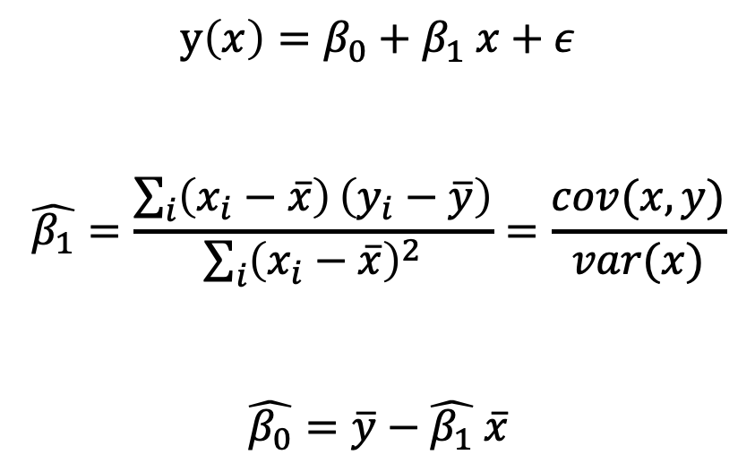
OLS has an analytical solution:
$$y\left(x\right)=β_{0}+β_{1} x+ε$$
$$\hat{β_{1}}=\frac{\sum_{i}{\left(x_{i}−\overline{x}\right)}\left(y_{i}−\overline{y}\right)}{\sum_{i}{{\left(x_{i}−\overline{x}\right)}^{2}}}=\frac{cov(x,y)}{var(x)}$$
$$\hat{β_{0}}=\overline{y}−\hat{β_{1}} \overline{x}$$

Slide 15
OLS has an analytical solution:
$$y\left(x\right)=β_{0}+β_{1} x+ε$$
$$\hat{β_{1}}=\frac{\sum_{i}{\left(x_{i}−\overline{x}\right)}\left(y_{i}−\overline{y}\right)}{\sum_{i}{{\left(x_{i}−\overline{x}\right)}^{2}}}=\frac{cov(x,y)}{var(x)}$$
$$\hat{β_{0}}=\overline{y}−\hat{β_{1}} \overline{x}$$
Python exercises.

Slide 16
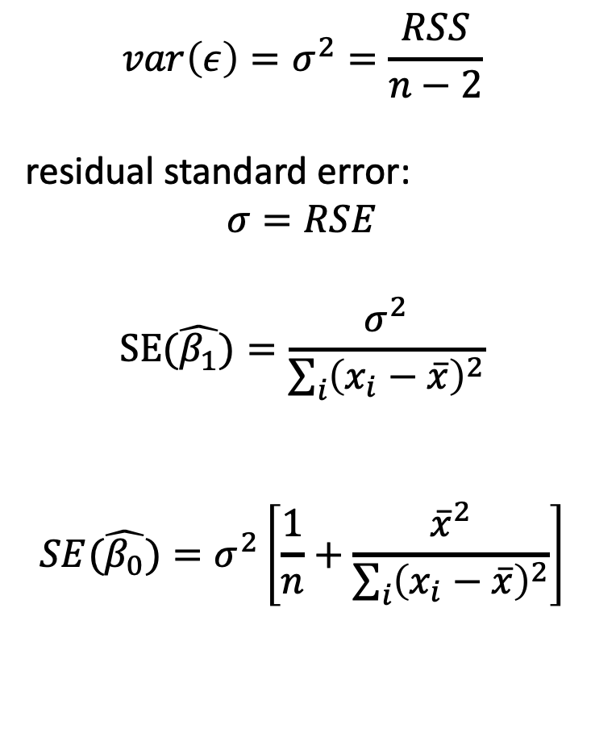
OLS has an analytical solution:
$$var\left(ε\right)=σ^{2}=\frac{RSS}{n−2}$$
residual standard error:
$$σ=RSE$$
$$SE(\hat{β_{1}})=\frac{σ^{2}}{\sum_{i}{{\left(x_{i}−\overline{x}\right)}^{2}}}$$
$$SE(\hat{β_{0}})=σ^{2}\left[\frac{1}{n}+\frac{{\overline{x}}^{2}}{\sum_{i}{{\left(x_{i}−\overline{x}\right)}^{2}}}\right]$$
$$y\left(x\right)=β_{0}+β_{1} x+ε$$
$$\hat{β_{1}}=\frac{\sum_{i}{\left(x_{i}−\overline{x}\right)}\left(y_{i}−\overline{y}\right)}{\sum_{i}{{\left(x_{i}−\overline{x}\right)}^{2}}}=\frac{cov(x,y)}{var(x)}$$
$$\hat{β_{0}}=\overline{y}−\hat{β_{1}} \overline{x}$$

Slide 17
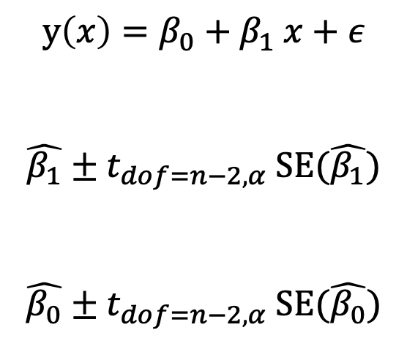
Confidence Interval for parameters:
$$y\left(x\right)=β_{0}+β_{1} x+ε$$
$$\hat{β_{1}}±t_{dof=n−2,α} SE(\hat{β_{1}})$$
$$\hat{β_{0}}±t_{dof=n−2,α} SE(\hat{β_{0}})$$

Slide 18
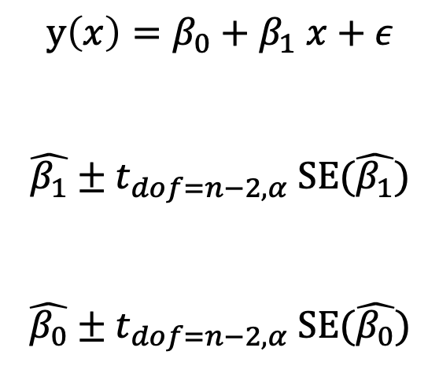
Hypothesis Test:
H₀: No relation between x and y
H_{a}: x and y are related to each other
$$y\left(x\right)=β_{0}+β_{1} x+ε$$
$$\hat{β_{1}}±t_{dof=n−2,α} SE(\hat{β_{1}})$$
$$\hat{β_{0}}±t_{dof=n−2,α} SE(\hat{β_{0}})$$

Slide 19
Hypothesis Test:
H₀: No relation between x and y
H_{a}: x and y are related to each other
$$y\left(x\right)=β_{0}+β_{1} x+ε$$
$$\hat{β_{1}}±t_{dof=n−2,α} SE(\hat{β_{1}})$$
$$\hat{β_{0}}±t_{dof=n−2,α} SE(\hat{β_{0}})$$
Does confidence interval contain 0?
If so, then can’t reject H₀.
Otherwise, reject H₀.

Slide 20
Hypothesis Test:
H₀: No relation between x and y
H_{a}: x and y are related to each other
Python exercises.
$$y\left(x\right)=β_{0}+β_{1} x+ε$$
$$\hat{β_{1}}±t_{dof=n−2,α} SE(\hat{β_{1}})$$
$$\hat{β_{0}}±t_{dof=n−2,α} SE(\hat{β_{0}})$$
Does confidence interval contain 0?
If so, then can’t reject H₀.
Otherwise, reject H₀.

Slide 21
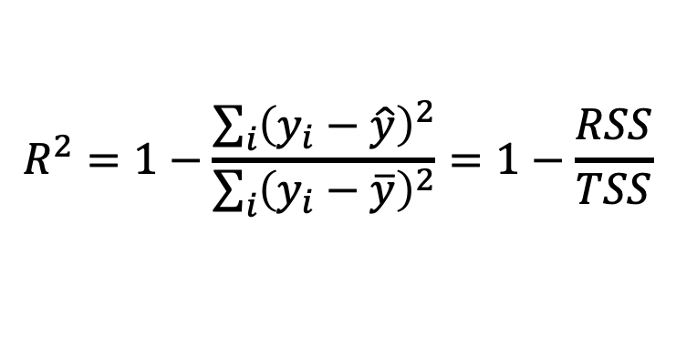
How much of the variance in the data is explained by the model?
residual sum of squares
$$R^{2}=1−\frac{\sum_{i}{{\left(y_{i}−\hat{y}\right)}^{2}}}{\sum_{i}{{\left(y_{i}−\overline{y}\right)}^{2}}}=1−\frac{RSS}{TSS}$$
total sum of squares

Slide 22
How much of the variance in the data is explained by the model?
variance NOT explained by model
residual sum of squares
$$R^{2}=1−\frac{\sum_{i}{{\left(y_{i}−\hat{y}\right)}^{2}}}{\sum_{i}{{\left(y_{i}−\overline{y}\right)}^{2}}}=1−\frac{RSS}{TSS}$$
total sum of squares
total variance of data

Slide 23
How much of the variance in the data is explained by the model?
variance NOT explained by model
residual sum of squares
$$R^{2}=1−\frac{\sum_{i}{{\left(y_{i}−\hat{y}\right)}^{2}}}{\sum_{i}{{\left(y_{i}−\overline{y}\right)}^{2}}}=1−\frac{RSS}{TSS}$$
total sum of squares
total variance of data
Python exercises.

Slide 24
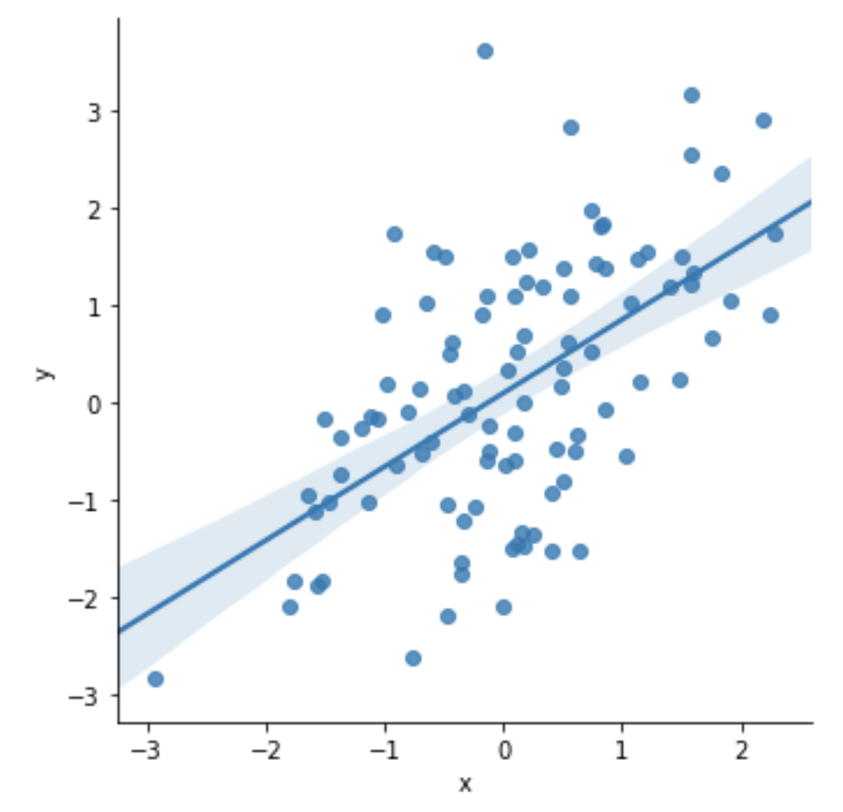
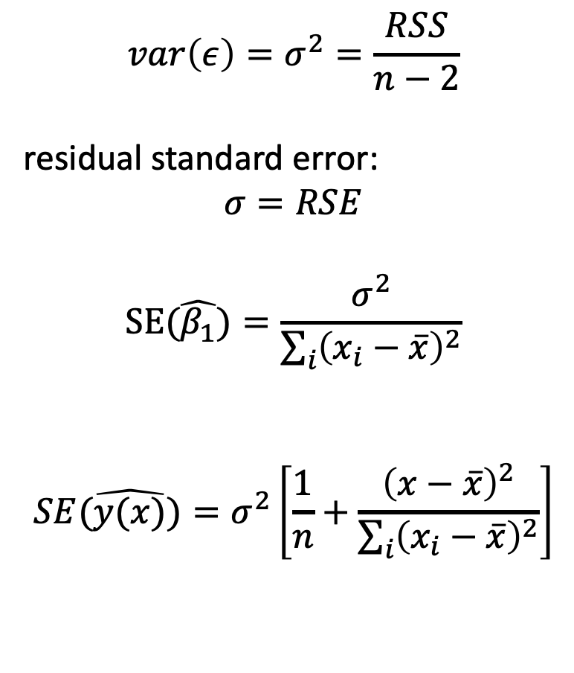
OLS has an analytical solution:
$$var\left(ε\right)=σ^{2}=\frac{RSS}{n−2}$$
residual standard error:
$$σ=RSE$$
$$SE(\hat{β_{1}})=\frac{σ^{2}}{\sum_{i}{{\left(x_{i}−\overline{x}\right)}^{2}}}$$
$$SE(\hat{y(x)})=σ^{2}\left[\frac{1}{n}+\frac{{\left(x−\overline{x}\right)}^{2}}{\sum_{i}{{\left(x_{i}−\overline{x}\right)}^{2}}}\right]$$

Slide 25
OLS has an analytical solution:
$$var\left(ε\right)=σ^{2}=\frac{RSS}{n−2}$$
residual standard error:
$$σ=RSE$$
$$SE(\hat{β_{1}})=\frac{σ^{2}}{\sum_{i}{{\left(x_{i}−\overline{x}\right)}^{2}}}$$
$$SE(\hat{y(x)})=σ^{2}\left[\frac{1}{n}+\frac{{\left(x−\overline{x}\right)}^{2}}{\sum_{i}{{\left(x_{i}−\overline{x}\right)}^{2}}}\right]$$
Python exercises.

Slide 26
Simple Linear Regression
$$y\left(x\right)=m x+b+noise$$
$$y\left(x\right)=β_{0}+β_{1} x+ε$$
Goal is to estimate $β_{0}$ and $β_{1}$ given the data (x, y).
residuals
$$y_{0}$$
$$β_{0}$$
$$x_{0}$$
$$ε_{0}$$
$$y_{1}$$
$$β_{0}$$
$$x_{1}$$
$$ε_{1}$$
.
.
.
.
.
.
.
.
.
.
.
.
$$= +β_{1}$$
$$+$$
$$y_{n}$$
$$β_{0}$$
$$x_{n}$$
$$ε_{n}$$
One way to get best estimate is to minimize the sum of squared residuals (RSS).
This is ordinary least squares (OLS) linear regression.

Slide 27







Simple Linear Regression
$$y\left(x\right)=m x+b+noise$$
$$y\left(x\right)=β_{0}+β_{1} x+ε$$
Goal is to estimate $β_{0}$ and $β_{1}$ given the data (x, y).
residuals
$$y_{0}$$
$$1$$
$$x_{0}$$
$$ε_{0}$$
$$y_{1}$$
$$1$$
$$x_{1}$$
$$ε_{1}$$
.
.
.
.
.
.
.
.
.
.
.
.
$$=β_{0} +β_{1}$$
$$+$$
$$y_{n}$$
$$1$$
$$x_{n}$$
$$ε_{n}$$
One way to get best estimate is to minimize the sum of squared residuals (RSS).
This is ordinary least squares (OLS) linear regression.

Slide 28
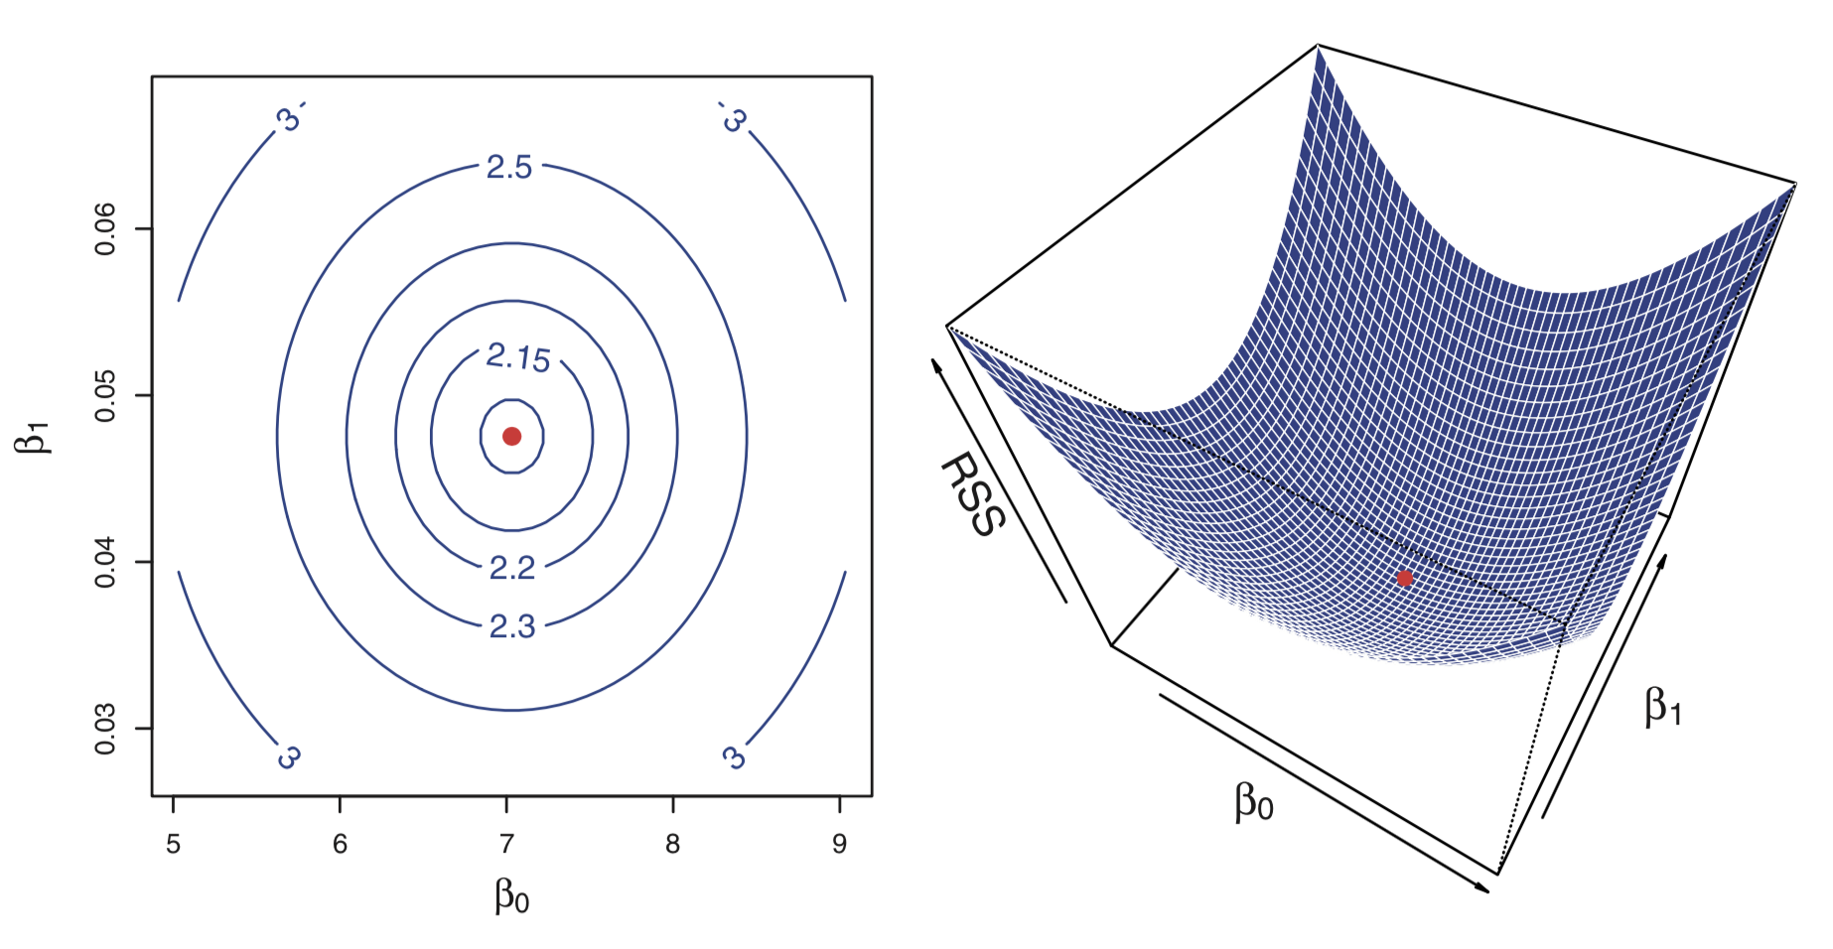

Slide 29
Python exercises.

Slide 30
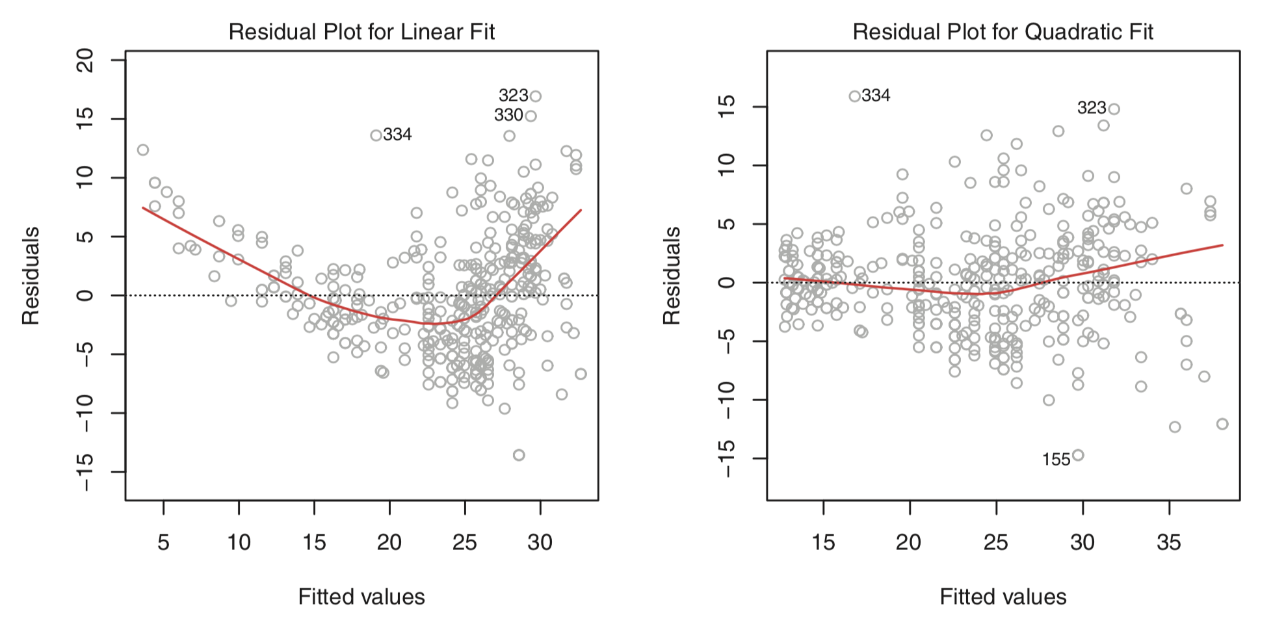
Use residuals to visually assess whether linear fit is appropriate.

Slide 31
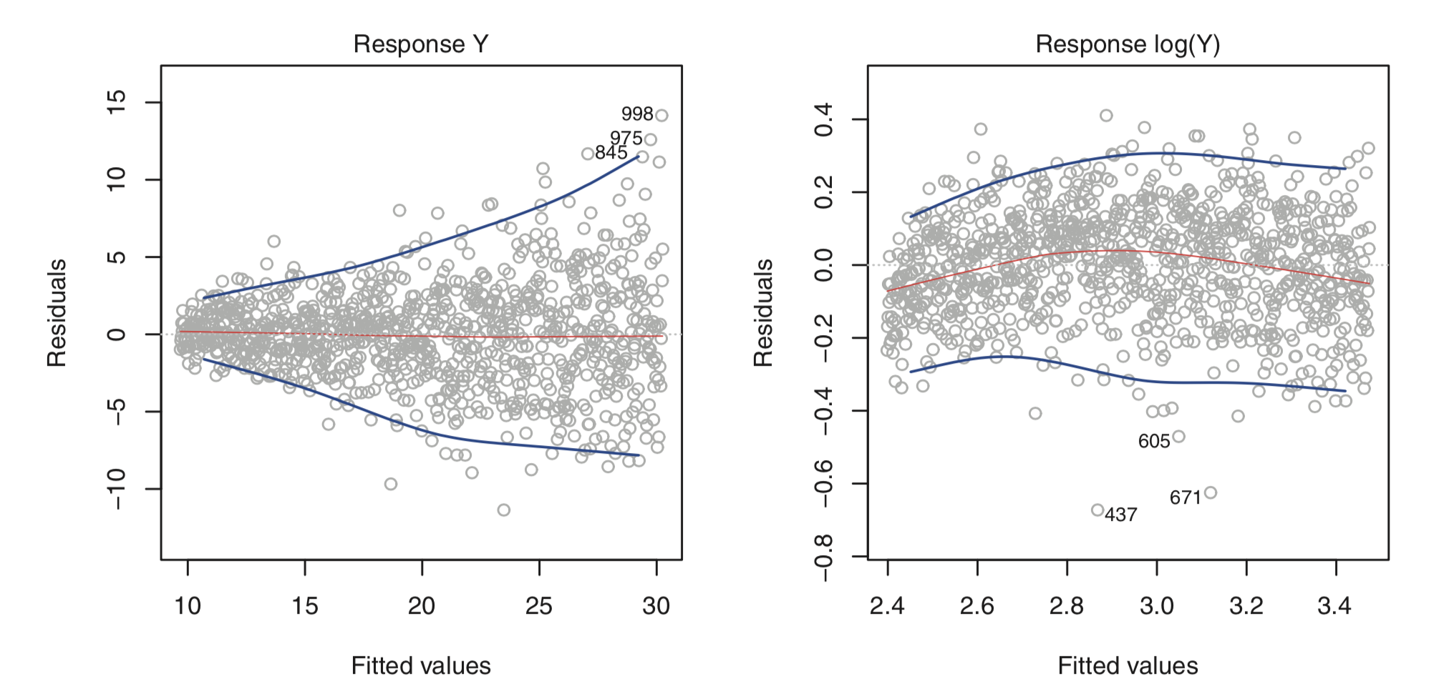
Variance should be normally distributed equally throughout.
If not, can we transform data to achieve this?

Slide 32
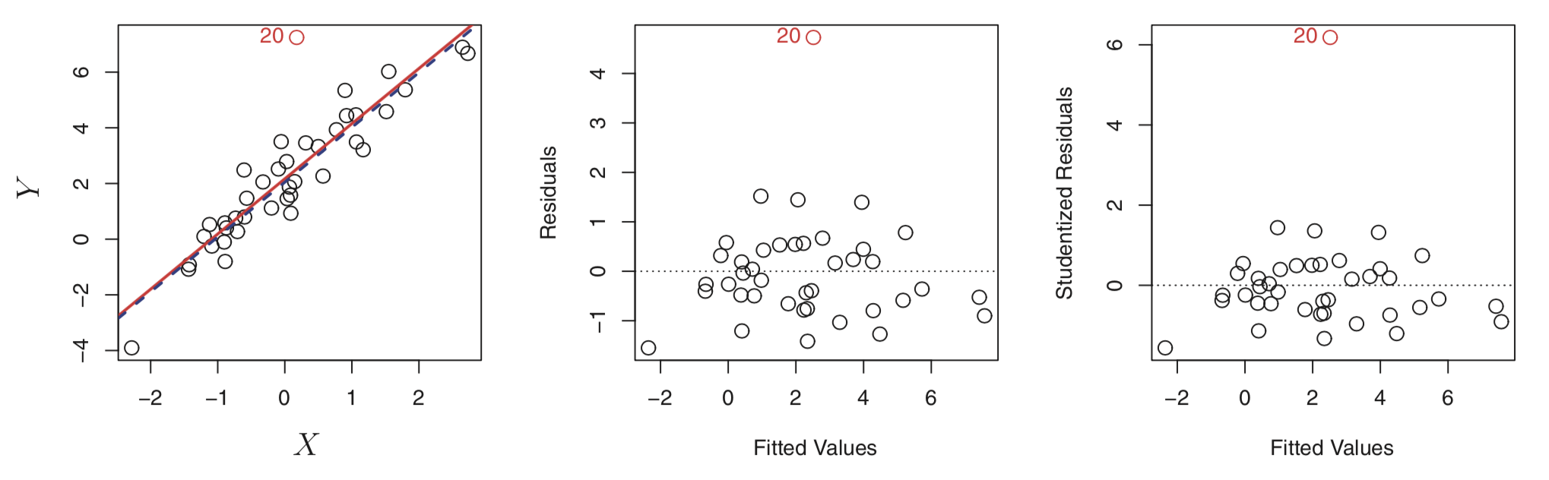
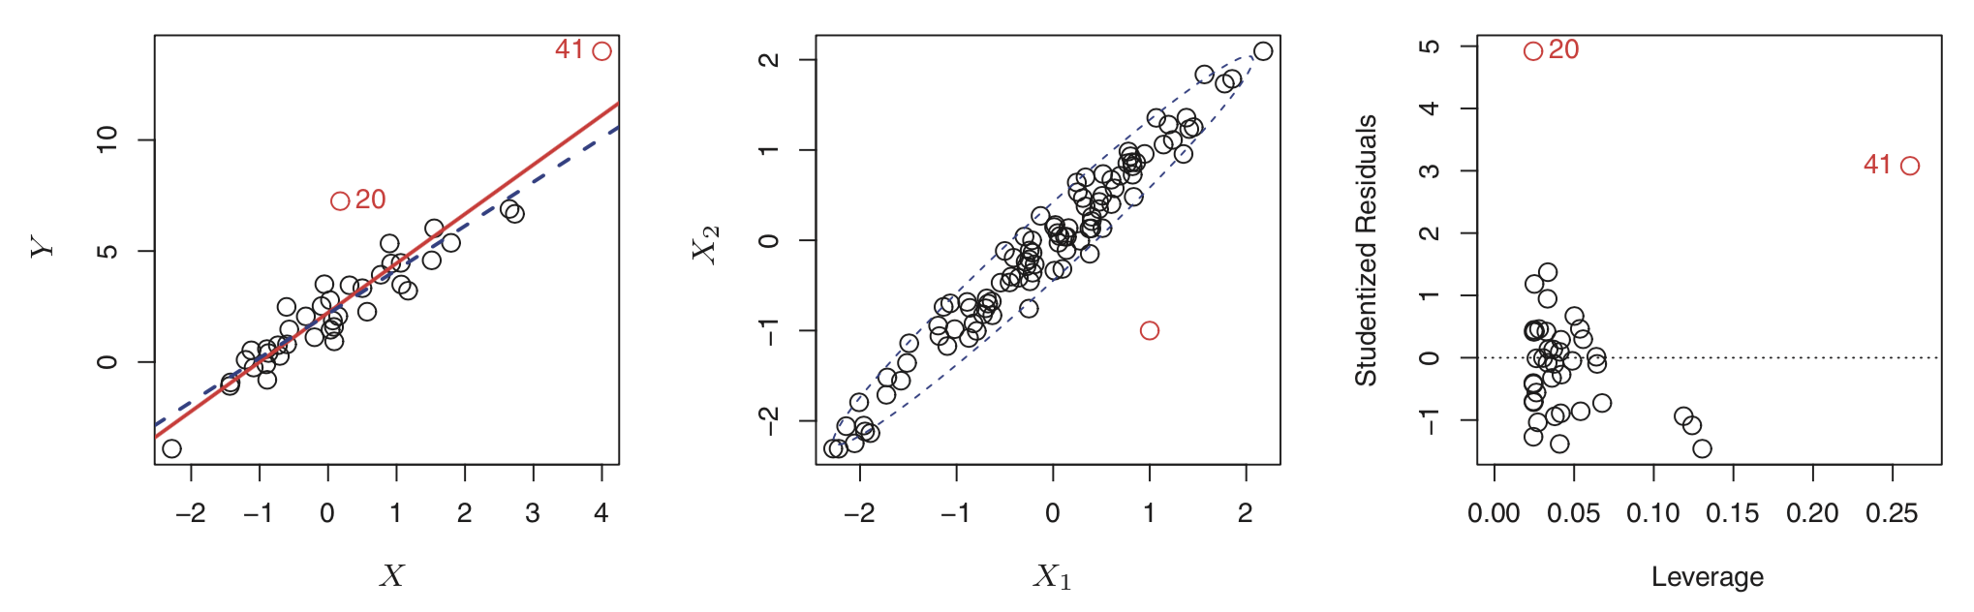
Outliers and leverage.

Slide 33
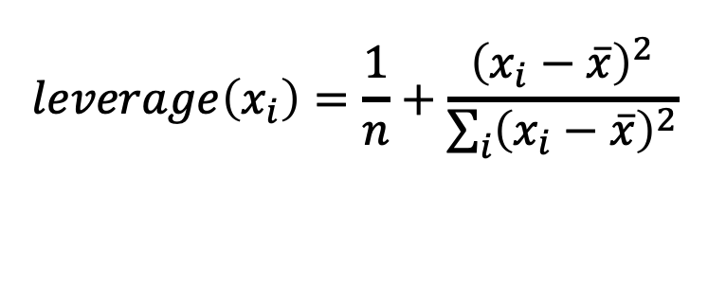
Outliers and leverage.
$$leverage\left(x_{i}\right)=\frac{1}{n}+\frac{{\left(x_{i}−\overline{x}\right)}^{2}}{\sum_{i}{{\left(x_{i}−\overline{x}\right)}^{2}}}$$

Slide 34
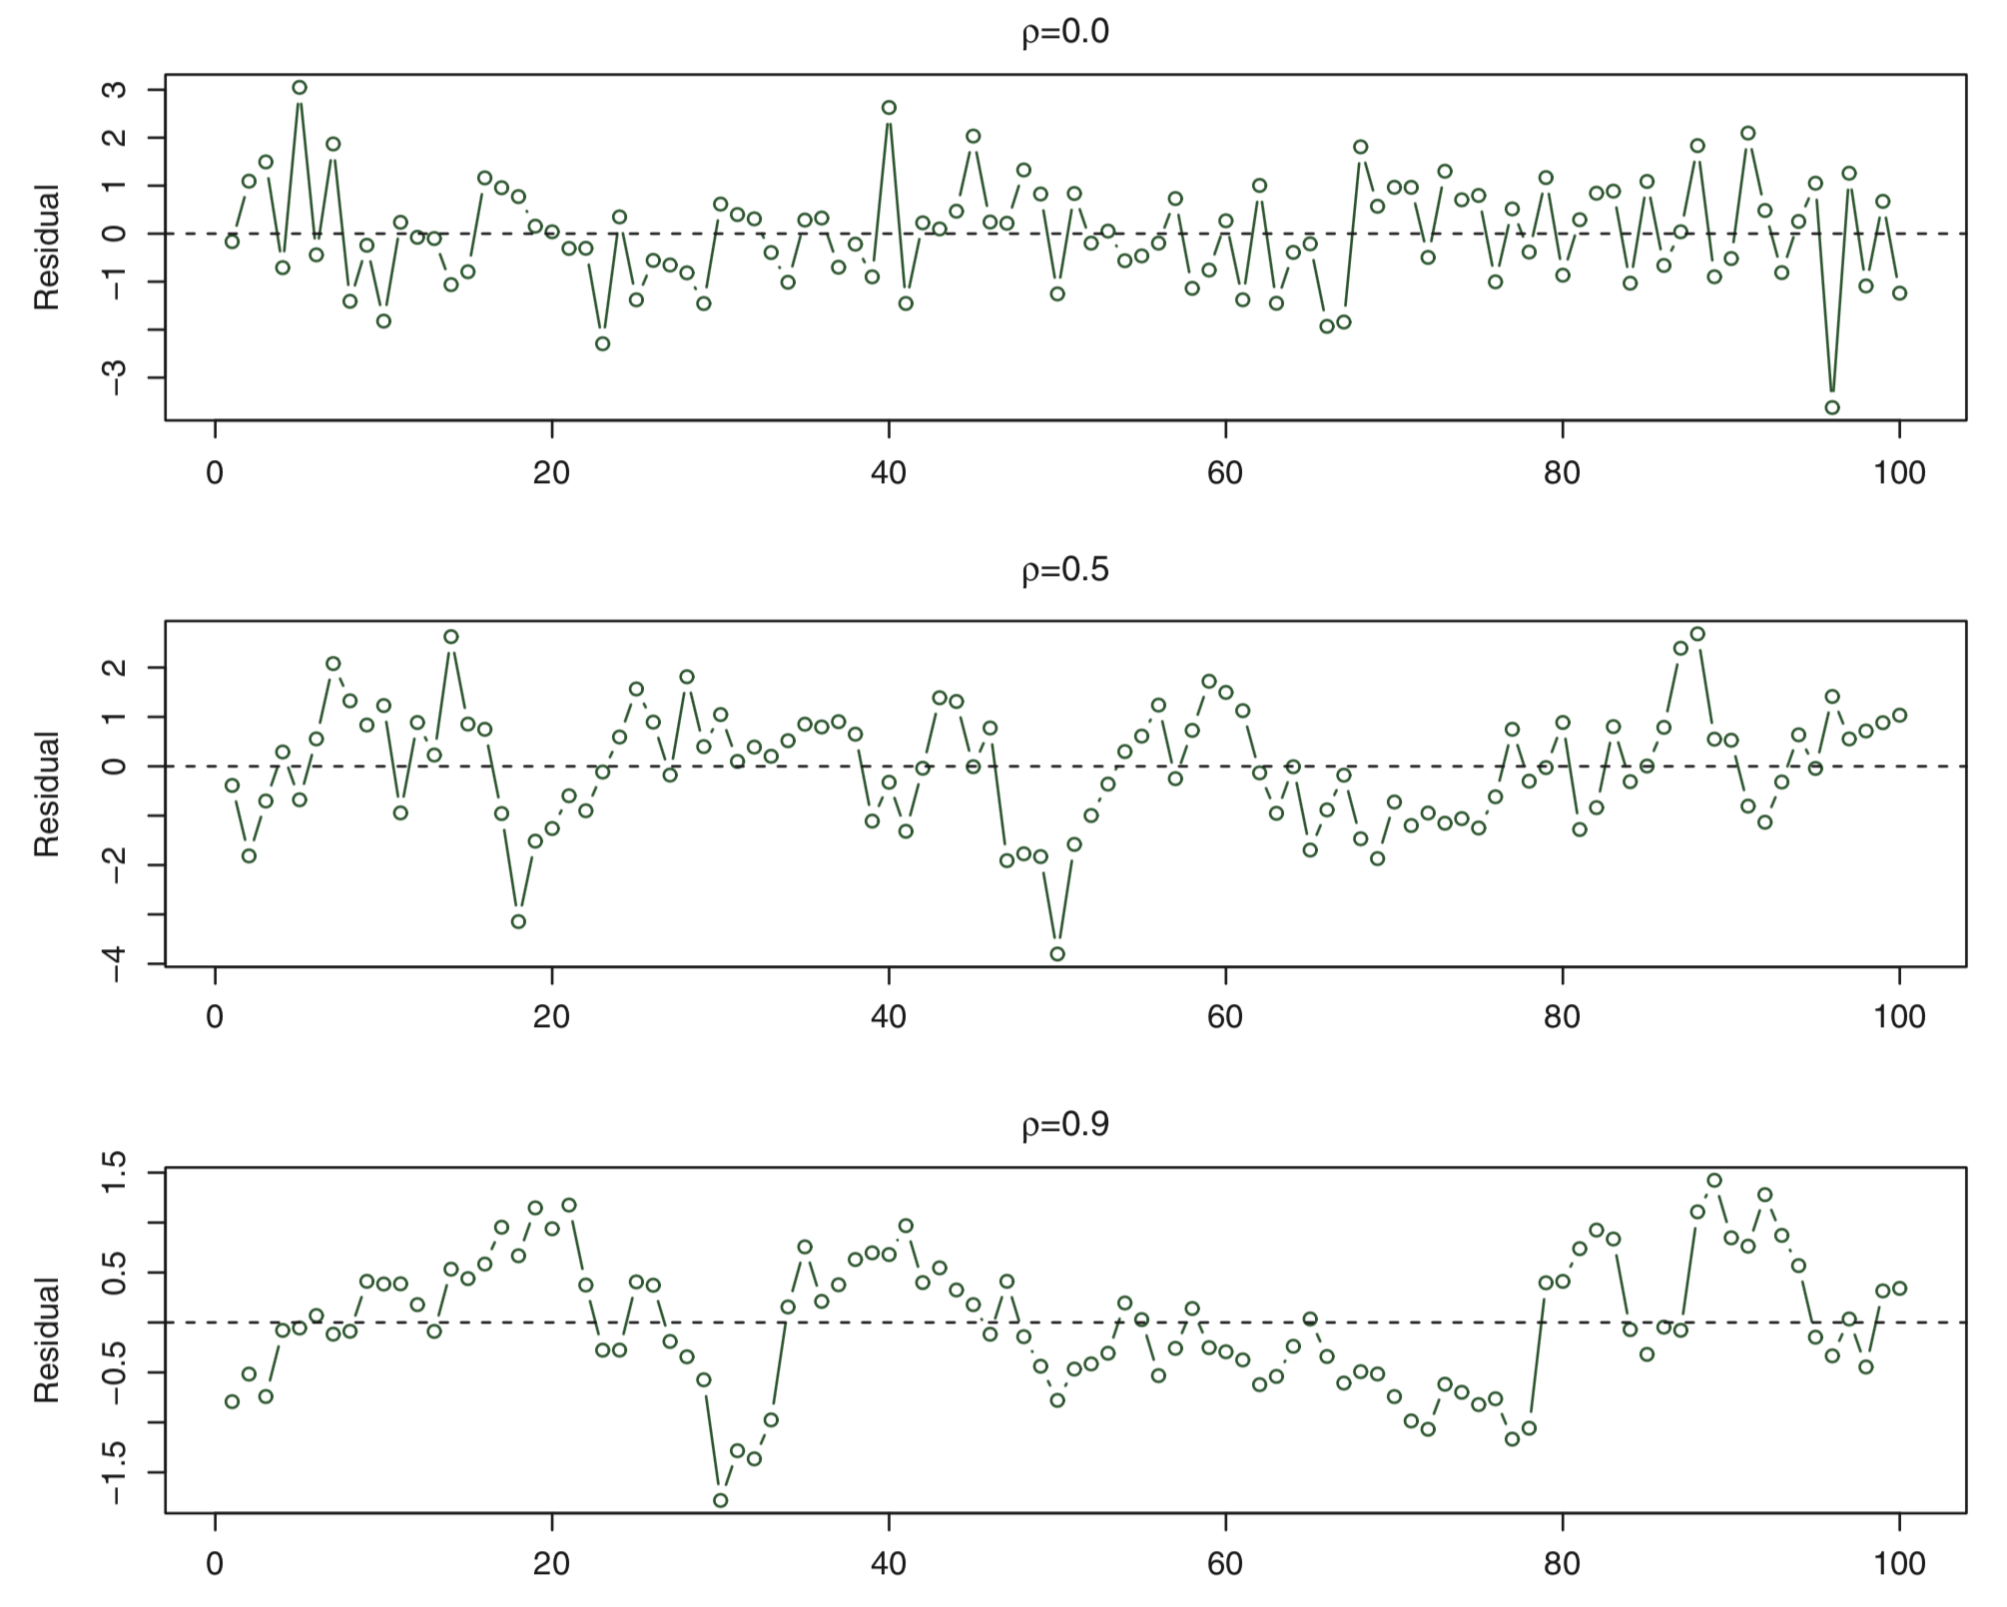
OLS assumes errors are NOT correlated.

Slide 35
OLS assumes errors are NOT correlated.
Python exercises.

