Slide 1
Midterm Review
Probability Distributions
Maximum Likelihood Estimation
Optimization
Hypothesis Testing
p-Value
t-Test
Bootstrap Confidence Intervals
Permutation Test

Slide 2

Describe a sample data set…
data $[ x_{0} x_{1} x_{2} ⋯ x_{n−1} ]$

Slide 3
data $[ x_{0} x_{1} x_{2} ⋯ x_{n−1} ]$
Yes
Are the data reasonably described by a parametric probability distribution?
No

Slide 4
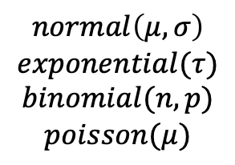
data $[ x_{0} x_{1} x_{2} ⋯ x_{n−1} ]$
Yes
Are the data reasonably described by a parametric probability distribution?
No
Which distribution?
Use sample mean, variance, etc. to describe data.
$$normal\left(μ,σ\right)$$
$$exponential(τ)$$
$$binomial(n,p)$$
$$poisson(μ)$$

Slide 5
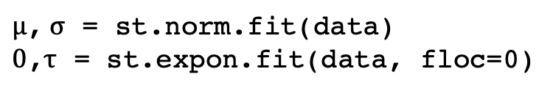
data $[ x_{0} x_{1} x_{2} ⋯ x_{n−1} ]$
Yes
Are the data reasonably described by a parametric probability distribution?
No
Which distribution?
Use sample mean, variance, etc. to describe data.
What is the maximum likelihood estimate (MLE) for the distribution parameters? i.e. Your best guess.
$μ$, $σ$ = st.norm.fit(data)
$0$,$τ$ = st.expon.fit(data, floc=0)

Slide 6
data $[ x_{0} x_{1} x_{2} ⋯ x_{n−1} ]$
Yes
Are the data reasonably described by a parametric probability distribution?
No
Which distribution?
Use sample mean, variance, etc. to describe data.
What is the maximum likelihood estimate (MLE) for the distribution parameters? i.e. Your best guess.
If you cannot find the MLE of the distribution parameters analytically, you can always minimize a cost function that returns the sum of the negative loglikelihoods of all the data points.
def cost(params):
n,p = params
return -st.binom.logpmf(data, n, p).sum()
result = opt.minimize(cost, [n0, p0], …)
n,p = result.x

Slide 7
data $[ x_{0} x_{1} x_{2} ⋯ x_{n−1} ]$
Yes
Are the data reasonably described by a parametric probability distribution?
No
Which distribution?
Use sample mean, variance, etc. to describe data.
What is the maximum likelihood estimate (MLE) for the distribution parameters? i.e. Your best guess.
If you cannot find the MLE of the distribution parameters analytically, you can always minimize a cost function that returns the sum of the negative loglikelihoods of all the data points.
data $\left[ x_{0} x_{1} x_{2} ⋯ x_{n−1} \right] ⟹$ parameter(s) $\{ p_{i} \}$

Slide 8
data $\left[ x_{0} x_{1} x_{2} ⋯ x_{n−1} \right] ⟹$ parameter(s) $\{ p_{i} \}$
How good are our estimates of the parameters?
i.e. What are our confidence intervals?

Slide 9
data $\left[ x_{0} x_{1} x_{2} ⋯ x_{n−1} \right] ⟹$ parameter(s) $\{ p_{i} \}$
How good are our estimates of the parameters?
i.e. What are our confidence intervals?
Yes
Is there an appropriate parametric model describing the confidence intervals (i.e. central limit theorem)?
No

Slide 10
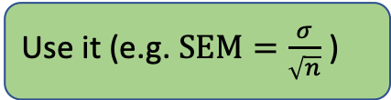
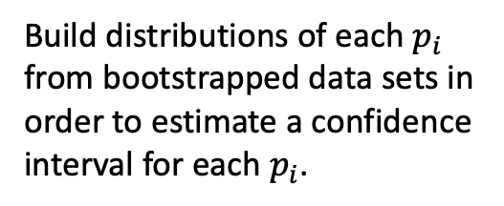
data $\left[ x_{0} x_{1} x_{2} ⋯ x_{n−1} \right] ⟹$ parameter(s) $\{ p_{i} \}$
How good are our estimates of the parameters?
i.e. What are our confidence intervals?
Yes
Is there an appropriate parametric model describing the confidence intervals (i.e. central limit theorem)?
No
Use it (e.g. $SEM=\frac{σ}{\sqrt{n}}$)
Bootstrap confidence intervals
Build distributions of each $p_{i}$ from bootstrapped data sets in order to estimate a confidence interval for each $p_{i}$.

Slide 11
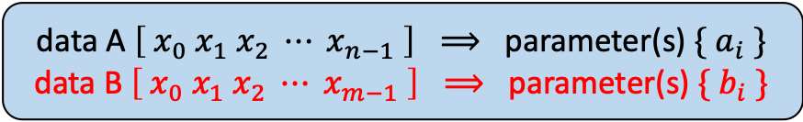
Compare sample data sets A and B...
data A $\left[ x_{0} x_{1} x_{2} ⋯ x_{n−1} \right] ⟹$ parameter(s) $\{ a_{i} \}$
data B $\left[ x_{0} x_{1} x_{2} ⋯ x_{m−1} \right] ⟹$ parameter(s) $\{ b_{i} \}$

Slide 12
data A $\left[ x_{0} x_{1} x_{2} ⋯ x_{n−1} \right] ⟹$ parameter(s) $\{ a_{i} \}$
data B $\left[ x_{0} x_{1} x_{2} ⋯ x_{m−1} \right] ⟹$ parameter(s) $\{ b_{i} \}$
Formulate null (H₀) and alternative (H_{a}) hypotheses.

Slide 13
data A $\left[ x_{0} x_{1} x_{2} ⋯ x_{n−1} \right] ⟹$ parameter(s) $\{ a_{i} \}$
data B $\left[ x_{0} x_{1} x_{2} ⋯ x_{m−1} \right] ⟹$ parameter(s) $\{ b_{i} \}$
Formulate null (H₀) and alternative (H_{a}) hypotheses.
Assuming H₀ is true, perform a test to decide whether or not to reject H₀.

Slide 14
data A $\left[ x_{0} x_{1} x_{2} ⋯ x_{n−1} \right] ⟹$ parameter(s) $\{ a_{i} \}$
data B $\left[ x_{0} x_{1} x_{2} ⋯ x_{m−1} \right] ⟹$ parameter(s) $\{ b_{i} \}$
Formulate null (H₀) and alternative (H_{a}) hypotheses.
Assuming H₀ is true, perform a test to decide whether or not to reject H₀.
Yes
Are you comparing means and are A and B normally distributed with similar variance?
No

Slide 15
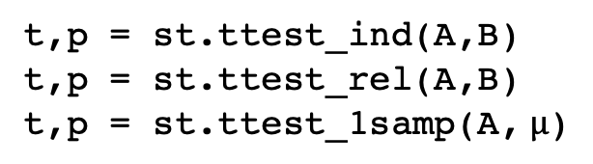

data A $\left[ x_{0} x_{1} x_{2} ⋯ x_{n−1} \right] ⟹$ parameter(s) $\{ a_{i} \}$
data B $\left[ x_{0} x_{1} x_{2} ⋯ x_{m−1} \right] ⟹$ parameter(s) $\{ b_{i} \}$
Formulate null (H₀) and alternative (H_{a}) hypotheses.
Assuming H₀ is true, perform a test to decide whether or not to reject H₀.
Yes
Are you comparing means and are A and B normally distributed with similar variance?
No
$t$-test
t,p = st.ttest_ind(A,B)
t,p = st.ttest_rel(A,B)
t,p = st.ttest_1samp(A, $μ$)

Slide 16
data A $\left[ x_{0} x_{1} x_{2} ⋯ x_{n−1} \right] ⟹$ parameter(s) $\{ a_{i} \}$
data B $\left[ x_{0} x_{1} x_{2} ⋯ x_{m−1} \right] ⟹$ parameter(s) $\{ b_{i} \}$
Formulate null (H₀) and alternative (H_{a}) hypotheses.
Assuming H₀ is true, perform a test to decide whether or not to reject H₀.
Yes
Are you comparing means and are A and B normally distributed with similar variance?
No
$t$-test
Yes
Is there an appropriate parametric test?
t,p = st.ttest_ind(A,B)
t,p = st.ttest_rel(A,B)
t,p = st.ttest_1samp(A, $μ$)
No

Slide 17
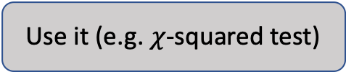
data A $\left[ x_{0} x_{1} x_{2} ⋯ x_{n−1} \right] ⟹$ parameter(s) $\{ a_{i} \}$
data B $\left[ x_{0} x_{1} x_{2} ⋯ x_{m−1} \right] ⟹$ parameter(s) $\{ b_{i} \}$
Formulate null (H₀) and alternative (H_{a}) hypotheses.
Assuming H₀ is true, perform a test to decide whether or not to reject H₀.
Yes
Are you comparing means and are A and B normally distributed with similar variance?
No
$t$-test
Use it (e.g. $χ$-squared test)
Yes
Is there an appropriate parametric test?
No

Slide 18
data A $\left[ x_{0} x_{1} x_{2} ⋯ x_{n−1} \right] ⟹$ parameter(s) $\{ a_{i} \}$
data B $\left[ x_{0} x_{1} x_{2} ⋯ x_{m−1} \right] ⟹$ parameter(s) $\{ b_{i} \}$
Formulate null (H₀) and alternative (H_{a}) hypotheses.
Assuming H₀ is true, perform a test to decide whether or not to reject H₀.
Yes
Are you comparing means and are A and B normally distributed with similar variance?
No
$t$-test
Use it (e.g. $χ$-squared test)
Yes
Is there an appropriate parametric test?
No
Yes
Is H_{0/a} that A and B are from the same/different population(s)?
No

Slide 19
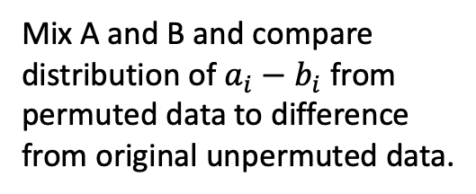
data A $\left[ x_{0} x_{1} x_{2} ⋯ x_{n−1} \right] ⟹$ parameter(s) $\{ a_{i} \}$
data B $\left[ x_{0} x_{1} x_{2} ⋯ x_{m−1} \right] ⟹$ parameter(s) $\{ b_{i} \}$
Formulate null (H₀) and alternative (H_{a}) hypotheses.
Assuming H₀ is true, perform a test to decide whether or not to reject H₀.
Yes
Are you comparing means and are A and B normally distributed with similar variance?
No
$t$-test
Use it (e.g. $χ$-squared test)
Yes
Is there an appropriate parametric test?
No
Yes
Is H_{0/a} that A and B are from the same/different population(s)?
No
Mix A and B and compare distribution of $a_{i}−b_{i}$ from permuted data to difference from original unpermuted data.
Permutation test

Slide 20
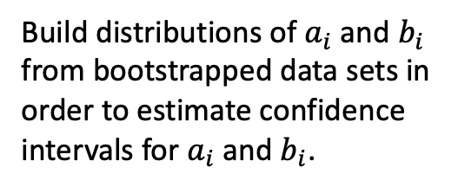
data A $\left[ x_{0} x_{1} x_{2} ⋯ x_{n−1} \right] ⟹$ parameter(s) $\{ a_{i} \}$
data B $\left[ x_{0} x_{1} x_{2} ⋯ x_{m−1} \right] ⟹$ parameter(s) $\{ b_{i} \}$
Formulate null (H₀) and alternative (H_{a}) hypotheses.
Assuming H₀ is true, perform a test to decide whether or not to reject H₀.
Yes
Are you comparing means and are A and B normally distributed with similar variance?
No
$t$-test
Use it (e.g. $χ$-squared test)
Yes
Is there an appropriate parametric test?
No
Yes
Is H_{0/a} that A and B are from the same/different population(s)?
No
Build distributions of $a_{i}$ and $b_{i}$ from bootstrapped data sets in order to estimate confidence intervals for $a_{i}$ and $b_{i}$.
Permutation test
Bootstrap confidence intervals

Slide 21
data A $\left[ x_{0} x_{1} x_{2} ⋯ x_{n−1} \right] ⟹$ parameter(s) $\{ a_{i} \}$
data B $\left[ x_{0} x_{1} x_{2} ⋯ x_{m−1} \right] ⟹$ parameter(s) $\{ b_{i} \}$
Formulate null (H₀) and alternative (H_{a}) hypotheses.
Assuming H₀ is true, perform a test to decide whether or not to reject H₀.
Yes
Are you comparing means and are A and B normally distributed with similar variance?
No
$t$-test
Use it (e.g. $χ$-squared test)
Yes
Is there an appropriate parametric test?
No
Kolmogorov-Smirnov test
Wilcoxon-Mann-Whitney test
etc.
Yes
Is H_{0/a} that A and B are from the same/different population(s)?
No
Permutation test
Bootstrap confidence intervals

