Slide 1
RESAC 2026 · MEMORIAL UNIVERSITY · PANEL 4
Digitizing Ancient Religious Texts in the Age of AI
From Author to Editor: Moving the Scholarly Team Up One Rung
Dr. Ken M. Penner & Demarquis Moss · St. Francis Xavier University · SSHRC IDG R0253025
GREEK UNCIAL TRANSCRIPTION
4–5 Hours ➔ ~20 Min
• Manual transcription: 4–5 hours per page of 6th-c. uncial scriptio continua.
• Auditing AI draft: ~20 minutes for rigorous human verification.
➔ Order-of-magnitude reduction in keystroke labor.
LEMMAS & MORPHOLOGICAL TAGGING
Days of Work ➔ ~5 Min
• Manual tagging: Days of inflectional parsing and lexical lookup.
• AI-assisted pass: ~5 minutes of automated machine inference.
➔ Human checking is 5–10× faster than tagging from scratch.
Notes:
SLIDE TIMING: 0:00 – 1:15 (1 min 15 sec)
SPEAKER(S): Ken → Demarquis → Ken
--- SPEAKER SCRIPT ---
KEN: Thank you, and good afternoon. I'm Ken Penner, and this is Demarquis Moss, the research assistant on our SSHRC project. We'll start with two numbers from our own work.
DEMARQUIS: It took me four to five hours to transcribe a single page of a Greek manuscript by hand. Checking the AI's transcription of that page, thoroughly, now takes me about twenty minutes.
The same thing happened with lemmatization and morphological tagging. What used to take days is now a five-minute pass by the machine, followed by a human check that runs five to ten times faster than doing the tagging ourselves.
KEN: So the question is no longer whether AI saves time in editing ancient texts. The question is where the saved time goes, and what that does to the people who do the work. That's what we want to talk about today.
--- CONTEXT ---
Conference: RESAC 2026 (Teaching, Technology, and the Future of Religious Studies). Session: Saturday, September 26, 2026, 1:30–3:00 PM, Panel 4, Memorial University. Format: 11 slides, about 15:45 delivery, plus Q&A. Co-presenters: Dr. Ken M. Penner (Principal Investigator, St. Francis Xavier University) and Demarquis Moss (Lead Research Assistant). Project: SSHRC Insight Development Grant R0253025.
Thesis: AI does not remove the scholar. It moves every member of the team up one rung: the drafting moves to the machine, and human effort shifts to the start and end of a project, where the most discernment is needed.
Who speaks: Demarquis speaks in the first person where the evidence is his own work (his timings on Slide 1, the benchmark, the 90/10/1 flow, the limits, his example on Slide 8, the recommendations; about 7 minutes). Ken opens, carries the argument and closes (about 8½ minutes). Each slide's notes name its speaker; in the scripts, a name marks each change of speaker.
Sources: Every figure comes from resac2026/clean_suite_master.csv and clean_suite_visual_cer.csv (57 configurations of 44 models that pass the coverage and cache-replay gates, rebuilt 2026-09-22) or from resac2026/PROVENANCE.md. The timing figures on Slides 1 and 3 are the project's own experience and are presented as such.

Slide 2
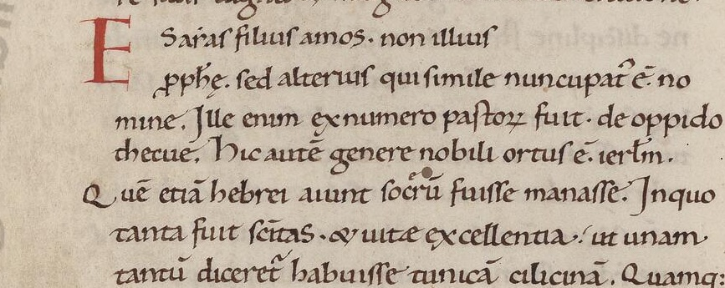
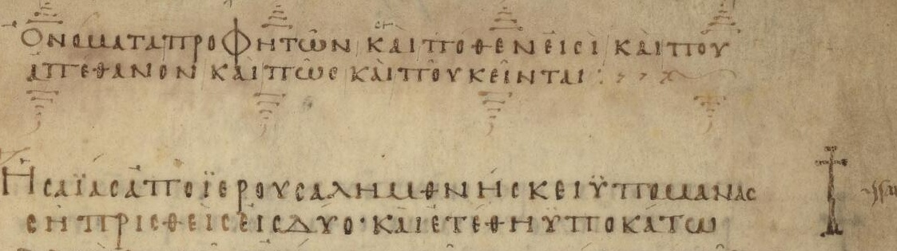
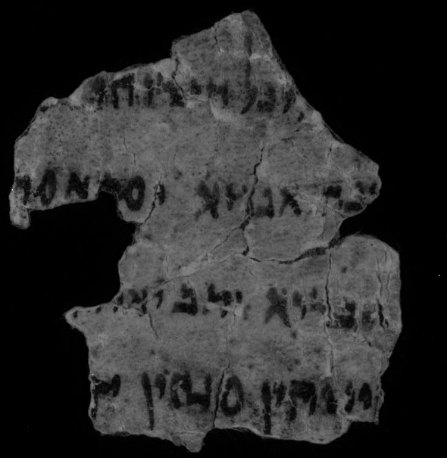
SLIDE 2 · EXPERIMENTAL DESIGN
What We Tested: editio-bench
One benchmark, three manuscripts across a damage gradient, and the entire editorial workflow
EASY / CLEAN
Latin: Vat.lat.629 f. 3v
Caroline minuscule (12th c.)
MODERATE / UNCIAL
Greek: Vat. gr. 2125 p. 11
Codex Marchalianus (6th c.)
VERY HARD / DAMAGED
Aramaic: 4Q530 Frag. 6
Book of Giants (DSS leather)
Transcription ➔ Collation ➔ Translation ➔ Lacunae ➔ Morphology ➔ TEI XML
13 Scored Tasks · 44 Models · 57 Verified Configurations · Three-Judge Consensus
Notes:
SLIDE TIMING: 1:15 – 2:30 (1 min 15 sec)
SPEAKER(S): Demarquis
--- SPEAKER SCRIPT ---
DEMARQUIS: Those timings come from practice, so we also wanted a controlled test.
We built an open benchmark, editio-bench, on three manuscripts that run from easy to very hard: a clean twelfth-century Latin page of Isidore, a sixth-century Greek uncial page of the Lives of the Prophets from Codex Marchalianus, and a damaged Dead Sea Scrolls fragment of the Aramaic Book of Giants.
We didn't stop at transcription. The thirteen tasks cover the whole editorial workflow: transcribing from the image, collating witnesses, translating, handling lacunae, lemma and morphological annotation, and TEI encoding.
We ran forty-four models in fifty-seven configurations, and a panel of three AI judges scored every answer against our human ground truth. We also audited the benchmark itself, and when some of our own headline numbers failed that audit, we withdrew them. Ken will come back to that, because it turns out to be part of the argument.

Slide 3
SLIDE 3 · WORKFLOW ARCHITECTURE
The Escalation Cascade: 90 / 10 / 1
The saving comes from a scholarly filter, not from full autonomous generation
100% — COMPUTER DRAFTS EVERYTHING
Machine generates candidate text across all tokens
EMPIRICAL GROUNDING
Greek Codex Marchalianus p. 11
• Best model CER: 0.0365 (< 4% Error)
• ~96% of characters right before human review.
• The R.A.'s 20-minute check IS the 10% filter.
➔ Effort compresses because scholars edit rather than authoring from scratch.
~10% — RESEARCH ASSISTANT REVISES
R.A. audits, catches errors, and corrects the draft
~1% — ESCALATED TO SUPERVISOR / P.I.
Only genuinely difficult Cruces reach senior review
* 90/10/1 is our project working impression, consistent with benchmark error distributions.
Notes:
SLIDE TIMING: 2:30 – 4:00 (1 min 30 sec)
SPEAKER(S): Demarquis
--- SPEAKER SCRIPT ---
DEMARQUIS: Here's how the work actually flows now. Our rough impression is ninety, ten, one.
About ninety percent of what the AI drafts is right as it stands. I revise the other ten percent. And about a tenth of those revisions, one percent of the whole, are hard enough that I take them to Ken.
Those proportions are an impression, not a measurement. But they fit the benchmark: on our Greek page the best model's character error rate is under four percent. That's the text I'm checking in my twenty minutes.
So the saving doesn't come from the machine doing the edition. It comes from a filter. The machine does the bulk, I catch what's wrong, and only the genuinely difficult questions reach Ken. That's where the order-of-magnitude reduction in human effort comes from.

Slide 4
SLIDE 4 · EPIGRAPHIC LIMITS
Limitations: Where the Cascade Breaks
The cascade holds on clean manuscripts, but breaks completely on degraded physical materials
MANUSCRIPT TIER | MEDIAN CER | CONFIGS ≤ 0.05 | SCHOLAR'S ROLE
Latin: Vat.lat.629 (Caroline minuscule) | 0.03 (97% correct) | 37 of 57 configs | Editor (Cascade Holds)
Greek: Vat. gr. 2125 (Uncial scriptio continua) | 0.13 (best 0.0365) | 14 of 56 configs | Editor (Cascade Holds)
Aramaic: 4Q530 (Broken leather fragment) | 0.80 (best 0.63) | 0 of 57 configs | Author (Cascade Breaks)
ARAMAIC VISUAL SCORE: 7.0 / 100
• Text-based tasks score 72–87 / 100.
• Visual transcription of damaged leather collapses to 7.0 / 100 average.
• Frontier model gets 63% of letters wrong.
THE CARDINAL EPIGRAPHIC RULE
• On legible manuscripts: The AI draft is high quality; the scholar acts as an Editor.
• On degraded fragments: There is nothing worth editing; the scholar is still the Author.
Notes:
SLIDE TIMING: 4:00 – 5:30 (1 min 30 sec)
SPEAKER(S): Demarquis
--- SPEAKER SCRIPT ---
DEMARQUIS: That cascade has a precondition: the first draft has to be mostly right. And whether it is depends far more on the manuscript than on the model.
On the clean Latin page, the typical configuration gets ninety-seven percent of characters right, and most configurations have an error rate under five percent. On the Greek uncial page, the median is around thirteen percent error, and a good share of models are excellent.
On the Dead Sea Scrolls fragment, carbon ink on dark, broken leather, the median error rate is eighty percent, and even the best model gets sixty-three percent of characters wrong. There is nothing there worth editing.
So the cascade breaks exactly where the material is hardest. On a legible page, I'm an editor. On a fragment like 4Q530, the scholar is still the author.

Slide 5
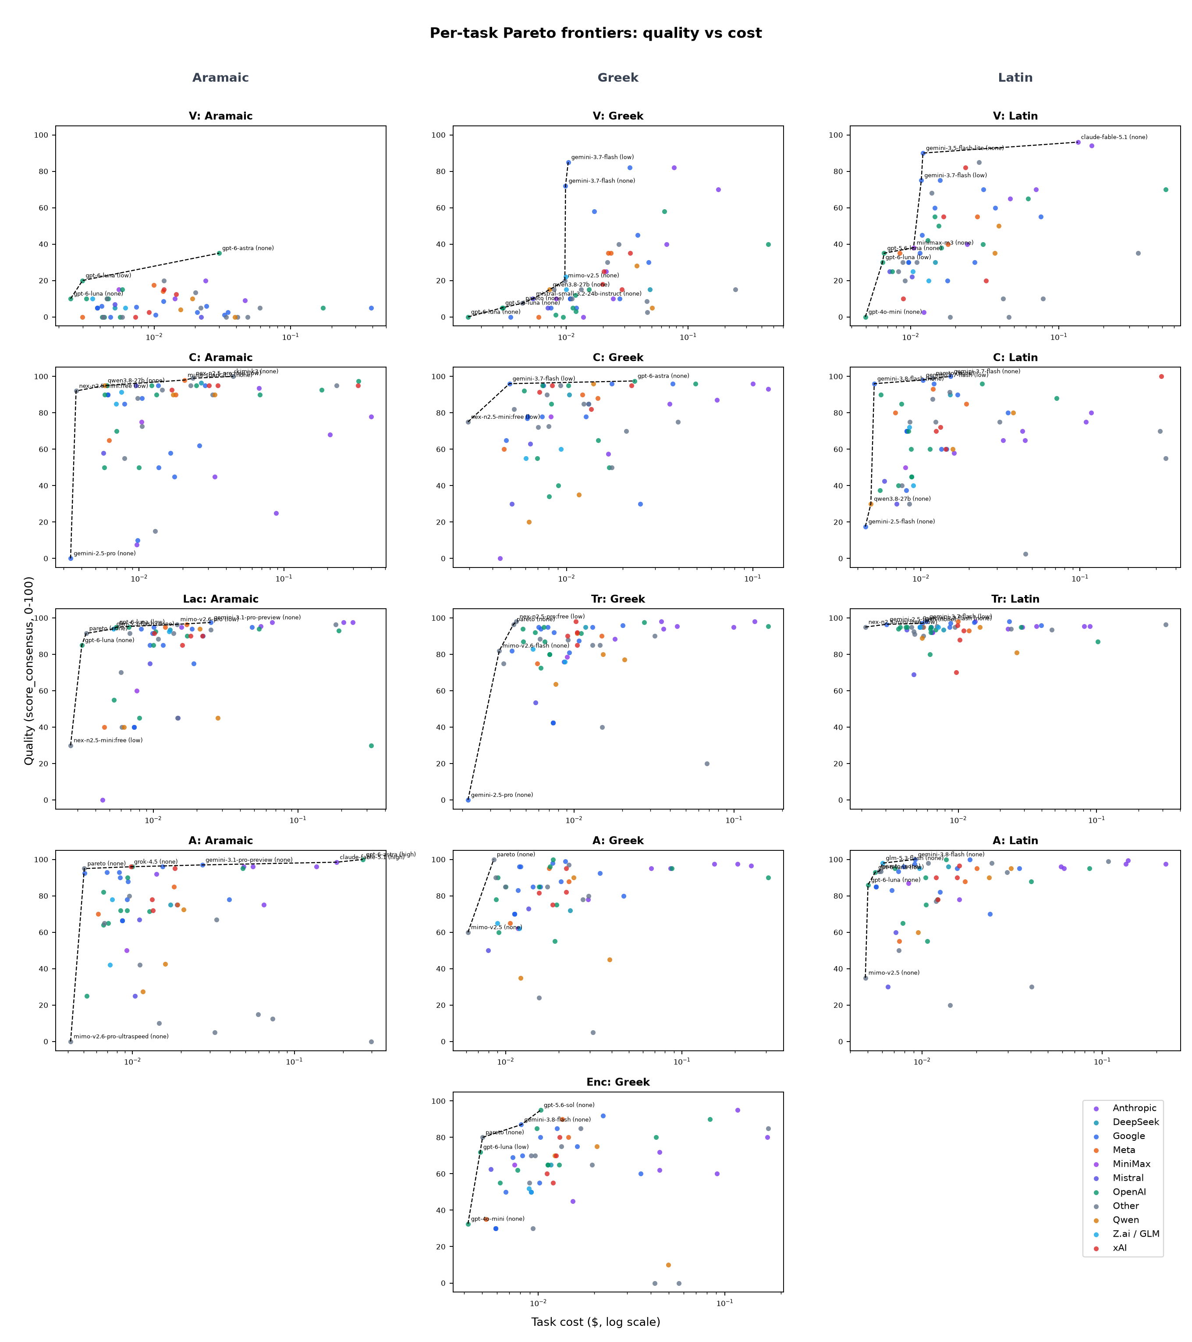
SLIDE 5 · MODEL SELECTION STRATEGY
Use Different Models for Different Tasks and Languages
No single model dominates; effective projects assemble task specialists
TASK / CORPUS | LEADING MODEL (SCORE / 100)
Collation | Grok 4.7 (96.7) · GPT-6 Astra (94.5)
Translation | Gemini 3.1 Pro (97.0) · Grok 4.7 (97.0)
Latin Corpus | Gemini 3.7 Flash (92.4)
Greek Corpus | Gemini 3.1 Pro (91.7)
Aramaic Corpus | Claude Fable 5.1 (87–91) · Next: 78.5
BUDGET SPECIALISTS VS. SINGLE BEST
• Best model per task (< $0.20 / suite) ➔ 89.2 Score
• Single best model overall ➔ 90.3 Score at $1.72
➔ Save 8× budget for ~1 point of difference.
Notes:
SLIDE TIMING: 5:30 – 7:00 (1 min 30 sec)
SPEAKER(S): Ken
--- SPEAKER SCRIPT ---
KEN: The second lesson is that there's no single best model. The leader changes from task to task and from language to language.
For collation, Grok 4.7 and GPT-6 Astra lead. For translation, Gemini 3.1 Pro and Grok 4.7 tie. For Latin as a whole, Gemini 3.7 Flash; for Greek, Gemini 3.1 Pro; and for Aramaic one model, Claude Fable, is well ahead of everyone else.
That has a practical consequence. If you pick the best model for each task, and restrict yourself to cheap configurations under twenty cents for the whole suite, you get within about one point of the single best model, which costs at least eight times as much.
So the question for a project isn't 'which AI should we use?' It's 'which model for which step, and in which language?'

Slide 6
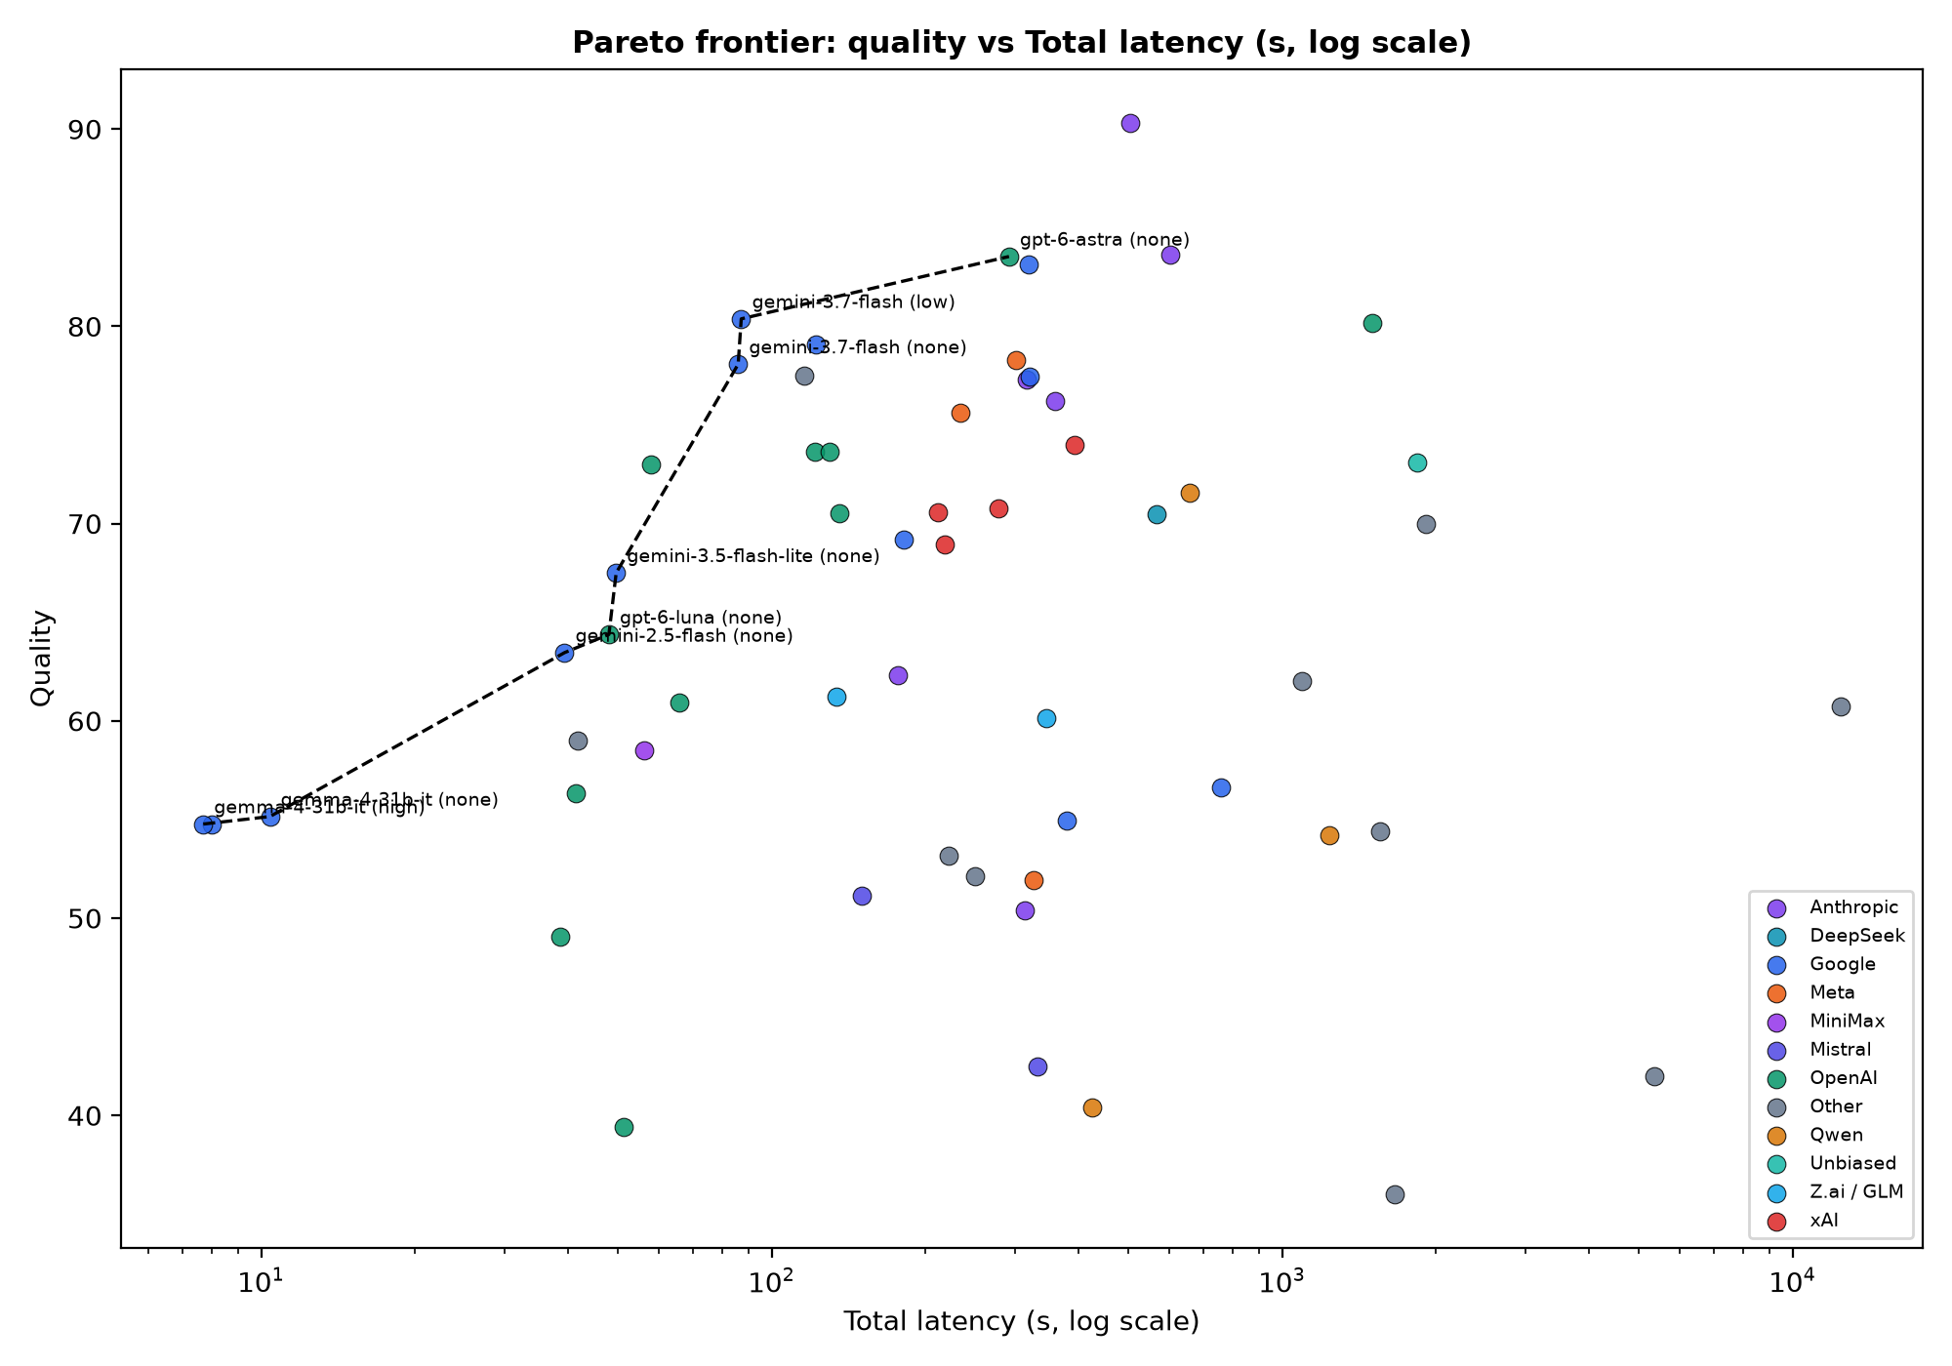
SLIDE 6 · LATENCY & EFFICIENCY
Speed and Cost Tend to Correlate
Fast is usually cheap, and waiting longer does not buy higher philological quality
THE REASONING-EFFORT PARADOX
Higher 'Thinking' Effort Scored Lower
MODEL | NONE | LOW | HIGH | EXTRA
Claude Fable 5.1 | 90.3 | — | 83.6 | +22%
GPT-6 Astra | 83.5 | — | 80.2 | 4.4×
Gemini 3.7 Flash | 78.1 | 80.4 | 77.5 | 2×
➔ Practical Rule: Set reasoning effort low or off. Extended thinking loops do not improve ancient text decipherment.
Cost vs. Latency: r = 0.57 | Quality vs. Latency: r ≈ 0.04
Notes:
SLIDE TIMING: 7:00 – 8:15 (1 min 15 sec)
SPEAKER(S): Ken
--- SPEAKER SCRIPT ---
KEN: Third, a principle that should guide decisions and standards: speed and cost tend to go together. Across our fifty-seven configurations, the models that take longer are, on the whole, the ones that cost more.
What doesn't go with time is quality. The correlation between how long a model takes and how well it scores is essentially zero.
We tested this directly by turning up the models' reasoning effort, telling them to think longer. For the three leading models, the high-effort setting cost more, took longer, and scored lower. GPT-6 Astra at high effort cost four times as much, took five times as long, and lost three points.
So waiting longer for the machine doesn't buy you a better draft.

Slide 7
SLIDE 7 · SCHOLARLY ALLOCATION
Where Human Effort Goes: The Shaping Stages
AI compresses mechanical drafting; human effort concentrates at the two ends
THE BOW-TIE MODEL OF EDITORIAL LABOR
• BEFORE AI: Effort bulged in the middle (months of manual transcription, collation, tagging).
• WITH AI: The middle is compressed. Human discernment concentrates at:
➔ INPUT END: Setting parameters, standards, baselines, and philological goals.
➔ OUTPUT END: Auditing results, resolving Cruces, and critical interpretation.
INPUT: STANDARDS DECISION
Greek Ground Truth & Diplomatic Baseline
• Initial CER was ~9.5% because ground truth tested normalized text.
• Ken's ruling on diplomatic baseline (State C) dropped CER to 0.0365 (<4%).
➔ Apparent difficulty was manufactured by human standards.
OUTPUT: HUMAN AUDIT CATCHES
Catches That Automated Scripts Missed
• Caught a headline 70.5 score resting on only 2 of 13 tasks.
• Unmasked duplicate cache replays across runs.
• Caught AI judges giving 100/100 on empty images.
➔ Discovered by human auditors, not automated scripts.
Notes:
SLIDE TIMING: 8:15 – 10:15 (2 min 00 sec)
SPEAKER(S): Ken
--- SPEAKER SCRIPT ---
KEN: So where does the saved time go? Before AI, most of an editor's effort sat in the middle of a project: the trial and error of transcribing, tagging, collating. AI compresses that middle. What's left concentrates at the two ends.
At the beginning, we shape the input: we set the parameters, the standards, the goals, the methods. At the end, we shape the output: we interpret the results and decide how to present them. I'd argue that's exactly where human effort belongs, because those are the stages that need the highest-level discernment.
Our own benchmark is the best illustration we have. At the beginning: our best early Greek error rate was about ten percent. Much of that turned out not to be the models' fault. Our ground truth had staged the normalized edition as if it were the diplomatic transcription. Once we made a ruling on the diplomatic baseline, the best Greek error rate fell below four percent. Part of the 'difficulty' had been manufactured by our standards.
At the end: our audit found a score of seventy-point-five that rested on only two of thirteen tasks. We found 'separate' runs that were really replays of the same run. And just this week we found two of our three AI judges giving a perfect score to a model that claimed no image had been attached, when it had been. No script flagged any of these. People did.
That's what discernment at the ends of a project looks like.

Slide 8
SLIDE 8 · TEAM ROLES
Everyone Moves Up a Rung
At every level, the human role shifts from author to editor
THE ELEVATION OF RESEARCH ROLES
➔ P.I. / Senior Scholar
Higher-level design, theoretical synthesis, ethics
➔ Supervisor / Postdoc
Methodological direction (what the P.I. used to do)
➔ Research Assistant
Critical audit & apparatus collation (supervisor work)
➔ Computer / AI
Initial candidate transcription (what R.A.s used to do)
R.A. AS SCHOLARLY AUDITOR
Demarquis Moss: Lead Auditor
• Ruled on disputed Latin readings against Chaparro Gómez's critical edition.
• Diagnostic Validity: Audited prompt suites for authentic palaeographical tests.
• Judge Calibrations: Screened AI judges against human scholarly ground truth.
• Editorial Leadership: Conducted supervisory research formerly reserved for postdocs.
➔ Result: Every team member does higher-level work.
Notes:
SLIDE TIMING: 10:15 – 12:00 (1 min 45 sec)
SPEAKER(S): Ken → Demarquis → Ken
--- SPEAKER SCRIPT ---
KEN: Put those pieces together and you get what we think is the real change. The tasks a computer can do now are the tasks a research assistant used to do. The tasks a research assistant can do now are the tasks a supervisor used to do. And so on up. Every person on the team does higher-level work. Demarquis?
DEMARQUIS: You can see it in my own work this summer, which went well beyond typing transcriptions. I ruled on disputed readings in our Latin ground truth against Chaparro Gómez's critical edition, and I audited whether our benchmark tasks and our AI judges were testing the right things. A few years ago, that would have been a supervisor's job.
KEN: At every level, the human role shifts from author, the person who produces the first draft, to editor: the person who judges it, corrects it, and takes responsibility for it.

Slide 9
SLIDE 9 · PEDAGOGICAL FRAMEWORK
Teaching the Ladder: The Digital Methods Course
One phase a week, taught three ways: students must learn the entire ladder
MEETING 1: BY HAND
Direct Experience
• Type & decipher data manually.
• Builds palaeographical intuition.
• Foundation for critical literacy.
MEETING 2: PRE-AI TOOLS
Computational Tools
• Deterministic algorithms & regex.
• CollateX, treebanks, databases.
• Fast, rule-governed processing.
MEETING 3: GENERAL LLMs
Critical Editor
• Shape inputs: prompts & schemas.
• Curate & audit AI draft outputs.
• Trains real-world editorial judgment.
THE CARDINAL PEDAGOGICAL PRINCIPLE:
"You cannot judge a transcription you couldn't have made yourself."
Notes:
SLIDE TIMING: 12:00 – 13:30 (1 min 30 sec)
SPEAKER(S): Ken
--- SPEAKER SCRIPT ---
KEN: This is a teaching conference, so let me take the argument into the classroom.
If everyone moves up a rung, students need to learn the whole ladder. My Digital Methods course spends one week on each phase of a digital scholarly edition, from cataloguing and imaging through transcription, collation, markup and translation, to presentation and publication.
Each week we meet three times on the same task. First, by hand: we type the data ourselves. Second, with pre-AI computer tools, deterministic algorithms and purpose-built applications that do the same work more efficiently. Third, with general-purpose language models: we put the input into a form the model can work with, and then we curate what it produces.
That third meeting trains exactly the shaping stages I described. And the first meeting is what makes the third possible: you can't judge a transcription you couldn't have made yourself.

Slide 10
SLIDE 10 · PRACTICAL RECOMMENDATIONS
Model Recommendations: This Week's Snapshot
September 2026 snapshot — models change rapidly, but workflow principles endure
PROJECT NEED | RECOMMENDED MODEL | BENCHMARK EVIDENCE | COST / SUITE
Budget Project | Gemini 3.7 Flash (low) | 80.4 score · 87s latency | $0.14 / suite
Balanced Production | GPT-6 Astra (none) | 83.5 score · 292s latency | $0.60 / suite
Highest Quality | Claude Fable 5.1 (none) | 90.3 score · 504s latency | $1.72 / suite
Collation | Grok 4.7 (low) / GPT-6 Astra | 96.7 / 94.5 task score | Sub-task
Translation | Gemini 3.1 Pro / Grok 4.7 | 97.0 / 97.0 task score | Sub-task
1. TURN REASONING DOWN
High effort costs 4× more, runs 5× slower, and scores lower on philology.
2. BEWARE FREE TIERS
Good for tests, but fail on production runs due to hard quota exhaustion.
3. RUN DUAL FAMILIES
Compare two distinct models; loci where they disagree pinpoint human review.
Notes:
SLIDE TIMING: 13:30 – 15:00 (1 min 30 sec)
SPEAKER(S): Demarquis
--- SPEAKER SCRIPT ---
DEMARQUIS: People always ask which model to use, so here's our answer, with a warning: this is a snapshot of this month's runs, and it will be out of date in weeks, maybe days.
On a budget, Gemini 3.7 Flash at low effort: about eighty out of a hundred for fourteen cents for the entire suite. For balance, GPT-6 Astra. For the highest quality, and especially for Aramaic, Claude Fable, at about twelve times the cost of Flash.
Three rules will last longer than the table. Turn reasoning effort down as far as it goes. Free tiers are fine for experimenting, but don't expect paid-tier quality, and on a real project you'll hit their quotas. And run two different model families side by side: where they disagree is where you should look.
Above all, the AI isn't doing the work for you. It speeds the work up by making you the editor instead of the author. The model list will change; that division of labour won't. So before you commit to a model, test it on a few pages of your own material.

Slide 11
CONCLUSION & CORE THESIS
From Author to Editor: Elevating the Team
AI does not replace the scholar. It moves every member of the team up one rung:
the machine drafts, the R.A. edits, and human effort concentrates at the start and end of the project.
OPEN RESEARCH DELIVERABLES
• editio-bench: Open 13-task benchmark suite & consensus scoring harness.
• PROVENANCE.md: Complete registry mapping every published score to its run.
• Clean Suite Master: 57 verified configurations passing quality & replay gates.
• GitHub Repository: github.com/kmpenner/IDG (XML ground truth, code, data).
PRESENTERS & SUPPORT
Dr. Ken M. Penner
Principal Investigator · St. Francis Xavier University
Email: kpenner@stfx.ca
Demarquis Moss
Lead Research Assistant & Scholarly Quality Auditor
Supported by SSHRC IDG R0253025
Notes:
SLIDE TIMING: 15:00 – 15:45 (45 sec)
SPEAKER(S): Ken
--- SPEAKER SCRIPT ---
KEN: To sum up: AI doesn't replace the scholar. It moves every member of the team up one rung. The machine drafts, the research assistant edits, and the scholar's effort goes where it counts most: shaping the input at the start, and interpreting the output at the end.
The benchmark, the data, and the record of every number we've shown you are openly available.
Thank you. Demarquis and I look forward to your questions.

Slide 12
PANEL REFERENCE
Panel Q&A Cheat Sheet
Anticipated technical and methodological questions for the discussion period
• Q1: Are models just reciting pre-trained printed editions?
➔ No. Greek p.11 has no published diplomatic edition; Latin editions are normalized; Aramaic failed completely (80% CER).
• Q2: What does this pipeline cost in actual research practice?
➔ Budget setup was $0.14 for all 13 tasks (~1 cent/task). Frontier suite was $1.72 total. No supercomputers needed.
• Q3: How solid is the 90 / 10 / 1 rule of thumb?
➔ Project working impression on legible texts, verified by Greek CER 0.0365 (96% right). Breaks on broken leather.
• Q4: Does this deskill undergraduate students and R.A.s?
➔ No, it elevates them. The course keeps weekly 'by-hand' meetings: you cannot edit what you couldn't write yourself.
• Q5: How are copyright and manuscript image rights governed?
➔ Ingested under academic fair dealing at calibrated resolutions. Raw facsimiles remain under institutional ownership.
Notes:
SLIDE TIMING: Panel Discussion / Q&A
SPEAKER(S): Ken & Demarquis
--- SPEAKER SCRIPT ---
Q1: Aren't the models just reciting published editions of these texts?
Answer: Not for what we measured. No diplomatic transcription of this Greek page is published. The published Latin edition (Chaparro Gómez) is normalized, not diplomatic, so a model can't reproduce the scribe's abbreviations and letterforms by recalling it. The Aramaic fragment is where recall would help most, and it's where every model failed.
Q2: What does this cost in practice?
Answer: The budget configuration (Gemini 3.7 Flash, low effort) ran the full 13-task suite for $0.14 including judging — about a cent per task. The most expensive frontier configuration was about $1.72 for the suite.
Q3: How solid is the 90/10/1 figure?
Answer: It's our working impression from the project, not a measured rate, and it only holds on legible material (Slide 4). On a legible Greek page, the best model gets about 96% of characters right, which is consistent with it.
Q4: Doesn't this deskill students and RAs?
Answer: That's why the course keeps the by-hand meeting every week (Slide 9). The editor's judgment depends on being able to do the author's work; what changes is how much of it they have to do.
Q5: How do you handle intellectual property and library image rights?
Answer: All images (Vatican DigiVatLib, IAA Leon Levy) are ingested under academic fair dealing / research exceptions at calibrated resolutions, with raw high-resolution facsimiles remaining under institutional ownership.

