Slide 1



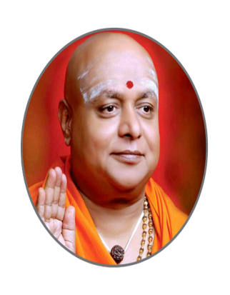
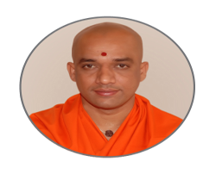

| | Jai Sri Gurudev || Sri AdichunchanagiriShikshana Trust ® SJB INSTITUTE OF TECHNOLOGY An Autonomous Institution under Visvesvaraya Technological University, Belagavi
BGS Health & Education City, Dr. Vishnuvardhan Road, Kengeri, Bengaluru - 560 060
Approved by AICTE, New Delhi, Accredited by NAAC, New Delhi with ‘A+’ Grade
Accredited by National Board of Accreditation, New Delhi
Recognized by UGC, New Delhi with 2(f) and 12(B), Certified by ISO 9001-2015 Department of Master of Computer Application
His Divine Soul Jagadguru Padmabushana
Sri Sri Sri Dr. Balagangadharanatha
Maha Swamiji
Founder President
Sri Adichunchanagiri Shikshana Trust ®
His Holiness Jagadguru
Sri Sri Sri Dr. Nirmalanandanatha
Maha Swamiji
President
Sri Adichunchanagiri Shikshana Trust ®
Revered
Sri Sri Dr. Prakashanatha
Swamiji
Managing Director
BGS and SJB Group of Institutions

Slide 2
SJB INSTITUTE OF TECHNOLOGY
An Autonomous Institution under Visvesvaraya Technological University, Belagavi
Title: Water Scarcity in India
PRESENTED BY : HARISH GOUD MALI PATIL 1JB23MC011
KIRAN T V 1JB23MC017
PRASANNA KUMAR K M 1JB23MC034

Slide 3
THANK YOU

