Slide 1
Understanding Correlates of Obesity: Hierarchical Clustering Approaches
Katherine M. Prioli
CSC 8515 Final Project
December 05, 2019

Slide 2
BACKGROUND
Overweight and obesity are growing public health concerns
Obesity is defined as body mass index (BMI) ≥ 30 kg/m²
71.6% of American adults are overweight; 39.8 are obese%.¹
Obesity strongly correlates with increased morbidity and mortality.²
Economic burden of obesity is high, both for direct costs (e.g., healthcare utilization) and indirect costs (e.g., work productivity loss).^{3,4}
The National Health and Nutrition Examination Survey (NHANES) is a biennial health surveillance study performed by the Centers for Disease Control and Prevention (CDC).
Seeks to understand population-level health by gathering demographic, medical, mental health, and behavioral data
Data collection through self-report and physical examination
NHANES has uncovered some demographic correlates of obesity
Much remains unknown about the interactions of these correlates and how constellations of these correlates may be used to identify obesity at the population level

Slide 3
INCREASING NATIONAL OBESITY, 1985-2008*
*CDC data, based on self-reported height and weight gathered on the Behavioral Risk Factor Surveillance annual survey; .gif from Wikimedia Commons⁵

Slide 4
OBJECTIVES
Explore a carefully selected set of NHANES variables with respect to BMI weight category through two hierarchical clustering methods (unsupervised)
4 weight categories of BMI:
Underweight (BMI < 18.5 kg/m²)
Healthy weight (18.5 ≤ BMI < 25.0 kg/m²)
Overweight (25.0 ≤ BMI < 30.0 kg/m²)
Obese (BMI ≥ 30 kg/m²)
Compare cluster homogeneity by BMI weight category between methods

Slide 5
METHODS
Selected variables representing characteristics known or suspected to be correlated with obesity
Informed by literature search
Wrangled data and explored via descriptive analysis
For continuous variables, imputed missing values
Used Wilcoxon RS tests at the α = 0.05 level to ensure imputation didn’t meaningfully change the data
Omitted any post-imputation variables found to be statistically different than the pre-imputation versions

Slide 6
METHODS
Performed agglomerative clustering (AGNES) and divisive clustering (DIANA)
Selected variables that were ≥90% complete, then subset to include complete cases only
Created representative 5% sample stratified by BMI category
Necessary to use a smaller dataset because visualizing ~5,000 cases in a dendrogram plot isn’t very informative!
Generated dissimilarity matrix based on Gower distance⁶
Gower distance was used because variables were of mixed type (continuous, categorical)
Used clustering statistics to generate scree and silhouette plots
Used these plots to inform number of clusters needed for each approach

Slide 7
METHODS
Three analyses:
4-level BMI categories, AGNES k = 7, DIANA k = 6
Dichotomous BMI categories*, AGNES k = 7, DIANA k = 6
Dichotomous BMI categories*, AGNES k = 10, DIANA k = 9
For each analysis:
Plotted radial dendrograms with colored branches to indicate clusters and colored leaves to indicate BMI category
Assessed cluster homogeneity and congruency of clusters vs. BMI category labels
Compared AGNES and DIANA
* Dichotomous BMI categories defined as not overweight or obese vs. overweight or obese

Slide 8
THE DATA
DOMAIN | DESCRIPTION
Demographics | Age, gender, race, level of education, marital status, family income category
Medical history | Comorbidities (diabetes, hypertension, coronary artery disease, myocardial infarction, thyroid disease, depression), has been advised by doctor to lose weight and/or exercise, functional limitations, BMI category
Dietary behavior | Daily calories consumed, daily water consumed, self-assessment of dietary healthiness, fast food and sit-down restaurant food consumption in past 12 months, has used or would use nutritional information to select meal at fast food or sit-down restaurant
Exercise behavior | Minutes of moderate to vigorous activity daily (work and recreation); minutes spent sedentary daily
All variables were obtained from 2015-2016 NHANES survey (most recent available)
Historic data excluded due to rapidly changing epidemiology of obesity
Inclusion criteria were age ≥20 and non-missing BMI data
Final dataset comprised 5,406 cases and 39 variables
Majority of variables are categorical!
Notes:
BMI is categorized differently for adults vs. children; focusing on adults in this analysis. Age ≥20 is consistent with NHANES definition of adult.

Slide 9
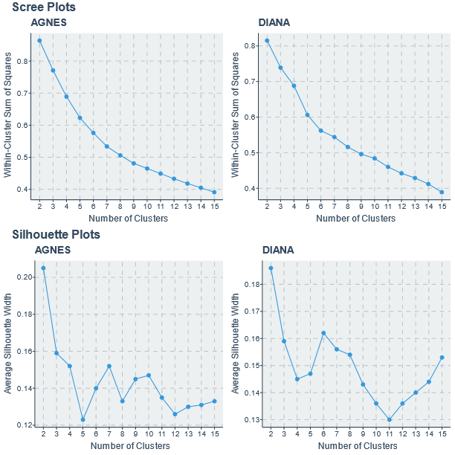
RESULTS: SCREE AND SILHOUETTE PLOTS
AGNES scree plot was very smooth
Possible elbow at 7 clusters
DIANA scree plot shows elbows at 6 and 9 clusters
Silhouette plots were based on overall average silhouette width (ASW)⁷
ASW is a measure of dissimilarity between vs. within clusters based on a given k
ASW ∈ [-1, 1]
Choose the value of k that maximizes ASW (and is reasonable given what is known about the data)
AGNES silhouette plot suggests k = 7
DIANA silhouette plot suggests k = 6

Slide 10
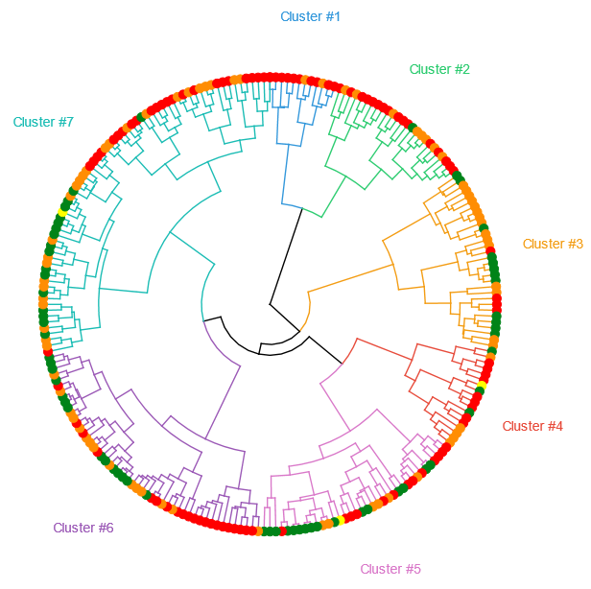
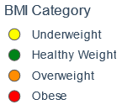
RESULTS: ANALYSIS 1, AGNES (k = 7)
Cluster 1 showed high homogeneity (83.3% obese) but was small (n=12)
Cluster 7 showed poorest homogeneity (37.7% overweight, 36.2% obese, 24.6% healthy weight) and was also largest
Mean homogeneity was 52.8% (range 37.7-83.3%)
Cluster | Size (n) | Underweight (n, %) | Healthy Weight (n, %) | Overweight (n, %) | Obese (n, %)
1 | 12 | 0 (0%) | 0 (0%) | 2 (16.7%) | 10 (83.3%)
2 | 25 | 0 (0%) | 1 (4%) | 8 (32.0%) | 16 (64.0%)
3 | 31 | 0 (0%) | 12 (38.7%) | 15 (48.4%) | 4 (12.9%)
4 | 18 | 1 (5.6%) | 3 (16.7%) | 5 (27.8%) | 9 (50.0%)
5 | 36 | 1 (2.8%) | 16 (44.4%) | 6 (16.7%) | 13 (36.1%)
6 | 50 | 0 (0%) | 14 (28.0%) | 15 (30.0%) | 21 (42.0%)
7 | 69 | 1 (1.4%) | 17 (24.6%) | 26 (37.7%) | 25 (36.2%)

Slide 11
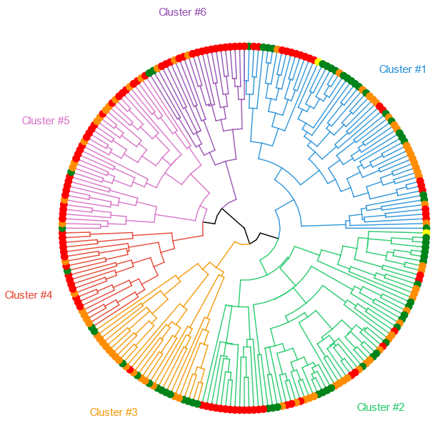
RESULTS: ANALYSIS 1, DIANA (k = 6)
Cluster 6 was the most homogeneous with 17 (77.3%) obese
Clusters 4 and 5 also had reasonable homogeneity (63.6% and 64.1% respectively)
Mean homogeneity was 54.7% (range 33.3-77.3%)
DIANA outperforms AGNES
Cluster | Size (n) | Underweight (n, %) | Healthy Weight (n, %) | Overweight (n, %) | Obese (n, %)
1 | 61 | 2 (3.3%) | 22 (36.1%) | 19 (31.1%) | 18 (29.5%)
2 | 69 | 1 (1.4%) | 23 (33.3%) | 22 (31.9%) | 23 (33.3%)
3 | 28 | 0 (0%) | 12 (42.9%) | 15 (53.6%) | 1 (3.6%)
4 | 22 | 0 (0%) | 2 (9.1%) | 6 (27.3%) | 14 (63.6%)
5 | 39 | 0 (0%) | 2 (5.1%) | 12 (30.8%) | 25 (64.1%)
6 | 22 | 0 (0%) | 2 (9.1%) | 3 (13.6%) | 17 (77.3%)

Slide 12
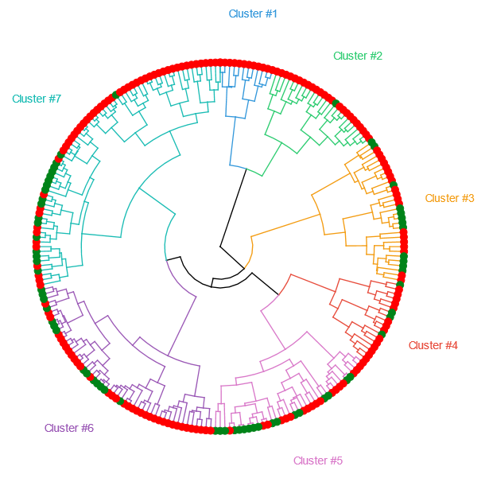
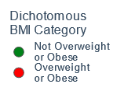
RESULTS: ANALYSIS 2, AGNES (k = 7)
Cluster 1 showed perfect homogeneity; Cluster 2 was 96% homogeneous
Poorest homogeneity in Cluster 5 (52.8%)
Mean homogeneity was 76.3% (range 52.8-100.0%)
These results are an improvement over AGNES Analysis #1
Cluster | Size (n) | Not Overweight or Obese (n, %) | Overweight or Obese (n, %)
1 | 12 | 0 (0%) | 12 (100.0%)
2 | 25 | 1 (4.0%) | 24 (96.0%)
3 | 31 | 12 (38.7%) | 19 (61.3%)
4 | 18 | 4 (22.2%) | 14 (77.8%)
5 | 36 | 17 (47.2%) | 19 (52.8%)
6 | 50 | 14 (28.0%) | 36 (72.0%)
7 | 69 | 18 (26.1%) | 51 (73.9%)

Slide 13
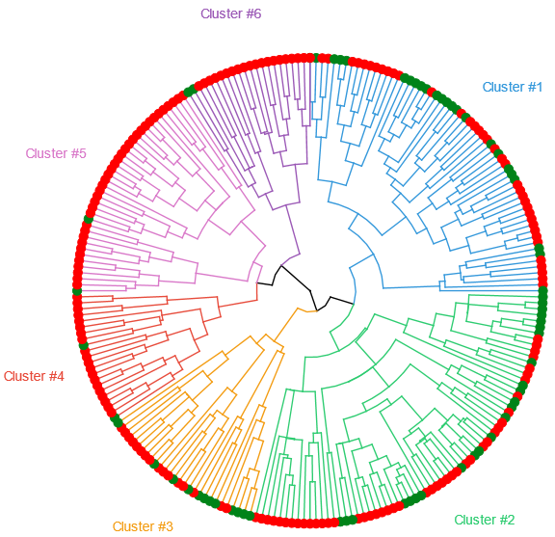
RESULTS: ANALYSIS 2, DIANA (k = 6)
Cluster 5 was 94.9% homogeneous; Clusters 4 and 6 were both 90.9% homogeneous
Poorest homogeneity seen in Cluster 3 (57.1%)
Mean homogeneity was 76.6% (range 57.1-94.9%)
DIANA again outperforms AGNES
Cluster | Size (n) | Not Overweight or Obese (n, %) | Overweight or Obese (n, %)
1 | 61 | 24 (39.3%) | 37 (60.7%)
2 | 69 | 24 (34.8%) | 45 (65.2%)
3 | 28 | 12 (42.9%) | 16 (57.1%)
4 | 22 | 2 (9.1%) | 20 (90.9%)
5 | 39 | 2 (5.1%) | 37 (94.9%)
6 | 22 | 2 (9.1%) | 20 (90.9%)

Slide 14
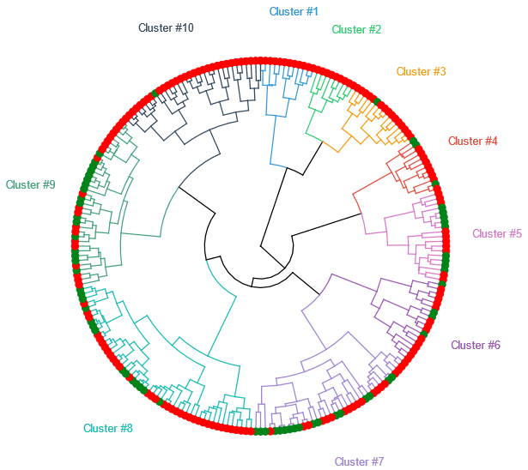
RESULTS: ANALYSIS 3, AGNES (k = 10)
Clusters 1 and 2 were perfectly homogeneous, and Clusters 3 and 10 had 93.8% and 96.9% homogeneity respectively
Poorest homogeneity in Cluster 5 (52.6%)
Mean homogeneity was 77.5% (range 52.6-100.0%)
Results are an improvement over AGNES Analysis #2
Cluster | Size (n) | Not Overweight or Obese (n, %) | Overweight or Obese (n, %)
1 | 12 | 0 (0%) | 12 (100.0%)
2 | 9 | 0 (0%) | 9 (100.0%)
3 | 16 | 1 (6.2%) | 15 (93.8%)
4 | 12 | 3 (25.0%) | 9 (75.0%)
5 | 19 | 9 (47.4%) | 10 (52.6%)
6 | 18 | 4 (22.2%) | 14 (77.8%)
7 | 36 | 17 (47.2%) | 19 (52.8%)
8 | 50 | 14 (28.0%) | 36 (72.0%)
9 | 37 | 17 (45.9%) | 20 (54.1%)
10 | 32 | 1 (3.1%) | 31 (96.9%)

Slide 15
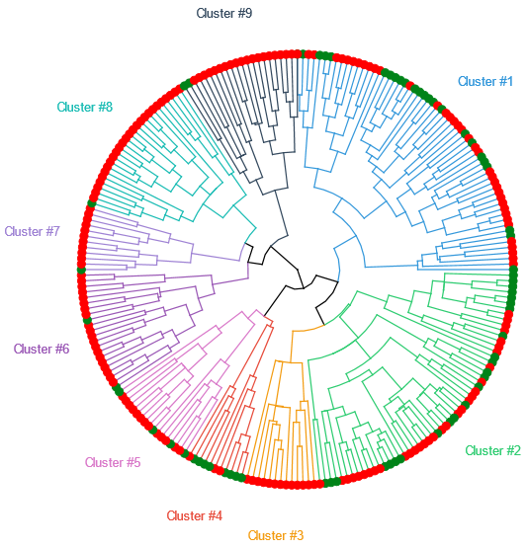
RESULTS: ANALYSIS 3, DIANA (k = 9)
Cluster 3 was perfectly homogeneous, and Clusters 6 through 9 all had >90% homogeneity
Poorest homogeneity seen in Cluster 2 (57.1%)
Mean homogeneity was 81.2% (range 57.1-100.0%)
Beats all other results
Found a cluster which is predominantly not overweight or obese (Cluster 4)
Cluster | Size (n) | Not Overweight or Obese (n, %) | Overweight or Obese (n, %)
1 | 61 | 24 (39.3%) | 37 (60.7%)
2 | 56 | 24 (42.9%) | 32 (57.1%)
3 | 13 | 0 (0%) | 13 (100.0%)
4 | 11 | 8 (72.7%) | 3 (27.3%)
5 | 17 | 4 (23.5%) | 13 (76.5%)
6 | 22 | 2 (9.1%) | 20 (90.9%)
7 | 12 | 1 (8.3%) | 11 (91.7%)
8 | 27 | 1 (3.7%) | 26 (96.3%)
9 | 22 | 2 (9.1%) | 20 (90.9%)

Slide 16
DISCUSSION
DIANA outperformed AGNES for all 3 analyses and had narrower homogeneity ranges
High homogeneities in most clusters in Analysis 3 exceed population prevalence of dichotomous BMI weight category so these results are likely meaningful
Dichotomizing BMI categories improved clustering analysis
This approach is defensible because overweight individuals account for greater healthcare expenditure and productivity loss as compared to those of healthy weight
They may benefit from similar weight management interventions as those with obesity
Clustering analyses rely on dissimilarity matrix calculations
Distance loses meaning for categorical variables, especially nominal
Gower distance is best for mixed type variables but another method may exist that handles nominal categories better

Slide 17
LIMITATIONS
NHANES variables may not be optimally suited to this secondary analysis
Initial dataset was relatively small (n = 5,406 with 39 variables)
Data was largely categorical, with many categories having few levels
May result in noise
Fewer variables or more category levels may improve homogeneity
These analyses were seeded to ensure stable results
Some pilot cases run without seeding had more well defined scree and silhouette plots for DIANA

Slide 18
CONCLUSION
Findings indicate it may be possible to identify those likely to be overweight or obese using a relatively small set of demographic, behavioral, and medical variables
Useful for appropriate targeting of weight management interventions
Future work includes refining clustering approach by reassessing variable selection and distance calculation methodology

Slide 19
REFERENCES
Selected health conditions and risk factors, by age: United States, selected years 1988-1994 through 2015-2016. Centers for Disease Control and Prevention. Health, United States, 2017: Trend Tables. https://www.cdc.gov/nchs/data/hus/2017/053.pdf.
Defining Adult Overweight and Obesity. Centers for Disease Control and Prevention. https://www.cdc.gov/obesity/adult/defining.html. Updated April 11, 2017.
Hruby A, Hu FB. The Epidemiology of Obesity: A Big Picture. Pharmacoeconomics. 2015;33(7):673-89. doi:10.1007/s40273-014-0243-x.
Li Q, Blume SW, Huang JC, Hammer M, Ganz ML. Prevalence and healthcare costs of obesity-related comorbidities: evidence from an electronic medical records system in the United States. J Med Econ. 2015;18(12):1020-8. doi: 10.3111/13696998.2015.1067623.
Animation of U.S. Obesity Trends by State, 1985-2008 (%of people with BMI >30). Original data and visualizations by Centers for Disease Control and Prevention. Wikimedia Commons. https://commons.wikimedia.org/wiki/File:CDC_Overweight_and_Obesity_map3.gif.
Gower JC. A General Coefficient of Similarity and Some of Its Properties. Biometrics. 1971;27(4):857-71. doi: 10.2307/2528823.
Rousseeuw PJ. Silhouettes: A Graphical Aid to the Interpretation and Validation of Cluster Analysis. Journal of Computational and Applied Mathematics. 1987(20): 53-65. https://doi.org/10.1016/0377-0427(87)90125-7.

Slide 20

QUESTIONS?
Full project code available on GitHub: https://github.com/kmprioliPROF/CSC_8515_Final_Project

Slide 21
SUPPLEMENTAL SLIDES

Slide 22
RANDOM FOREST

Slide 23

METHODS
Classified data via RandomForestClassifier()
Used RepeatedKFold() for n × k-fold crossvalidation
Assessed mean model accuracy
Tuned hyperparameters to maximize accuracy:
n (number of repeats)
k (number of splits)
Number of trees in the forest
Minimum leaf size
Maximum tree depth
Dichotomized BMI (underweight & healthy weight vs. overweight & obese), reduced number of variables suspected to be most highly correlated with BMI, and reran analysis

