Slide 1
Understanding Correlates of Obesity: Supervised and Unsupervised Learning Approaches
Katherine M. Prioli
CSC 8515 Final Project
December 05, 2019

Slide 2
BACKGROUND
Overweight and obesity are growing public health concerns
71.6% of American adults are overweight; 39.8 are obese%.¹
Obesity strongly correlates with increased morbidity and mortality.²
Economic burden of obesity is high, both for direct costs (e.g., healthcare utilization) and indirect costs (e.g., work productivity loss).^{3,4}
The National Health and Nutrition Examination Survey (NHANES) is a biennial health surveillance study performed by the Centers for Disease Control and Prevention (CDC).
NHANES has uncovered some demographic correlates of obesity
Much remains unknown about the interactions of these correlates and how constellations of these correlates may be used to identify obesity at the population level

Slide 3
INCREASING NATIONAL ADIPOSITY, 1985-2008*
*CDC data; .gif from Wikimedia Commons⁵

Slide 4
OBJECTIVES
UPDATE
x
Use Python and R together in an RMarkdown document

Slide 5
THE DATA
UPDATE
VARIABLE | DESCRIPTION
fred_disposable | Per-capita disposable income, adjusted for inflation in chained $US 2012, seasonally adjusted⁶
fred_debt | Household debt service payments as a percent of disposable personal income, seasonally adjusted⁷
fred_savings | Personal saving as a percentage of disposable personal income, seasonally adjusted⁸
All variables were obtained from the Federal Reserve Bank of St. Louis
All share a common year of valuation ($US 2012)
All are already seasonally adjusted
All three TS were subset to common time horizon (Q1 1980 through Q3 2018)
155 observations in each TS

Slide 6
METHODS
UPDATE
Two analyses:
Disposable income
Savings vs. debt
Stages to each analysis:
Explore the data
​ggtsdisplay()
Decomposition
Scaled periodogram
CCF
Model the data leaving out last 3 observations
​auto.arima(), Arima(), lmtest::coeftest(), and checkresiduals()
Make predictions for last 3 observations and check against known values
​forecast()

Slide 7
DISPOSABLE INCOME
UPDATE

Slide 8
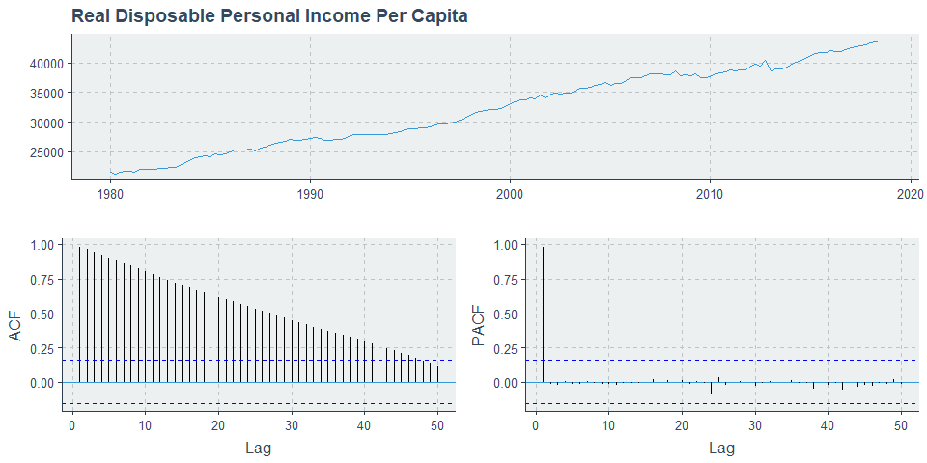
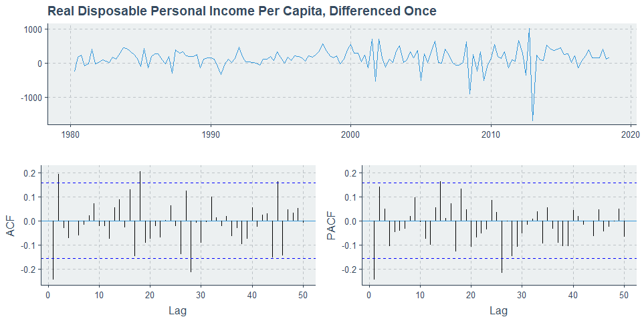
DATA EXPLORATION
UPDATE
Raw data shows clear increasing trend without any obvious seasonality
ACF plot suggests differencing is needed
After differencing, series appears stationary
AR(1) may be appropriate

Slide 9
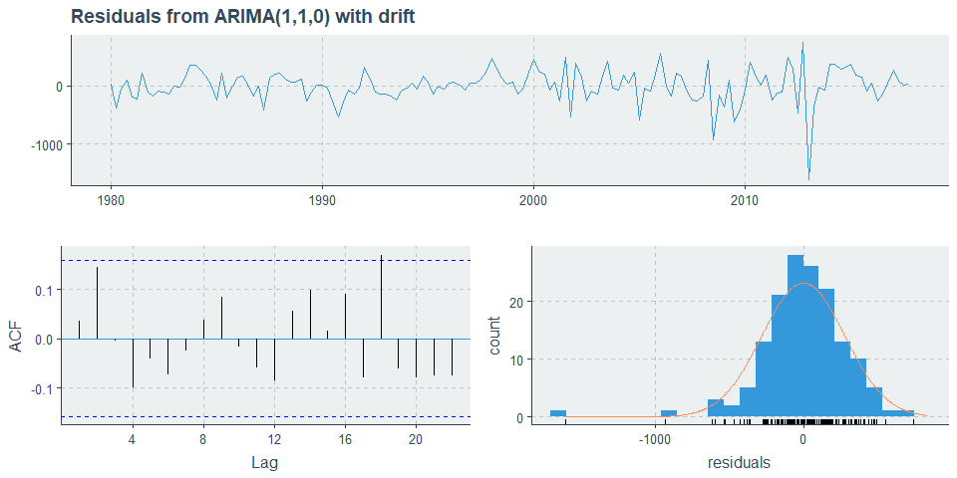
MODEL
UPDATE
Series: fred_disposable_train
ARIMA(1,1,0) with drift
Coefficients:
ar1 drift
-0.2489 142.5335
s.e. 0.0790 18.2321
sigma^2 estimated as 79132: log likelihood=-1064.84
AIC=2135.67 AICc=2135.84 BIC=2144.73
z test of coefficients:
Estimate Std. Error z value Pr(>|z|)
ar1 -0.248912 0.079026 -3.1497 0.001634 **
drift 142.533522 18.232105 7.8177 5.379e-15 ***
---
Signif. codes: 0 ‘***’ 0.001 ‘**’ 0.01 ‘*’ 0.05 ‘.’ 0.1 ‘ ’ 1
Ljung-Box test
data: Residuals from ARIMA(1,1,0) with drift
Q* = 6.4507, df = 6, p-value = 0.3746
Model df: 2. Total lags used: 8
Model recommended by auto.arima() is ARIMA(1,1,0) with drift
Histogram shows reasonable normality for bulk of data but evidence of nontrivial deviation from normality about lower tail
ACF looks like white noise and Ljung-Box test is NSS over 8 lags, indicating residuals are consistent with white noise

Slide 10
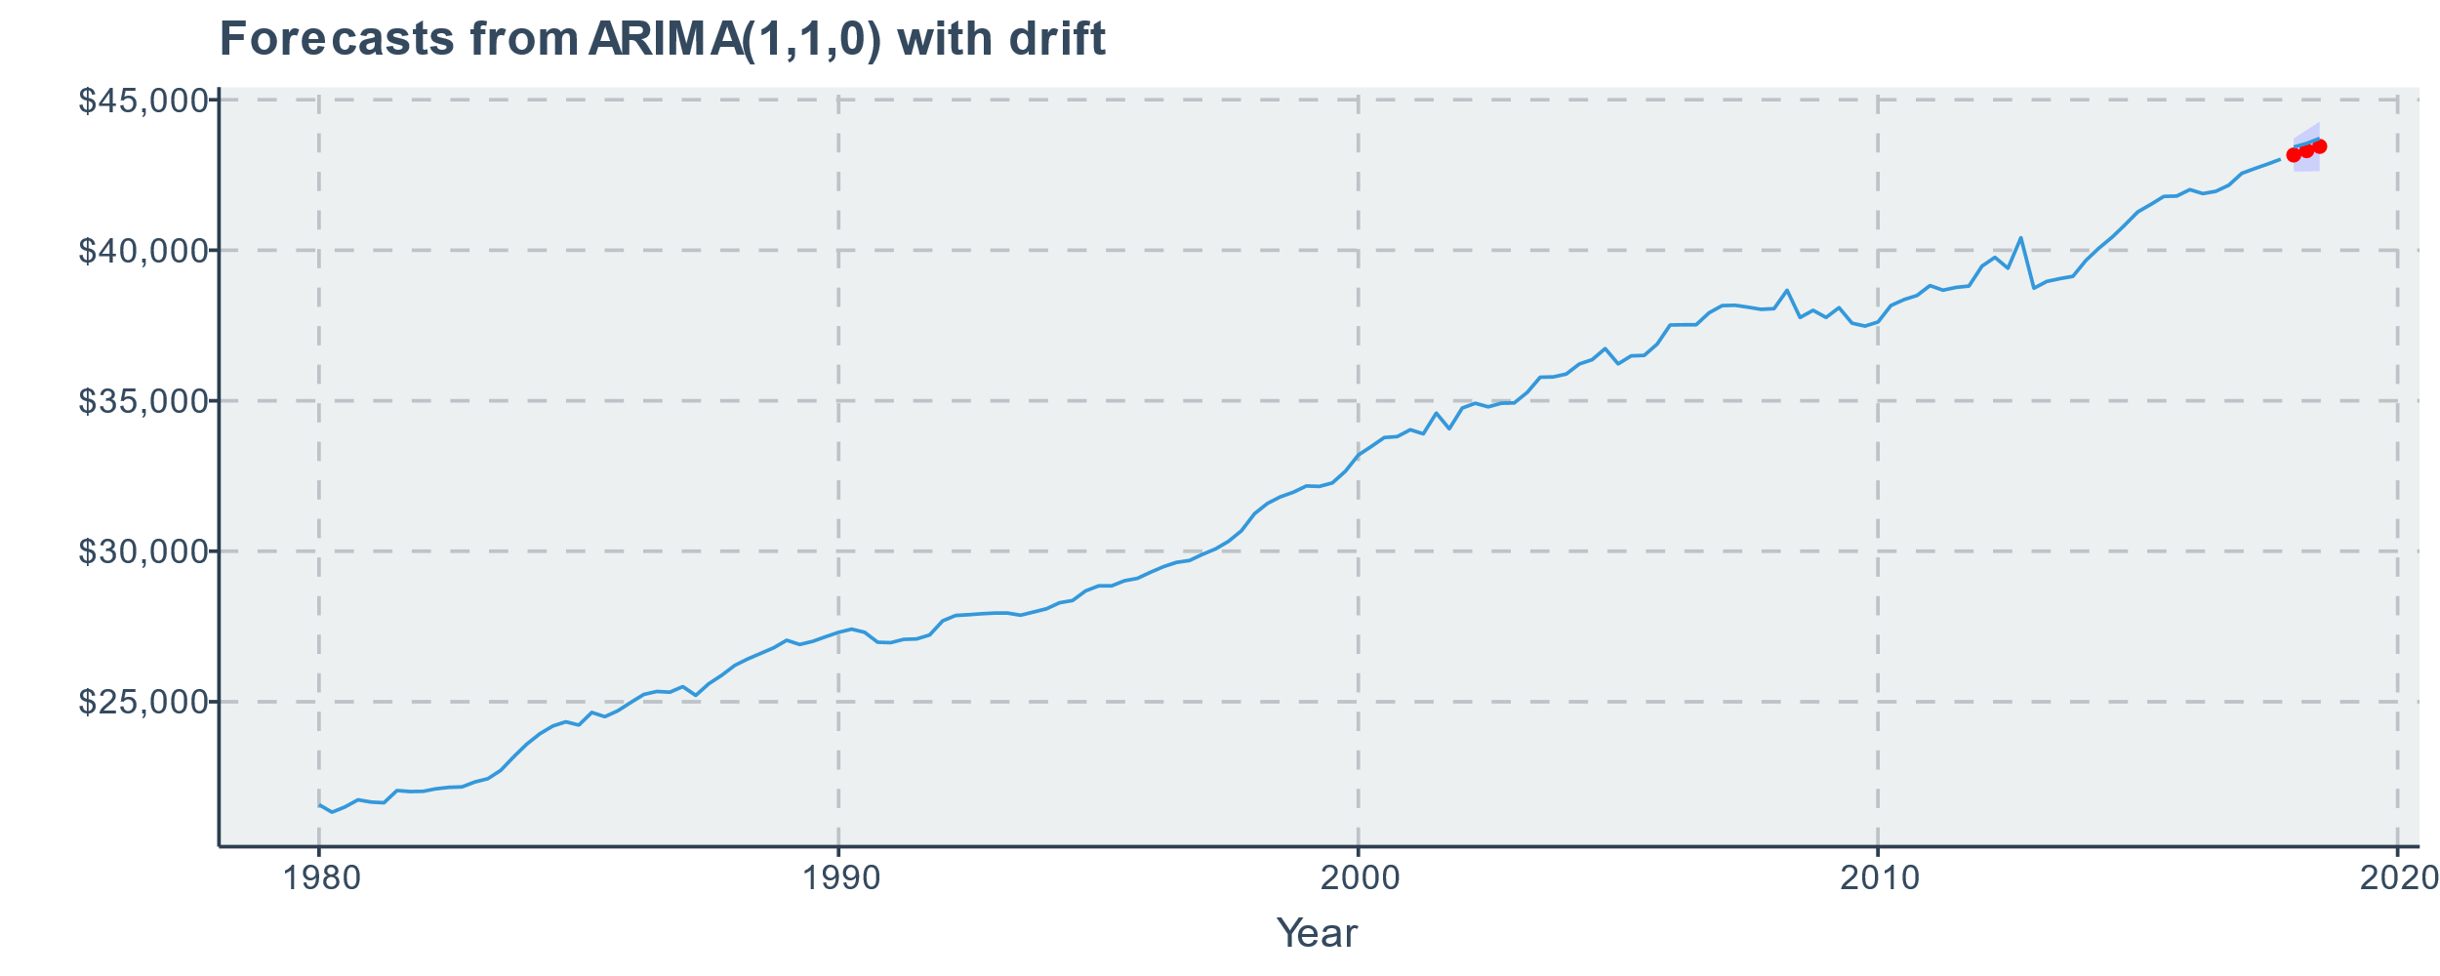

FORECASTS
UPDATE
Predictions are quite good!
Error within 1% in all cases
Predictions are slightly lower than observed values
|Timepoint | Predicted Values| Actual Values| Percent Error|
|:---------|----------------:|-------------:|-------------:|
|Q1 2018 | $43,165| $43,430| -0.61|
|Q2 2018 | $43,309| $43,549| -0.55|
|Q3 2018 | $43,451| $43,718| -0.61|

Slide 11
SAVINGS VS. DEBT
UPDATE

Slide 12
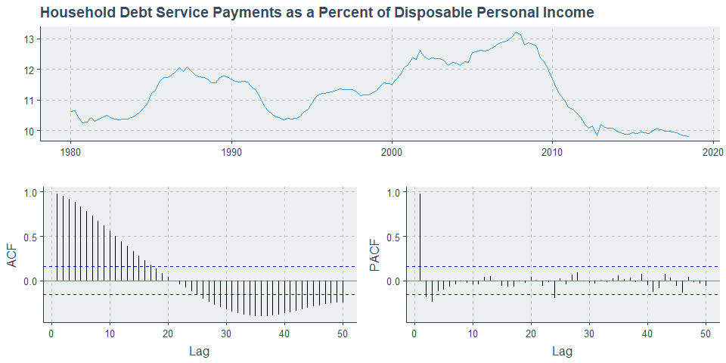
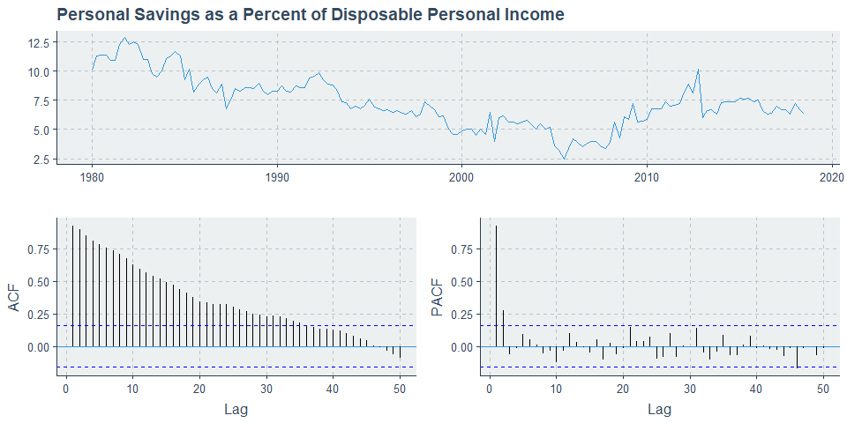
DATA EXPLORATION
UPDATE
Both series clearly require differencing (not shown here)
Rough relationship seen: as debt increases, savings decreases

Slide 13

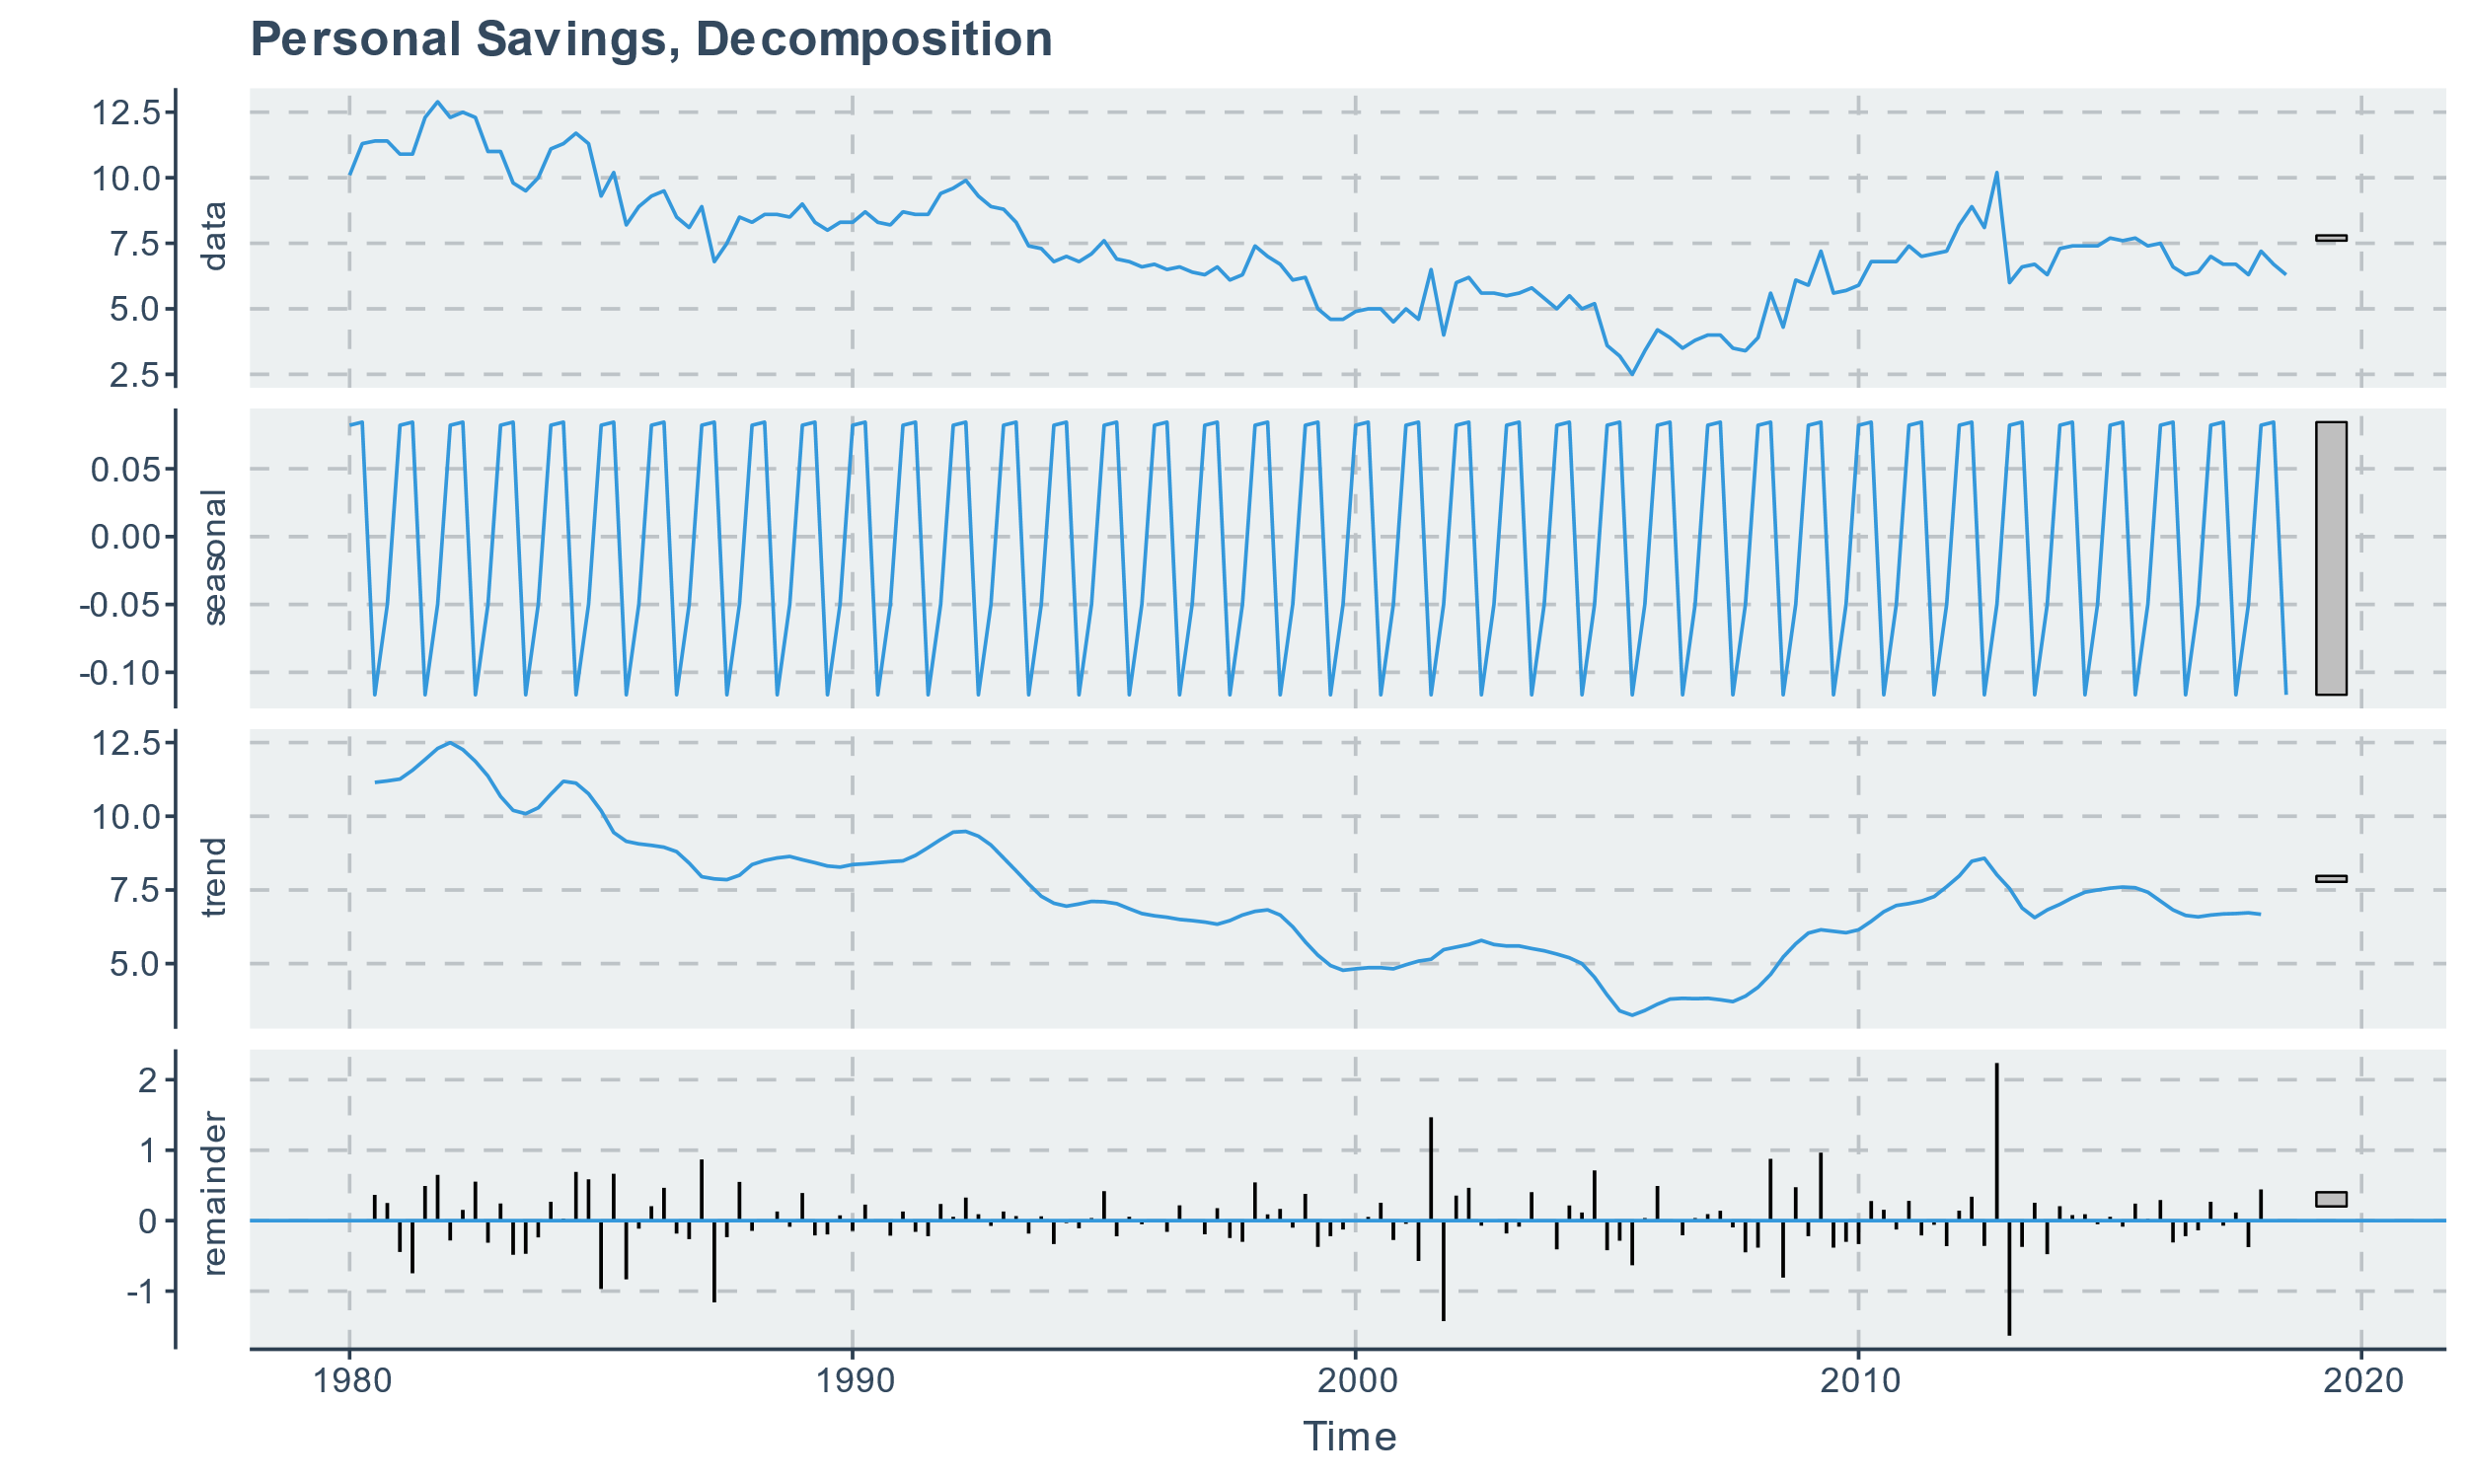
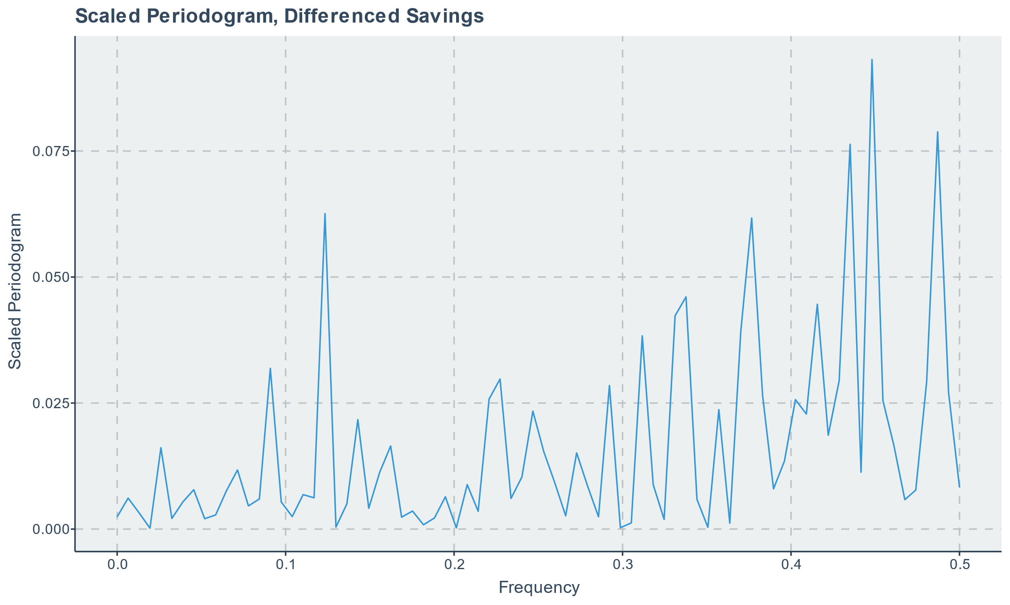
SAVINGS PERIODOGRAM
UPDATE
Of the three decompositions, greatest seasonality was seen in savings data
Small in magnitude compared to scale of savings
Scaled periodogram of differenced savings shows 3 key frequencies
ω₁ = 0.123, ω₂ = 0.377, ω₃ = 0.448 with clustering about ω₃
None of these are expected to be meaningful (data is already seasonally adjusted) so nothing further was done with the frequency domain approach
| Frequency|
|---------:|
| 0.123|
| 0.377|
| 0.435|
| 0.448|
| 0.487|

Slide 14
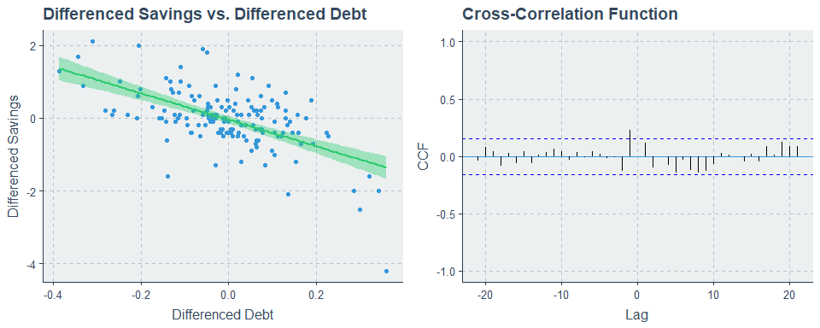
CROSS-CORRELATION
UPDATE
General decrease in differenced savings as differenced debt increases
Nontrivial degree of spread is seen in the plotted points
Cross-correlation seen at lag h=-1
Small in magnitude
Suggests that differenced debt at h=-1 may only be weakly predictive of differenced savings

Slide 15
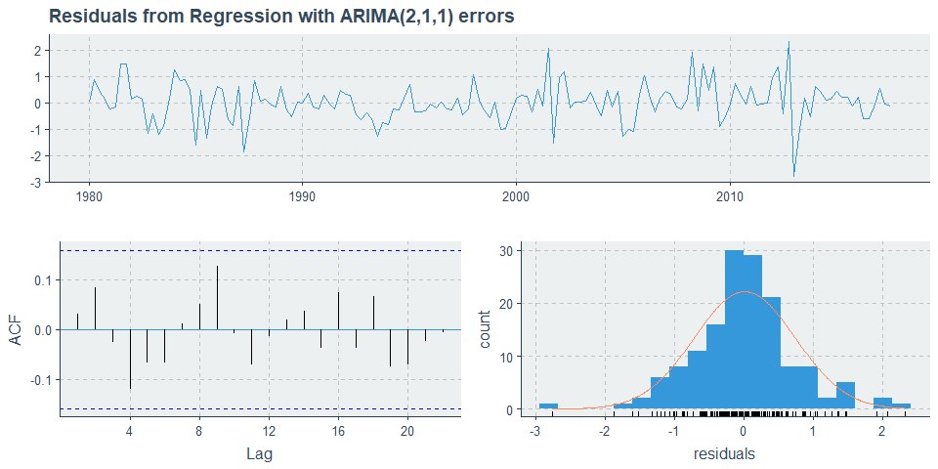
MODEL
UPDATE
Series: savdebt_ts[, 2]
Regression with ARIMA(2,1,1) errors
Coefficients:
ar1 ar2 ma1 drift xreg
0.3977 0.2882 -0.9324 -0.0327 -1.0207
s.e. 0.0971 0.0904 0.0507 0.0139 0.2683
sigma^2 estimated as 0.5494: log likelihood=-165.7
AIC=343.39 AICc=343.98 BIC=361.46
z test of coefficients:
Estimate Std. Error z value Pr(>|z|)
ar1 0.397680 0.097130 4.0943 4.235e-05 ***
ar2 0.288219 0.090370 3.1893 0.0014261 **
ma1 -0.932420 0.050732 -18.3792 < 2.2e-16 ***
drift -0.032696 0.013879 -2.3557 0.0184876 *
xreg -1.020721 0.268268 -3.8049 0.0001419 ***
---
Signif. codes: 0 ‘***’ 0.001 ‘**’ 0.01 ‘*’ 0.05 ‘.’ 0.1 ‘ ’ 1
Ljung-Box test
data: Residuals from Regression with ARIMA(2,1,1) errors
Q* = 5.434, df = 3, p-value = 0.1426
Model df: 5. Total lags used: 8
Model was fit with lagged debt to predict savings (h=-1)
Recommended model was ARIMA(2,1,1) with drift
Includes the needed differencing
Histogram shows reasonable normality for bulk of data with slight deviation from normality at tails
ACF looks like white noise and Ljung-Box test is NSS over 8 lags, thus residuals are consistent with white noise

Slide 16
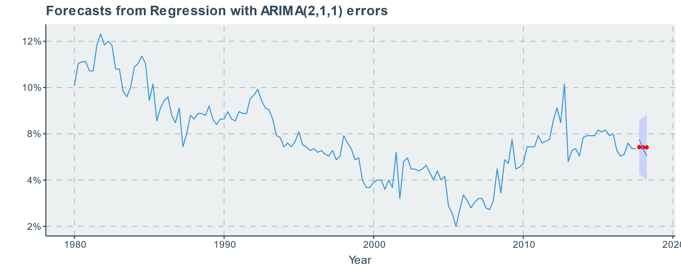
FORECASTS
UPDATE
Predictions are acceptable but not great, consistent with expectations per CCF plot
Error ranges from ~1% to ~7.5% in magnitude
Observed values are within 95% PI
Local volatility results in poorer predictions
|Timepoint | Predicted Values| Actual Values| Percent Error|
|:---------|----------------:|-------------:|-------------:|
|Q4 2017 | 6.78| 7.2| -5.83|
|Q1 2018 | 6.77| 6.7| 1.04|
|Q2 2018 | 6.77| 6.3| 7.46|

Slide 17
DISCUSSION
UPDATE
Model for disposable personal income worked very well for forecasting
Model for savings vs. debt worked reasonably well for forecasting
Suggests another predictor may be needed
Consider including a predictor for nonessential spending (e.g., recreation, dining out)
Smoothing may help improve predictions when they occur at turning points

Slide 18
LIMITATIONS
UPDATE
Data was already seasonally adjusted when it was obtained
Limits ability to incorporate additional datapoints when they become available
Data is not static, therefore not wise to simply gather future datapoints and compare to predicted values (not really an apples-to-apples comparison)
Limits usefulness of frequency approach
Some seasonality remained in each TS, but it was of diminishing magnitude in comparison to scale of raw data
Periodogram was predictably uninteresting

Slide 19
CONCLUSION
UPDATE
Forecasting works well when a strong trend is seen
Forecasting with a lagged predictor may perform acceptably but not well when data is locally volatile and/or when CCF plot shows a weak cross-correlation
Time series analysis toolset provided by forecast package is easy to use, well documented, and plays nicely with established tidyverse syntax and functions

Slide 20
REFERENCES
FINISH UPDATING
Selected health conditions and risk factors, by age: United States, selected years 1988-1994 through 2015-2016. Centers for Disease Control and Prevention. Health, United States, 2017: Trend Tables. https://www.cdc.gov/nchs/data/hus/2017/053.pdf.
Defining Adult Overweight and Obesity. Centers for Disease Control and Prevention. https://www.cdc.gov/obesity/adult/defining.html. Updated April 11, 2017.
Hruby A, Hu FB. The Epidemiology of Obesity: A Big Picture. Pharmacoeconomics. 2015;33(7):673-89. doi:10.1007/s40273-014-0243-x.
Li Q, Blume SW, Huang JC, Hammer M, Ganz ML. Prevalence and healthcare costs of obesity-related comorbidities: evidence from an electronic medical records system in the United States. J Med Econ. 2015;18(12):1020-8. doi: 10.3111/13696998.2015.1067623.
Animation of U.S. Obesity Trends by State, 1985-2008 (%of people with BMI >30). Original data and visualizations by Centers for Disease Control and Prevention. Wikimedia Commons. https://commons.wikimedia.org/wiki/File:CDC_Overweight_and_Obesity_map3.gif.
(OLD HEREAFTER)Hyndman R, Athanasopoulos G, Bergmeir C, Caceres G, Chhay L, O'Hara-Wild M, Petropoulos F, Razbash S, Wang E, Yasmeen F. 2019. “forecast: Forecasting functions for time series and linear models.” R package version 8.5. http://pkg.robjhyndman.com/forecast.
Federal Reserve Bank of St. Louis. 2018. “Household Debt Service Payments as a Percent of Disposable Personal Income.” https://fred.stlouisfed.org/series/TDSP.
Federal Reserve Bank of St. Louis. 2018. “Real Disposable Personal Income – Per Capita.” https://fred.stlouisfed.org/series/A229RX0Q048SBEA.
Federal Reserve Bank of St. Louis. 2018. “Personal Saving as a Percent of Disposable Personal Income.” https://fred.stlouisfed.org/series/A072RC1Q156SBEA.

Slide 21

QUESTIONS?
Full project code available on GitHub: https://github.com/kmprioliPROF/CSC_8515_Final_Project

