Slide 1
Disposable Income, Debt, and Savings: Q1 1980 – Q3 2018
Katherine M. Prioli
MAT 8444 Final Project
May 08, 2019

Slide 2
BACKGROUND
Americans are on average spending more and saving less over the past decade.
As of the fourth quarter 2018, total household debt in the United States has hit a ten-year high at $869B.¹
As debt increases, so does household spending, up from $9.7M in 2008 to $12.9M in 2017.²
Total household savings is on the decline, decreasing from 9.1% in 2012 to 6.9% in 2017.³
Wages have increased modestly during this time, and appears largely attributable to inflation.⁴

Slide 3
OBJECTIVES
Analyze US household real per-capita disposable income, debt service payments, and personal savings over time
Understand trends in personal disposable income
Determine whether savings can accurately be predicted from debt
Use tidyverse-friendly tooling where possible (e.g., forecast package)

Slide 4
THE DATA
VARIABLE | DESCRIPTION
fred_disposable | Per-capita disposable income, adjusted for inflation in chained $US 2012, seasonally adjusted
fred_debt | Household debt service payments as a percent of disposable personal income, seasonally adjusted
fred_savings | Personal saving as a percentage of disposable personal income, seasonally adjusted
All variables were obtained from the Federal Reserve Bank of St. Louis
All share a common year of valuation ($US 2012)
All subset to common time horizon (Q1 1980 through Q3 2018)
155 observations in each TS

Slide 5
METHODS
Two analyses:
Disposable income
Savings vs. debt
Stages to each analysis:
Explore the data
ggtsdisplay()
Decomposition
CCF
Scaled periodogram
Model the data through Q3 2017
auto.arima(), Arima(), checkresiduals() , and coeftest()
Make predictions for Q1 2018 – Q3 2018 and check against known values
forecast()

Slide 6
DISPOSABLE INCOME

Slide 7
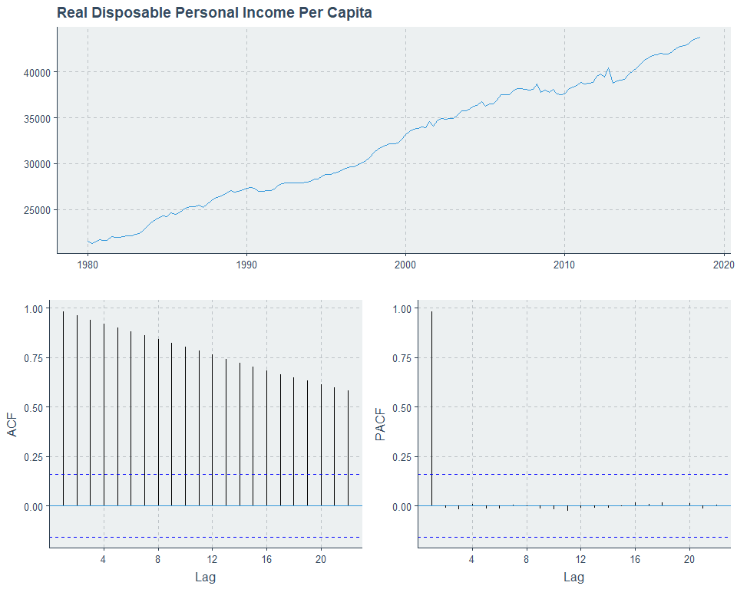
DATA EXPLORATION

Slide 8
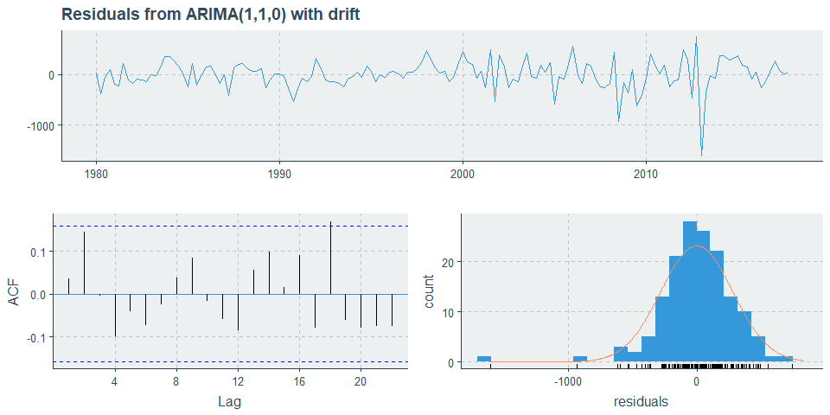
MODEL
Series: fred_disposable_train
ARIMA(1,1,0) with drift
Coefficients:
ar1 drift
-0.2489 142.5335
s.e. 0.0790 18.2321
sigma^2 estimated as 79132: log likelihood=-1064.84
AIC=2135.67 AICc=2135.84 BIC=2144.73
z test of coefficients:
Estimate Std. Error z value Pr(>|z|)
ar1 -0.248912 0.079026 -3.1497 0.001634 **
drift 142.533522 18.232105 7.8177 5.379e-15 ***
---
Signif. codes: 0 ‘***’ 0.001 ‘**’ 0.01 ‘*’ 0.05 ‘.’ 0.1 ‘ ’ 1
Ljung-Box test
data: Residuals from ARIMA(1,1,0) with drift
Q* = 6.4507, df = 6, p-value = 0.3746
Model df: 2. Total lags used: 8
ACF looks like white noise
Histogram shows reasonable normality for bulk of data but evidence of some nonnormality about tails
Ljung-Box test is NSS

Slide 9
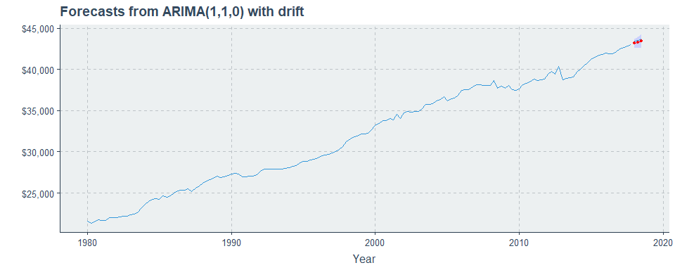

FORECASTS
Predictions are quite good!
Percent error within 1% of observed values in all cases
Predictions are slightly lower than observed values
|Timepoint | Predicted Values| Actual Values| Percent Error|
|:---------|----------------:|-------------:|-------------:|
|Q1 2018 | $43,165| $43,430| -0.61|
|Q2 2018 | $43,309| $43,549| -0.55|
|Q3 2018 | $43,451| $43,718| -0.61|

Slide 10
SAVINGS VS. DEBT

Slide 11
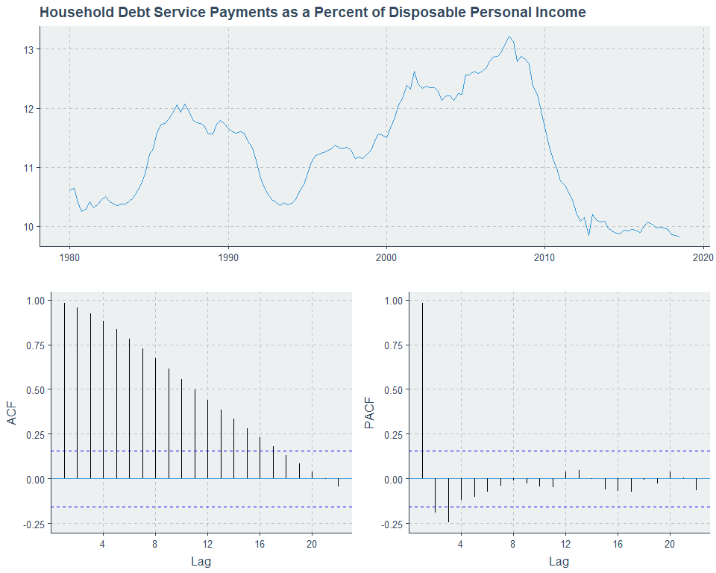
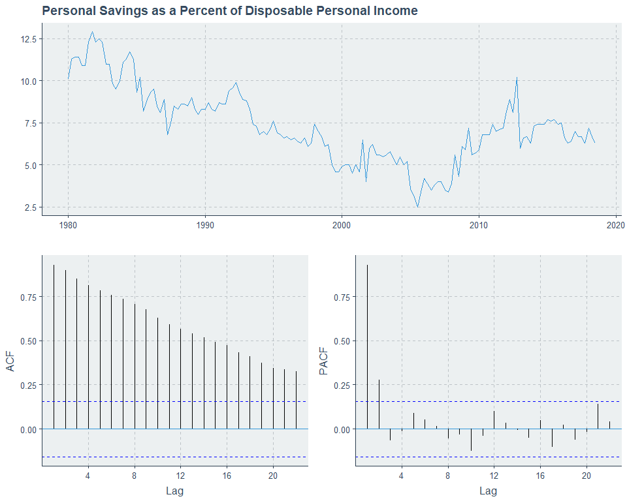
DATA EXPLORATION

Slide 12
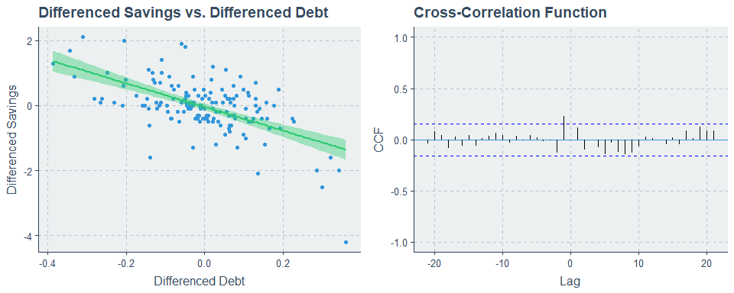
CROSS-CORRELATION
General decrease in differenced savings as differenced debt increases
Nontrivial degree of spread is seen in the plotted points
Cross-correlation seen at lag h=-1
Small in magnitude
Suggests that differenced debt at h=-1 may only be weakly predictive of differenced savings

Slide 13
HEADING

Slide 14
DISCUSSION
Text

Slide 15
LIMITATIONS
Text

Slide 16
CONCLUSION
Text

Slide 17

QUESTIONS?
Full project code available on GitHub:
https://github.com/kmprioliPROF/MAT_8444_Final_Project

Slide 18
REFERENCES
Federal Reserve Bank of New York Center for Microeconomic Data. 2019. “Quarterly Report on Household Debt and Credit: 2018 Q4.” https://www.newyorkfed.org/medialibrary/interactives/householdcredit/data/pdf//HHDC_2018Q4.pdf.
Organisation for Economic Co-operation and Development. 2018. “Household Spending.” https://data.oecd.org/hha/household-spending.htm.
Organisation for Economic Co-operation and Development. 2018. “Household Savings.” https://data.oecd.org/hha/household-savings.htm.
Federal Reserve Bank of St. Louis. 2016. “Consumer Price Index: Total All Items for the United States.” https://fred.stlouisfed.org/series/CPALTT01USM661S.
Federal Reserve Bank of St. Louis. 2018. “Household Debt Service Payments as a Percent of Disposable Personal Income.” https://fred.stlouisfed.org/series/TDSP.
Federal Reserve Bank of St. Louis. 2018. “Real Disposable Personal Income – Per Capita.” https://fred.stlouisfed.org/series/A229RX0Q048SBEA.
Federal Reserve Bank of St. Louis. 2018. “Personal Saving as a Percent of Disposable Personal Income.” https://fred.stlouisfed.org/series/A072RC1Q156SBEA.

