Slide 1
Disposable Income, Debt, and Savings: Q1 1980 – Q3 2018
Katherine M. Prioli
MAT 8444 Final Project
May 08, 2019

Slide 2
BACKGROUND
Text

Slide 3
OBJECTIVE
Text

Slide 4
METHODS
Two stages to the analysis:
Explore the data
Text
Text

Slide 5
THE DATA
VARIABLE | DESCRIPTION
fred_disposable | Per-capita disposable income, adjusted for inflation in chained $US 2012, seasonally adjusted
fred_debt | Household debt service payments as a percent of disposable personal income, seasonally adjusted
fred_savings | Personal saving as a percentage of disposable personal income, seasonally adjusted
All variables were obtained from the Federal Reserve Bank of St. Louis
All share a common year of valuation ($US 2012)

Slide 6
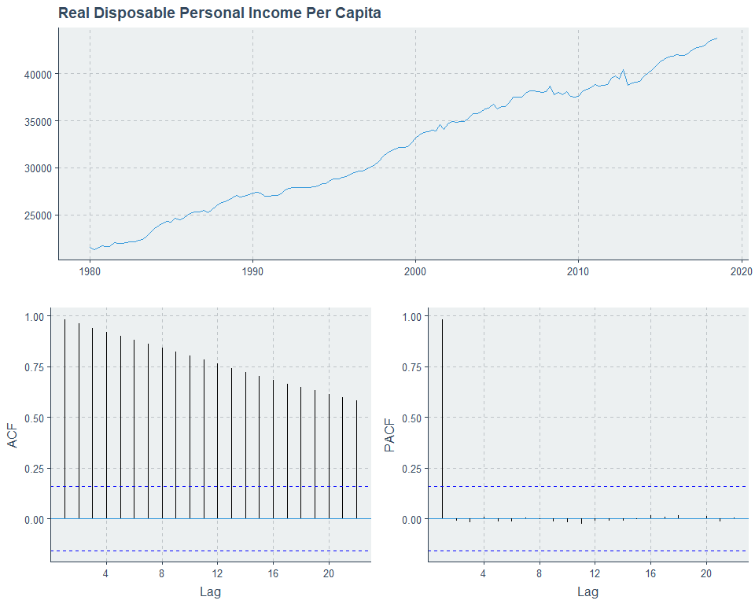
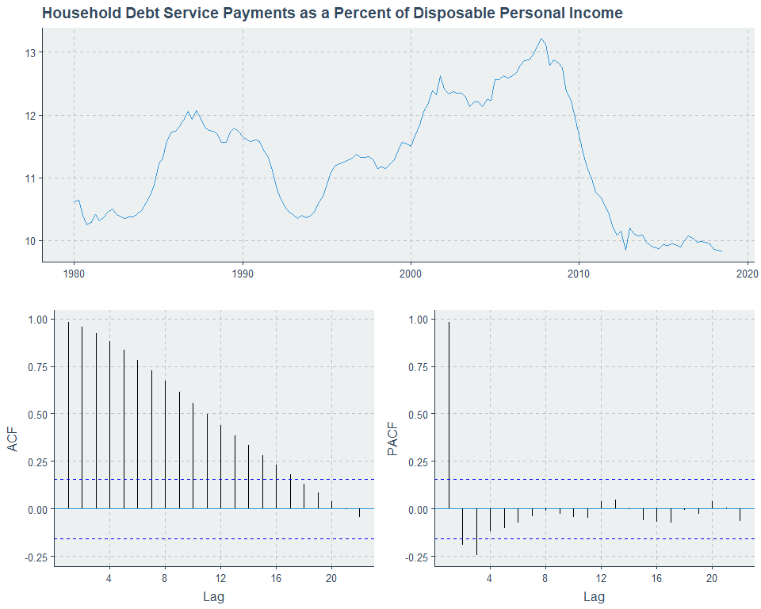
DATA EXPLORATION

Slide 7
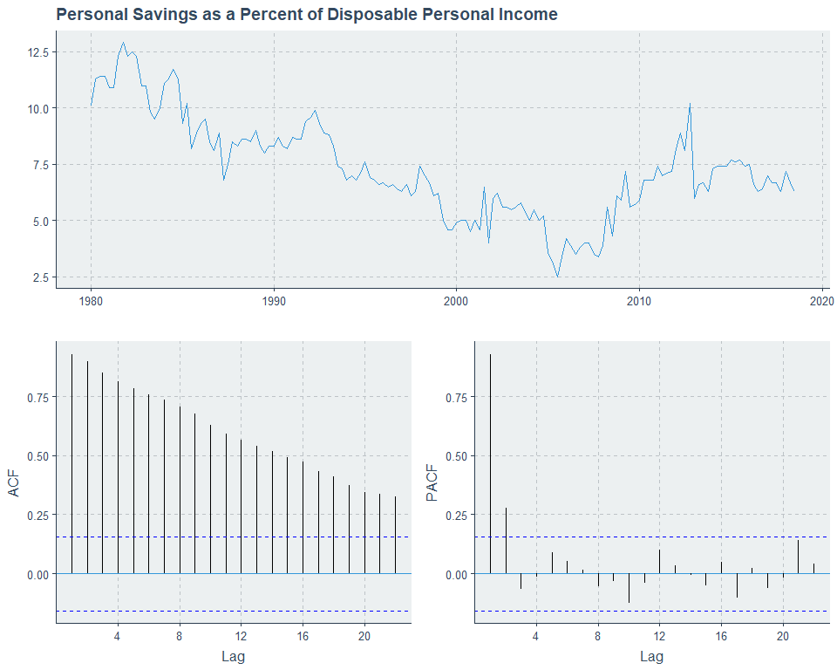
DATA EXPLORATION

Slide 8
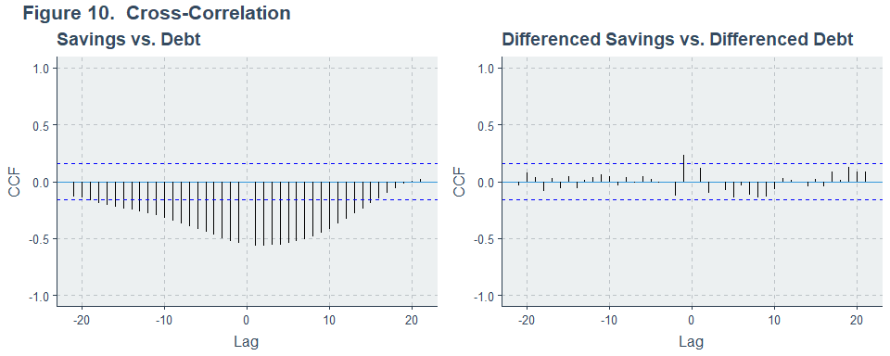
CROSS-CORRELATION

Slide 9
ANALYSES PERFORMED

Slide 10
HEADING
Text and code block
n <- length(alldata$HDIindex)
nBS <- 1000
set.seed(19811221)
BSout <- tibble(BSmean = numeric())
for(bs in 1:nBS){
bsHDIindex <- sample(alldata$HDIindex, n, replace = TRUE)
BSout[bs, 1] <- mean(bsHDIindex)
}
meanCI_BS <- tibble(CI_low = numeric(),
CI_high = numeric(),
width = numeric())
meanCI_BS[1, 1] <- round(quantile(BSout$BSmean, 0.025), digits = 4)
meanCI_BS[1, 2] <- round(quantile(BSout$BSmean, 0.975), digits = 4)
meanCI_BS$width = meanCI_BS$CI_high - meanCI_BS$CI_low
analysis1_nonpara <- meanCI_BS

Slide 11
DISCUSSION
Text

Slide 12
LIMITATIONS
Text

Slide 13
CONCLUSION
Text

Slide 14

QUESTIONS?
Full project code available on GitHub:
https://github.com/kmprioliPROF/MAT_8444_Final_Project

Slide 15
REFERENCES
Helliwell, John F., Richard Layard, and Jeffrey D. Sachs. 2018. “World Happiness Report.” http://worldhappiness.report/ed/2018/.
James, Gareth, Daniela Witten, Trevor Hastie, and Robert Tibshirani. 2013. “An Introduction to Statistical Learning.” Springer. https://www-bcf.usc.edu/~gareth/ISL/.
Murphy, Sherry L., Jiaquan Xu, Kenneth D. Kochanek, and Elizabeth Arias. 2018. “Mortality in the United States, 2017. NCHS Data Brief, No 328.” National Center for Health Statistics. https://www.cdc.gov/nchs/products/databriefs/db328.htm.
Prioli, Katherine M. 2018. “MAT_8790_Final_Project.” https://github.com/kmprioliPROF/MAT_8790_Final_Project.
Social Progress Imperative. 2018. “Social Progress Index.” https://www.socialprogress.org/?tab=4.
The United Nations Development Programme. 2018. “Human Development Index.” http://hdr.undp.org/en/data.
The World Bank. 2018. “Gross Domestic Product.” https://data.worldbank.org/indicator/ny.gdp.mktp.cd?view=map&year_high_desc=true.
World Economic Forum. 2016. “Gender Equality.” http://reports.weforum.org/global-gender-gap-report-2016/rankings/.
World Health Organization. 2018a. “Life Expectancy.” http://apps.who.int/gho/data/view.main.SDG2016LEXv?lang=en.
World Health Organization. 2018b. “Probability of Dying Per 1000 Live Births.” http://apps.who.int/gho/data/view.main.182?lang=en.

