Slide 1
Disposable Income, Debt, and Savings: Q1 1980 – Q3 2018
Katherine M. Prioli
MAT 8444 Final Project
May 08, 2019

Slide 2
BACKGROUND
Text

Slide 3
OBJECTIVE
Analyze US household debt service payments and personal savings as they relate to real per-capita disposable income over time
Use tidyverse-friendly tooling where possible (e.g., forecast package)

Slide 4
THE DATA
VARIABLE | DESCRIPTION
fred_disposable | Per-capita disposable income, adjusted for inflation in chained $US 2012, seasonally adjusted
fred_debt | Household debt service payments as a percent of disposable personal income, seasonally adjusted
fred_savings | Personal saving as a percentage of disposable personal income, seasonally adjusted
All variables were obtained from the Federal Reserve Bank of St. Louis
All share a common year of valuation ($US 2012)
All subset to common time horizon (Q1 1980 through Q3 2018)
155 observations in each TS

Slide 5
METHODS
Stages to the analysis:
Explore the data
ggtsdisplay()
Decomposition
CCF
Model the data through Q3 2017
auto.arima(), Arima(), and checkresiduals()
Predictions for Q1 2018 – Q3 2018
forecast()

Slide 6
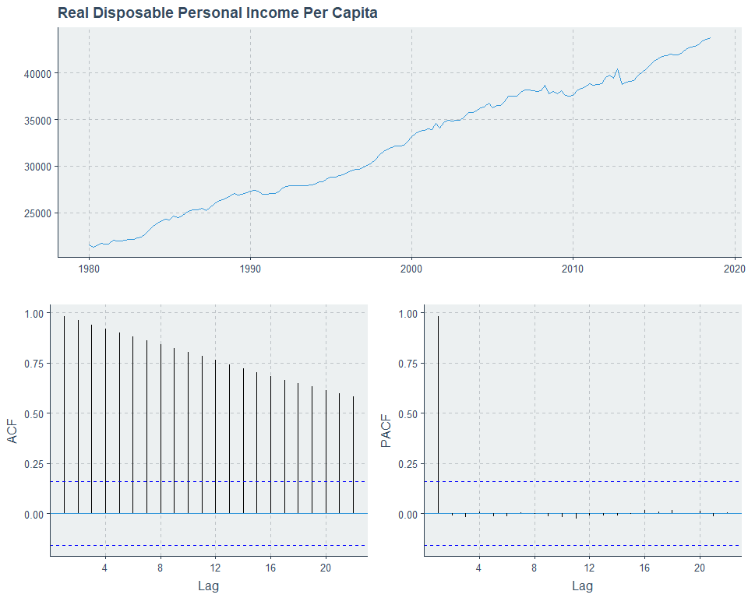
DATA EXPLORATION

Slide 7
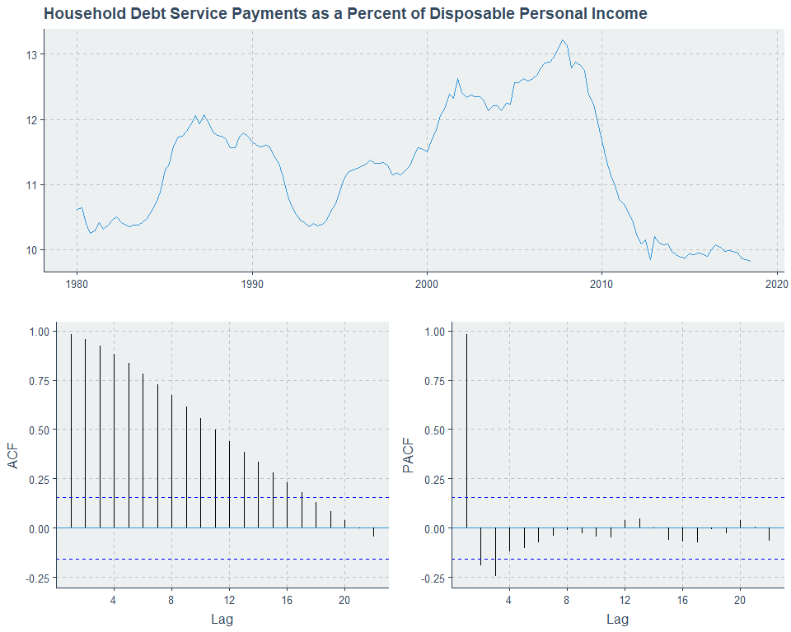
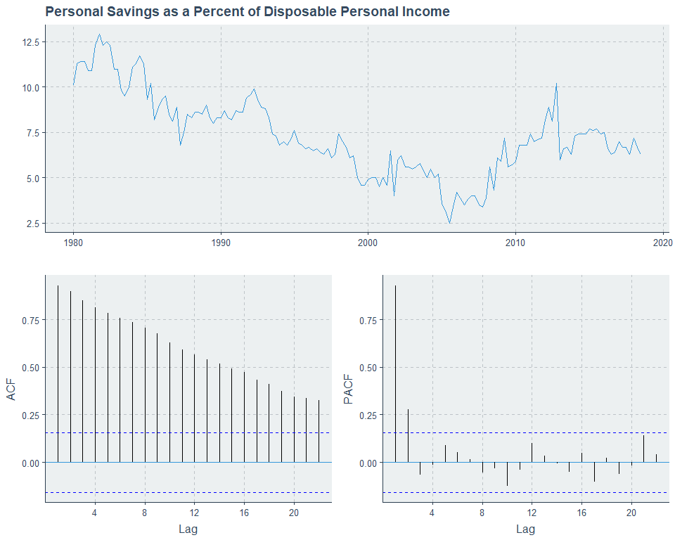
DATA EXPLORATION

Slide 8
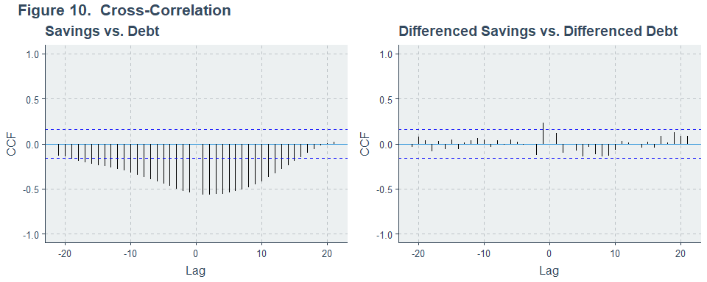
CROSS-CORRELATION

Slide 9
HEADING

Slide 10
HEADING
Text and code block
n <- length(alldata$HDIindex)
nBS <- 1000
set.seed(19811221)
BSout <- tibble(BSmean = numeric())
for(bs in 1:nBS){
bsHDIindex <- sample(alldata$HDIindex, n, replace = TRUE)
BSout[bs, 1] <- mean(bsHDIindex)
}
meanCI_BS <- tibble(CI_low = numeric(),
CI_high = numeric(),
width = numeric())
meanCI_BS[1, 1] <- round(quantile(BSout$BSmean, 0.025), digits = 4)
meanCI_BS[1, 2] <- round(quantile(BSout$BSmean, 0.975), digits = 4)
meanCI_BS$width = meanCI_BS$CI_high - meanCI_BS$CI_low
analysis1_nonpara <- meanCI_BS

Slide 11
DISCUSSION
Text

Slide 12
LIMITATIONS
Text

Slide 13
CONCLUSION
Text

Slide 14

QUESTIONS?
Full project code available on GitHub:
https://github.com/kmprioliPROF/MAT_8444_Final_Project

Slide 15
REFERENCES
Federal Reserve Bank of St. Louis. 2018. “Household Debt Service Payments as a Percent of Disposable Personal Income.” https://fred.stlouisfed.org/series/TDSP.
Federal Reserve Bank of St. Louis. 2018. “Real Disposable Personal Income – Per Capita.” https://fred.stlouisfed.org/series/A229RX0Q048SBEA.
Federal Reserve Bank of St. Louis. 2018. “Personal Saving as a Percent of Disposable Personal Income.” https://fred.stlouisfed.org/series/A072RC1Q156SBEA.

