Slide 1
Disposable Income, Debt, and Savings: Q1 1980 – Q3 2018
Katherine M. Prioli
MAT 8444 Final Project
May 08, 2019

Slide 2
BACKGROUND
Americans are on average spending more and saving less over the past decade.
As of the fourth quarter 2018, total household debt in the United States has hit a ten-year high at $869B.¹
As debt increases, so does household spending, up from $9.7M in 2008 to $12.9M in 2017.²
Total household savings is on the decline, decreasing from 9.1% in 2012 to 6.9% in 2017.³
Wages have increased only modestly during this time, and appears largely attributable to inflation.⁴

Slide 3
OBJECTIVES
Analyze US household real per-capita disposable income, debt service payments, and personal savings over time
Understand trends in personal disposable income
Determine whether savings can accurately be predicted from debt
Use tidyverse-friendly tooling where possible (e.g., forecast package⁵)

Slide 4
THE DATA
VARIABLE | DESCRIPTION
fred_disposable | Per-capita disposable income, adjusted for inflation in chained $US 2012, seasonally adjusted⁶
fred_debt | Household debt service payments as a percent of disposable personal income, seasonally adjusted⁷
fred_savings | Personal saving as a percentage of disposable personal income, seasonally adjusted⁸
All variables were obtained from the Federal Reserve Bank of St. Louis
All share a common year of valuation ($US 2012)
All are already seasonally adjusted
All three TS were subset to common time horizon (Q1 1980 through Q3 2018)
155 observations in each TS

Slide 5
METHODS
Two analyses:
Disposable income
Savings vs. debt
Stages to each analysis:
Explore the data
​ggtsdisplay()
Decomposition
Scaled periodogram
CCF
Model the data leaving out last 3 observations
​auto.arima(), Arima(), lmtest::coeftest(), and checkresiduals()
Make predictions for last 3 observations and check against known values
​forecast()

Slide 6
DISPOSABLE INCOME

Slide 7
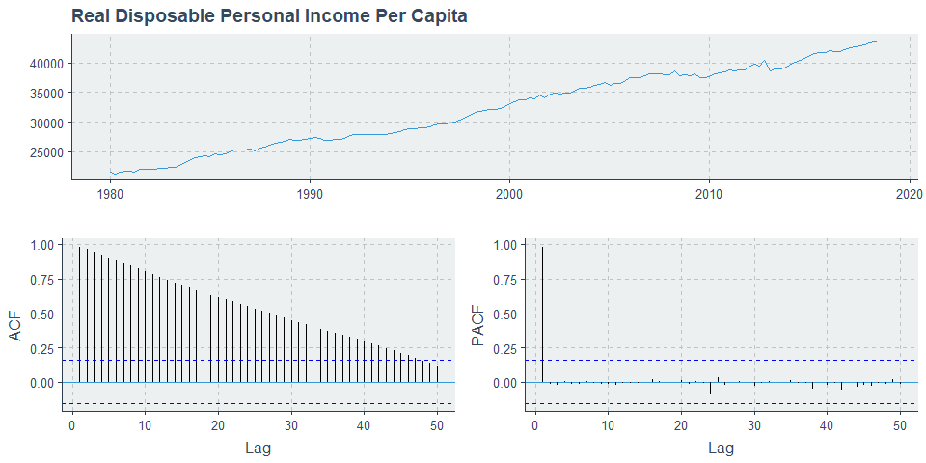
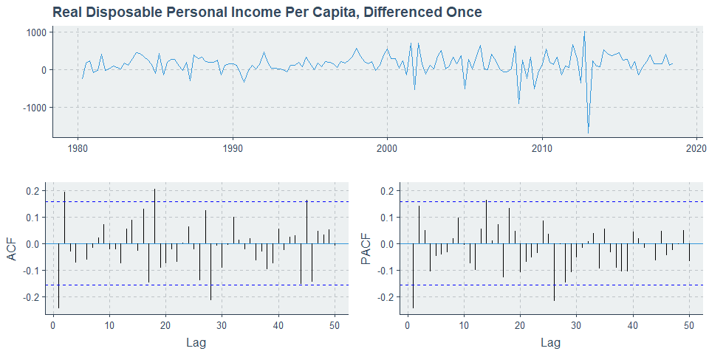
DATA EXPLORATION
Raw data shows clear increasing trend without any obvious seasonality
ACF plot suggests differencing is needed
After differencing, series appears stationary
AR(1) may be appropriate

Slide 8
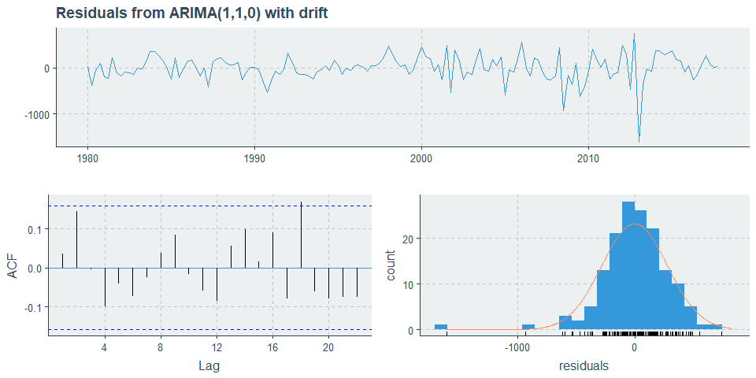
MODEL
Series: fred_disposable_train
ARIMA(1,1,0) with drift
Coefficients:
ar1 drift
-0.2489 142.5335
s.e. 0.0790 18.2321
sigma^2 estimated as 79132: log likelihood=-1064.84
AIC=2135.67 AICc=2135.84 BIC=2144.73
z test of coefficients:
Estimate Std. Error z value Pr(>|z|)
ar1 -0.248912 0.079026 -3.1497 0.001634 **
drift 142.533522 18.232105 7.8177 5.379e-15 ***
---
Signif. codes: 0 ‘***’ 0.001 ‘**’ 0.01 ‘*’ 0.05 ‘.’ 0.1 ‘ ’ 1
Ljung-Box test
data: Residuals from ARIMA(1,1,0) with drift
Q* = 6.4507, df = 6, p-value = 0.3746
Model df: 2. Total lags used: 8
Model recommended by auto.arima() is ARIMA(1,1,0) with drift
Histogram shows reasonable normality for bulk of data but evidence of nontrivial deviation from normality about lower tail
ACF looks like white noise and Ljung-Box test is NSS over 8 lags, indicating residuals are consistent with white noise

Slide 9
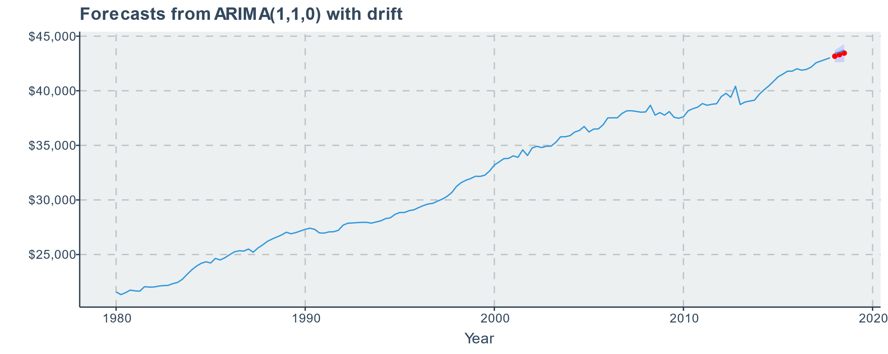

FORECASTS
Predictions are quite good!
Error within 1% in all cases
Predictions are slightly lower than observed values
|Timepoint | Predicted Values| Actual Values| Percent Error|
|:---------|----------------:|-------------:|-------------:|
|Q1 2018 | $43,165| $43,430| -0.61|
|Q2 2018 | $43,309| $43,549| -0.55|
|Q3 2018 | $43,451| $43,718| -0.61|

Slide 10
SAVINGS VS. DEBT

Slide 11
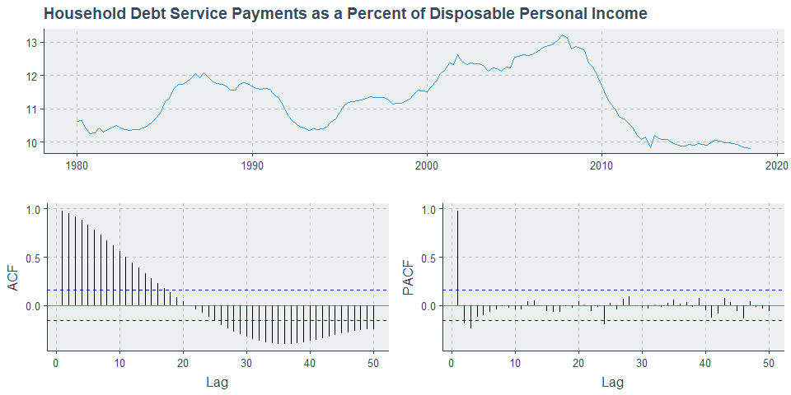
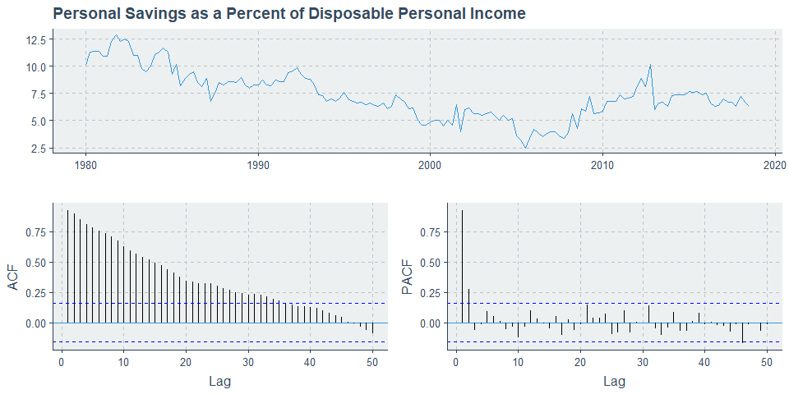
DATA EXPLORATION
Both series clearly require differencing (not shown here)
Rough relationship seen: as debt increases, savings decreases

Slide 12

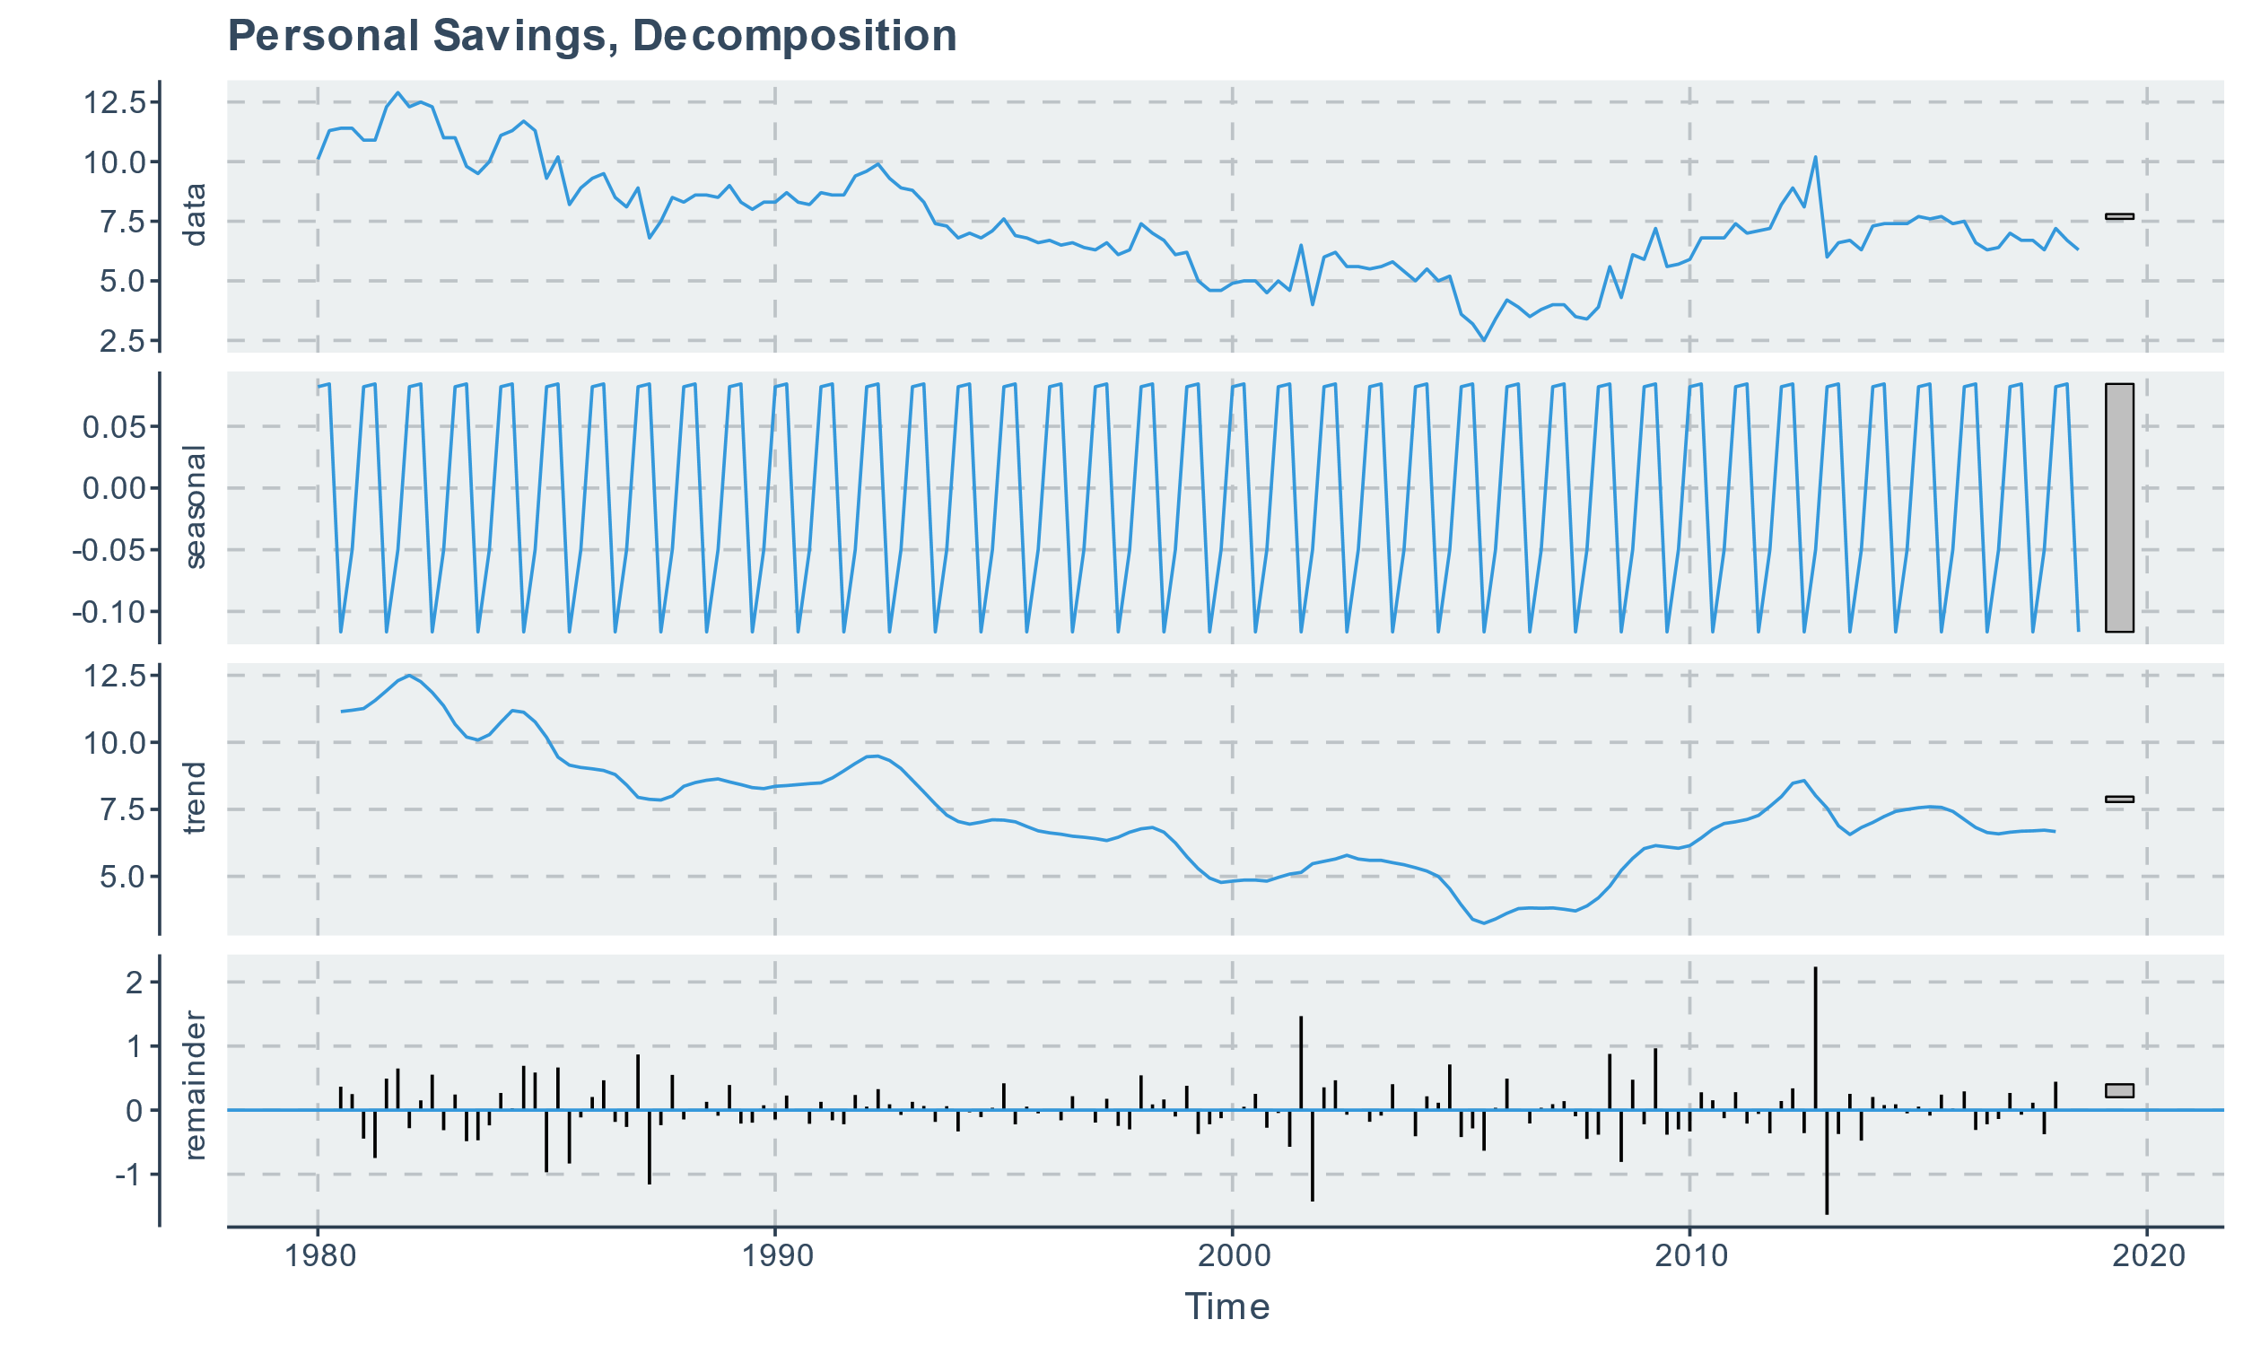
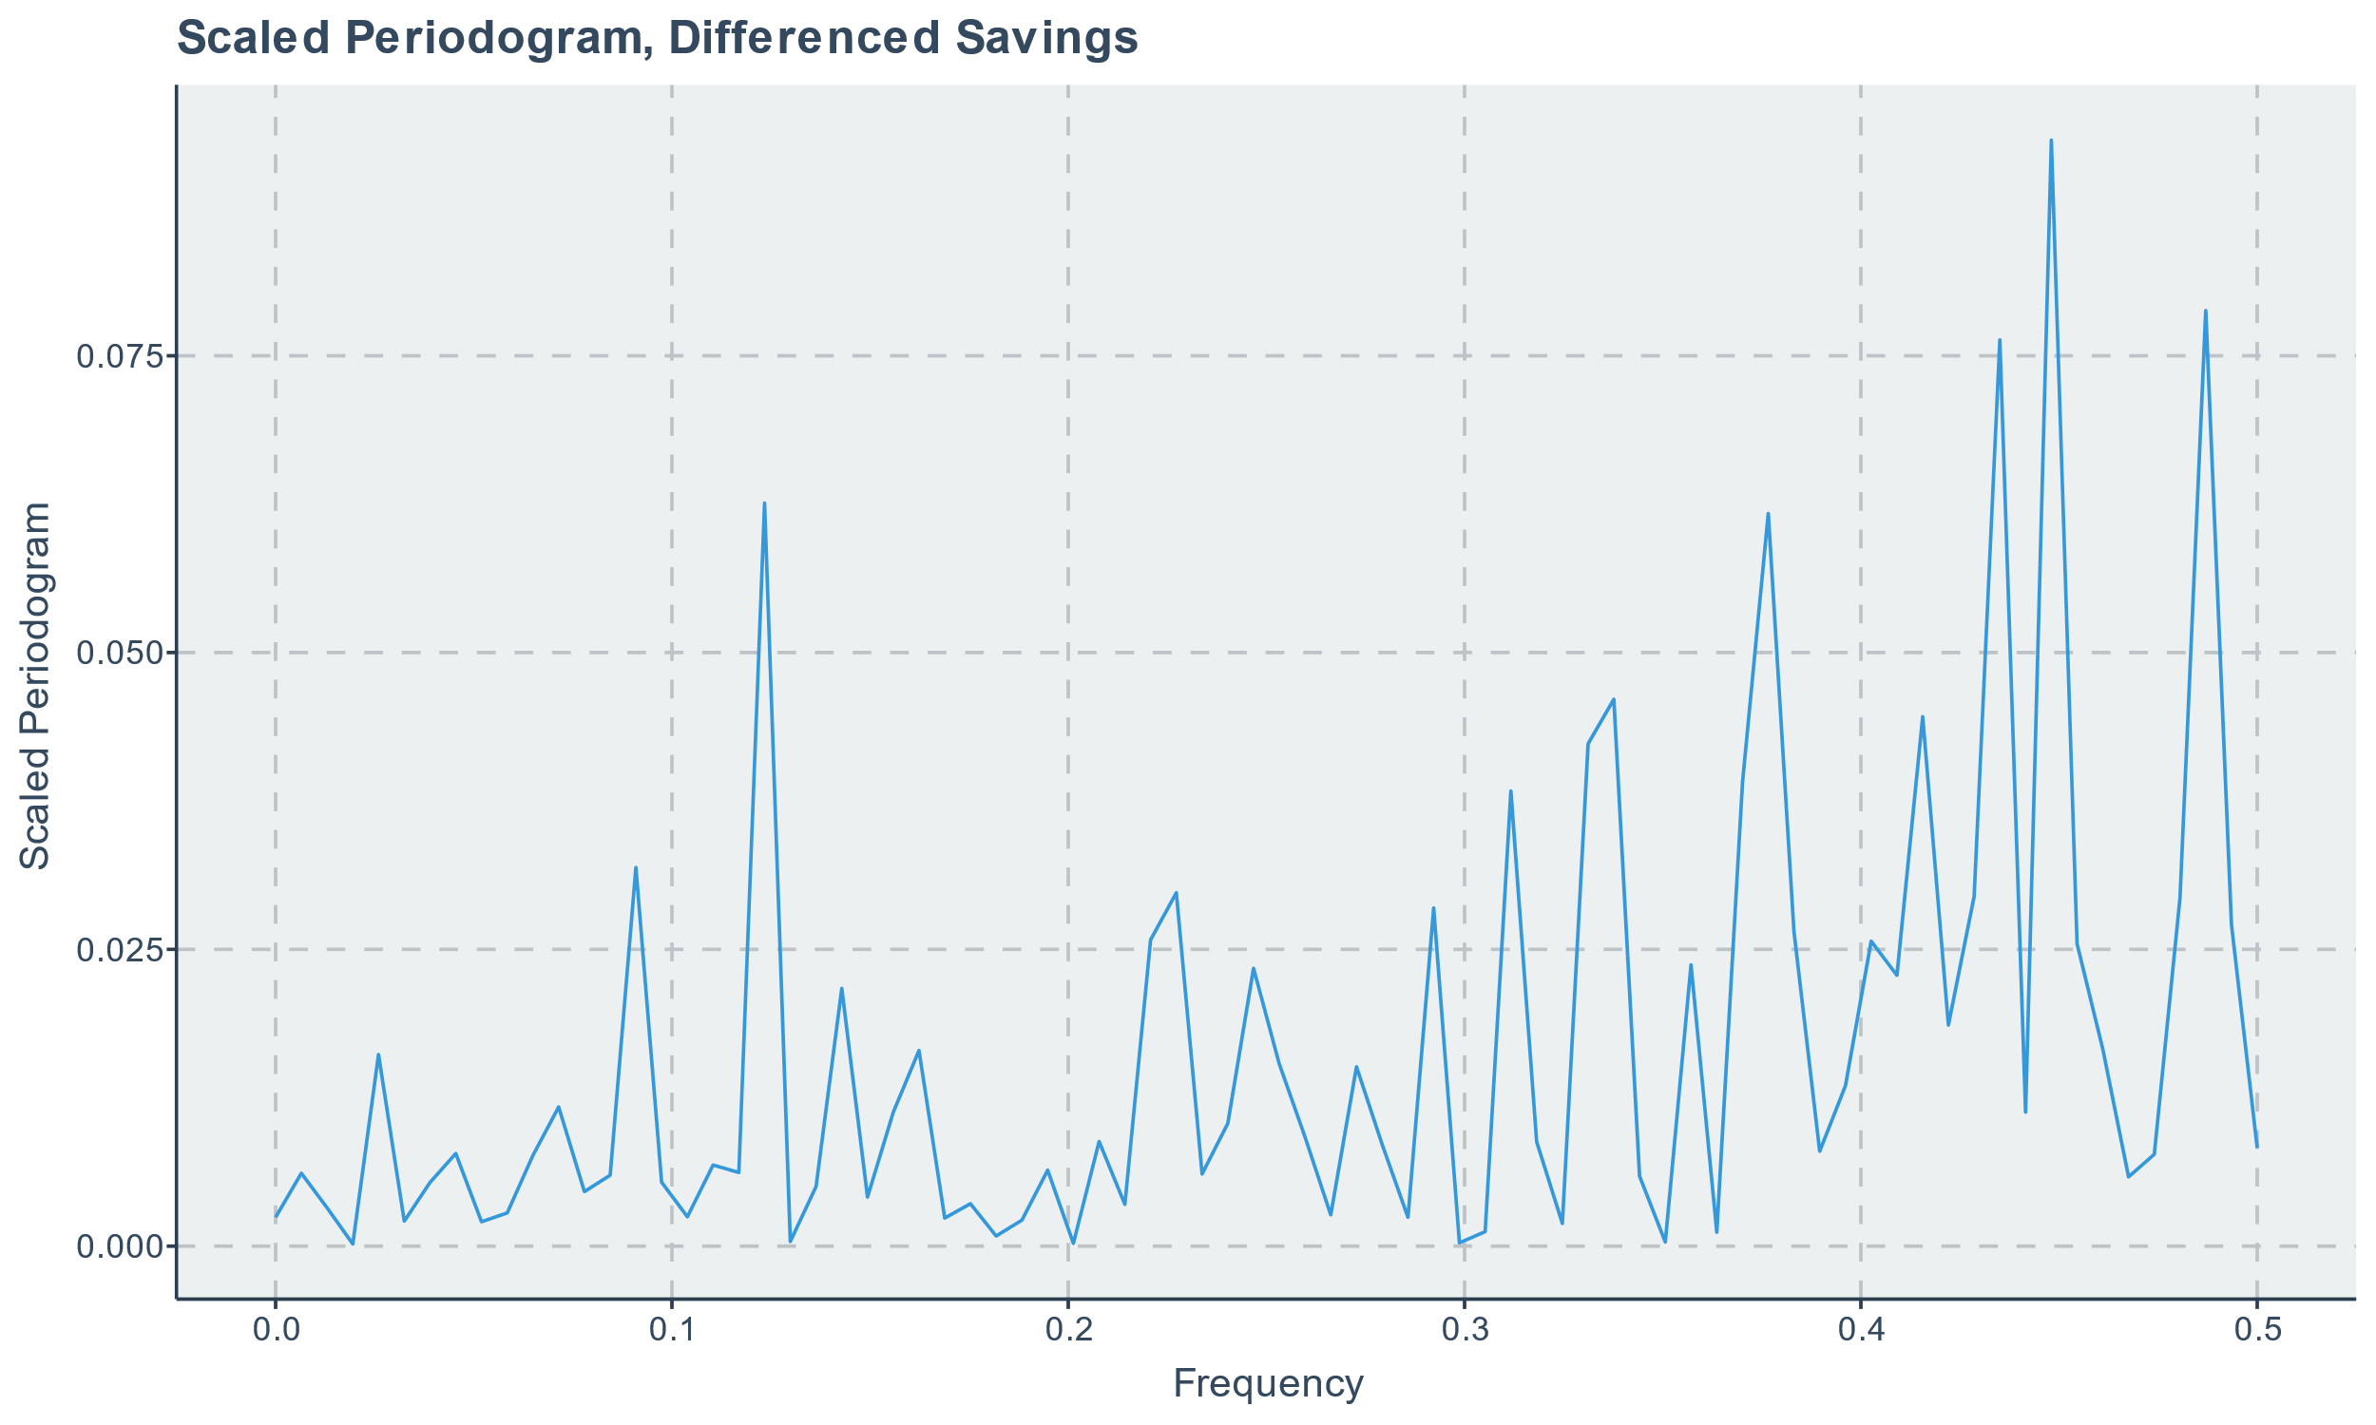
SAVINGS PERIODOGRAM
Of the three decompositions, greatest seasonality was seen in savings data
Small in magnitude compared to scale of savings
Scaled periodogram of differenced savings shows 3 key frequencies
ω₁ = 0.123, ω₂ = 0.377, ω₃ = 0.448 with clustering about ω₃
None of these are expected to be meaningful (data is already seasonally adjusted) so nothing further was done with the frequency domain approach
| Frequency|
|---------:|
| 0.123|
| 0.377|
| 0.435|
| 0.448|
| 0.487|

Slide 13
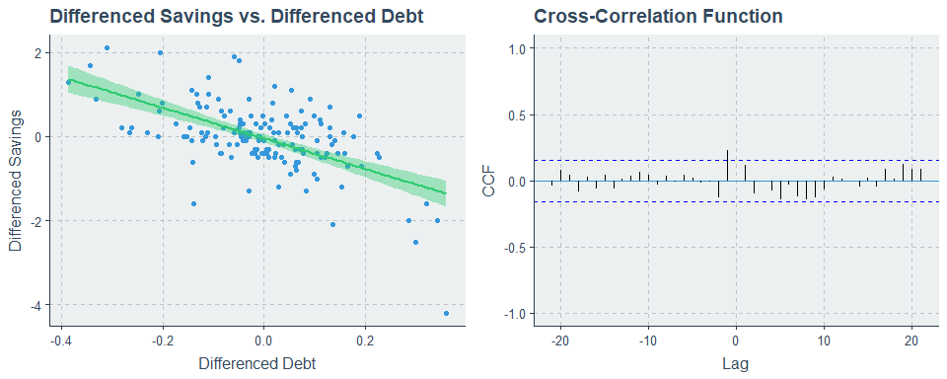
CROSS-CORRELATION
General decrease in differenced savings as differenced debt increases
Nontrivial degree of spread is seen in the plotted points
Cross-correlation seen at lag h=-1
Small in magnitude
Suggests that differenced debt at h=-1 may only be weakly predictive of differenced savings

Slide 14
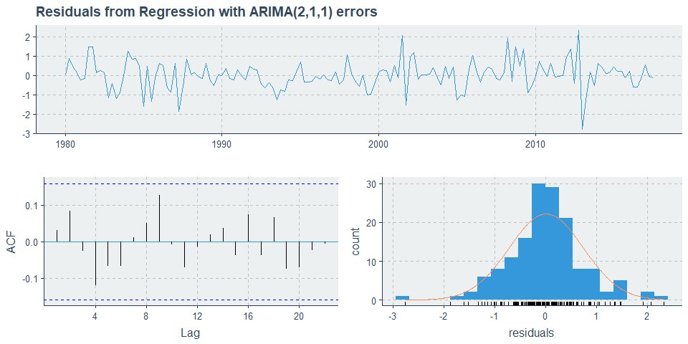
MODEL
Series: savdebt_ts[, 2]
Regression with ARIMA(2,1,1) errors
Coefficients:
ar1 ar2 ma1 drift xreg
0.3977 0.2882 -0.9324 -0.0327 -1.0207
s.e. 0.0971 0.0904 0.0507 0.0139 0.2683
sigma^2 estimated as 0.5494: log likelihood=-165.7
AIC=343.39 AICc=343.98 BIC=361.46
z test of coefficients:
Estimate Std. Error z value Pr(>|z|)
ar1 0.397680 0.097130 4.0943 4.235e-05 ***
ar2 0.288219 0.090370 3.1893 0.0014261 **
ma1 -0.932420 0.050732 -18.3792 < 2.2e-16 ***
drift -0.032696 0.013879 -2.3557 0.0184876 *
xreg -1.020721 0.268268 -3.8049 0.0001419 ***
---
Signif. codes: 0 ‘***’ 0.001 ‘**’ 0.01 ‘*’ 0.05 ‘.’ 0.1 ‘ ’ 1
Ljung-Box test
data: Residuals from Regression with ARIMA(2,1,1) errors
Q* = 5.434, df = 3, p-value = 0.1426
Model df: 5. Total lags used: 8
Model was fit with lagged debt to predict savings (h=-1)
Recommended model was ARIMA(2,1,1) with drift
Includes the needed differencing
Histogram shows reasonable normality for bulk of data with slight deviation from normality at tails
ACF looks like white noise and Ljung-Box test is NSS over 8 lags, thus residuals are consistent with white noise

Slide 15
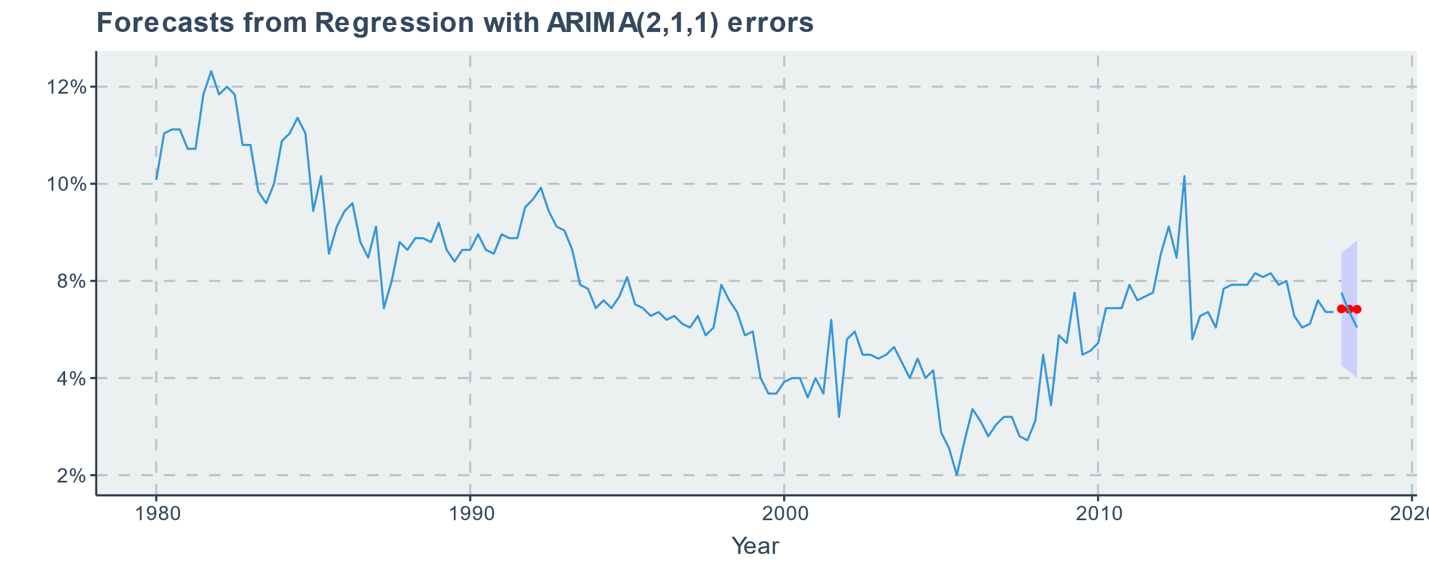
FORECASTS
Predictions are acceptable but not great, consistent with expectations per CCF plot
Error ranges from ~1% to ~7.5% in magnitude
Observed values are within 95% PI
Local volatility results in poorer predictions
|Timepoint | Predicted Values| Actual Values| Percent Error|
|:---------|----------------:|-------------:|-------------:|
|Q4 2017 | 6.78| 7.2| -5.83|
|Q1 2018 | 6.77| 6.7| 1.04|
|Q2 2018 | 6.77| 6.3| 7.46|

Slide 16
DISCUSSION
Model for disposable personal income worked very well for forecasting
Model for savings vs. debt worked reasonably well for forecasting
Suggests another predictor may be needed
Consider including a predictor for nonessential spending (e.g., recreation, dining out)
Smoothing may help improve predictions when they occur at turning points

Slide 17
LIMITATIONS
Data was already seasonally adjusted when it was obtained
Limits ability to incorporate additional datapoints when they become available
Data is not static, therefore not wise to simply gather future datapoints and compare to predicted values (not really an apples-to-apples comparison)
Limits usefulness of frequency approach
Some seasonality remained in each TS, but it was of diminishing magnitude in comparison to scale of raw data
Periodogram was predictably uninteresting

Slide 18
CONCLUSION
Forecasting works well when a strong trend is seen
Forecasting with a lagged predictor may perform acceptably but not well when data is locally volatile and/or when CCF plot shows a weak cross-correlation
Time series analysis toolset provided by forecast package is easy to use, well documented, and plays nicely with established tidyverse syntax and functions

Slide 19
REFERENCES
Federal Reserve Bank of New York Center for Microeconomic Data. 2019. “Quarterly Report on Household Debt and Credit: 2018 Q4.” https://www.newyorkfed.org/medialibrary/interactives/householdcredit/data/pdf//HHDC_2018Q4.pdf.
Organisation for Economic Co-operation and Development. 2018. “Household Spending.” https://data.oecd.org/hha/household-spending.htm.
Organisation for Economic Co-operation and Development. 2018. “Household Savings.” https://data.oecd.org/hha/household-savings.htm.
Federal Reserve Bank of St. Louis. 2016. “Consumer Price Index: Total All Items for the United States.” https://fred.stlouisfed.org/series/CPALTT01USM661S.
Hyndman R, Athanasopoulos G, Bergmeir C, Caceres G, Chhay L, O'Hara-Wild M, Petropoulos F, Razbash S, Wang E, Yasmeen F. 2019. “forecast: Forecasting functions for time series and linear models.” R package version 8.5. http://pkg.robjhyndman.com/forecast.
Federal Reserve Bank of St. Louis. 2018. “Household Debt Service Payments as a Percent of Disposable Personal Income.” https://fred.stlouisfed.org/series/TDSP.
Federal Reserve Bank of St. Louis. 2018. “Real Disposable Personal Income – Per Capita.” https://fred.stlouisfed.org/series/A229RX0Q048SBEA.
Federal Reserve Bank of St. Louis. 2018. “Personal Saving as a Percent of Disposable Personal Income.” https://fred.stlouisfed.org/series/A072RC1Q156SBEA.

Slide 20

QUESTIONS?
Full project code available on GitHub:
https://github.com/kmprioliPROF/MAT_8444_Final_Project

