Slide 1
Comparing World Quality of Life Measures: Nonparametric vs. Parametric Approaches
Katherine M. Prioli
MAT 8452 Final Project
December 17, 2018

Slide 2
BACKGROUND
With increasing globalization, it’s important to understand how United States compares to other countries on key Quality of Life (QoL) measures
This requires investigating the QoL measures and understanding how they may be related
Traditional parametric approaches may be inappropriate if their assumptions are not met, but nonparametric methods can be applied

Slide 3
OBJECTIVE
The objective of this study was to explore the distributions of and relationships between key QoL indicators using both nonparametric and parametric methods, and to compare the methods in terms of results and appropriateness

Slide 4
METHODS
Two stages to the analysis:
Explore the data
Univariate descriptive statistics and visualizations
Pairwise analysis via correlation matrix
Perform 5 parallel analyses using nonparametric methods and their parametric equivalents
Analyses chosen based on data exploration
All tests performed at the α = 0.05 level
Results compared in terms of:
Statistical test outcomes
Assumptions required

Slide 5
THE DATA
VARIABLE | DESCRIPTION | SOURCE
country | Country name | countrycodes package
SPI | Social Progress Index (compound measure, scale of 0:100) | Social Progress Imperative
logGDP | Gross Domestic Product, log transform, valued in $US 2018 | The World Bank
HDIindex | Human Development Index (compound measure, scale of 0:1) | The United Nations Development Programme
HDI_cat | Human Development Index category (4 levels, from “low” to “very high” | The United Nations Development Programme
happiness | World Happiness Score (compound measure, scale of 0:10) | The World Happiness Report
gendereq | Gender Equality Index (compound measure, scale of 0:1) | World Economic Forum
infantmort | Infant mortality rate | World Health Organization
birth_MF | Life expectancy at birth, males and females | World Health Organization
sixty_MF | Life expectancy at age 60, males and females | World Health Organization
Note: this dataset was originally created for the MAT 8790 final project.

Slide 6
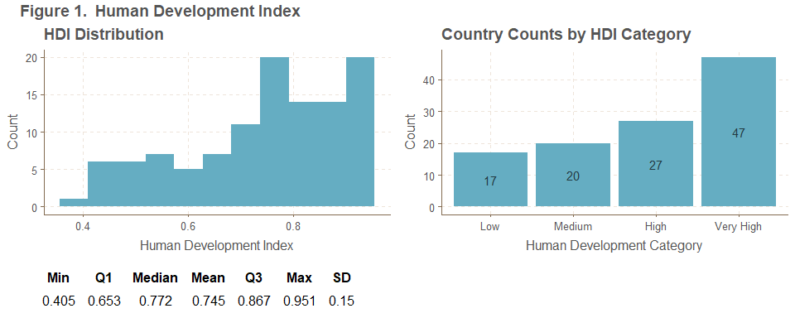
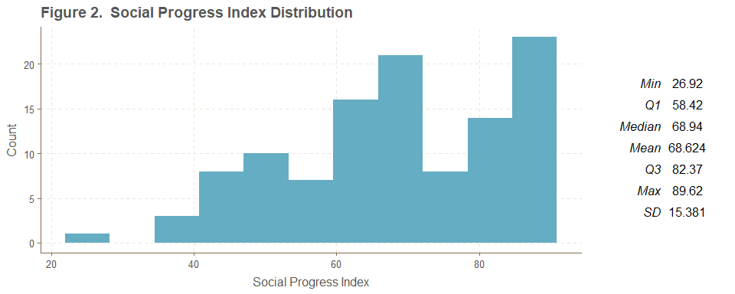
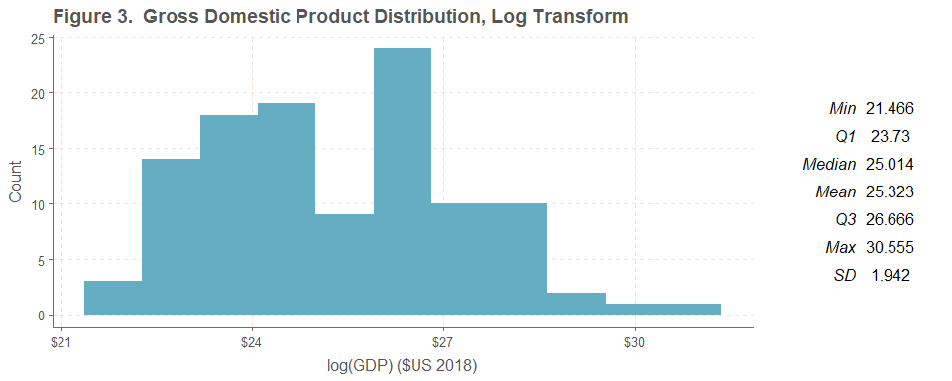
UNIVARIATE ANALYSES
Human Development Index
Social Progress Index
GDP, Log Transform

Slide 7
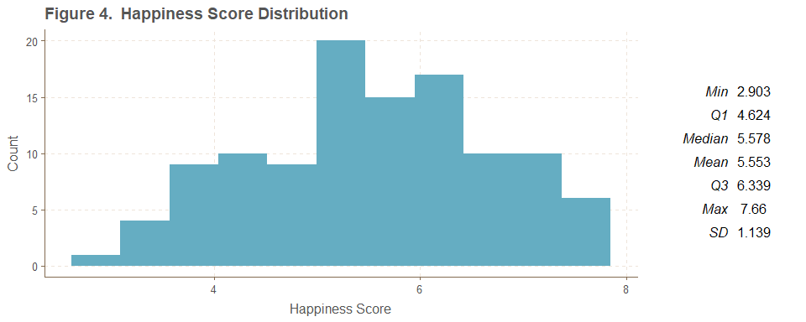
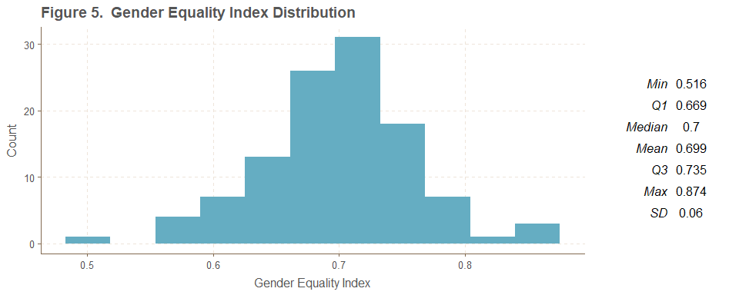
UNIVARIATE ANALYSES
Happiness Score
Gender Equality Index

Slide 8
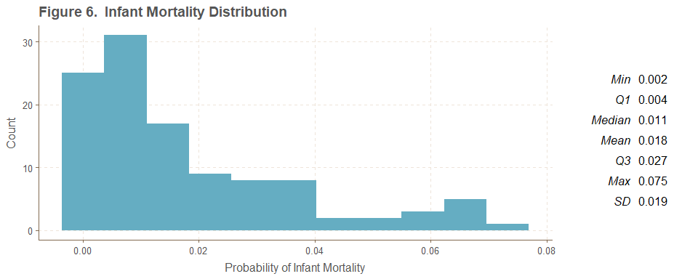
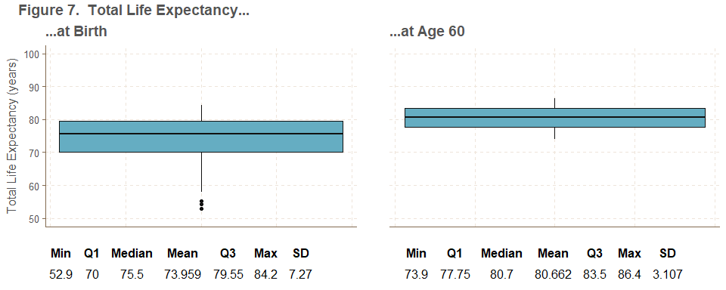
UNIVARIATE ANALYSES
Infant Mortality Rate
Total Life Expectancy…

Slide 9
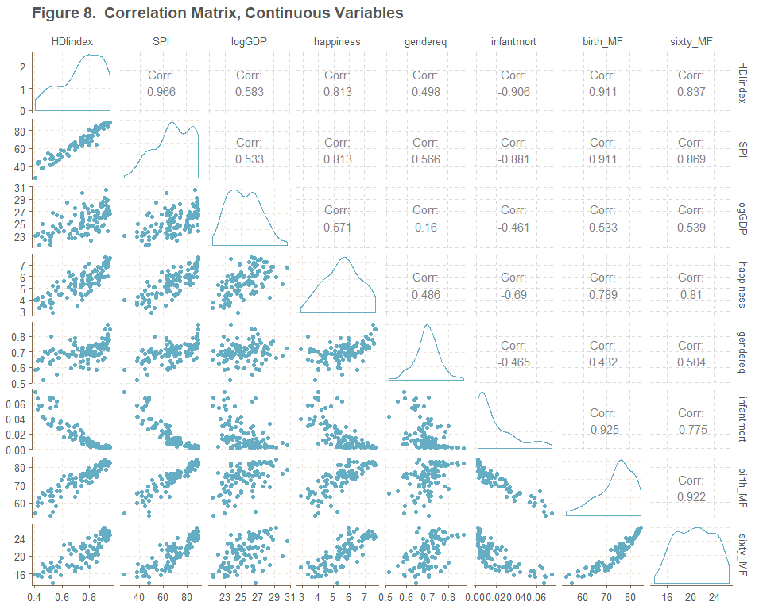
CORRELATION MATRIX
Correlation Matrix, Continuous Variables
Generated using GGally::ggpairs()
Fastest way of visualizing pairwise relationships
Lower triangle shows scatterplots, upper triangle gives Pearson correlations
Density plots along the diagonal
Many variables appear non-normally distributed
Relationships chosen for further analysis:
HDIindex and SPI (clear correlation)
logGDP and gendereq (no clear association)

Slide 10
ANALYSES PERFORMED
ANALYSIS | VARIABLE(S) | H₀ | H_{A} | NONPARAMETRIC TEST | PARAMETRIC TEST
1 | HDIindex | Population measure of location = 0 (used to find 95% CI for population median and mean) | Population measure of location ≠ 0 | One-Sample Sign Test | One-Sample t-test
2 | HDIindex, SPI | Human development and social progress are not associated | Human development and social progress are correlated | Kendall’s Tau | Pearson’s Correlation Test
3 | logGDP, gendereq | There is no relationship between log(GDP) and gender equality index | There is a relationship between log(GDP) and gender equality index | Hoeffding’s Test | Pearson’s Correlation Test
4 | happiness | Happiness is normally distributed | Happiness is not normally distributed | Lilliefors Test for Normality (a type of one-sample Kolmogorov-Smirnov test) | Shapiro-Wilk Test
5 | HDI_cat, log(infantmort) | Log infant mortality rate is the same across human development categories | Log infant mortality rate differs by human development category | Permutation F-Test | ANOVA

Slide 11
ANALYSIS 1

Slide 12
ANALYSIS 2

Slide 13
ANALYSIS 3

Slide 14
SELECTED RESULTS: ANALYSIS 4
Testing for normality of happiness via one-sample Kolmogorov-Smirnov (nonparametric) vs Shapiro-Wilk (parametric)
Code:
p_{KS} = 0.915 and p_{SW} = 0.129
Both exceed α so H₀ is retained for both tests
Conclusion: there is insufficient evidence to assert that the happiness score is not normally distributed
Both tests assume a continuous distribution
Satisfied by the data ∴ both approaches are acceptable
Although neither p-value is significant, p_{SW} is much smaller than p_{KS}
KS test may be less sensitive to deviations from normality
analysis4_nonpara <- ks.test(alldata$happiness, "pnorm", mean(alldata$happiness), sd(alldata$happiness))
analysis4_para <- shapiro.test(alldata$happiness)

Slide 15
ANALYSIS 4

Slide 16
ANALYSIS 5
Testing for difference in log(infantmort) across levels of HDI_cat via permutation F-test (nonparametric) vs ANOVA (parametric)
Code:
Both tests yielded p < 0.001, leading to rejection of H₀ in both cases
Conclusion: at the α = 0.05 level, there is evidence of a difference in infant mortality rate across human development categories
Both tests assume independence and constant variance
Satisfied by the data
ANOVA assumes normality
Violated by Medium category (see next slide)
The parametric method is inappropriate in this case but the nonparametric approach works
analysis5_nonpara <- perm.f.test(response = log(alldata$infantmort), treatment = alldata$HDI_cat,
num.sim = 1000)
analysis5_para <- aov(as.numeric(HDI_cat) ~ log(infantmort), data = alldata)

Slide 17
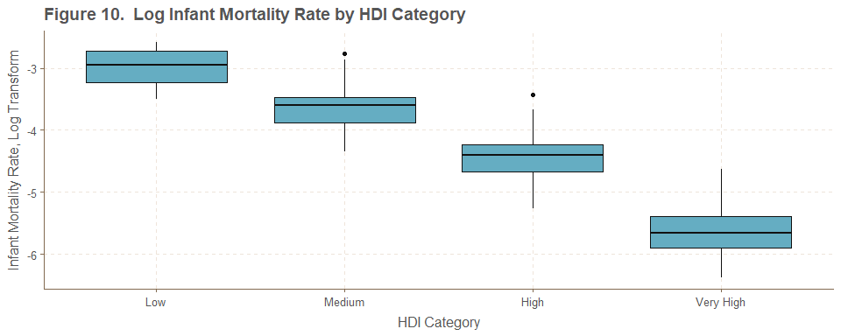
SELECTED RESULTS: ANALYSIS 5
Infant Mortality Rate by HDI Category

Slide 18
SUMMARY OF RESULTS
ANALYSIS | NONPARAMETRIC | PARAMETRIC
1
2
3
4
5

Slide 19
DISCUSSION

Slide 20
REFERENCES
Helliwell, John F., Richard Layard, and Jeffrey D. Sachs. 2018. “World Happiness Report.” http://worldhappiness.report/ed/2018/.
James, Gareth, Daniela Witten, Trevor Hastie, and Robert Tibshirani. 2013. “An Introduction to Statistical Learning.” Springer. https://www-bcf.usc.edu/~gareth/ISL/.
Murphy, Sherry L., Jiaquan Xu, Kenneth D. Kochanek, and Elizabeth Arias. 2018. “Mortality in the United States, 2017. NCHS Data Brief, No 328.” National Center for Health Statistics. https://www.cdc.gov/nchs/products/databriefs/db328.htm.
Prioli, Katherine M. 2018. “MAT_8790_Final_Project.” https://github.com/kmprioliPROF/MAT_8790_Final_Project.
Social Progress Imperative. 2018. “Social Progress Index.” https://www.socialprogress.org/?tab=4.
The United Nations Development Programme. 2018. “Human Development Index.” http://hdr.undp.org/en/data.
The World Bank. 2018. “Gross Domestic Product.” https://data.worldbank.org/indicator/ny.gdp.mktp.cd?view=map&year_high_desc=true.
World Economic Forum. 2016. “Gender Equality.” http://reports.weforum.org/global-gender-gap-report-2016/rankings/.
World Health Organization. 2018a. “Life Expectancy.” http://apps.who.int/gho/data/view.main.SDG2016LEXv?lang=en.
World Health Organization. 2018b. “Probability of Dying Per 1000 Live Births.” http://apps.who.int/gho/data/view.main.182?lang=en.

Slide 21

QUESTIONS?
Full project code available on GitHub:
https://github.com/kmprioliPROF/MAT_8452_Final_Project

