Slide 1
Comparing World Quality of Life Measures: Nonparametric vs. Parametric Approaches
Katherine M. Prioli
MAT 8452 Final Project
December 17, 2018

Slide 2
BACKGROUND
With increasing globalization, it’s important to understand how the United States compares to other countries on key Quality of Life (QoL) measures
This is the aim of my MAT 8790 project
This requires investigating the QoL measures and understanding how they may be related
Traditional parametric approaches may be inappropriate if their assumptions are not met, but nonparametric methods can be applied

Slide 3
OBJECTIVE
Explore the distributions of and relationships between key QoL indicators using both nonparametric and parametric methods
Compare the methods in terms of results and appropriateness

Slide 4
METHODS
Two stages to the analysis:
Explore the data
Univariate descriptive statistics and visualizations
Pairwise analysis via correlation matrix
Perform 6 parallel analyses using nonparametric methods and their parametric equivalents
Analyses chosen based on data exploration
All tests performed at the α = 0.05 level
Results compared in terms of:
Statistical test outcomes
Assumptions required

Slide 5
THE DATA
VARIABLE | DESCRIPTION | SOURCE
country | Country name | countrycodes package
HDIindex | Human Development Index (compound measure, scale of 0:1); subitems include years of schooling, life expectancy at birth, and per-capita income (among others) | The United Nations Development Programme
HDI_cat | Human Development Index category (4 levels, from “low” to “very high”) | The United Nations Development Programme
SPI | Social Progress Index (compound measure, scale of 0:100); subitems include three broad categories: basic human needs (e.g., nutrition, safety), foundations of wellbeing (e.g., basic knowledge, environmental quality), and opportunity (e.g., personal rights, freedoms) | Social Progress Imperative
logGDP | Gross Domestic Product (GDP), log transform | The World Bank
happiness | World Happiness Score (compound measure, scale of 0:10); subitems include per-capita GDP, healthy life expectancy, social support, freedoms, and perception of corruption, among others | The World Happiness Report
gendereq | Gender Equality Index (compound measure, scale of 0:1); measures gender-related gaps in economic participation, education, health and survival, and political offices held, among others | World Economic Forum
infantmort | Infant mortality rate (neonatal deaths per 1,000 live births) | World Health Organization
birth_MF | Life expectancy at birth, males and females | World Health Organization
sixty_MF | Life expectancy at age 60, males and females | World Health Organization
Note: this dataset was originally created for the MAT 8790 final project. Countries with missing data were excluded from the analytic dataset.

Slide 6
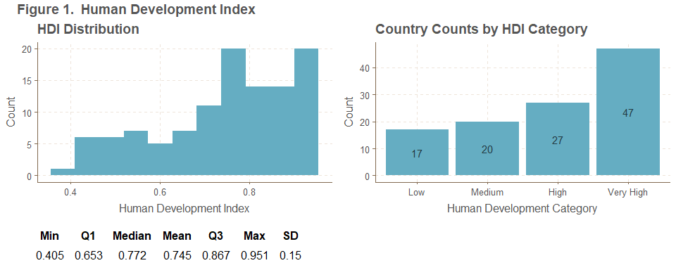
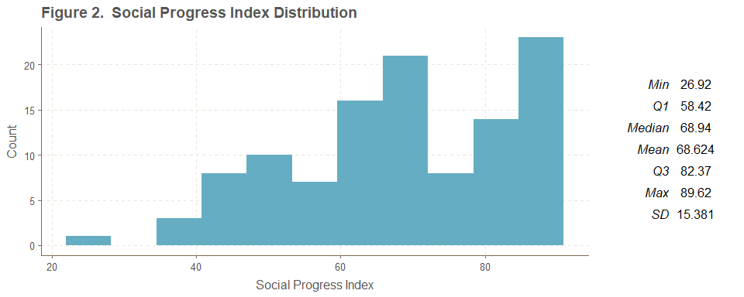
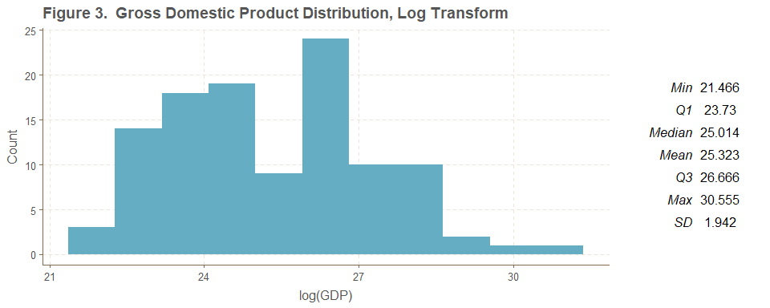
UNIVARIATE ANALYSES
Human Development Index
Social Progress Index
GDP, Log Transform

Slide 7
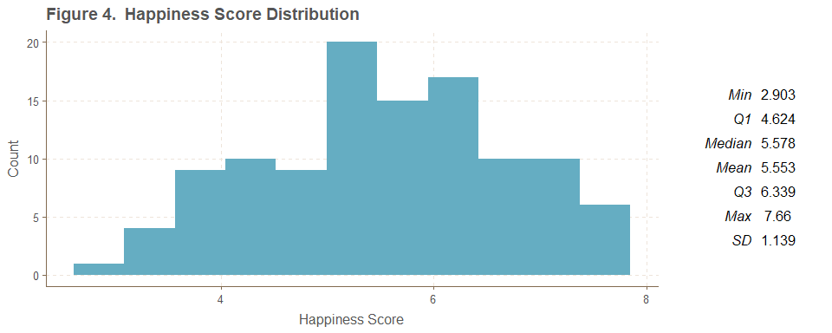
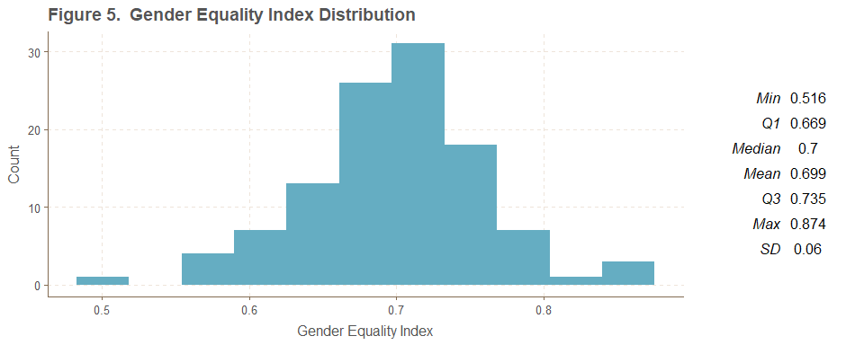
UNIVARIATE ANALYSES
Happiness Score
Gender Equality Index

Slide 8
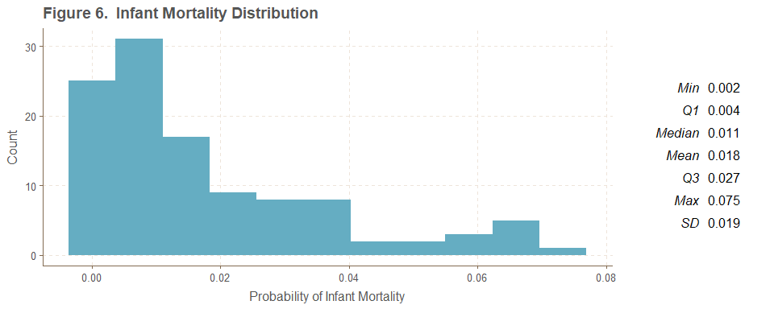
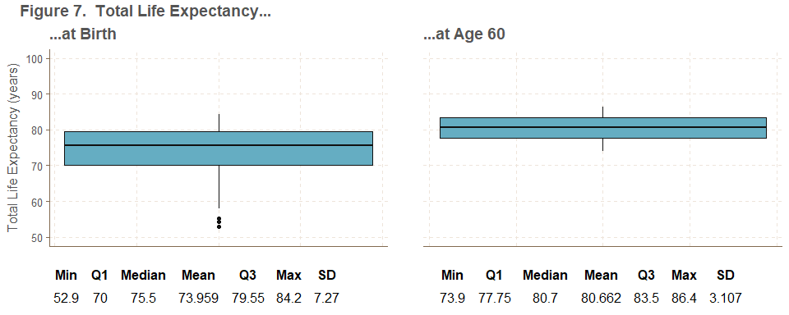
UNIVARIATE ANALYSES
Infant Mortality Rate
Total Life Expectancy…

Slide 9
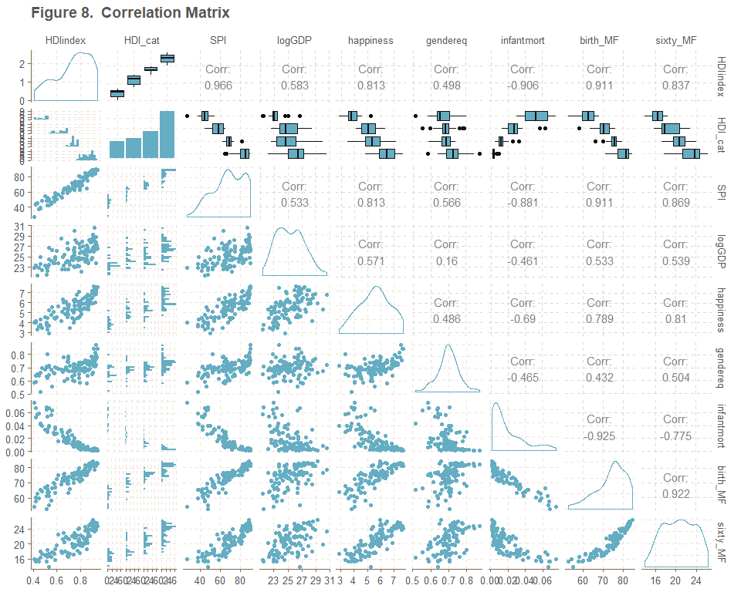
CORRELATION MATRIX
Correlation Matrix
Generated using GGally::ggpairs()
Fastest way of visualizing pairwise relationships
Lower triangle shows scatterplots (continuous data) or histograms (one categorical variable), upper triangle gives Pearson correlations (continuous data) or boxplots (one categorical variable)
Density plots (continuous) and bar charts (categorical) along the diagonal
Many variables appear non-normally distributed
Relationships chosen for further analysis:
HDIindex and SPI (clear correlation)
logGDP and gendereq (no clear association)
infantmort and HDI_cat (clear difference by category)
happiness and HDI_cat (similar in Medium and High categories)

Slide 10
ANALYSES PERFORMED
ANALYSIS | VARIABLE(S) | H₀ | H_{A} | NONPARAMETRIC TEST | PARAMETRIC TEST
1 | HDIindex | Nonparametric 95% confidence interval (CI) for the population mean (no formal hypotheses tested) | Parametric 95% CI for the population mean | Bootstrapping | One-Sample t-test
2 | HDIindex, SPI | Human development and social progress are not associated | Human development and social progress are correlated | Kendall’s Tau | Pearson’s Correlation Test
3 | logGDP, gendereq | There is no relationship between log(GDP) and gender equality index | There is a relationship between log(GDP) and gender equality index | Hoeffding’s Test | Pearson’s Correlation Test
4 | happiness | Happiness is normally distributed | Happiness is not normally distributed | Lilliefors Test for Normality (a type of one-sample Kolmogorov-Smirnov test) | Shapiro-Wilk Test
5 | HDI_cat, log(infantmort) | Log infant mortality rate is the same across human development categories | Log infant mortality rate differs by human development category | Permutation F-Test | ANOVA
6 | HDI_cat, happiness | There is no difference in scale for happiness score across Medium and High HDI categories | Happiness score differs in scale across Medium and High HDI categories | Wilcoxon Rank-Sum Test (check assumptions), Ansari-Bradley Test | Two-Sample t-Test (check assumptions), Levene’s Test for Homogeneity

Slide 11
ANALYSIS 1
Generating a 95% CI for the population mean via bootstrapping (nonparametric) and one-sample t-test (parametric)
Bootstrapping code (t-test CI found by specifying conf.level = 0.95 in t.test()):
n <- length(alldata$HDIindex)
nBS <- 1000
set.seed(19811221)
BSout <- tibble(BSmean = numeric())
for(bs in 1:nBS){
bsHDIindex <- sample(alldata$HDIindex, n, replace = TRUE)
BSout[bs, 1] <- mean(bsHDIindex)
}
meanCI_BS <- tibble(CI_low = numeric(),
CI_high = numeric(),
width = numeric())
meanCI_BS[1, 1] <- round(quantile(BSout$BSmean, 0.025), digits = 4)
meanCI_BS[1, 2] <- round(quantile(BSout$BSmean, 0.975), digits = 4)
meanCI_BS$width = meanCI_BS$CI_high - meanCI_BS$CI_low
analysis1_nonpara <- meanCI_BS

Slide 12
ANALYSIS 1
95% CIs:
The nonparametric approach yielded a slightly narrower CI at 95.75% the width of the parametric CI
The parametric assumption of a normal distribution is violated
The nonparametric approach is appropriate
APPROACH | 2.5% | 97.5% | CI WIDTH
Nonparametric | 0.7157 | 0.7698 | 0.0541
Parametric | 0.7163 | 0.7728 | 0.0565

Slide 13
ANALYSIS 2
Testing for an association between social progress index and human development index
Both tests assume a continuous distribution (satisfied by the data)
Kendall’s test assumes no ties present for either SPI or HDIindex
Assessed for ties as follows (example code for SPI):
No ties found, so simulation not required
Code for tests should be familiar:
Both tests yielded p < 0.0001
Decision: reject H₀
Conclusion: at the α = 0.05 level, there is sufficient evidence to conclude that SPI and HDIindex are associated
Either test is acceptable when the relationship is as strong as seen on the correlation matrix
SPI_ties <- alldata %>%
group_by(SPI) %>%
mutate(count = n()) %>%
ungroup() %>%
select(count) %>%
filter(count > 1)
dim(SPI_ties)[[1]]
analysis2_nonpara <- cor.test(alldata$SPI, alldata$HDIindex, method = “kendall”)
analysis2_para <- cor.test(alldata$SPI, alldata$HDIindex, method = “pearson”)

Slide 14
ANALYSIS 3
Testing for an association between log(GDP) and gender equality index:
Both tests assume a continuous distribution
Satisfied by the data
p_{Hoeffding} = 0.0383 and p_{Pearson} = 0.0984
Hoeffding’s test is significant
Conclusion: at the α = 0.05 level, there is sufficient evidence to conclude that logGDP and gendereq are associated
Pearson’s test is not significant
Doesn’t matter: the assumption of linearity is not met
The parametric method is inappropriate here, but the nonparametric method is acceptable
analysis3_nonpara <- testforDEP(alldata$logGDP, alldata$gendereq, test = “HOEFFD”)
analysis3_para <- testforDEP(alldata$logGDP, alldata$gendereq, test = “PEARSON”)

Slide 15
ANALYSIS 4
Testing for normality of happiness via Lilliefors (nonparametric) vs Shapiro-Wilk (parametric)
The Lilliefors test is a normality-specific version of the one-sample Kolmogorov-Smirnov test
Performing these tests is straightforward:
p_{Lilliefors} = 0.624 and p_{SW} = 0.129
Both exceed α, so H₀ is retained for both tests
Conclusion: there is insufficient evidence to assert that the happiness score is not normally distributed
Both tests assume a continuous distribution
Satisfied by the data ∴ both approaches are acceptable
Although neither p-value is significant, p_{SW} is much smaller than p_{Lilliefors}
Lilliefors test may be less sensitive to deviations from normality
This is OK – when testing for normality, assume normality! (i.e., Shapiro-Wilk is the appropriate test)
analysis4_nonpara <- lillie.test(alldata$happiness)
analysis4_para <- shapiro.test(alldata$happiness)

Slide 16
ANALYSIS 5
Testing for difference in log(infantmort) across levels of HDI_cat via permutation F-test (nonparametric) vs ANOVA (parametric)
Code:
Both tests yielded p < 0.001, leading to rejection of H₀ in both cases
Conclusion: at the α = 0.05 level, there is evidence of a difference in infant mortality rate across human development categories
Both tests assume independence and constant variance
Satisfied by the data
ANOVA assumes normality
Violated by Medium category (see next slide)
The parametric method is inappropriate in this case but the nonparametric approach works
analysis5_nonpara <- perm.f.test(response = log(alldata$infantmort),
treatment = alldata$HDI_cat,
num.sim = 1000)
analysis5_para <- aov(as.numeric(HDI_cat) ~ log(infantmort), data = alldata)

Slide 17
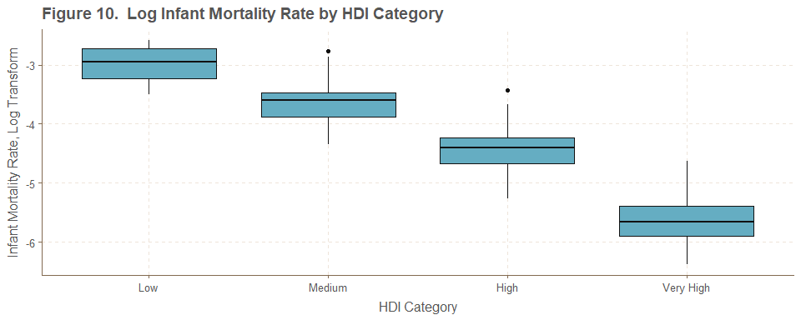
ANALYSIS 5
Infant Mortality Rate by HDI Category

Slide 18
ANALYSIS 6
Testing for difference in happiness score across Medium and High levels of HDI_cat
Requires checking assumption that locations do not differ (nonparametric: two-sample Wilcoxon Rank-Sum Test, parametric: two-sample t-test)
Both tests yielded nonsignificant p-values (p_{Wilcoxon} = 0.280; p_{t} = 0.249) so fail to reject the assumption of equal locations
Nonparametric test via ansari.test()
p_{AB} = 0.753
Parametric test via car::leveneTest()
p_{Levene} = 0.389
Conclusion: at the α = 0.05 level, there is insufficient evidence of a difference in scale for happiness across the Medium and High HDI categories
All tests assume independence (satisfied by the data)
T-test and Levene’s Test assume normality (also satisfied)
Boxplots seem to suggest difference in scale, but this is not supported by either Ansari-Bradley or Levene (see next slide)
Both the nonparametric and parametric approaches are appropriate in this case

Slide 19
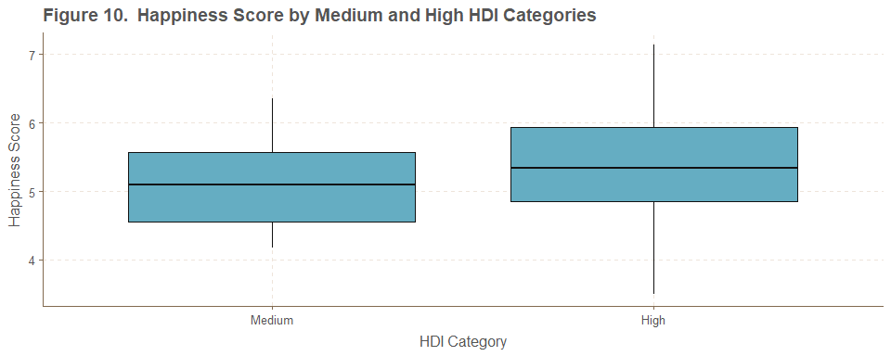
ANALYSIS 6
Happiness Score by Medium and High HDI Categories

Slide 20
OVERALL FINDINGS
ANALYSIS | NONPARAMETRIC | PARAMETRIC
1 | J | L
2 | J | J
3 | J | L
4 | K | J
5 | J | L
6 | J | J
Nonparametric methods performed pretty well!

Slide 21
DISCUSSION
Nonparametric methods performed acceptably in all analyses
Parametric methods were only appropriate in 3/6 analyses
Nonparametric methods are appropriate when analyzing data that violates the assumption of normality
May be less powerful than traditional parametric methods when working with normal data

Slide 22
LIMITATIONS
Major limitation was missing data
Original dataset had n=205 countries
Omitted countries with incomplete data, yielding n=111 in analytic dataset
Countries omitted by HDI category:
Some of these NA belong to countries for which HDI category can’t be calculated
e.g., North Korea, Somalia, Kosovo
Nontrivial proportion of omitted countries have low-to-medium developmental level
These countries are likely to perform poorly on other QoL measures
Omitting them may bias the data
HDI CATEGORY | FREQUENCY
Low | 20
Medium | 18
High | 26
Very High | 12
NA | 18

Slide 23
LIMITATIONS
Interrelatedness of data
We saw that human development index and social progress index contain some of the same subitems (slide “THE DATA”)
We saw (unsurprisingly) that they were highly correlated
Multicollinearity limits the ability to perform distinct analyses
Note that on the correlation matrix, the columns for HDIindex and SPI show the same patterns on pairwise scatterplots
Though these variables differ in scale (HDIindex over 0:1, SPI over 0:100), and intersect on only a subset of their subitems, they appear to measure the same thing!
This is a finding of this analysis, but unfortunately limits the utility of these variables
Also interrelated were infant mortality and the life expectancy variables
Several other interesting QoL measures exist but were not included in this analysis
e.g., hours per week worked, within-country economic disparity, average household indebtedness, out-of-pocket healthcare expenditures…the list is long!

Slide 24
CONCLUSION
Nonparametric methods represent an important toolset when working with data that violates normality
This analysis gives evidence that they can perform favorably as compared to their parametric equivalents, and should be considered when analyzing data that is unsuitable for parametric approaches
Repurposing datasets created for other uses can present challenges

Slide 25

QUESTIONS?
Full project code available on GitHub:
https://github.com/kmprioliPROF/MAT_8452_Final_Project

Slide 26
REFERENCES
Helliwell, John F., Richard Layard, and Jeffrey D. Sachs. 2018. “World Happiness Report.” http://worldhappiness.report/ed/2018/.
James, Gareth, Daniela Witten, Trevor Hastie, and Robert Tibshirani. 2013. “An Introduction to Statistical Learning.” Springer. https://www-bcf.usc.edu/~gareth/ISL/.
Murphy, Sherry L., Jiaquan Xu, Kenneth D. Kochanek, and Elizabeth Arias. 2018. “Mortality in the United States, 2017. NCHS Data Brief, No 328.” National Center for Health Statistics. https://www.cdc.gov/nchs/products/databriefs/db328.htm.
Prioli, Katherine M. 2018. “MAT_8790_Final_Project.” https://github.com/kmprioliPROF/MAT_8790_Final_Project.
Social Progress Imperative. 2018. “Social Progress Index.” https://www.socialprogress.org/?tab=4.
The United Nations Development Programme. 2018. “Human Development Index.” http://hdr.undp.org/en/data.
The World Bank. 2018. “Gross Domestic Product.” https://data.worldbank.org/indicator/ny.gdp.mktp.cd?view=map&year_high_desc=true.
World Economic Forum. 2016. “Gender Equality.” http://reports.weforum.org/global-gender-gap-report-2016/rankings/.
World Health Organization. 2018a. “Life Expectancy.” http://apps.who.int/gho/data/view.main.SDG2016LEXv?lang=en.
World Health Organization. 2018b. “Probability of Dying Per 1000 Live Births.” http://apps.who.int/gho/data/view.main.182?lang=en.

