Slide 1

Cloud Pub/Sub on GCP: The what, Whys and Hows
Karen Reeves
Connect Forward
December 2020

Slide 2

Let’s talk Pub/Sub
What is Pub/Sub Messaging
Definitions
Use Cases
Cloud Pub/Sub on GCP
Benefits
Publishers
Subscribers
What happens when things go wrong
Next Steps

Slide 3
Pub/Sub Messaging
Asynchronous messaging pattern that decouples applications to increase reliability, performance, and scalability
Any message sent by a publisher is immediately received by any subscribers to the topic.
Used for Event driven microservice or serverless architectures

Slide 4
Pub/Sub Terms
Message
The unit of data being sent by the publisher
Topic
An intermediary channel that the publisher posts to. The topic has a list of subscriptions that it publishes messages to.
Publisher
An application that sends messages to topic
Subscription
A queue from each Topic. A topic may have multiple subscriptions and every message will be sent simultaneously to all subscriptions.
Subscriber - An application that subscribes to a topic via a subscription to receive messages published by another application

Slide 5
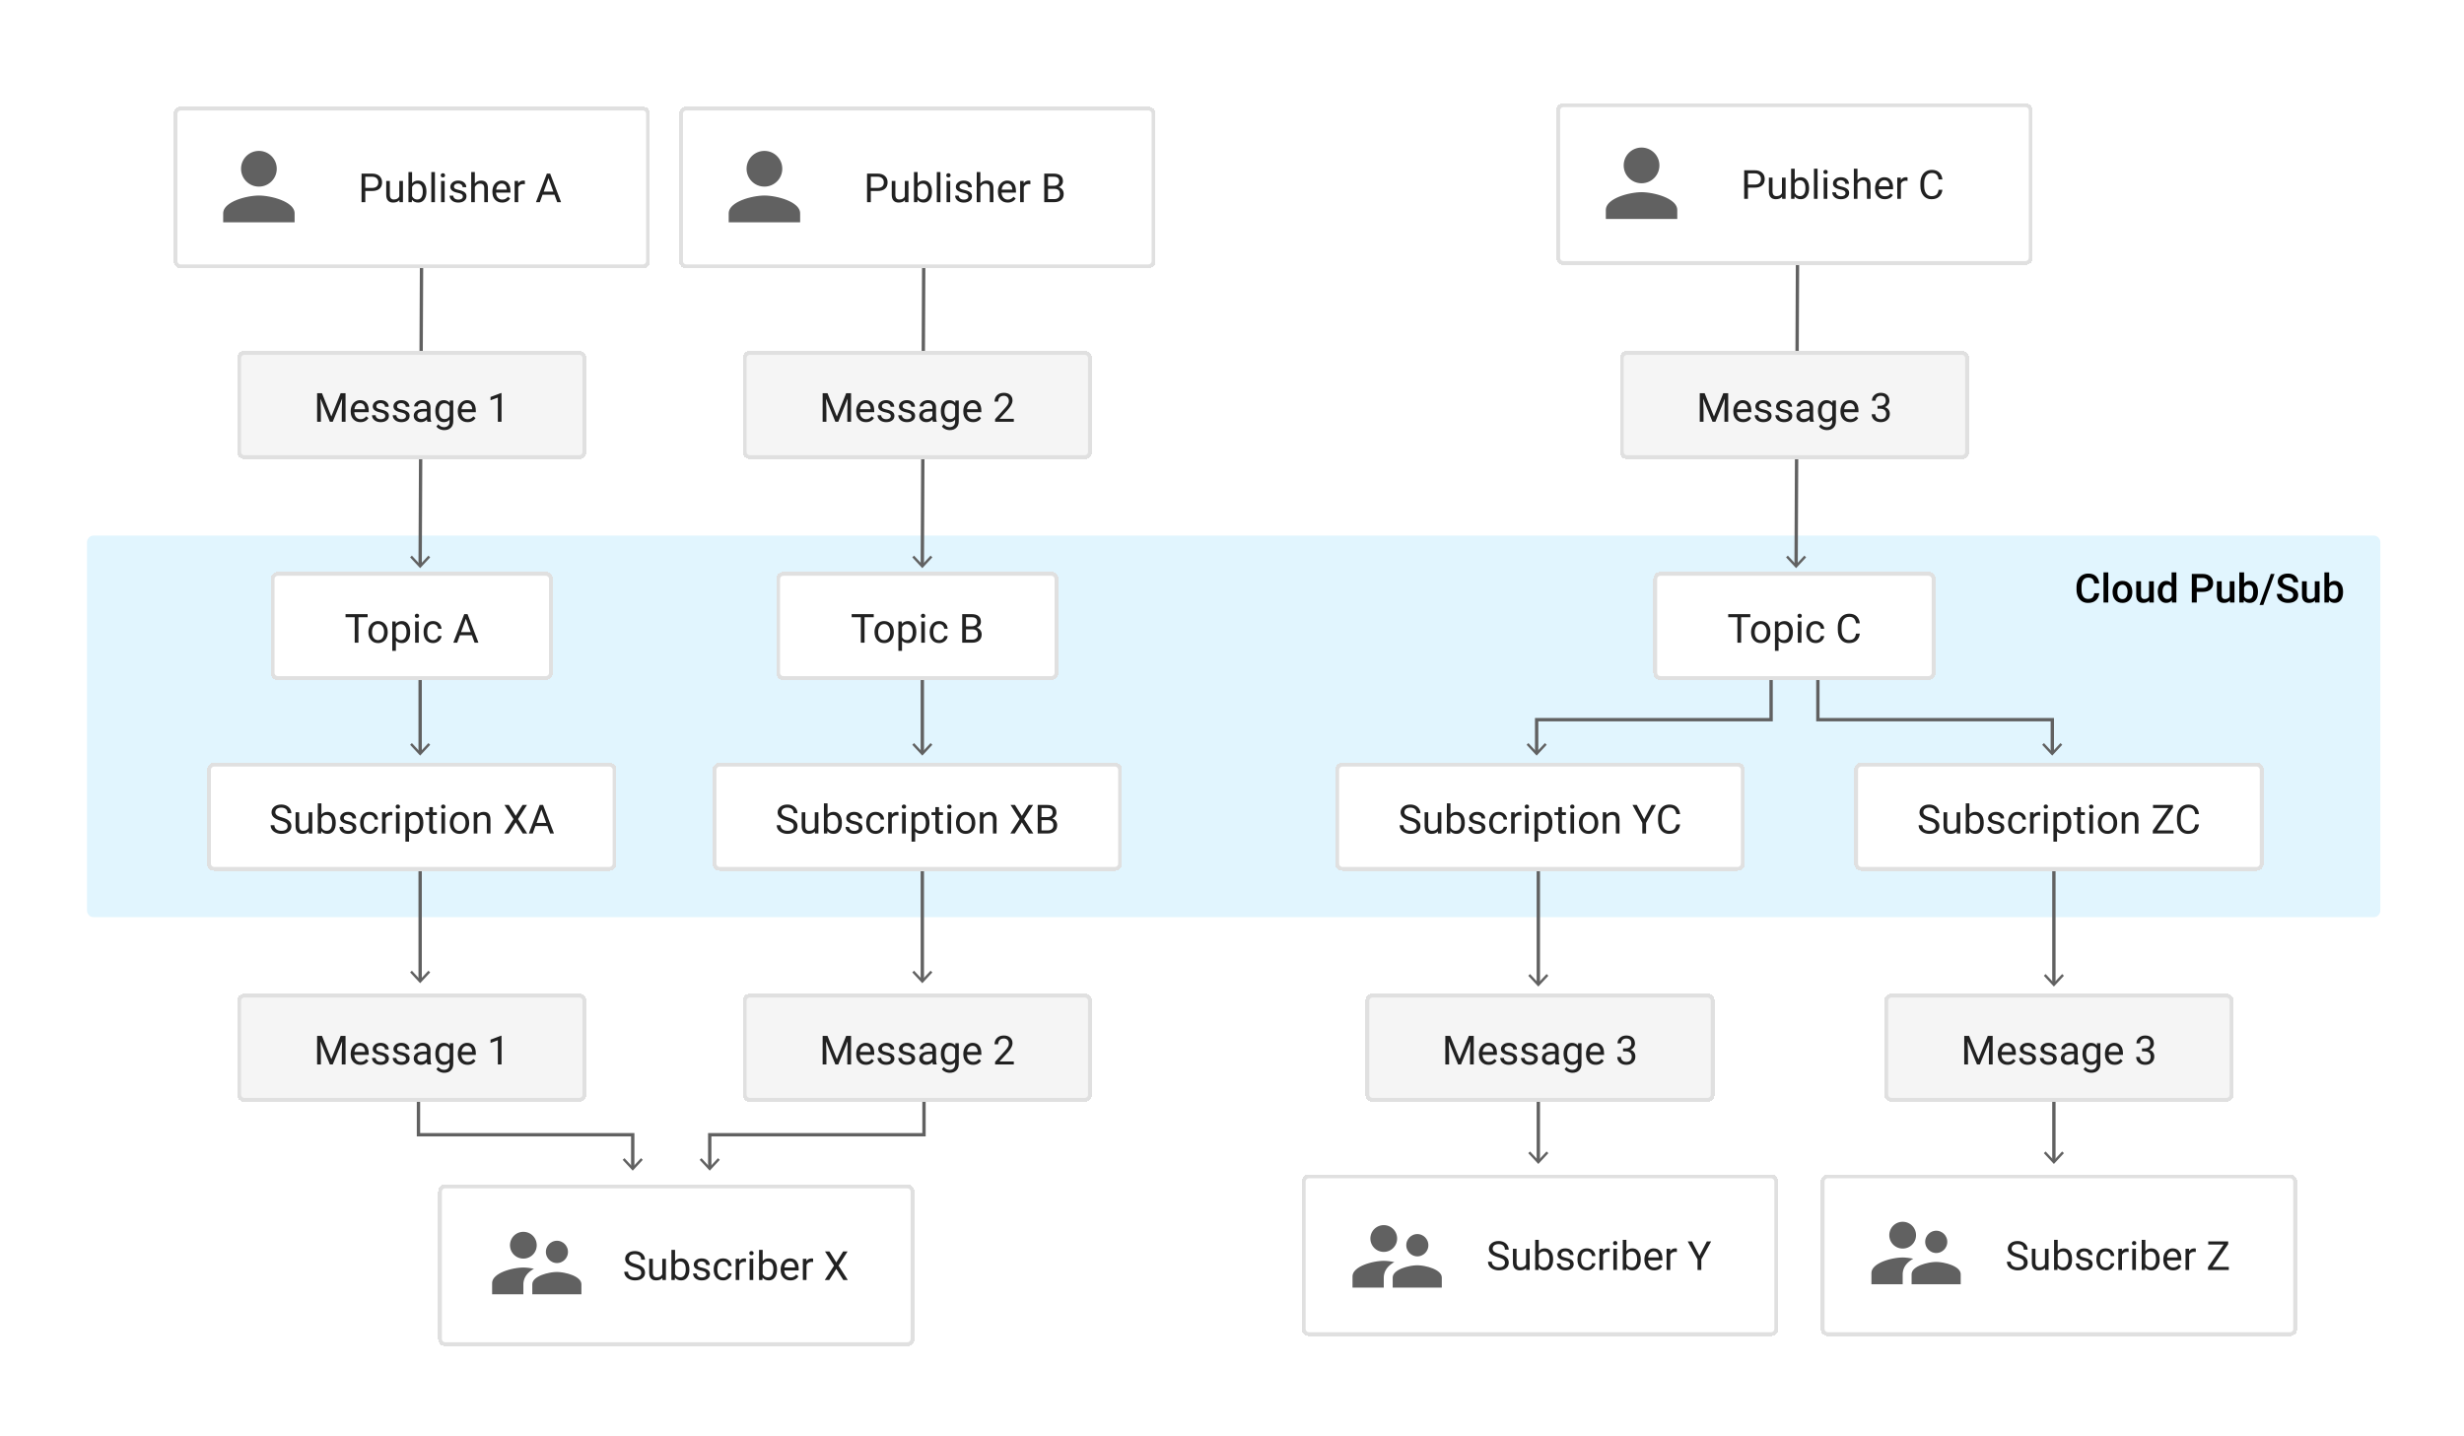

Slide 6
Common use cases https://cloud.google.com/pubsub/docs/overview
Balancing workloads in network clusters
Implementing asynchronous workflows
Distributing event notifications
Refreshing distributed caches
Logging to multiple systems
Data streaming from various processes or devices
Reliability improvement

Slide 7
Google Cloud Pub/Sub
Guaranteed at least once delivery
Global, Load Balanced
Messages persisted until they expire or are acknowledged
Configurable message expiration
Built in monitoring
Best effort ordering
Setting to persist acknowledged messages for specified period
Forced Message Ordering
Notes:
Forced Message Ordering – If you use an ordering key and your messages are in the same region, you can enable forced message ordering by setting a flag when connecting to the subscription. When pubsub redelivers a message it redelivers every message with a subsequent order key in the order it originally received them
Can increase latency.

Slide 8
Publishing to a Topic
Publisher creates message
Send request to pub/sub server
Attributes
Ordering Key
Content
Pub/Sub publishes to topic

Slide 9
Cloud Pub/Sub Subscriptions
Pull
Push
Pub/Sub sends via webhook
Subscriber responds with a HTTP response code.
Subscriber app sends request to Pub/Sub
Pub/Sub sends message
Subscriber acknowledges message
Any Non-Success response code will cause the message to be resent
Un-acknowledged messages will be resent until the configured acknowledge expiration is reached
Pub/Sub removes message from queue when acknowledged or expired
Good when throughput critical and large number of messages
If Pub/Sub gets a success message it removes the message from the queue
Good when Public HTTPS endpoint with non-self signed cert not feasible
Allows flow control
Good in environments where Google Credentials are not feasible to set up

Slide 10

What happens when things go wrong?

Slide 11
Like…
Message that can’t be processed for some reason
Issue in the application so it isn’t processing messages
Messages sent that don’t need to be processed

Slide 12
Retry Policy
Retry Delay - initialRetryDelay
Exponential Retry Backoff – retryDelayMultiplier (Default 1.3)
Maximum Retry Interval – maxRetryDelay

Slide 13
Seek
Seek to Timestamp
Automatically Acknowledges all messages before timestamp set
Unacknowledges all messages after the timestamp
Requires setting to keep acknowledged messages to be on
Seek To Snapshot
Create a snapshot
Will resend everything from the snapshot after
Does not require keeping acknowledged messages
Sometimes used after deployments

Slide 14
Dead Letter Queue
Newer feature of pub/sub
Configure delivery retry a message for a set number of times
If message not acknowledged after retries sent to Dead Letter Queue
Message removed from Subscription
Stops using resources for messages that can’t be processed
Allows processing by another method

Slide 15

What Now?
Check out Google’s Docs
https://cloud.google.com/pubsub/docs/overview
https://cloud.google.com/pubsub/architecture
Create a GCP account and play
Pluralsight and Qwiklabs have some resources if you have access to them.

Slide 16
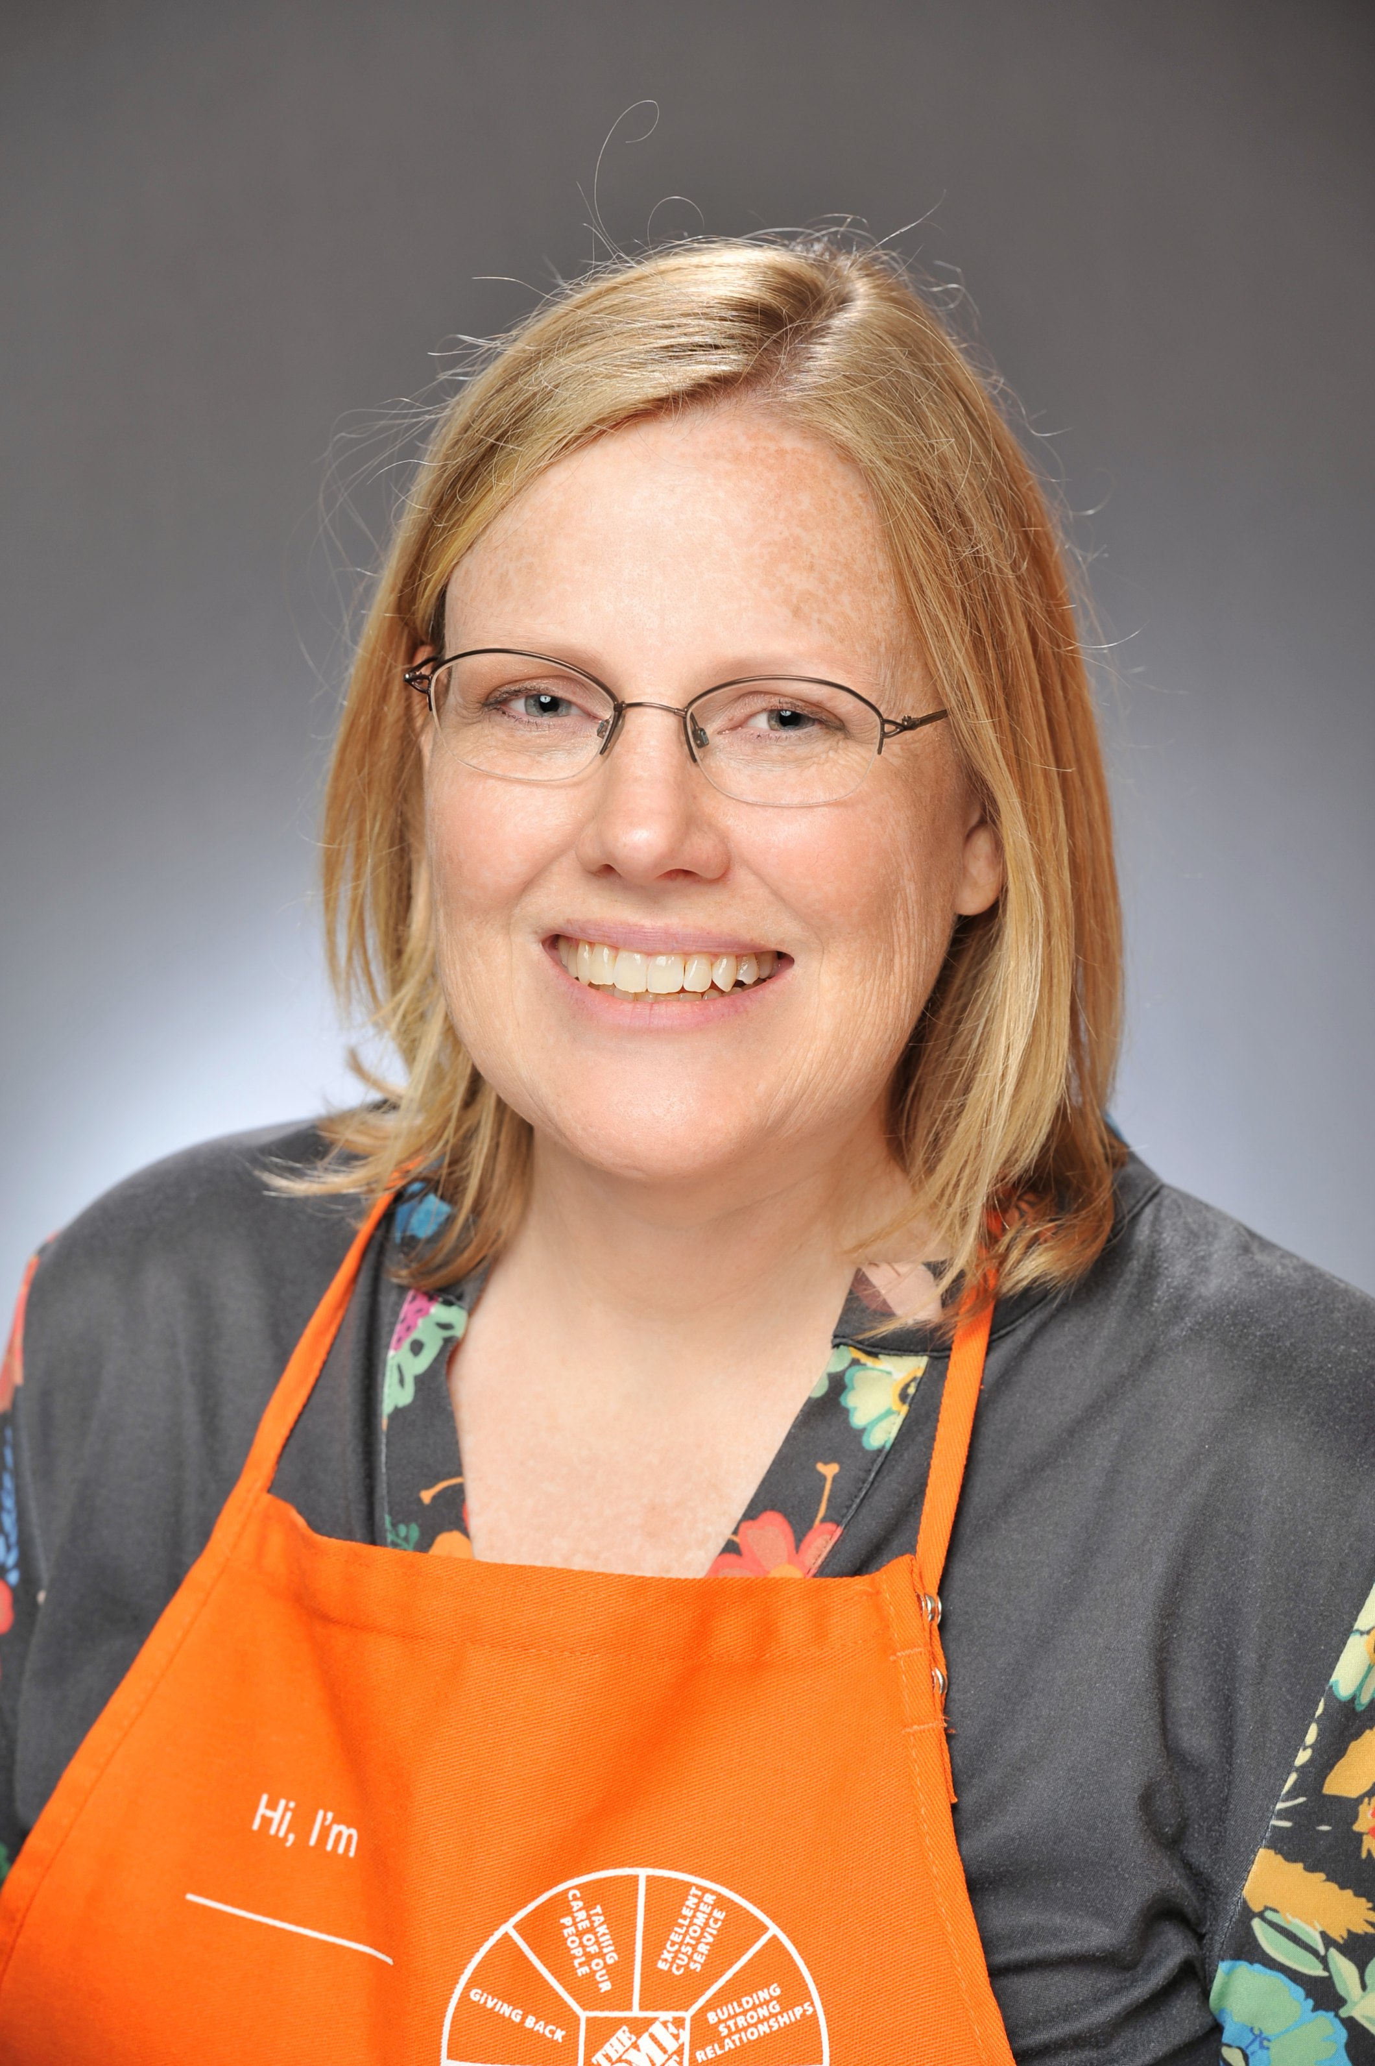


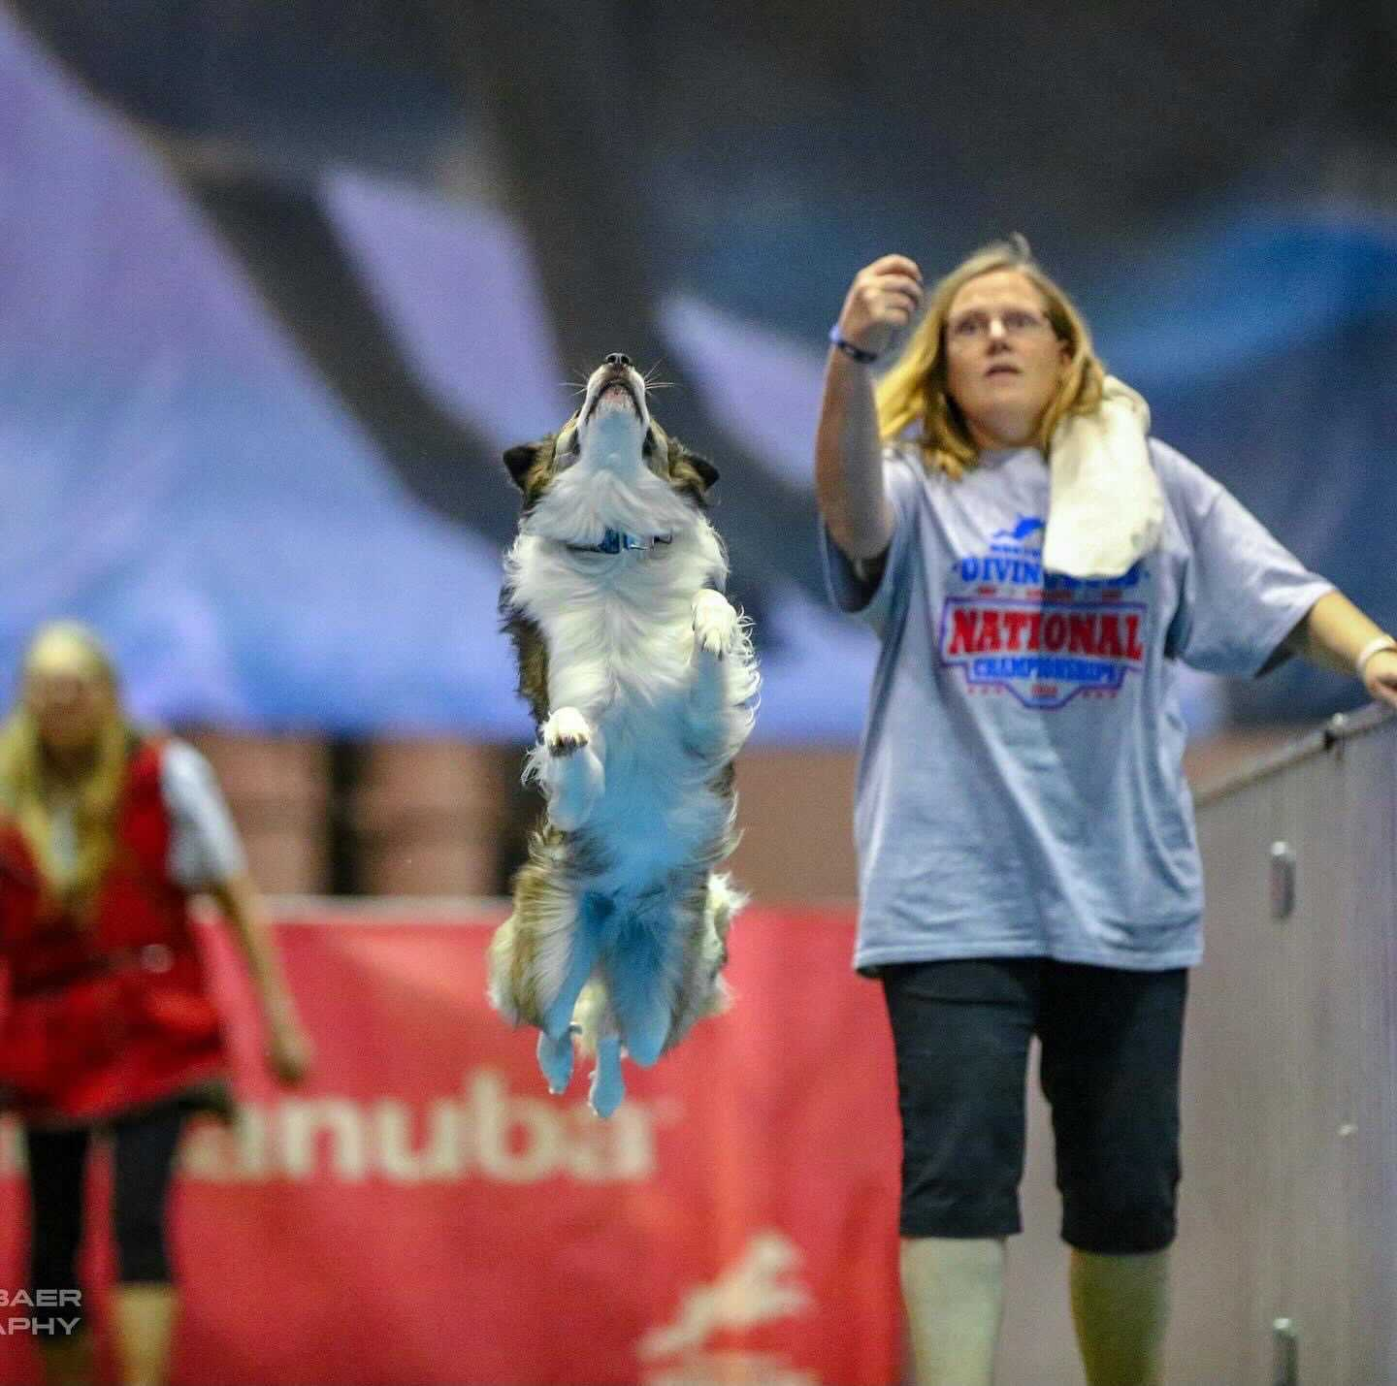
About Me
Karen Reeves
Home Depot
Senior Software Engineer
Email: karen_m_reeves@homedepot.com
LinkedIn: karenmreeves
Twitter: @quiltndogs
Slide Deck: https://kmr0018.github.io/ConnectForward-PubSubOnGCP/
Karen is a software engineer at Home Depot working on GCP, Java Microservices and React. She has 22 years experience in Java and Web Development. In her spare time she plays dog sports with her dogs and quilts, which explains her twitter and IG handle.

Slide 17
Resources
https://thenewstack.io/publish-subscribe-introduction-to-scalable-messaging/
https://cloud.google.com/pubsub/docs/overview
https://cloud.google.com/pubsub/architecture
https://aws.amazon.com/pub-sub-messaging/
https://blog.stackpath.com/pub-sub/

