Slide 1


Internship Report
Company: Rane Steering Systems Ltd, R&D Division
Duration: 4 weeks (26th May – 20th June)
Presented by – Mohnish Raja
Date: 20/06/2025

Slide 2
Initial Plan (What I intended)
Learn about Steering Column parts, their functions and working.
Understand design phases, new product development, and structural/mechanical analysis.
Discover innovations in design, patents, and learn about CAD/CAE tools.
Participate in an application-oriented tasks and present learnings.

Slide 3
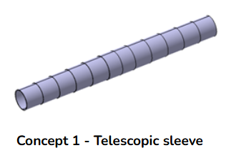
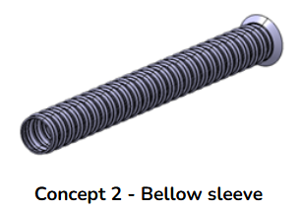
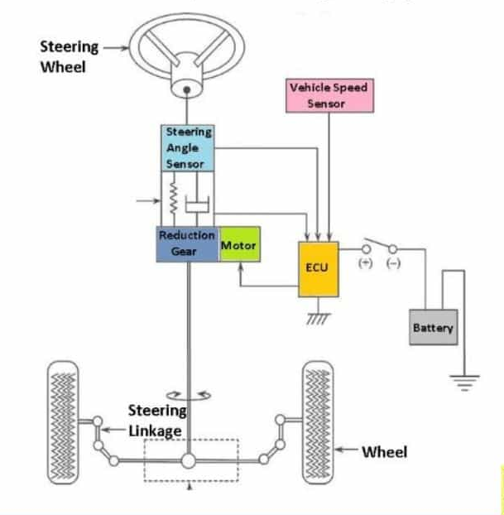
What I Actually Did
Studied Steering Column design & performed design tasks (ex: Disc Spring Washer Design, Extension Spring Design for MSC).
Proposed design ideas for Column Sleeve and learnt how to create a comparison matrix for different types of sleeves (Bellow – type, telescopic, etc.)
Learnt the working of EPS through discussions with Senior Managers & Engineers. Studied few patents to understand the control loops in EPS.
Observed CAE use cases (linear/non-linear) & created internal documents and presented learnings to the R&D team.

Slide 4
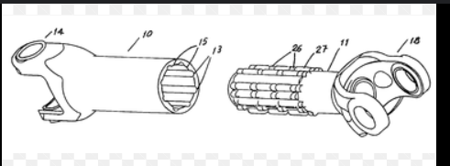
What I Actually Did
Visited the Testing Lab and observed MSC and EPS validations, gaining a clear understanding of test conditions and column performance.
This experience offered valuable insight into how columns behave and perform under real-world use.
Had an overview of how innovations are implemented in existing designs and how they are verified.
Studied and created flowcharts in Product Development procedures like QSP (Quality System Procedure) charts.

Slide 5
Planned v/s Actual Comparison
Week | Planned Activities | Actual Activities
Week 1 | Learn parts & working of steering columns | Understood parts & performed design tasks
Week 2 | Design phases, new product dev, and structural analysis | Created a sleeve design comparison matrix, studied and created flowcharts of Product Development processes
Week 3 | Innovations, CAE tools, patents | Test Lab visit, CAE use cases overview, EPS working overview
Week 4 | Application-oriented tasks & presentation | Modification of previous design task(Extension Spring) & presentation.

Slide 6
Why the plan evolved
The actual work was aligned with R&D priorities and mentors’ guidance, making it more application-focused.
A couple of tasks that were planned didn’t come under the scope of the company, for example - Ergonomics.
Previously unplanned visit to Test Lab gave hands on exposure where I observed how columns perform and are validated under different conditions.

Slide 7
Final Deliverables
Design Iterations & Spec for:
Disc Spring Washer for Lever of MSC
Wave Washer for Lever of MSC
Extension Spring for Tilt Mechanism in MSC
Sleeve for Column Shaft:
Design Ideas – Bellow Type & Telescopic
Sleeve Comparison Matrix for 4 types of sleeves
Contributed in QSP Process Flow Chart creation with the help of existing QAS Chart

Slide 8
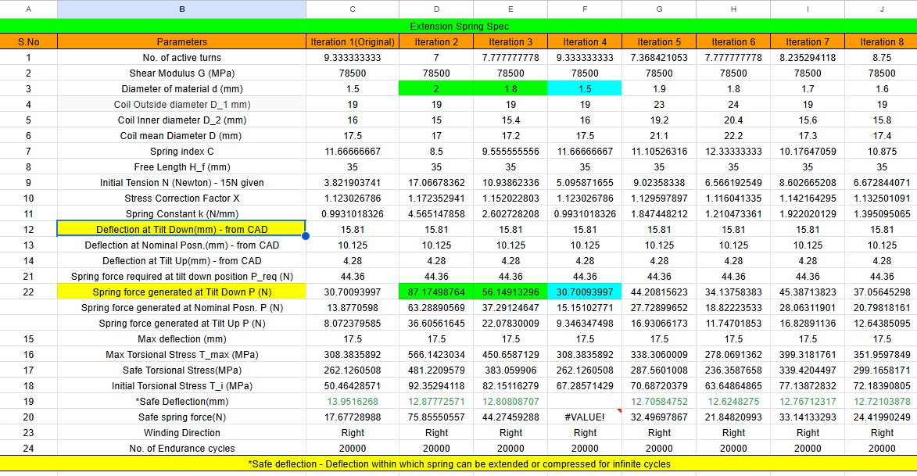
Extension Spring Calculation

Slide 9
Technical Learnings
Understanding constraints in steering column design majorly through the performed Design tasks. Also learnt the dynamics of springs & washers.
Role of CAE and Testing in design verification. Observed various methods and conditions in which Steering Columns are tested.
Had insights on the Process Flow of developing a new product through the QSP & QAS flow charts.
Understood the importance of checking on the feasibility of a product while designing it.

Slide 10
Soft Skills Developed
Technical communication and structured reporting.
Time management across varying tasks given.
Learnt how to seek and apply feedback from mentors, managers and colleagues, who are on a busy schedule.
Understanding multidisciplinary interactions within R&D.
Proper documentation of work done and tasks performed.

Slide 11
Acknowledgements & Reflections
Thanks to the R&D team and especially my mentors – Mr. Ezhumbarithi & Mr. Venkadeshwaran for their support and guidance throughout the Internship.
Special Thanks to Mr. Ramnath for providing me this opportunity.
Through this Internship, I developed a more realistic view of how theoretical knowledge applies in industry.

Slide 12
Thank You!

