Slide 1
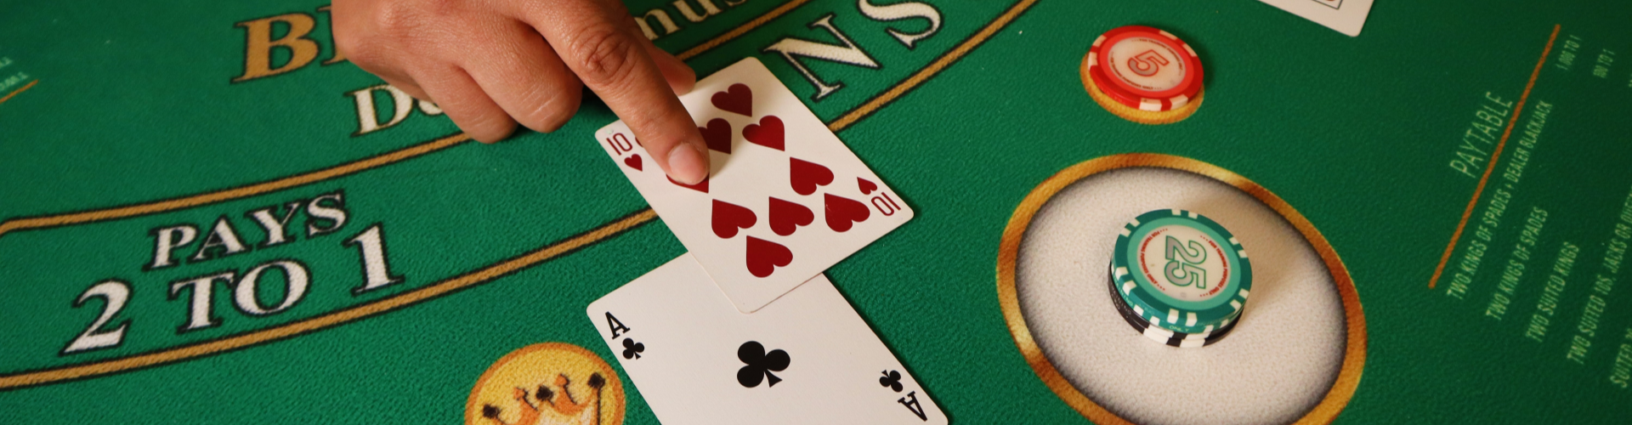
Monte Carlo Methods and Random Processes
An Exploration in Blackjack and Reinforcement Learning

Slide 2
Video Presentation
YouTube Link : https://youtu.be/K8Mxj1uDIGM N.B – Please email me at kazi-mushfiq.rafid.358@my.csun.edu if you cannot access the video link. Thank you.

Slide 3
Introduction to Random Processes
What are Random Processes?
- A sequence of random variables evolving over time.
- Used to model stochastic systems like weather, stock prices, and games.
Applications:
- Simulation of real-world phenomena.
- Foundation for probabilistic decision-making.
Notes:
Random processes are sequences of events that change over time in unpredictable ways. They’re useful for modeling things like weather, stock prices, or games. By understanding these processes, we can make better predictions and decisions in uncertain environments.

Slide 4
Monte Carlo Methods Overview
What are Monte Carlo Methods?
- A computational approach using random sampling.
- Estimate mathematical functions and optimize systems.
Key Idea:
- Use randomness to solve problems that might be deterministic in principle.
Notes:
Monte Carlo methods solve problems by simulating random scenarios instead of trying to calculate everything exactly. They estimate outcomes, optimize strategies, and work well for complex problems. These methods use randomness as a tool to explore and improve systems.

Slide 5
Blackjack as a Random Process
Why Blackjack?
- The game is inherently stochastic.
- Player and dealer decisions are based on probabilities.
State of the Game:
- Player's sum, dealer's showing card, and usable ace.
- Actions: Stick or Hit.
Notes:
Blackjack is a good example of a random process. The cards you and the dealer draw are unpredictable, and your decisions—whether to hit or stick—depend on probabilities. This makes Blackjack a great way to test how Monte Carlo methods can improve decision-making.

Slide 6
Episode Generation in Blackjack
Simulating Random Episodes:
- Generate a sequence of states, actions, and rewards.
- Use policies like random sampling or epsilon-greedy.
Example:
- If the player's sum ≤ 18, higher probability of hitting.
- Otherwise, stick.
Notes:
To improve strategy in Blackjack, we simulate games called episodes. Each episode is a sequence of states (like your card total), actions (hit or stick), and rewards (win or lose). For example, if your total is 15, you might hit; with 20, you’d likely stick. By running many episodes, we gather data to refine strategies.

Slide 7
Policy Improvement via Monte Carlo
Using Episodes for Policy Optimization:
- Collect data from episodes.
- Estimate the value of actions in different states (Q-values).
- Update the policy to maximize expected returns.
Notes:
Monte Carlo methods help us improve strategies by analyzing these episodes. We calculate the expected rewards for different actions and update the strategy to prioritize actions that lead to better outcomes.

Slide 8
Epsilon-Greedy Policies
Balancing Exploration and Exploitation:
- Exploration: Randomly sample actions to discover new strategies.
- Exploitation: Choose the best-known action to maximize rewards.
Epsilon-Greedy:
- With probability ε, take a random action.
- With 1-ε, take the action with the highest estimated value.
Notes:
When learning, we face a choice: Should we explore new actions or stick with the best-known ones? Epsilon-greedy policies handle this balance by exploring randomly some of the time and exploiting the best options most of the time. As the strategy improves, we explore less and exploit more.

Slide 9
Role of Randomness in Learning
Why Randomness?
- Prevents premature convergence to suboptimal policies.
- Ensures exploration of the entire state-action space.
Key Insight:
- Randomness drives learning in stochastic environments.
Notes:
Randomness ensures we explore all possibilities and don’t get stuck on bad strategies. It drives learning by helping the algorithm discover the best actions through trial and error.

Slide 10
Expected Value Calculation
The expected value (EV) quantifies the average outcome of a random variable over many trials.
In Blackjack, EV is used to estimate the state-value function V(s) or the action-value function Q(s,a):
V(s) = E[G_t | S_t = s]
Q(s,a) = E[G_t | S_t = s, A_t = a]
G_t is the return (sum of discounted rewards), and the expectation is computed via Monte Carlo sampling.
V(s) = E[G_t | S_t = s] Q(s,a) = E[G_t | S_t = s, A_t = a]
Notes:
We used Python to apply these ideas: OpenAI Gym simulated the Blackjack environment, NumPy helped with calculations for rewards and actions, and Matplotlib created visualizations to interpret results. This combination made it easier to test and improve the strategy.

Slide 11
Discounted Rewards
Future rewards are discounted to give more weight to immediate rewards and less to distant ones.
The discount factor γ (0 ≤ γ ≤ 1) controls the weight of future rewards:
G_t = R_t+1 + γR_t+2 + γ^2R_t+3 + …
This helps balance short-term and long-term rewards in decision-making.
G_t = R_t+1 + γR_t+2 + γ^2R_t+3 + …
Notes:
Our implementation included simulating episodes to gather data, calculating Q-values for state-action pairs using Monte Carlo methods, refining strategies with epsilon-greedy policies, and visualizing results with 3D state-value plots and heatmaps to validate decisions.

Slide 12
Argmax for Policy Selection
To select the best action during exploitation, the argmax function is used:
a* = argmax_a Q(s,a).
This ensures the policy chooses the action with the highest estimated value.
a* = argmax_a Q(s,a)
Notes:
Visualization made the results clear. For instance, 3D plots showed which situations were favorable, like when you have 20 and the dealer shows a low card. Heatmaps illustrated whether to hit or stick in different situations, giving a clear view of the strategy.

Slide 13
Bellman Equation
Although not directly used in Monte Carlo methods, the Bellman equation is fundamental to reinforcement learning:
V(s) = E[R_t+1 + γV(S_t+1)].
Monte Carlo methods approximate V(s) or Q(s,a) by sampling rather than explicitly solving the Bellman equation.
V(s) = E[R_t+1 + γV(S_t+1)]
Notes:
Here are some key ideas behind the math: Expected Value (EV) tells us the average reward for a state or action. Discounted Rewards weigh immediate rewards more heavily than future ones. Probability Functions define how likely an action is, which is especially useful for epsilon-greedy policies.

Slide 14
Gradient Updates (for Policy Improvement)
In some cases, the policy can be refined using gradient-based updates:
θ ← θ + α∇J(θ), where:
θ represents the parameters of the policy,
J(θ) is the performance measure (e.g., expected reward),
and α is the learning rate.
θ ← θ + α∇J(θ)
Notes:
We also used advanced techniques like the Bellman Equation to connect current and future rewards, Gradient Updates to adjust strategies step by step, and Argmax to pick the best action. These techniques are powerful and can be applied beyond Blackjack.

Slide 15
Probability Functions
Probability distributions are crucial for random sampling.
When generating episodes, actions are sampled from a policy (e.g., epsilon-greedy), which defines the probabilities of choosing each action:
π(a|s) = {1−ε + ε/|A|, if a = argmax_a Q(s,a);
ε/|A|, otherwise}.
Here, ε controls exploration by adding randomness to the policy.
π(a|s) = {1−ε + ε/|A|, if a = argmax_a Q(s,a); ε/|A|, otherwise}
Notes:
Random processes have challenges: estimates can vary a lot, and it takes time to learn effective strategies. To handle this, we run many simulations and reduce exploration over time as the strategy improves.

Slide 16
Averages for Value Estimation
To compute V(s) or Q(s,a), we use sample averages:
Q(s,a) = (1 / N(s,a)) Σ G_t(i), where
N(s,a) is the number of times the state-action pair (s,a) has been visited,
and G_t(i) is the return observed from each visit.
Q(s,a) = (1 / N(s,a)) Σ G_t(i)
Notes:
Monte Carlo methods are used in fields like predicting stock prices, optimizing queues in customer service, and solving complex math problems. Their flexibility makes them useful in many areas, from finance to artificial intelligence.

Slide 17
Statistical Sampling
Monte Carlo relies heavily on random sampling:
Uniform sampling: Used when actions are selected randomly.
Weighted sampling: Used in epsilon-greedy policies or when applying importance sampling for more advanced Monte Carlo techniques.
Notes:
To summarize: Random processes and Monte Carlo methods help with decision-making in uncertain situations. Balancing exploration and exploitation is key to learning. These tools can solve problems in many real-world scenarios.

Slide 18
Normalization
When visualizing or comparing data (e.g., heatmaps), normalization ensures values are scaled to a specific range, making trends easier to observe.
Notes:
We used resources like Sutton and Barto’s book on reinforcement learning and tools like OpenAI Gym and Matplotlib to guide our project.

Slide 19
Linear Algebra for State-Action Spaces
In environments with large state-action spaces, vectorized operations (e.g., using NumPy) simplify computations for Q(s,a) and rewards.

Slide 20
Coding Approach
How We Solved the Problem:
- Used Python for implementation.
- Leveraged OpenAI Gym's Blackjack environment to simulate the game.
- Applied Monte Carlo methods for reinforcement learning:
- Policy evaluation with Q-value estimation.
- Policy improvement using epsilon-greedy strategies.
Key Python Libraries:
- NumPy for numerical computations.
- Matplotlib for data visualization.
- OpenAI Gym for environment simulation.

Slide 21
Coding Highlights
Key Components of the Code:
- Episode Generation:
- Simulated sequences of states, actions, and rewards.
- Monte Carlo Prediction:
- Estimated state-action values (Q-values) using sampled episodes.
- Monte Carlo Control:
- Updated the policy iteratively for optimal decision-making.
- Visualization:
- 3D state-value plots and 2D policy heatmaps for insights.
Frameworks:
- Python's flexibility enabled quick iteration and testing.

Slide 22
Visualization of Random Outcomes
State-Value Function (V):
- 3D plots show expected returns for each state.
Policy:
- Heatmaps reveal optimal actions (stick or hit) in different states.

Slide 23
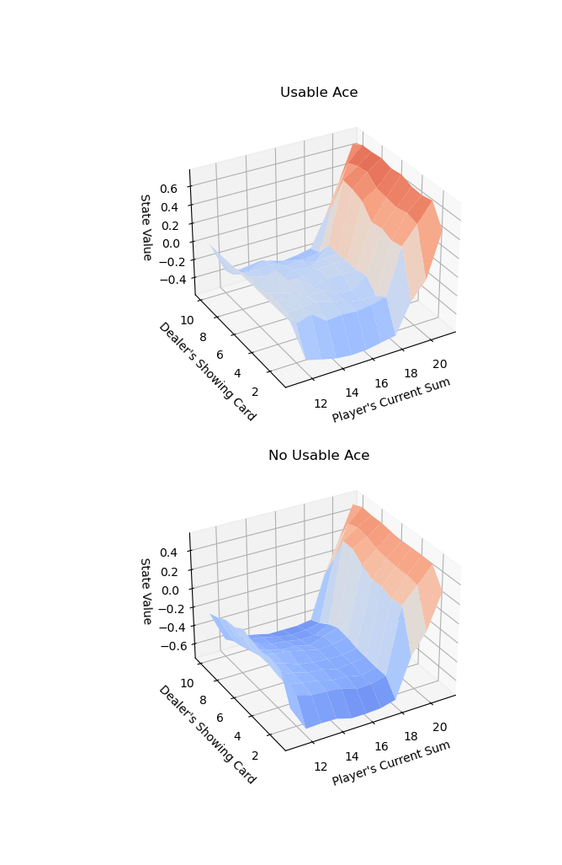
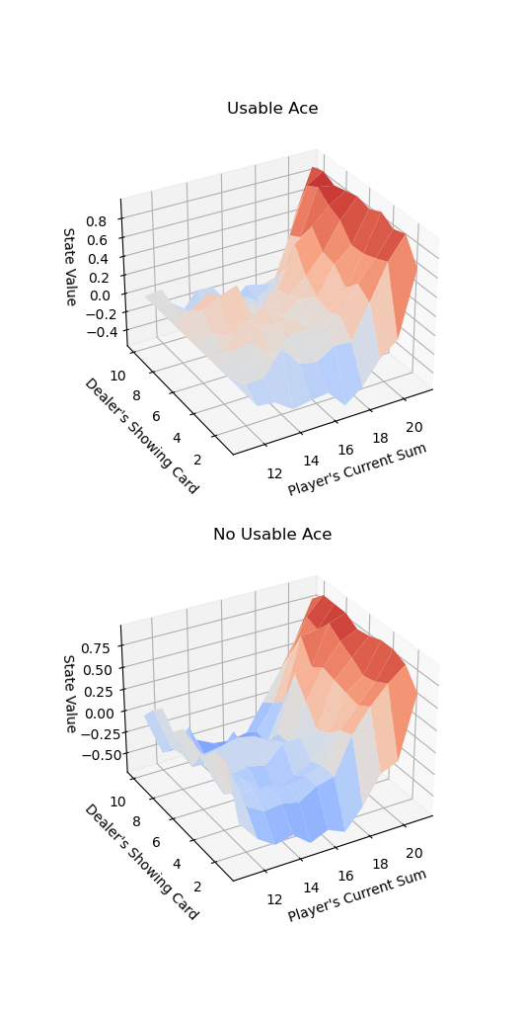
Outcomes

Slide 24
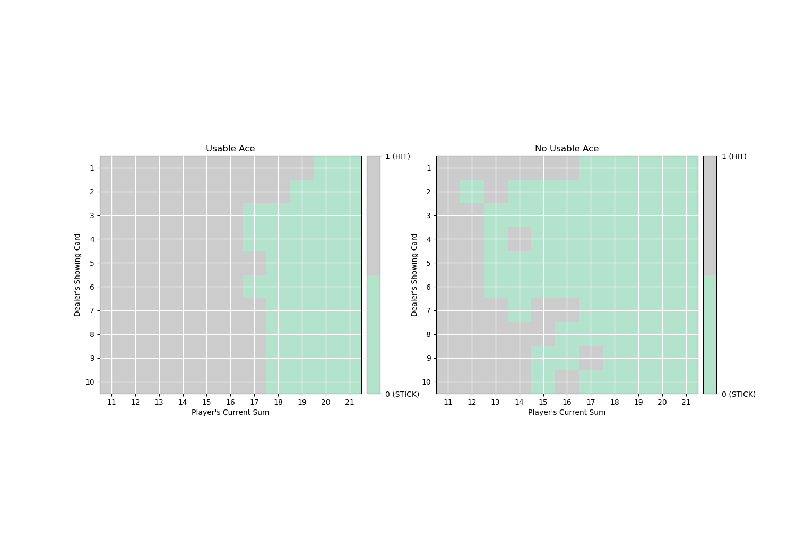
Outcomes

Slide 25
Challenges of Random Processes
Issues with Randomness:
- High variance in value estimates.
- Convergence may be slow.
Solutions:
- Use large sample sizes.
- Implement epsilon decay to balance exploration and exploitation.

Slide 26
Applications Beyond Blackjack
Monte Carlo and Random Processes:
- Simulating stock market dynamics.
- Modeling queueing systems in operations research.
- Estimating integrals in high-dimensional spaces.

Slide 27
Key Takeaways
Lessons Learned:
- Random processes are powerful for modeling stochastic systems.
- Monte Carlo methods effectively leverage randomness for learning.
- Combining exploration and exploitation leads to optimal policies.

Slide 28
References
References:
- Sutton, R. S., & Barto, A. G. (2018). *Reinforcement Learning: An Introduction* (2nd ed.).
- OpenAI Gym Documentation: https://www.gymlibrary.dev/
- Matplotlib Visualization Library: https://matplotlib.org/
- NumPy: The fundamental package for scientific computing with Python: https://numpy.org/
- Pease, C. (2018, September 6). An Overview of Monte Carlo Methods. Medium; Towards Data Science. https://towardsdatascience.com/an-overview-of-monte-carlo-methods-675384eb1694
- Agent, T. P. (2020, April 25). Monte Carlo Methods — Learning from experience - Analytics Vidhya - Medium. Medium; Analytics Vidhya. https://medium.com/analytics-vidhya/monte-carlo-methods-learning-from-experience-1bfce2d53313
- Bajaj, A. (2022, July 21). Monte Carlo Simulation: A Hands-On Guide. Neptune.ai. https://neptune.ai/blog/monte-carlo-simulation
- Pelin Okutan. (2024, January 12). Monte Carlo Simulation: A Comprehensive Guide - Pelin Okutan - Medium. Medium. https://medium.com/@pelinokutan/monte-carlo-simulation-a-comprehensive-guide-67ba39028831
‌
‌
‌
‌

Slide 29
References
- Byrne, D. (2018, November 7). Learning To Win Blackjack With Monte Carlo Methods - Towards Data Science. Medium; Towards Data Science. https://towardsdatascience.com/learning-to-win-blackjack-with-monte-carlo-methods-61c90a52d53e
- Yijie, A. (2019, November 18). Fundamentals of Reinforcement Learning: Understanding Blackjack Strategy through Monte Carlo Methods. Medium; GradientCrescent. https://medium.com/gradientcrescent/fundamentals-of-reinforcement-learning-understanding-blackjack-strategy-through-monte-carlo-88c9b85194ed
- Adelson, A. (2017, June 22). Using Monte Carlo to Answer a Blackjack Question - Andrew Adelson - Medium. Medium. https://medium.com/@andrewadelson/using-monte-carlo-to-answer-a-blackjack-question-part-1-b5714e4592cb
- Vyacheslav Efimov. (2024, May 23). Reinforcement Learning, Part 3: Monte Carlo Methods. Medium; Towards Data Science. https://towardsdatascience.com/reinforcement-learning-part-3-monte-carlo-methods-7ce2828a1fdb
- Gianitsos, T., Isogawa, M., & Mendoza, D. (n.d.). CS238 Project Monte Carlo Blackjack. https://web.stanford.edu/class/aa228/reports/2019/final69.pdf
- Chiswick, M. (2020, September 21). Monte Carlo RL and Blackjack. Max Chiswick. https://chisness.github.io/2020-09-21/monte-carlo-rl-and-blackjack
‌
‌
‌
‌
‌
‌

Slide 30
Thank you

