Slide 1



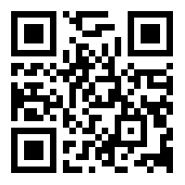


QR Code Generator & Scanner
SmartGurucool

Slide 2



01
What is QR Code?
  Quick Response Code
  Can store larger amounts of data as compared to bar code
  Invented in 1994 by Japanese company Denso Wave

Slide 3
Which kind of information
QR Code
can Store?

Slide 4
02
  Contact Details
  Social Media IDs like Facebook ID, Instagram ID, etc.
  Product Details
  Link which can directly download an app from Google Play Store or Apple App Store
  Digital Payment Transactions

Slide 5
Implementing QR Code System in Python

Slide 6
Packages We Need
qrcode
opencv-python
tkdesigner
pip install qrcode
We need this library for generating the qr code patterns.
pip install opencv-python
We need this library for analyzing the qr code, so that we can scan it.
pip install tkdesigner
We need this library for converting the Figma Design to Tkinter GUI automatically.

Slide 7
Project Structure

Slide 8
Stages
Figma
Design
Tkdesigner Automation
Python Code Customization

Slide 9
03
Let's Start
Figma Design

Slide 10
Let's work
with Tkdesinger

Slide 11
Finally, let 's do
Python Coding
04

Slide 12
Hurray!
We have done it!!

