Slide 1
Highway Tollgates Traffic Flow Prediction Travel Time & Traffic Volume Prediction Video link: https://www.youtube.com/watch?v=WOXEJLsxbzg
Manohar Katam (mxk164930)
Shiva Podugu (sxp170130)
Sravani Lingam (sxl170330)
Venkata Kartheek Madhavarapu (vxm153830)

Slide 2
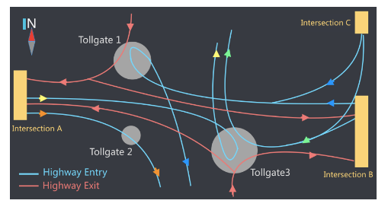
KDD CUP 2017
Highway Tollgates Traffic Flow Prediction
Travel Time & Traffic Volume Prediction
Task1: Average Travel time prediction in 20 min interval windows
Task2: Volume prediction in 20 min interval windows

Slide 3
HYPOTHESIS
Traffic flow’s average travel time and volume depends on mostly
Weather (rainfall, temperatures) – weather data given in dataset
Links, routes connecting the road – given in dataset
ADDED FEATURES
The day (weekday, weekend)
Holiday ? (looked at Chinese calender for holiday dates)
The hour (what hour it is ? Generally we see traffic at office hours
Lags (time series models mostly depends on the previous values)

Slide 4
PRE-PROCESSING
Outlier pre-processing
Data Imputation: Detecting NA values or outliers and replacing them.
Removing the uncorrelated attributes: through correlation plots.
Adding new features (Feature engineering): Adding extra features as needed.
Data Augmentation (adding instances)

Slide 5
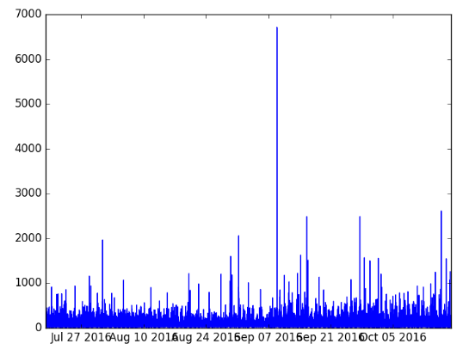
OUTLIER PRE-PROCESSING

Slide 6
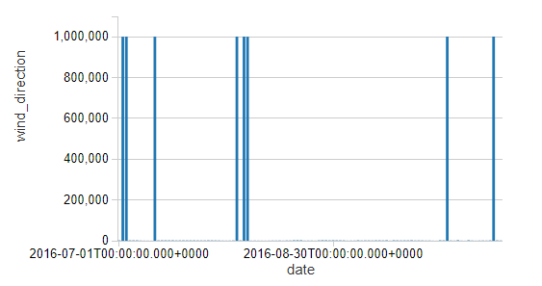
OUTLIER PRE-PROCESSING

Slide 7
DATA AUGMENTATION moving time windows w(t) to w(t-t0) There is less data when grouped by 20 min intervals
Time window | Window + 5 | Window -5 | Window + 3 | Window -3
00:00 – 00:20 | 00:05 – 00:25 | 23:55 – 00:15 | 00:03 – 00:23 | 23:57 – 00:17

Slide 8
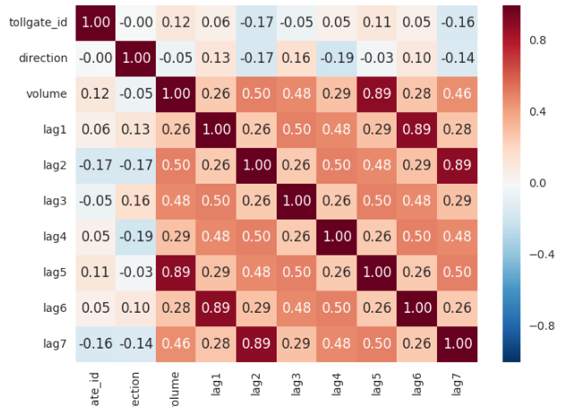
ADDING LAGS
Once traffic jam occurs there will be a steady rise & drops steadily
so avg_travel_time and volume at a tollgate will rise & drop
To follow the trend of traffic flow we added lags

Slide 9
ADDING DATE TIME DATA
Friday, Monday, Saturday, Sunday, Thursday, Tuesday, Wednesday, hour__0, hour__1, hour__2, hour__3, hour__4, hour__5, hour__6, hour__7, hour__8, hour__9, hour__10, hour__11, hour__12, hour__13, hour__14, hour__15, hour__16, hour__17, hour__18, hour__19, hour__20, hour__21, hour__22, hour__23, `0`, `20`, `40`, holiday

Slide 10
LINKS AND ROUTES DATA
in_link_cross_count, out_link_cross_count, length, link_count 1_length 2_length 3_length 4_length 1_count 2_count 3_count 4_count
Link_id | link id
Length | length (meters) of road link
Width | width (meters) of road link
Lanes | number of lanes on the road link
In_top | incoming road links, separated by comma “,”
Out_top | outgoing road links, separated by comma “,”
Lane_width | lane width (meters)
Intersection_id | Intersection ID
Tollgate_id | Tollgate ID
Vehicle_id | Vehicle ID
Starting_time | Time point when vehicle enters the route
Travel_seq | Trajectory in the form of a sequence of link traces separated by “;” and each trace consists of link id, enter time and travel time in seconds, separated by “#”
Travel_time | The total time (in seconds) the vehicle takes from intersection to the tollgate
Intersection_id | Intersection ID
Tollgate_id | Tollgate ID
Link_seq | A sequence of link IDs separated from intersection to tollgate separated by commas “,”

Slide 11
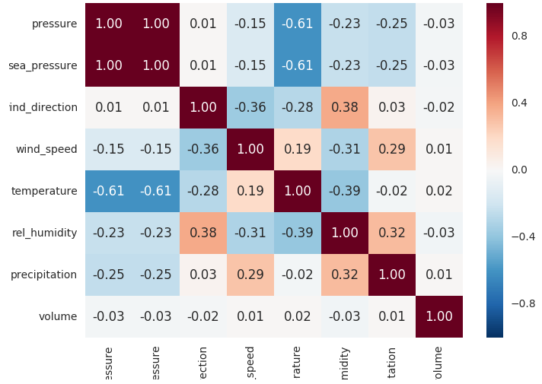
ADDING WEATHER DATA
Intersection_id | Intersection ID
Tollgate_id | Tollgate ID
Vehicle_id | Vehicle ID
Starting_time | Time point when vehicle enters the route
Travel_seq | Trajectory in the form of a sequence of link traces separated by “;” and each trace consists of link id, enter time and travel time in seconds, separated by “#”
Travel_time | The total time (in seconds) the vehicle takes from intersection to the tollgate
Time | The time when vehicle passes the tollgate
Tollgate_id | Tollgate ID
Direction | “0” for entry and “1” for exit
Vehicle_model | Capacity of the vehicle (range: 0-7) the bigger the higher capacity
Has_etc | Does vehicle has electronic toll collection tag? 0:No, 1:Yes
Vehicle_type | Vehicle type, 0:passenger type, 1:cargo vehicle
Date | Date
Hour | Hour (given for every 3 hours)
Pressure | Air pressure (in hPa)
Sea_pressure | Sea level pressure (in hPa)
Wind_direction | Wind direction (in Degree)
Wind_speed | Wind speed (in meters/sec)
Temperature | Temperature (in Degree Celsius)
Rel_humidity | Relative humidity
precipitation | Precipitation (in mm)

Slide 12
METRICS USED
MAPE (As per the competition requirement)
MAE
RMSE
R squared (Coefficient of Determination)

Slide 13
REGRESSION TECHNIQUES USED
Linear Regression
Random Forest Regression
Gradient Boosting Regression

Slide 14
DEMO
Task1 Preprocessing:
https://databricks-prod-cloudfront.cloud.databricks.com/public/4027ec902e239c93eaaa8714f173bcfc/5008245478875404/900645327760563/440415051426816/latest.html
Task1 Analysis with LR, RF and GBT using SparkMLlib:
https://databricks-prod-cloudfront.cloud.databricks.com/public/4027ec902e239c93eaaa8714f173bcfc/855389465014467/3665561683253945/4847935780219074/latest.html
Task2 Preprocessing:
https://databricks-prod-cloudfront.cloud.databricks.com/public/4027ec902e239c93eaaa8714f173bcfc/5008245478875404/727104593191945/440415051426816/latest.html
Task2 Analysis with LR, RF and GBT using SparkMLlib:
https://databricks-prod-cloudfront.cloud.databricks.com/public/4027ec902e239c93eaaa8714f173bcfc/5008245478875404/4245257127570951/440415051426816/latest.html

Slide 15
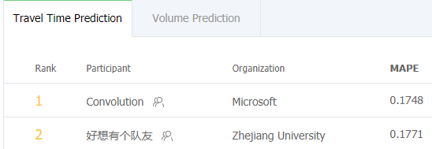
RESULTS https://tianchi.aliyun.com/competition/rankingList.htm?raceId=231597
Regression Technique | MAPE | MAE | RMSE | R²
Linear Regression | 0.21014478574298456 | 21.983251 | 31.877944 | 0.693847
Random Forest Regression | 0.25100822307748322 | 26.2604 | 38.9364 | 0.543259
Gradient Boosted Trees Regression | 0.23292589822325993 | 24.7269 | 35.545 | 0.619359
Task1 Results:
Task2 Results:
Regression Technique | MAPE | MAE | RMSE | R²
Linear Regression | 0.56683179152144236 | 9.868465 | 15.233811 | 0.892723
Random Forest Regression | 0.78647746101516436 | 11.6561 | 17.6491 | 0.856009
Gradient Boosted Trees Regression | 0.55801966599733666 | 9.85717 | 13.9279 | 0.910327

Slide 16
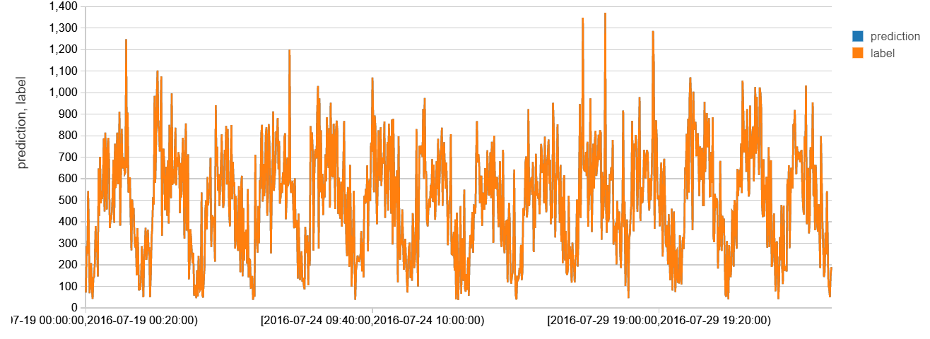
PREDICTED v/s ACTUAL PLOTS TASK-1

Slide 17
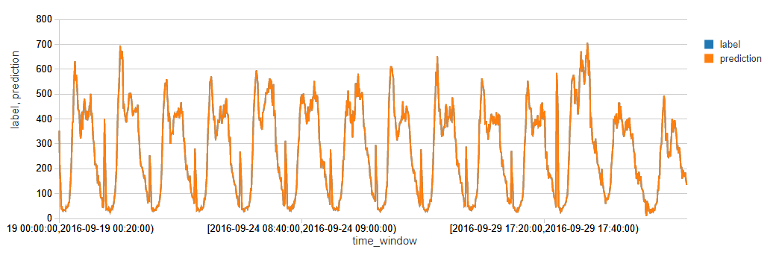
PREDICTED v/s ACTUAL PLOTS TASK-2

Slide 18
THANK YOU

