Slide 1


Busch Beer Analysis Anheuser Busch – Oct 18,2018

Slide 2
K n A Marketing Consultants, NY
Our expertise
Predominantly Marketing consultants
Study and apply Data analytics (Data Science)
Recommend marketing solutions based on the outcome
Go to market strategies as well as monitoring competition
Consumption Analytics – Pricing and promotions
Sales growth

Slide 3
Our Client - Anheuser Busch ltd
Established for 165 years with American values
Head quartered in St Louis MO.
One of the top brewers in US
Brews more than 100 brands.
Flag ship – “Budweiser” and “BudLight” brands.
Owns 23 breweries.
Has several craft partners, agricultural facilities and can lid plants.
14 Billion in revenue per year. - Anheuser Busch company website.

Slide 4
Story on Input data - Number of Breweries by States
Number of breweries per state – ordered highest to lowest.

Slide 5
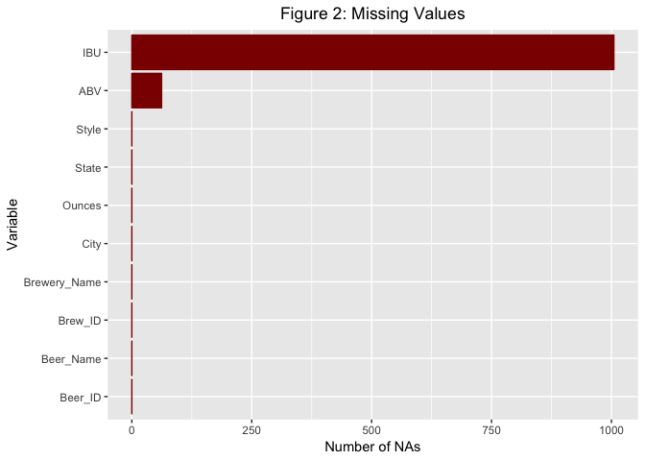
Missing data out of total input rows Except ABV and IBU we have no missing data.

Slide 6
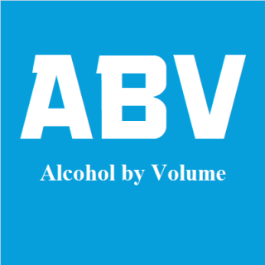
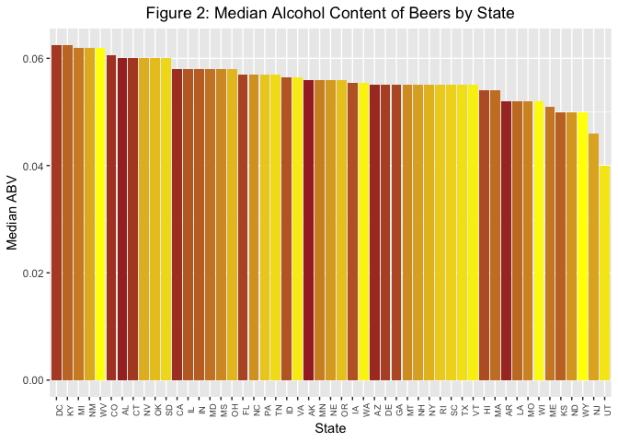

Slide 7

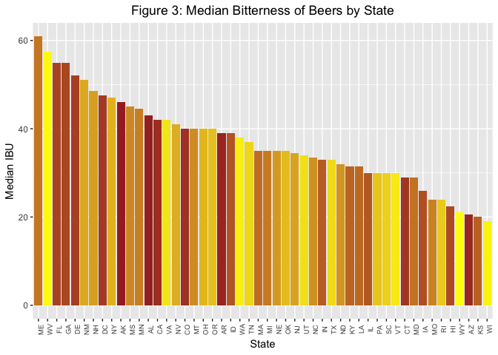

Slide 8
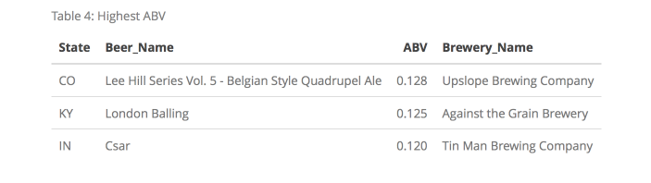
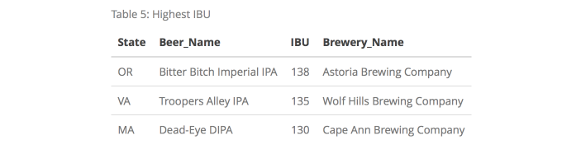
Maximum ABV and IBU
Table 2: End of Merged Data Frame

Slide 9
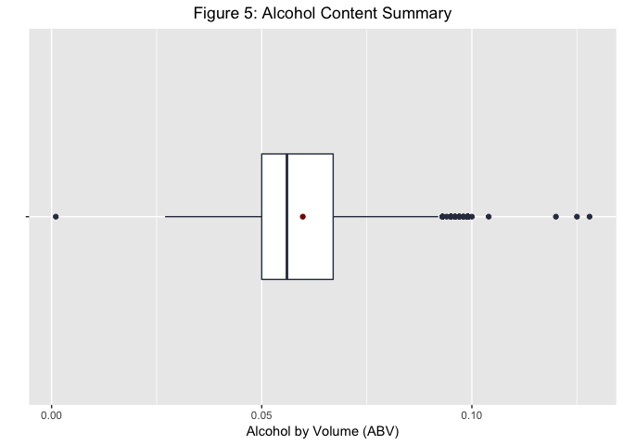
Summary of Alcohol by Volume
This summary shows the minimum, the mean, median and maximum of alcohol by volume (ABV). In percentage they represent 1%, 5.6% , 5.9% and 12.8% by volume respectively.

Slide 10
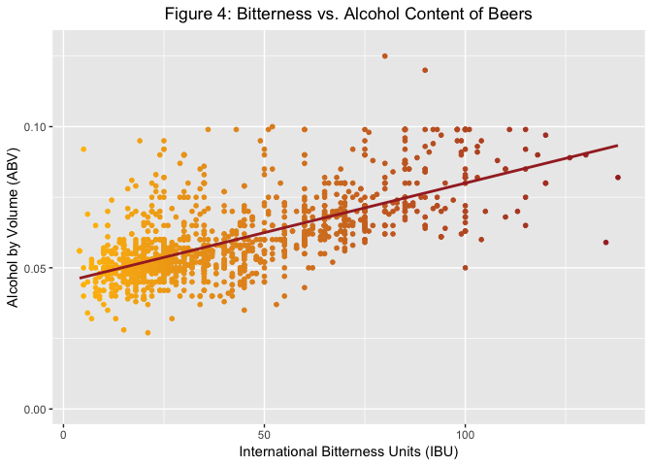
Linear relation between ABV and IBU
Pearson’s Correlation coefficient is around 0.67
Significant correlation (p < 0.0001)
Clustered around IBU less than 50 and ABV around 5%

Slide 11
Conclusion
Launch new product or improvise existing product with new flavors
Initially introduce in top 10 beer consuming states
Catchy advertisement (NFL halftime commercial)
Future follow-up

