Slide 1

Busch Beer Analysis Anheuser Busch Marketing Consultation – October - 2018

Slide 2
K n A Marketing Consultants, NY
Our Expertise:
Study and apply data analytics
Recommend marketing solutions based on the outcome
Go-to-market strategies as well as competition monitoring
Consumption analytics – pricing and promotions
Sales growth

Slide 3
Our Client - Anheuser Busch ltd
Established for 165 years with American values
Head quartered in St Louis MO.
One of the top brewers in US
Brews more than 100 brands.
Flag ship – “Budweiser” and “BudLight” brands.
Owns 23 breweries.
Has several craft partners, agricultural facilities and can lid plants.
14 Billion in revenue per year. - Anheuser Busch company website.

Slide 4
Story on Input data - Number of Breweries by States
Values order from higher to lower. Colorado shows Maximum while West Virginia the minimum.

Slide 5
Beers and Breweries - Merged Data
Table 1
Brewery_Name | City | State | Beer_Name | ABV | IBU | Style | Ounces
NorthGate Brewing | Minneapolis | MN | Pumpion | 0.060 | 38 | Pumpkin Ale | 16
NorthGate Brewing | Minneapolis | MN | Stronghold | 0.060 | 25 | American Porter | 16
NorthGate Brewing | Minneapolis | MN | Parapet ESB | 0.056 | 47 | Extra Special / Strong Bitter (ESB) | 16
NorthGate Brewing | Minneapolis | MN | Get Together | 0.045 | 50 | American IPA | 16
NorthGate Brewing | Minneapolis | MN | Maggie's Leap | 0.049 | 26 | Milk / Sweet Stout | 16
NorthGate Brewing | Minneapolis | MN | Wall's End | 0.048 | 19 | English Brown Ale

Slide 6
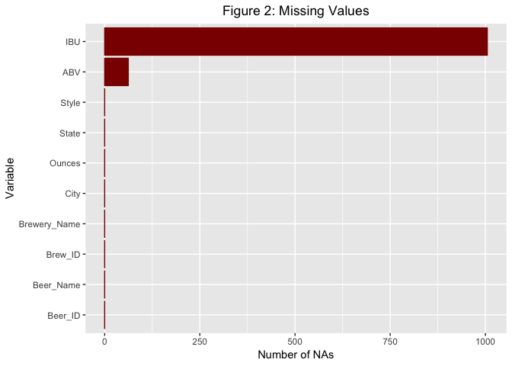
Missing data out of total input rows Except ABV and IBU we have no missing data.

Slide 7
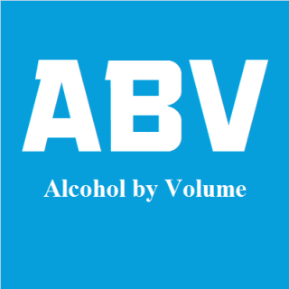
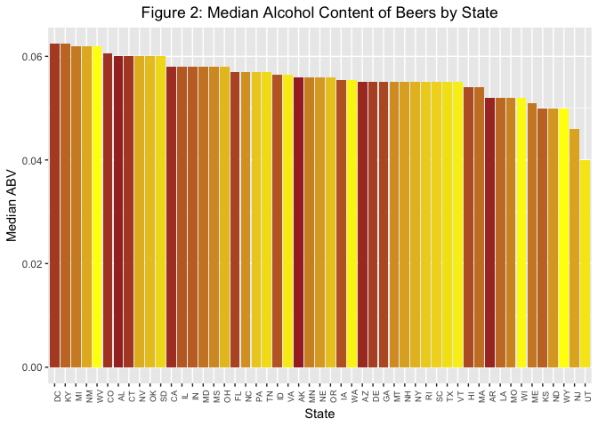

Slide 8

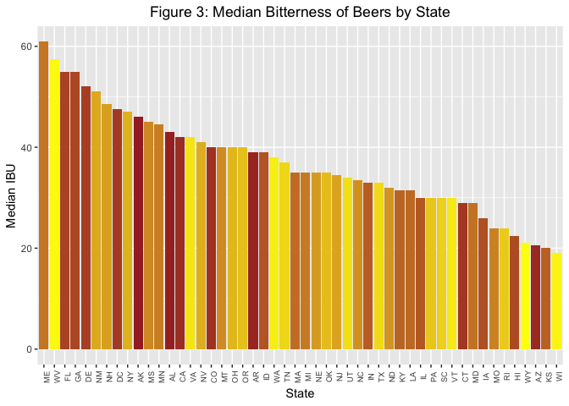

Slide 9
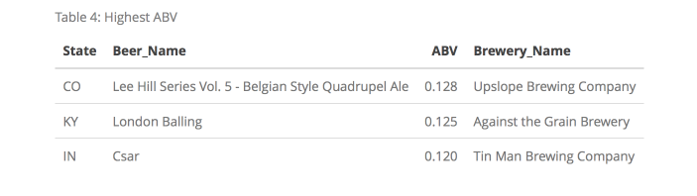
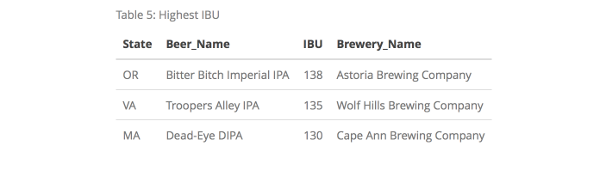
Maximum ABV and IBU
Table 2: End of Merged Data Frame

Slide 10
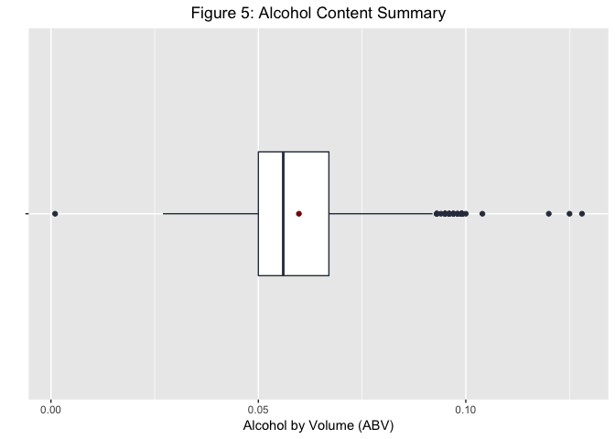
Summary of Alcohol by Volume
`The summary shows
the minimum, the median, mean, and maximum of alcohol by volume (ABV). In percentage they represent 1%, 5.6% , 5.9% and 12.8% by volume respectively.

Slide 11
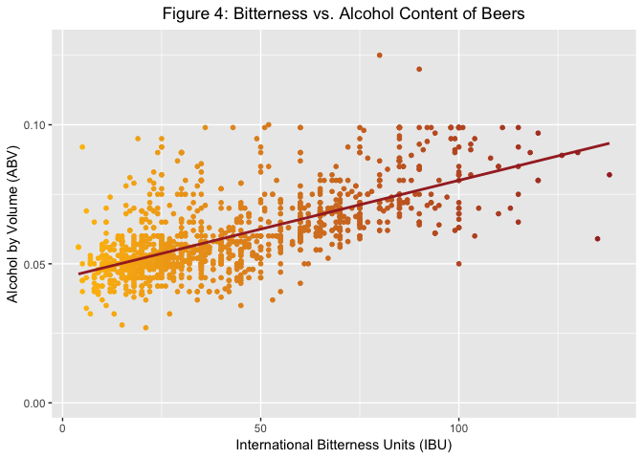
Linear relation between ABV and IBU
Pearson’s Correlation coefficient is around 0.67
Significant correlation (p < 0.0001)
Clustered around IBU less than 50 and ABV around 5%

Slide 12
Conclusion
Launch new product or improvise existing product with new flavors
Initially introduce in top 10 beer consuming states
Catchy advertisement (NFL halftime commercial)
Future follow-up

