Slide 1











$$e_{θ}$$
$$e_{t}\left(R+ΔR\right)$$
$$e_{r}\left(R+ΔR\right)$$
$$e_{θ}$$
$$ΔR$$
$$e_{t}\left(R\right)$$
$$Δθ$$
$$e_{r}\left(R\right)$$
$$r$$
$$R$$
$$O$$

Slide 2







$$x_{3}$$
$$q′$$
$$θ_{1}$$
$q(x_{1},x_{2}$, $x_{3}$)
$$p′$$
$$p\left(x_{1},x_{2}\right)$$
$$x_{2}$$

Slide 5
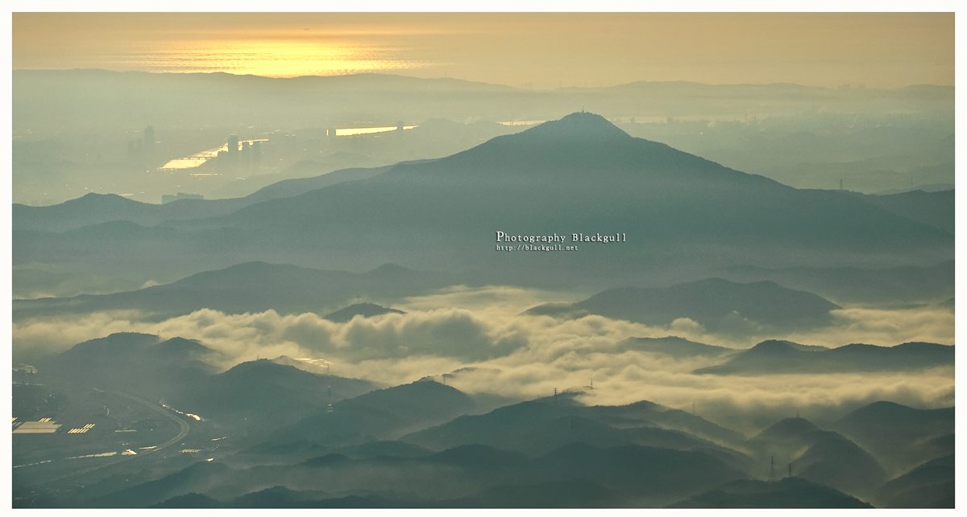

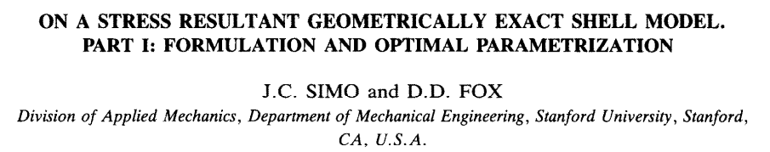
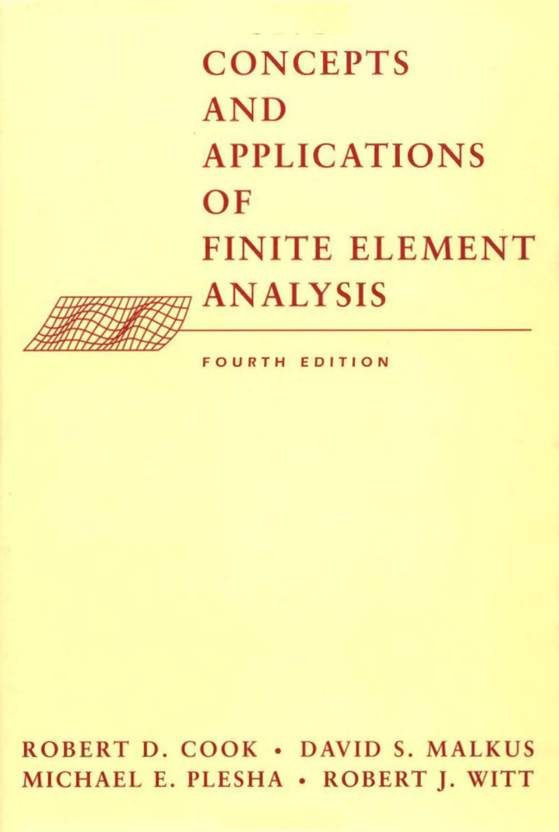
MEC 코드
Differential Gemoetry
Tensor
Simo & Fox 논문
Tangent space
Linear Algebra
Covector
Dual space
FEA 책
so(3) group
SO(3) group

