Slide 1
Coordinates

Slide 2

























$$β_{3}$$
$$y$$
$y$(들어가는 방향)
$z$(들어가는 방향)
$$z$$
$$x$$
$$β_{2}$$
$$x$$
$$β_{1}$$
$$z$$
$$x$$
$$y$$
$$β_{2}$$
$$γ_{1}$$
$$γ_{2}$$
$$e_{z}$$
$$r$$
$$e_{θ}$$
$$θ$$
$$β_{1}$$
$$z$$
$$P$$
$$e_{r}$$
$$e_{y}$$
$$e_{r}$$
$$θ$$
$$e_{θ}$$
$$θ$$
$$e_{x}$$

Slide 3















$$β_{3}$$
$${β′}_{3}$$
$$γ_{3}$$
$${β′}_{2}$$
$$α_{1}$$
$$α_{3}$$
$$γ_{2}$$
$${β′}_{1}$$
$$θ$$
$$α_{2}$$
$$β_{2}$$
$$γ_{1}$$
$$β_{1}$$
$$ℝ$$
$$ℝ^{2}$$
$$a$$
$$a$$

Slide 4













$$x$$
Elem csys
Formular csys
Projected output csys
Interface output csys
$$z$$
$$z$$
$$x$$
$$y$$
$$y$$
$$x$$
$$z$$
$$θ$$
$$x$$
$$y$$
$$y$$
$$z$$

Slide 5
Bar

Slide 6



$$p(x)$$
$$A(x)$$
$$x$$

Slide 7








$$p\left(x\right)$$
$$\left(σA\right)\left(x\right)$$
$$\left(σA\right)(x+∆x)$$
$$∆x$$
$$g$$
$$\left(qA\right)\left(x\right)$$
$$\left(qA\right)(x+∆x)$$
$$∆x$$

Slide 8














$$p(x)$$
$$f^{ext}$$
$$A(x)$$
$$L$$
$$x$$
$$p(x)$$
$$f^{ext}$$
$$Ω_{1}$$
$$Ω_{2}$$
$$⋯$$
$$Ω_{N_{E}}$$
$$A(x)$$
$$L$$
$$x$$

Slide 9





$$f_{1}^{i}$$
$$Ω_{i}$$
$$f_{2}^{i}$$
$$x_{1}^{i}$$
$$x_{2}^{i}$$

Slide 10
Beam

Slide 11
applied force

Slide 12




$$σ$$
$$τ$$
$$M$$
$$V$$

Slide 13













$$A$$
$$f$$
$$B$$
$$V_{A}$$
$$V_{B}$$
$$M_{A}$$
$$M_{B}$$
$$N_{A}$$
$$N_{B}$$
$$f$$
$$N_{B}$$
$$M_{B}$$
$$V_{B}$$

Slide 14














$$z$$
$$M_{z}$$
$$y$$
$$x$$
$$y$$
$$x$$
$$V_{y}$$
$$V_{z}$$
$$M_{x}$$
$$N_{y}$$
$$M_{y}$$
$$N_{x}$$
$$V_{x}$$
$$M_{x}$$

Slide 16
Shell

Slide 18
Composite Shell

Slide 19
Layer3
Layer2
Layer1

Slide 20











$$e_{θ}$$
$$e_{t}\left(R+ΔR\right)$$
$$e_{r}\left(R+ΔR\right)$$
$$e_{θ}$$
$$ΔR$$
$$e_{t}\left(R\right)$$
$$Δθ$$
$$e_{r}\left(R\right)$$
$$r$$
$$R$$
$$O$$

Slide 21









$$x_{3}$$
$$d$$
$$q$$
$$q′$$
$$p$$
$$x_{2}$$
$$d^{m}$$
$$p′$$
$$x_{1}$$

Slide 22







$$x_{3}$$
$$q′$$
$$θ_{2}$$
$$q$$
$$p′$$
$$d_{3}^{m}$$
$$p$$
$$d_{1}^{m}$$
$$x_{1}$$

Slide 23





$$x_{3}$$
$$q′$$
$$θ_{1}$$
$$q$$
$$p′$$
$$d_{3}^{m}$$
$$p$$
$$d_{2}^{m}$$
$$x_{2}$$

Slide 24
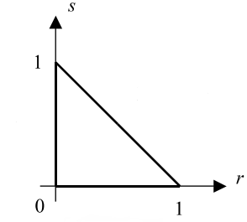

Slide 25



$$s_{3}$$
$$s_{1}$$
$$s_{2}$$

Slide 26



$$t_{2}$$
$$t_{3}$$
$$t_{1}$$

Slide 27





$$f_{1}$$
$$f_{2}$$
$$d_{1}$$
$$d_{2}$$

Slide 28




$$T_{1}$$
$$T_{2}$$
$$q_{1}$$
$$q_{2}$$

Slide 29






$$f_{1}$$
$$f_{2}$$
$$k$$
$$d_{1}$$
$$d_{2}$$

Slide 30














$$σ$$
$$^{tr}σ$$
$$c$$
$$^{n+1}σ$$
$$^{n}σ_{Y}$$
$$^{0}σ_{Y}$$
$$d$$
$$e$$
$$a$$
$$^{n}σ$$
$$b$$
$$R∆ε$$
$$ε$$
$$∆ε$$

Slide 31
$$σ$$
$$ε$$

Slide 32
$$σ$$
$$ε$$

Slide 33
Continuum

Slide 34
























$$σ\left(β_{3}\right)=T_{3}^{i}β_{i}$$
$$β_{3}$$
$$T_{3}^{3}$$
$$β_{2}$$
$$T_{3}^{2}$$
$$T_{3}^{1}$$
$$β_{1}$$
$$T_{2}^{3}$$
$$σ\left(β_{1}\right)=T_{1}^{i}β_{i}$$
$$T_{2}^{2}$$
$$T_{1}^{3}$$
$$T_{1}^{2}$$
$$T_{2}^{1}$$
$$σ_{2}^{2}+Δσ_{2}^{2}$$
$$σ\left(β_{2}\right)=T_{2}^{i}β_{i}$$
$$T_{1}^{1}$$
$$σ_{2}^{1}+Δσ_{2}^{1}$$
$$σ_{1}^{2}+Δσ_{1}^{2}$$
$$∆x^{2}$$
$$∆x^{1}$$
$$σ_{1}^{1}+∆σ_{1}^{1}$$
$$β_{3}$$
$$β_{2}$$
$$β_{1}$$

Slide 35
$$σ\left(β_{3}\right)=T_{3}^{i}β_{i}$$
$$β_{3}$$
$$T_{3}^{3}$$
$$β_{2}$$
$$T_{3}^{2}$$
$$T_{3}^{1}$$
$$β_{1}$$
$$T_{2}^{3}$$
$$σ\left(β_{1}\right)=T_{1}^{i}β_{i}$$
$$T_{2}^{2}$$
$$T_{1}^{3}$$
$$T_{1}^{2}$$
$$T_{2}^{1}$$
$$σ_{2}^{2}+Δσ_{2}^{2}$$
$$σ\left(β_{2}\right)=T_{2}^{i}β_{i}$$
$$T_{1}^{1}$$
$$σ_{2}^{1}+Δσ_{2}^{1}$$
$$σ_{1}^{2}+Δσ_{1}^{2}$$
$$∆x^{2}$$
$$∆x^{1}$$
$$σ_{1}^{1}+∆σ_{1}^{1}$$
$$β_{3}$$
$$β_{2}$$
$$β_{1}$$

Slide 36
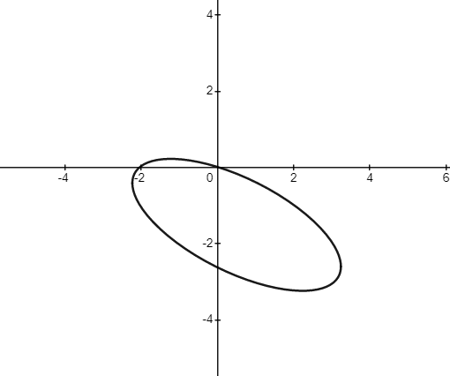




$$y$$
$$v$$
$$x$$
$$u$$

Slide 39
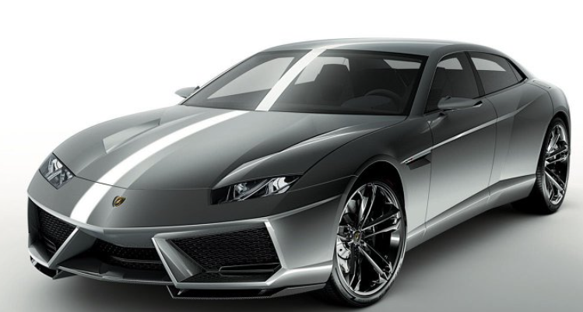
성민이꺼

Slide 40
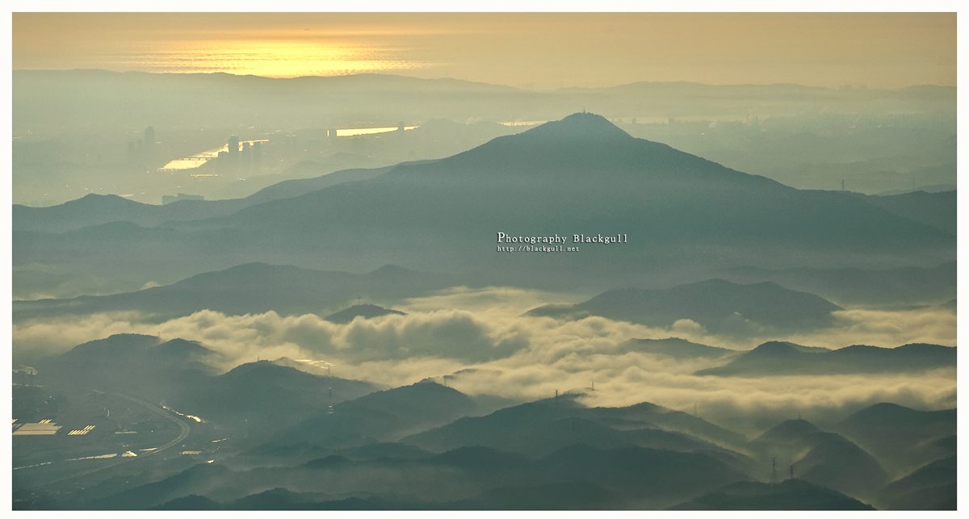



MEC 코드
Differential Gemoetry
Tensor
Simo & Fox 논문
Tangent space
Linear Algebra
Covector
Dual space
FEA 책
so(3) group
SO(3) group

Slide 41
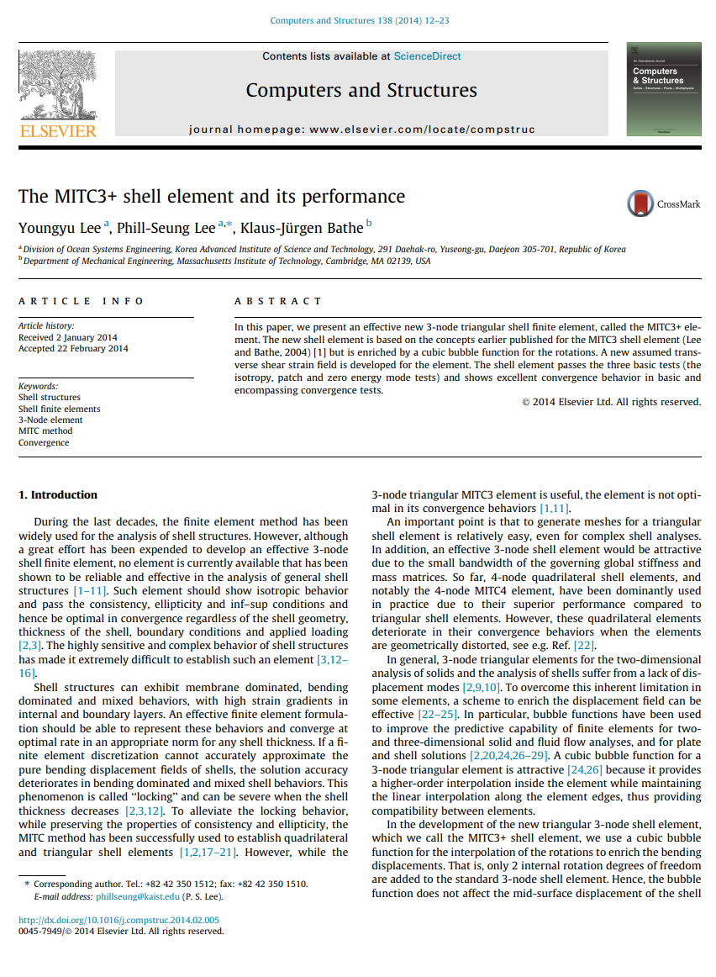
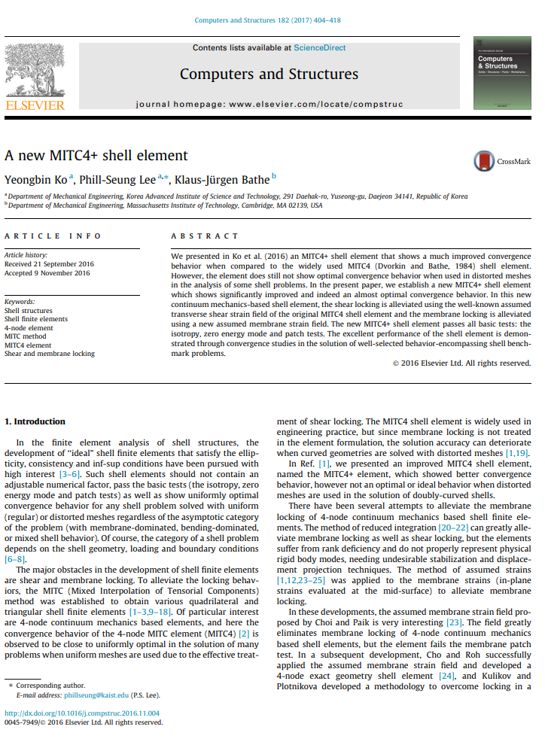

Slide 42




Slide 43
