Slide 1











$$e_{θ}$$
$$e_{t}\left(R+ΔR\right)$$
$$e_{r}\left(R+ΔR\right)$$
$$e_{θ}$$
$$ΔR$$
$$e_{t}\left(R\right)$$
$$Δθ$$
$$e_{r}\left(R\right)$$
$$r$$
$$R$$
$$O$$

Slide 2









$$x_{3}$$
$$d$$
$$q$$
$$q′$$
$$p$$
$$x_{2}$$
$$d^{m}$$
$$p′$$
$$x_{1}$$

Slide 3







$$x_{3}$$
$$q′$$
$$θ_{2}$$
$$q$$
$$p′$$
$$d_{3}^{m}$$
$$p$$
$$d_{1}^{m}$$
$$x_{1}$$

Slide 4





$$x_{3}$$
$$q′$$
$$θ_{1}$$
$$q$$
$$p′$$
$$d_{3}^{m}$$
$$p$$
$$d_{2}^{m}$$
$$x_{2}$$

Slide 7
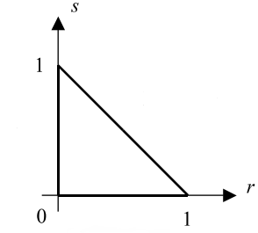

Slide 8



$$s_{3}$$
$$s_{1}$$
$$s_{2}$$

Slide 9



$$t_{2}$$
$$t_{3}$$
$$t_{1}$$

Slide 10





$$f_{1}$$
$$f_{2}$$
$$d_{1}$$
$$d_{2}$$

Slide 11




$$T_{1}$$
$$T_{2}$$
$$q_{1}$$
$$q_{2}$$

Slide 12






$$f_{1}$$
$$f_{2}$$
$$k$$
$$d_{1}$$
$$d_{2}$$

Slide 14
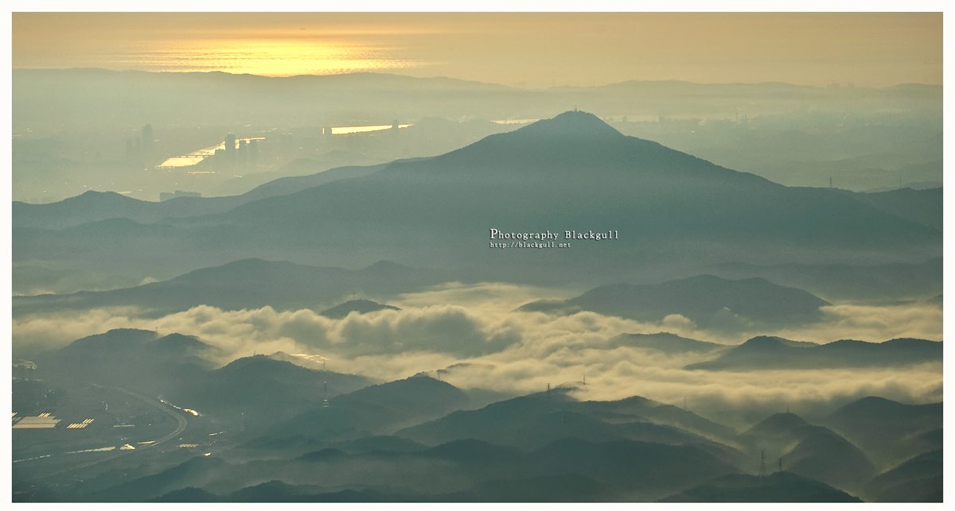

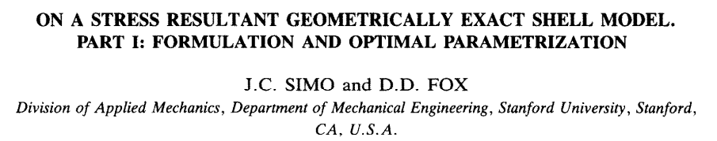
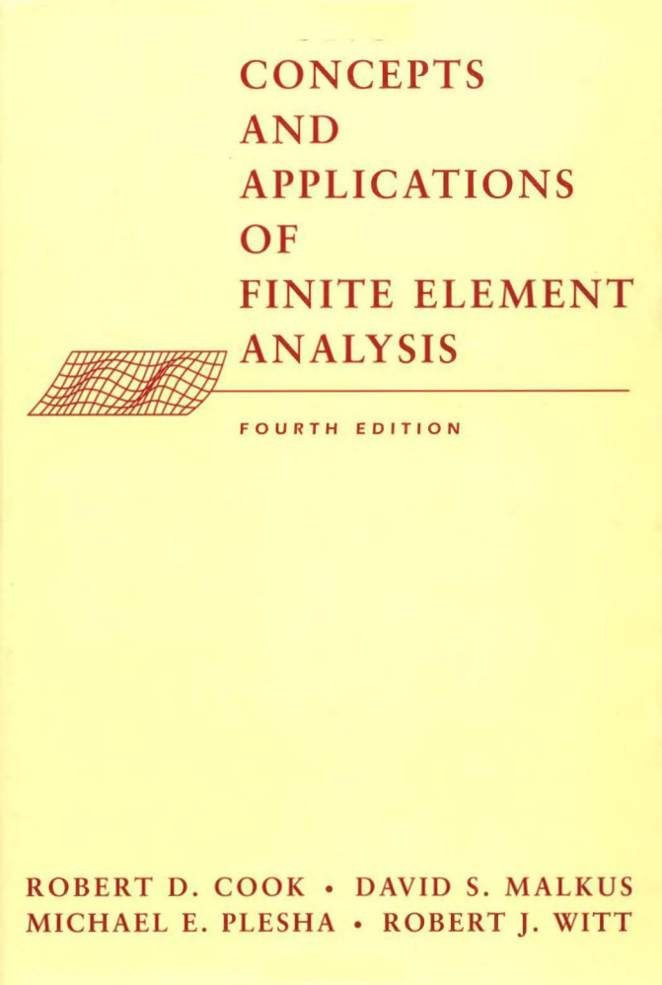
MEC 코드
Differential Gemoetry
Tensor
Simo & Fox 논문
Tangent space
Linear Algebra
Covector
Dual space
FEA 책
so(3) group
SO(3) group

Slide 15
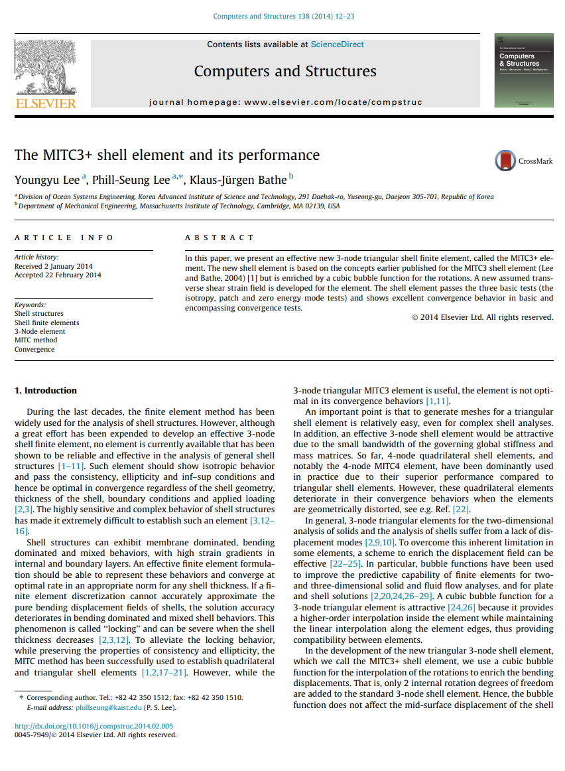
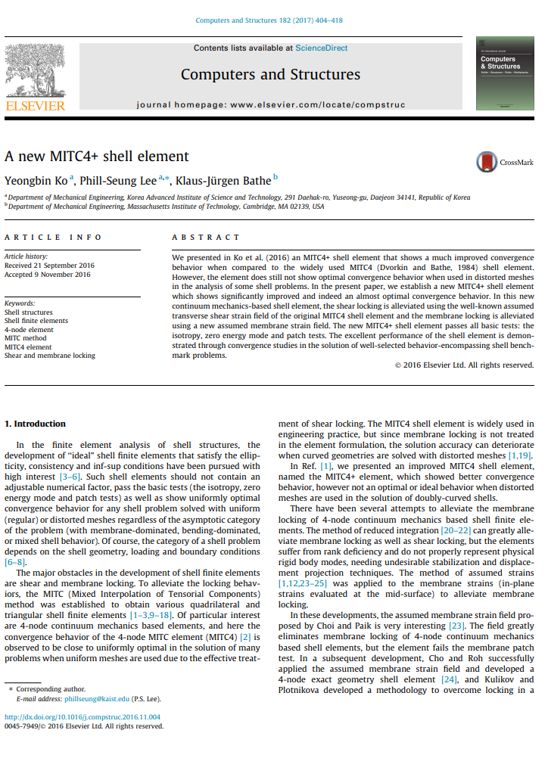

Slide 16
