Slide 1
Final Project Utilizing Sentiment Analysis for Index Prediction
Shah,Kavach
AD561 A1 Financial Analytics
Boston University MET College

Slide 2
Introduction
NLP
Sentiment analysis
Notes:
Natural language processing (NLP) is a machine learning technology that gives computers the ability to interpret, manipulate, and comprehend human language. Sentiment analysis is a natural language processing technique used to determine the sentiment (positive, negative, or neutral) expressed in a piece of text

Slide 3
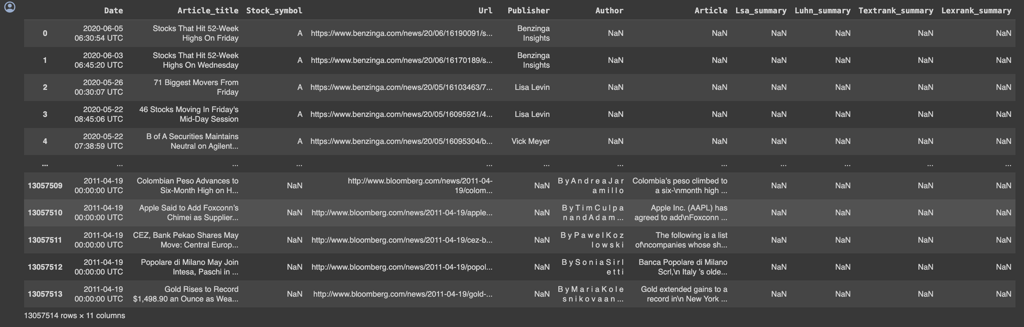
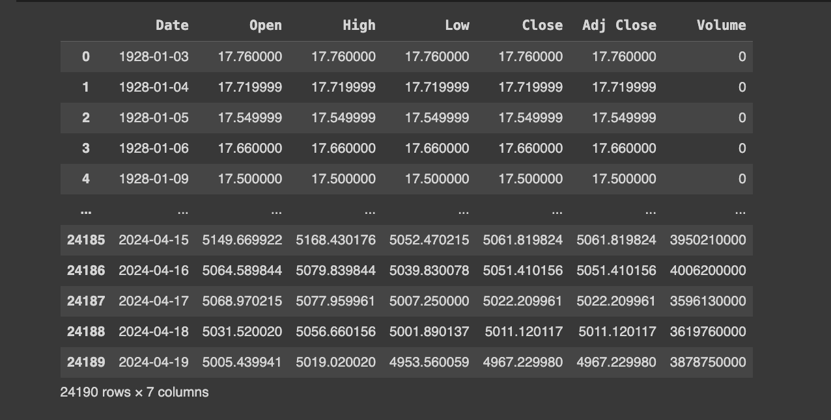
Dataset:
FNSPID:: A Comprehensive Financial News Dataset in Time Series
S&P 500
Notes:
The FNSPID dataset was created by Cornell University on 9 Feb 2024
a large-scale financial dataset that combines stock price data with financial news records for 4,775 S&P500 companies from 1999 to 2023
he dataset approx. 13 million time-aligned financial news

Slide 4
Methodology
Clean of dataset
Text Preprocessing
RE
Sentiment Analysis
LSTM for Prediction
NLTK
combination of score

Slide 5
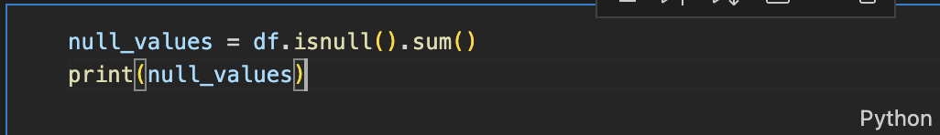
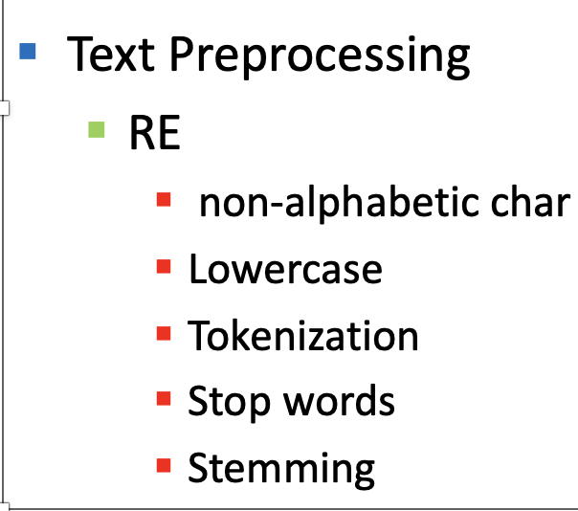
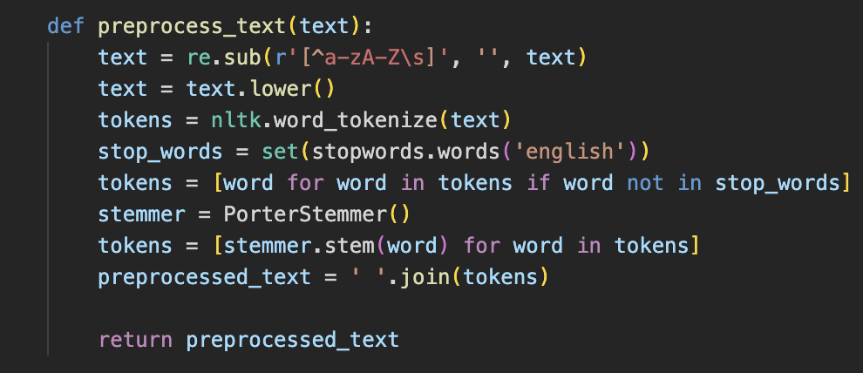
Methodology
Clean of Dataset
Null values
Drop Columns

Slide 6
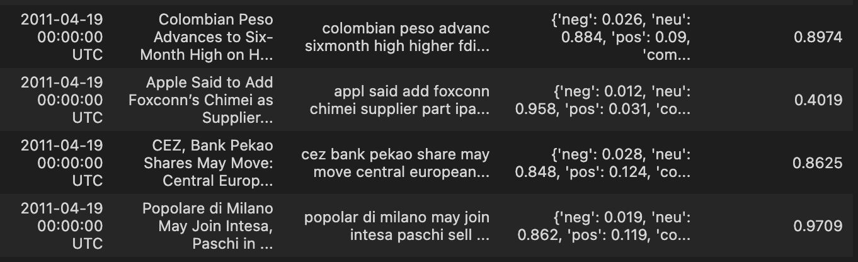
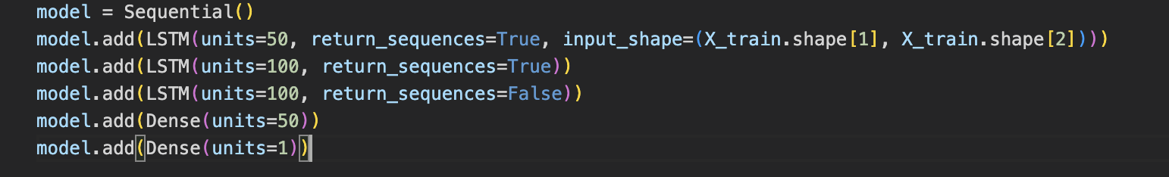
Methodology
Sentiment Analysis
NLTK
Combining Scores
LSTM for Prediction
Combining all parameters
2- Dense layers for sequence Prediction

Slide 7
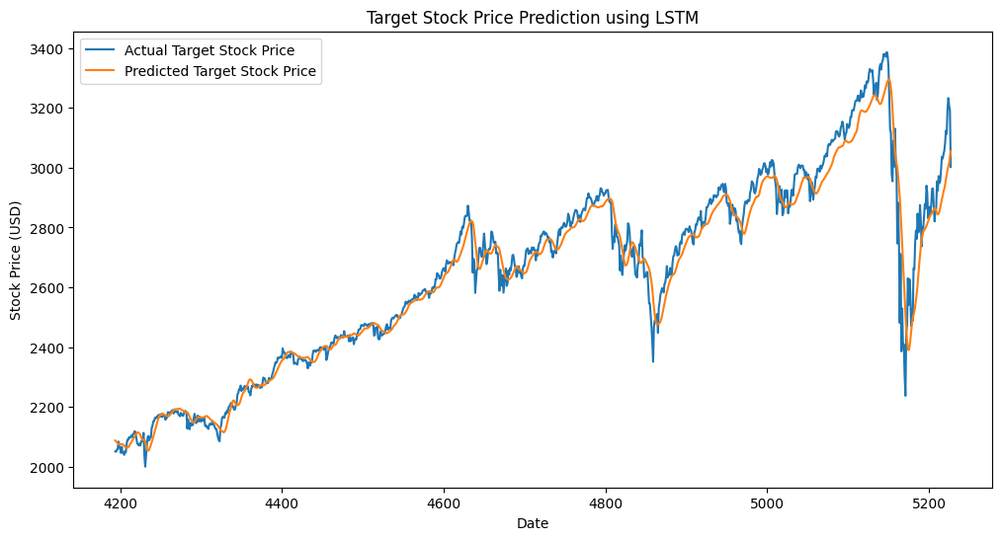
Results
Notes:
In the context of this line plot showing stock price predictions over time, the x-axis labeled "Date" represents the timeline or sequence of dates for which the actual and predicted target stock prices are plotted.
The dates are not explicitly shown as specific date values, but rather appear as an index or sequential ordering along the x-axis. This is a common practice when visualizing time series data, where the focus is on the progression of values over time rather than the exact dates themselves.
So, while the specific date values are not provided, the "Date" label on the x-axis indicates that the data points are ordered chronologically, allowing you to see how the actual and predicted stock prices evolve over the time period covered by the data.

Slide 8
Conclusion & Future works
Potential of sentiment analysis
Analysis of large dataset of FNSPID
Addition of more parameters
Other NN
Notes:
In conclusion, this project has demonstrated the potential of sentiment analysis in predicting stock price movements. By developing a sentiment analysis model capable of extracting sentiment from various textual data sources such as news articles, financial reports, and social media posts, we were able to analyze the relationship between sentiment scores and stock price movements.

Slide 9
Thank you

