Slide 1
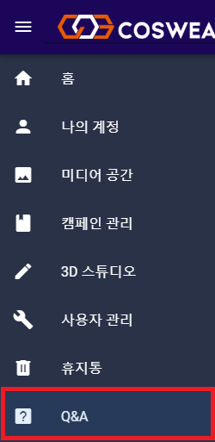
월-화 : 작성 완료 목-금 : 조회 완료
파일 첨부 등록
체크박스 필요
화면 캡쳐 후 버튼/이벤트 작동시 어떻게 타는지 적어 놓을 것.
1. slider-bar Q&A click
1-1 Board.vue page router.js 등록
//router.js에 Board.vue 파일의 path를 /board로 지정하여 router 등록
{
path: '/board', name: 'board',
component: () => import( './views/Board.vue')
},
2. Board.vue

Slide 2
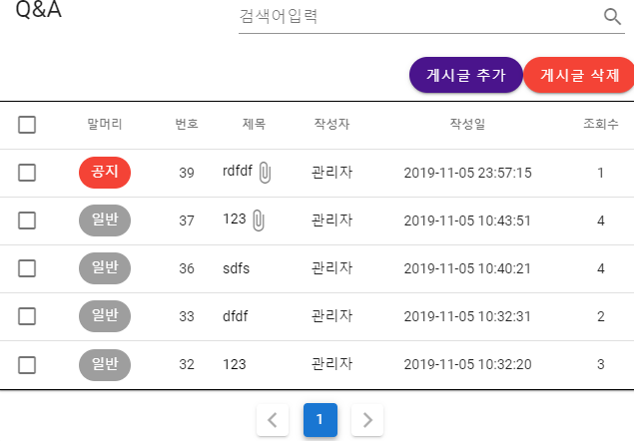
2-1 Board.vue fe
<template>
<div>
<v-card>
<v-card-title> Q&A
<v-spacer></v-spacer>
//검색 기능
<v-text-field
v-model="search"
append-icon="mdi-magnify" label="검색어입력"
single-line hide-details
></v-text-field>
</v-card-title>
<v-card-title>
//게시글 추가, 게시글 삭제 버튼
<v-row justify="end">
<v-btn @click="openAddModal" color="purple darken-4" dark
rounded
>게시글 추가</v-btn>
<v-btn
v-if="auth" dark color="red" rounded
>게시글 삭제</v-btn>
</v-row>
</v-card-title>
//data-table 설정
<v-data-table
v-model="selected"

Slide 3
:headers="headers"
:items="posts"
:search="search"
:page.sync="page"
:items-per-page="12" hide-default-footer class="elevation-1"
@page-count="pageCount = $event"
style="border-top:1px black solid;border-bottom:1px black solid"
:show-select="auth">
//말머리 data 삽입
<template v-slot:item.updatedAt="props">
<v-chip :color="getColor(props.item.board_post.name)" dark> {{props.item.board_post.name}} </v-chip>
</template>
//제목 data 삽입
<template v-slot:item.title="props">
<v-row>
<a @click="boardDetail(props.item)" style="color:black;text-align:left;display:block;">
{{props.item.title}}
</a>
//파일 첨부 게시글일 경우 제목에 file icon 삽입
<v-icon v-if="props.item.board_files.length !== 0">mdi-paperclip</v-icon>
</v-row>
</template>
</v-data-table>
//table footer pagination 설정
<div class="text-center pt-2">
<v-pagination v-model="page" :length="pageCount"></v-pagination>
</div>
</v-card>
<foot></foot>
</div>
</template>
2-2 api/board로 부터 axios.get
mounted (){
//toen 설정
const token = localStorage.token
this.user = localStorage.getItem('user') this.id = localStorage.getItem('id')
//axios.get 요청
axios.get('/api/board', {
//headers: { Authorization: token },
})
2-3 api/board/index.js에서 result에 Board table에 대한 정보 저장 후 posts로 send
router.get('/', async (req, res, next) => { try {
logger.method('"/board"에 get실행')
//Board DB에서 data를 가져온다
let result = await Board.findAll({ include: [{
//include table
model: Board_post,
}, {
model: User,
}, {

Slide 4
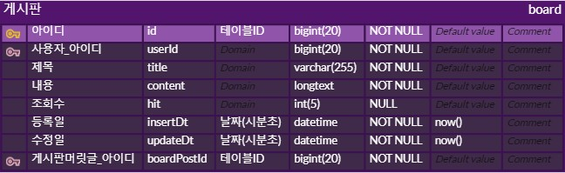


model: Board_file, include: [File]
}],
logging: (str) => {
str = str.substr(21); logger.query(str)
}
})
logger.method('"/board"에 get실행완료') await res.send({ posts: result })
}
catch (e) {
logger.error('"/board"에 get에서 ERROR' + ' : ' + e) res.send({ success: false, msg: e.message })
}
});
2-4 Board.vue v-data-table item.posts에 DB data mapping
mounted ()
{
this.posts = r.data.posts
},
3. WritePostModal.vue (게시글 추가 modal compnent)
3-1 Board.vue 게시글 추가 버튼 click → WritePostModal.vue open
/Board.vue의 게시글 추가 버튼 code
<v-card-title>
<v-row justify="end">
<v-btn

Slide 5
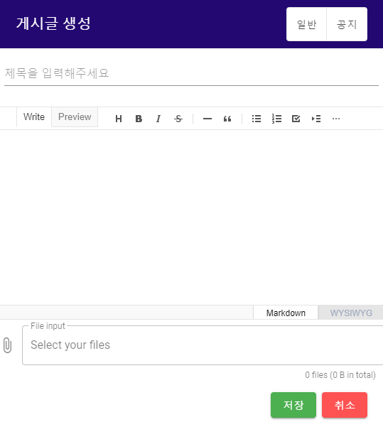
@click="openAddModal" color="purple darken-4" dark
rounded>
게시글 추가</v-btn>
</v-row>
</v-card-title>
button click event, components/BoardComp/WritePostModal.vue로 EventBus emit
methods:
{
openAddModal(){ eventBus.$emit('triggerAddModal','add');
},
WritePostModal.vue 에서 EventBus on, modal open
eventBus.$on('triggerAddModal', (item) => { this.WModal=true
this.mode='게시글 생성'
});
3-2 WritePostModal.vue fe

Slide 6
<template>
<v-dialog
v-model="WModal" max-width="800px" persistent scrollable>
<v-card>
//modal title
<v-card-title
v-model="form.title" style="color:white;background-color:#230871" class=font-weight-white id=board
>{{mode}}
<v-spacer></v-spacer>
//공지or일반 선택 버튼
//클릭한 정보가 말머리에 표시되게 methods 실행
<v-btn-toggle v-model="text" color="pink"
style="background-color:white">
<v-btn tile outlined
value="left" @click="setNormal"> 일반
</v-btn>
<v-btn tile outlined
value="center" @click="setNotice"> 공지
</v-btn>
</v-btn-toggle>
</v-card-title>
//제목 입력 text-filed
<v-form ref="form" v-model="valid" lazy-validation>
<v-text-field class="ma-2"
placeholder="제목을 입력해주세요" v-model="form.title"
:rules="titleRules">
</v-text-field>
</v-form>
<v-card-text class="pa-0">
//이지웍 editor
<editor v-model="form.content"/>
<v-file-input
v-model="files"
color="deep-purple accent-4" counter
label="File input" multiple
placeholder="Select your files" prepend-icon="mdi-paperclip" outlined
id="bin"
:show-size="1000" enctype="multipart/form-data" class="mt-2"
>
//modal에 나타낼 v-chip 개수 설정
<template v-slot:selection="{ index, text }">
<v-chip
v-if="index < 3"
color="deep-purple accent-4" dark
label small
>
{{ text }}
</v-chip>

Slide 7

// 설정한 개수 이상 file input되면 +{{ files.length - 3 }} File(s) 형태로 표시
<span
v-else-if="index === 3"
class="overline grey--text text--darken-3 mx-2"
>
+{{ files.length - 3 }} File(s)
</span>
</template>
</v-file-input>
<v-card-actions>
<v-row justify="end" class="mr-4">
<v-btn
color="success" @click="saveClick()"
>저장</v-btn>
<v-btn
color="error" @click="modalClose"
>취소</v-btn>
</v-row>
</v-card-actions>
</v-card-text>
</v-card>
</v-dialog>
</template>
3-3 file.input,
vuetify file input component 사용 file input 영역 click → file input modal open
file input modal

Slide 8
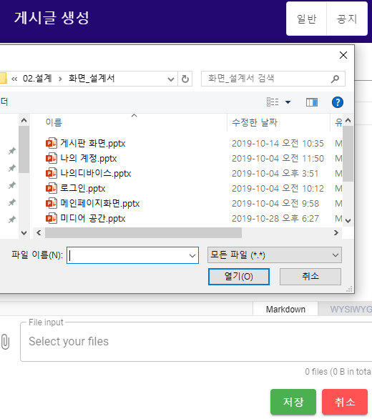
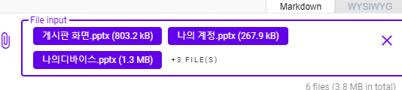
file input code
<v-file-input
v-model="files"
color="deep-purple accent-4" counter
label="File input" multiple
placeholder="Select your files" prepend-icon="mdi-paperclip" outlined
id="bin"
:show-size="1000" enctype="multipart/form-data" class="mt-2"
>
</v-file-input>
선택 file v-chip 형태로 표시, 4개 이상 file 선택시 +@ FILE S 형태로 보여줌
<template v-slot:selection="{ index, text }">
<v-chip

Slide 9

v-if="index < 3"
color="deep-purple accent-4" dark
label small
>
{{ text }}
</v-chip>
// 설정한 개수 이상 file input되면 +{{ files.length - 3 }} File(s) 형태로 표시
<span
v-else-if="index === 3"
class="overline grey--text text--darken-3 mx-2"
>
+{{ files.length - 3 }} File(s)
</span>
</template>
3-4 저장 버튼 saveClick(), methods 실행
saveClick () {
//제목,내용 공백제거
this.form.title = this.form.title.trim() this.form.content = this.form.content.trim()
if (!this.form.title || !this.form.content) return
if(this.catagory !== ''){ if(this.catagory === '공지')
var cata = 1 if(this.catagory === '일반')
var cata = 2
let fd = new FormData() let i=0;
//게시글 생성시 fd.append
this.files.forEach(file => { fd.append(`${i}`, file) i++
});
fd.append('userId', this.id) fd.append('title', this.form.title) fd.append('boardPostId', cata) fd.append('content', this.form.content) fd.append('hit', 0) fd.append('id',this.form.id)
if(this.mode === '게시글 생성'){ axios.post('/api/board',fd)
.then((r) => { eventBus.$emit('triggerAlert',true);
})
.catch((e) => { console.error(e.message)
});
}
else if(this.mode === '게시글 수정'){ axios.delete('/api/board/fileDel',
{
data: { files: this.del_files }
})
.catch((e) => {

Slide 10

this.alertText='에러가 발생했습니다' this.alert=true console.error(e.message)
})
//axio.put 성공시 AlterSnackBar.vue로 emit
axios.put('/api/board',fd )
.then((r) => { eventBus.$emit('triggerAlert',true);
})
//error 발생시 errorSnackBar.vue로 emit
.catch((e) => { eventBus.$emit('triggerError',true); console.error(e.message)
})
}
}
},
3-5 게시글 추가 성공 AlterSnackBar.vue(snackbar) open
<template>
<v-snackbar
:timeout='false' v-model="alert" top
persistent multi-line
color="blue lighten-2" dark
icon="mdi-alert-circle-outline" transition="scale-transition"
>완료되었습니다
<v-btn flat color="blue lighten-2" @click="alertConfirm">확인</v-btn>
</v-snackbar>
</template>
<script>
import axios from 'axios'
import eventBus from "./eventBus.js";
export default { data() {
return {
alert:false,
}
},
mounted(){
eventBus.$on('triggerAlert', (item) => { this.alert = true
});
},
methods:{
alertConfirm(){ location.href='/board'
}
}
}
</script>
3-6 게시글 추가 에러 ErrorSnackBar.vue(snackbar) open

Slide 11

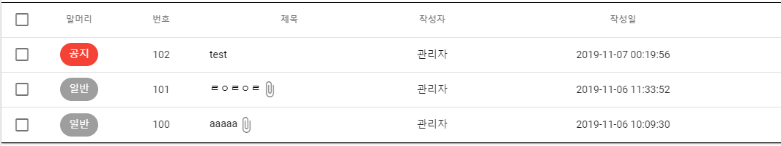
<template>
<v-snackbar
:timeout='false' v-model="alert" top
persistent multi-line
color="blue lighten-2" dark
icon="mdi-alert-circle-outline" transition="scale-transition"
>에러가 발생했습니다
<v-btn flat color="blue lighten-2" @click="alertConfirm">확인</v-btn>
</v-snackbar>
</template>
<script>
import eventBus from "./eventBus.js";
export default { data() {
return{
alert:true
}
},
mounted() {
eventBus.$on('triggerError', (item) => { this.alert = true
});
},
methods :{
alertConfirm(){ location.herf = '/board'
}
}
}
</script>
4. 게시글 열람
4-1 게시글 열람
제목에 부분을 클릭하면 게시판을 열람할수있음
views/board.vue

Slide 12
<template v-slot:item.title="props">
<v-row>
<!-- 제목클릭시 게시판열람가능 boarddetail메소드호출 -->
<a @click="boardDetail(props.item)" style="color:black;text-align:left;display:block;">
{{props.item.title}}
</a>
<v-icon v-if="props.item.board_files.length !== 0">mdi-paperclip</v-icon>
</v-row>
</template>
4-2 게시글 제목부분 클릭시 boardDetail 메소드 호출
eventBus.$emit('triggerDModal')으로 triggerDModal을 통해 연결된 DetailModal.vue 컴포넌트에 전달 views/board.vue
boardDetail(item){
item.hit= item.hit+1 this.boardId = item.id this.form.id = item.id this.form.title = item.title
this.form.writer = item.user.userNm this.form.content = item.content if(item.board_files.length !== 0)
생략 ../..
this.comments = r.data.comments eventBus.$emit('triggerDModal',this.boardId,this.form,this.comments);
})
.catch((e) => { console.error(e.message)
})
},
4-3 게시글 열람 dialog 생성
eventBus.$on으로 board.vue에서 emit한 triggerDModal을 받아서 this.DModal을 true로 바꿔주므로 게시판 열람 dialog생성

Slide 13
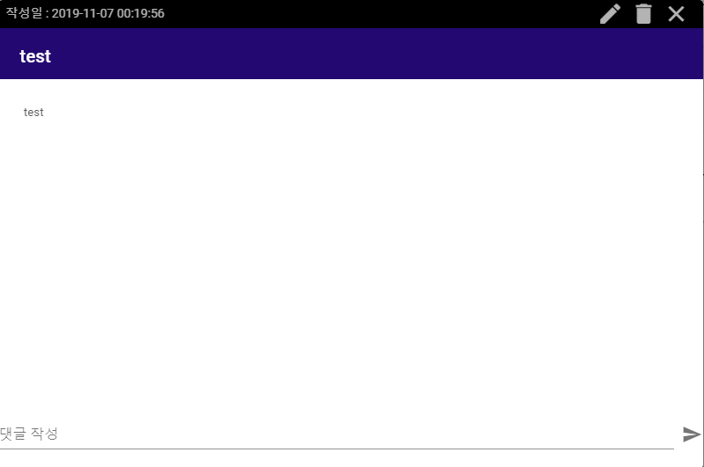
mounted() {
// this.user = localStorage.getItem('user')
// this.id = localStorage.getItem('id') eventBus.$on('triggerDModal', (boardId,form,comments) => {
this.boardId = boardId this.form = form this.comments = comments this.DModal = true
});
}
4-4 systembar 작성일 생성
board에서 받은 데이터로 작성시간을 보여준다
views/board.vue에서 전달받은 데이터
if(item.createdAt.length < 10){
var today = new Date()
this.form.createdAt = today.getFullYear()+'-'+(today.getMonth()+1)+'-' +today.getDate()+' '+ item.createdAt
}
4-5 제목과 내용 부분

Slide 14


form.title이 제목 form.content로 board.vue에서 전달받은 데이터 표시
<v-card-title style="color:white;background-color:#230871">{{form.title}}
</v-card-title>
<v-card-text class="pa-0">
<v-container>
<viewer :value="form.content" style="min-height: 300px" class="ma-4"></viewer>
</v-container>
4-6 댓글 작성 폼
댓글생성전
<v-text-field
v-model="commentAdd" label="댓글 작성"
append-outer-icon="mdi-send" @click:append-outer="addComment"
></v-text-field>
4-7 댓글 작성 함수
댓글생성후 addComment 호출 api/board로 부터 axios.get

Slide 15

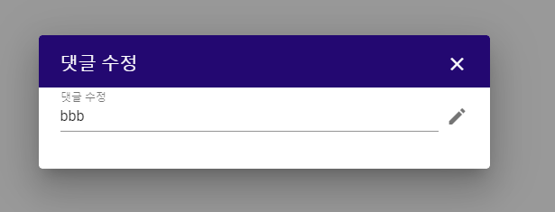
addComment()
{
axios.post('/api/board/comment/add', { boardId:this.boardId, userId:this.id, content:this.commentAdd,
})
...
})
},
4-8 댓글 수정 component 연결
연필 아이콘 클릭시 새로운 dialog 생성
DetailModal.vue 에서 emit( triggerAddCommentModal)을 해주고 AddCommentModal.vue에서 on( triggerAddCommentModal)받아준다
components/DetailModal.vue
modCommentDialog (cmt) {
this.commentDialog = true this.commentId = cmt.id
this.commentModify = cmt.content //현재의 컨텐츠 내용 this.commentSell = cmt eventBus.$emit('triggerAddCommentModal',cmt);
},
components/AddCommentModal.vue
mounted(){
eventBus.$on('triggerAddCommentModal', (item) => { this.commentModify = item.commentModify this.commentId = item.id
this.commentModify = item.content //현재의 컨텐츠 내용
this.commentSell = item this.commentDialog = true
});
},

Slide 16


4-9 댓글수정 dialog생성
eventBus.$on으로 commentDialog true로 dialog 생성
<v-dialog v-model="commentDialog" width="500">
<v-card>
<v-card-title
style="color:white;background-color:#230871"
>
댓글 수정
<v-spacer></v-spacer>
<v-icon
dark @click="modalClose()"
>mdi-close
</v-icon>
</v-card-title>
<v-card-text>
<v-text-field
label="댓글 수정"
v-model="commentModify"
append-outer-icon="mdi-pencil" @click:append-outer="modComment(item)"
/>
</v-card-text>
</v-card>
<ErrorSnackBar></ErrorSnackBar>
</v-dialog>
4-10 댓글 수정 dialog close버튼 4-10-1 close
click시 modalclose 함수 호출 commentDialog 속성 false 변경후 dialog닫
modalClose(){
this.commentModify = '' this.commentDialog = false
},
4-10-2 저장

Slide 17
pencil 아이콘 click 시 modComment 메소드 호출
현재 쓰고있는 text내용v-model= commentModify가 전 dialog commentSell.content를 변경해주는 부분 , 그이후 api/board/comment로 부터 axios.get
modComment()
{
this.commentSell.content = this.commentModify this.commentDialog=false
axios.put('/api/board/comment', { id: this.commentId,
content: this.commentSell.content }
)
.then((r) => { let i=0;
for(i=0;i<this.comments.length;i++){ if(this.comments[i].id === this.commentId){
this.comments[i].content = this.commentSell.content
}
}
})
.catch((e) => { eventBus.$emit('triggerError',true); console.error(e.message)
})
},
5. 검색
5-1 검색할 text-field 생성
v-data-table option인 v-model="search" 에 의해 자동으로검색
<v-text-field
v-model="search"
append-icon="mdi-magnify" label="검색어입력"
single-line hide-details
></v-text-field>
v-data-table
<v-data-table
:search="search"//search:''
>
</v-data-table>
검색어 입력전

Slide 18
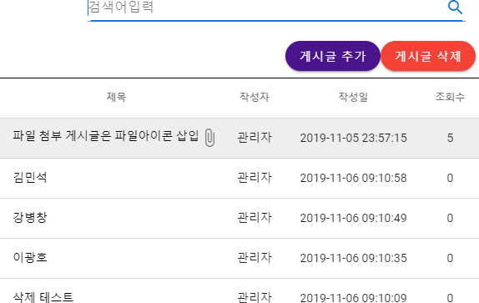
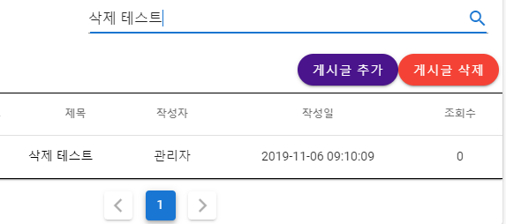
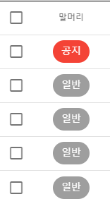
"삭제 테스트" 검색어 입력후
5-2 show-select

Slide 19

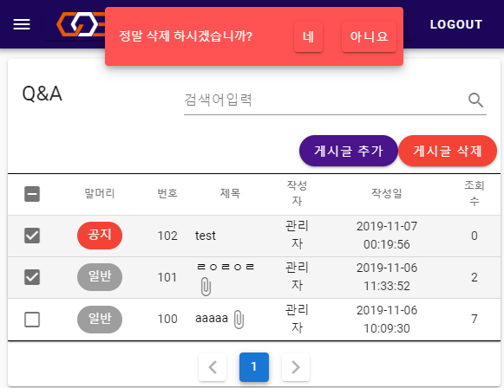
<v-data-table
v-model="selected" //selected:[] 배열에 check된 row의 data가 배열로 담김
show-select //v-data-table option인 show-select에 의해 자동으로 checkbox 생성
>
</v-data-table>
6. Selected 게시글 Delete
6-1 게시글 Delete Button
<v-btn
@click="deleteAll" v-if="auth"
dark color="red" rounded
>게시글 삭제</v-btn>
6-2 게시글 선택후 게시글 삭제 버튼 Click→ deleteAll methods 실행
6-3 components/BoardComp/ConfirmSnackBar.vue로 seleted data $emit
19

Slide 20

deleteAll(){
eventBus.$emit('triggerSelect',this.selected);
}
6-4 ConfirmSnackBar.vue에서 seleted data $on
//confirm snackbar open mounted(){
eventBus.$on('triggerSelect', (item) => { this.selected = item
this.confirm = true //snackbar open this.CommentORPost = 'deleteAll'
});
}
//
6-5 ConfirmSnackBar.vue에서 seleted data $on
<v-snackbar
:timeout=10000
v-model="confirm" top
multi-line persistent color="error" dark
icon="mdi-alert-circle-outline" transition="scale-transition"
>정말 삭제 하시겠습니까?
<v-btn flat color="error" @click="confirmYes">네</v-btn>
<v-btn flat color="error" @click="confirmNo">아니요</v-btn>
</v-snackbar>
6-6 "네" button click -? confirmYes methods 실행
methods : {
confirmYes(){
axios.delete('/api/board/deleteAll',
{
data: { posts : this.selected }
})
.then((r)=>{
location.href = '/board'
})
.catch((e) => { this.alertText='에러가 발생했습니다' this.alert=true console.error(e.message)
})
}
20

Slide 21
21

