Slide 1

7TH INTERNATIONAL CONFERENCE ON INTELLIGENT COMPUTING & OPTIMIZATION 2022 VIRTUAL CONFERENCE HELD ON 27-28TH APRIL 2023 A Comparative Study of Convolutional Neural
Network Architectures for Detecting Prostate Cancer
By
K. M. Safin Kamal, Mysha Maliha Priyanka, Alfe Suny, Maimuna Akter Liza, Sanjeda Sara Jennifer and *Ahmed Wasif Reza
Department of Computer Science and Engineering, East West University, Dhaka-1212, Bangladesh

Slide 2
Outline
Introduction
Motivation
Challenges
Related Work & Summary of Observation
Research Objectives
Research Contribution
Methodology
Implementation
Result and Discussion
Conclusion
Future Work
References

Slide 3
Introduction
Prevalence of Prostate Cancer
Importance of Early Detection
Study aim
Model Evaluation
Promising Prostate Cancer Detection Model

Slide 4
Motivations
Utilizing Large Prostate Biopsy Dataset
Early Detection with CNNs
Comparing CNN Architectures

Slide 5
Challenges
Collecting a large whole-slide image dataset of Prostate Cancer biopsy
Preprocessing of Dataset
Finding out relatively better CNN algorithms
Getting a good output from the algorithms

Slide 6
Related Work & Summary of Observation
Around 20 papers published in the recent years. From them five were considered, which were related to the topic wholly.
Based on the recent advancement of the technology many researchers are implementing CNN successfully in the various branches of Cancer detection, which can be observed through the recent scientific and research publications.
However, particularly in the branches of Prostate Cancer detection are insufficient and more research can be done using CNN in the future and get more accurate detection.

Slide 7
Research Objectives
To assess and compare the effectiveness of different CNN architectures in the detection of prostate cancer from medical images.
To use a vast collection of whole-slide images from prostate biopsies to improve the accuracy of Gleason score and ISUP grading.
To provide practical insights for selecting and optimizing CNN architectures in the context of medical imaging for enhanced diagnostic accuracy.

Slide 8
Research Contributions
• Using the largest whole-slide image (WSI) dataset available for a prostate biopsy to grade the Gleason score and International Society of Urological Pathology (ISUP).
• This paper have proposed techniques using CNN to detect prostate cancer from biopsies at an early stage.
• This paper have compared CNN architectures like MobileNet-v2, DenseNet-121, and ResNet-18 with our proposed architecture, EfficientNet-B1.

Slide 9
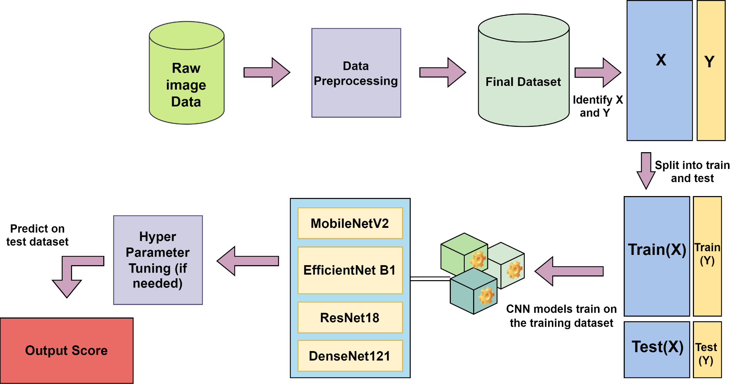
Materials and Method
Figure: Working Process

Slide 10
Implementation
A vast dataset of 22,000 digitized biopsy images.
Models
Mobile Net V2
Efficient Net B1
ResNet 18
DenseNet121
Adam Optimizer
Learning Rate 0.001
Epochs is 5
Evaluation Metrics Root Mean Squared Error (RMSE)

Slide 11
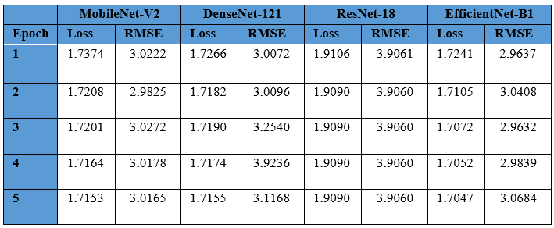
Experiment and Result

Slide 12
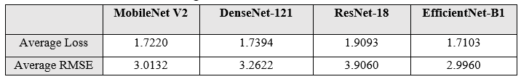
Experiment and Result (cont.)

Slide 13
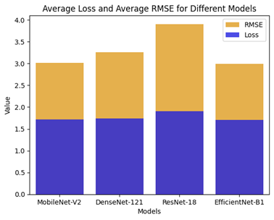
Experiment and Result (cont.)
Figure: Performance Comparison of the Architectures (lower is better)

Slide 14
Conclusion
The study analyzed a prostate cancer dataset with segmentation masks and cancer severity labels. Among various CNN architectures, EfficientNet-B1 outperformed others with an RMSE of 2.9960 on the validation set. This dataset offers valuable insights for improving prostate cancer diagnosis and classification models.

Slide 15
Future Work
Include more data providers to enhance dataset diversity and robustness.
Expand model comparison beyond CNN architectures, incorporating various deep learning and machine learning algorithms.
Apply and compare multiple segmentation masks for improved accuracy.
Perform extensive hyperparameter tuning to allow for longer training epochs and potentially more accurate results in future studies.

Slide 16
References
K. Sklinda, M. Frnczek, B. Mruk, and J. Walecki, ‘‘Normal 3T MR anatomy of the prostate gland and surrounding structures,’’ Adv. Med., vol. 2019, pp. 1–9, May 2019.
2. Mahumud RA, Alam K, Dunn J, Gow J. The burden of chronic diseases among Australian cancer patients: Evidence from a longitudinal exploration, 2007-2017. PLoS One. 2020 Feb 12;15(2):e0228744. doi: 10.1371/journal.pone.0228744. PMID: 32049978; PMCID: PMC7015395.
3. N. M. Schultz, K. O’Day, R. Sugarman, and K. Ramaswamy, ‘‘Budget impact of enzalutamide for nonmetastatic castration-resistant prostate cancer,’’ J. Managed Care Specialty Pharmacy, vol. 26, no. 4, pp. 538–549, Apr. 2020.
4. Jović S, Miljković M, Ivanović M, et al (2017) Prostate cancer probability prediction by machine learning technique. Cancer Investigation 35:647–651. doi: 10.1080/07357907.2017.1406496
5. Xya Hussain L, Ahmed A, Saeed S, et al (2018) Prostate cancer detection using machine learning techniques by employing a combination of features extracting strategies. Cancer Biomarkers 21:393–413. doi: 10.3233/cbm-170643
6. Li R, Shinde A, Liu A, et al (2020) Machine learning–based interpretation and visualization of nonlinear interactions in Prostate cancer survival. JCO Clinical Cancer Informatics 637–646. doi: 10.1200/cci.20.00002
7. Iqbal S, Siddiqui GF, Rehman A, et al (2021) Prostate cancer detection using deep learning and traditional techniques. IEEE Access 9:27085–27100. doi: 10.1109/access.2021.3057654
8. Regnier-Coudert O, McCall J, Lothian R, et al (2012) Machine learning for the improved pathological staging of prostate cancer: A performance comparison on a range of classifiers. Artificial Intelligence in Medicine 55:25–35. doi: 10.1016/j.artmed.2011.11.003

Slide 17
References
Partin A, Kattan M, Subong E, Walsh P, Wojno K, Oesterling J. Combination of prostate specific antigen, clinical stage, and Gleason score to predict pathological stage of localized prostate cancer: a multi-institutional update. Journal of the American Medical Association 1997;277(18):1445–51.
P. Lakhani et al., “Hello world deep learning in medical imaging,” J. Digital Imaging 31(3),283–289 (2018).
Y. Fan, D. Shen, R.C. Gur, R.E. Gur and C. Davatzikos, Com-839 pare: Classification of morphological patterns using adaptive 840 regional elements, IEEE Trans Med Imaging 26 (2007), 93–841 105. doi: 10.1109/TMI.2006.886812.
Chiu Y-C, Tsai C-Y, Ruan M-D, et al (2020) Mobilenet-SSDv2: An improved object detection model for embedded systems. 2020 International Conference on System Science and Engineering (ICSSE). doi: 10.1109/icsse50014.2020.9219319
Lksdnc A. A. Abbasi, L. Hussain, I. A. Awan, I. Abbasi, A. Majid,M. S. A. Nadeem, and Q.-A. Chaudhary, ‘‘Detecting prostate cancer using deep learning convolution neural network with transfer learning approach,’’ Cognit. Neurodynamics, vol. 4, pp. 523–533, Apr. 2020.
G. Huang, Z. Liu and L. van der Maaten, “Densely Connected Convolutional Networks,” 2018.
He K, Zhang X, Ren S, Sun J (2016) Deep residual learning for image recognition. 2016 IEEE Conference on Computer Vision and Pattern Recognition (CVPR). doi: 10.1109/cvpr.2016.9

Slide 18


