Slide 1
Do specific workouts impact calories burned? Does Gender impact this? Kyle Spalding DSC530 – Data Exploration and analysis 03/2/2025

Slide 2
Introduction
Objective: To analyze the impact of different workout types on calories burned and how gender influences this relationship.
Importance: Understanding these factors can help tailor fitness programs for better results.

Slide 3
Variables

Slide 4
Variables Used
Age:
Type: Integer
Description: Age of the respondent.
Gender:
Type: String
Description: Gender of the respondent (male/female).
Weight (kg):
Type: Floating point
Description: Weight of the respondent in kilograms.
Session_Duration (hours):
Type: Floating point
Description: Duration of the workout session in hours.
Calories_Burned:
Type: Floating point
Description: Total calories burned during the workout session.
Workout_Type:
Type: String
Description: Type of workout performed (Yoga, HIIT, Cardio, Strength).
Max_BPM:
Type: Integer
Description: Maximum beats per minute during the workout session.

Slide 5
Histograms

Slide 6
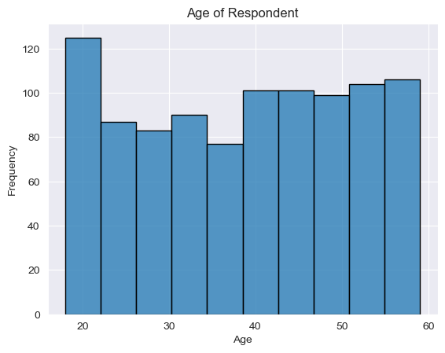
Age Variable

Slide 7
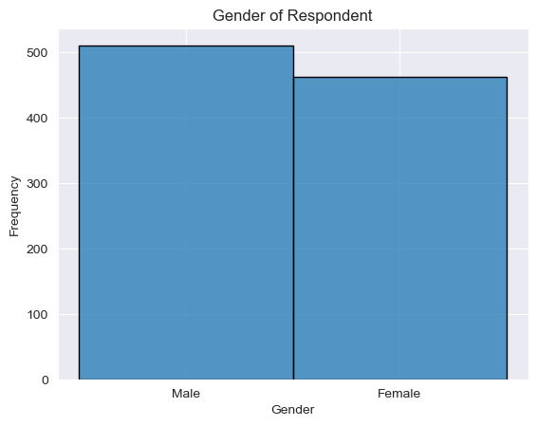
Gender variable

Slide 8
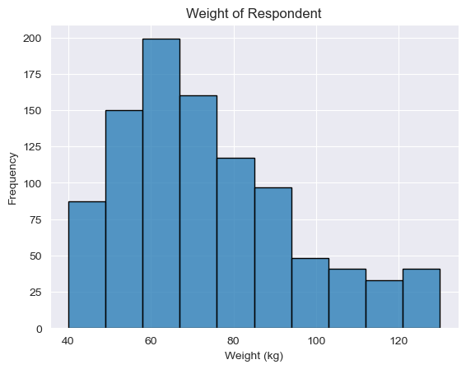
Weight (kg) variable

Slide 9
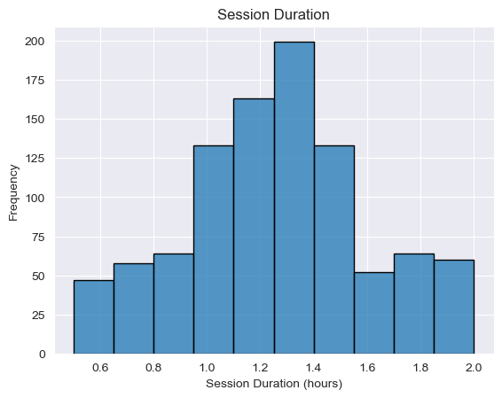
Session_duration (hours) variable

Slide 10
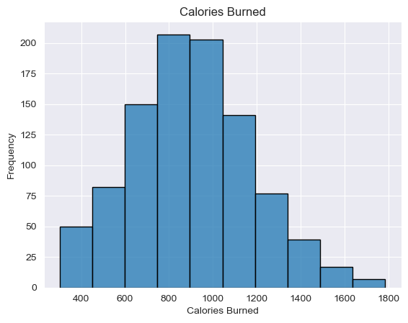
Calories_burned variable

Slide 11
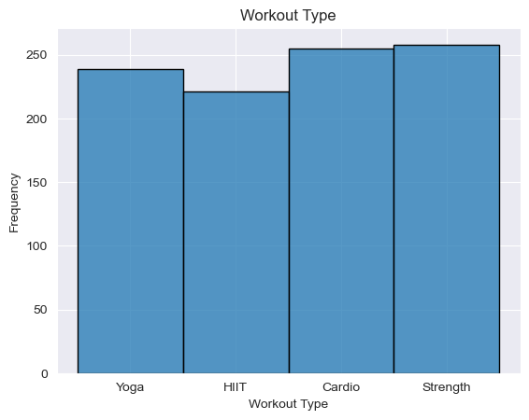
Workout_type variable

Slide 12
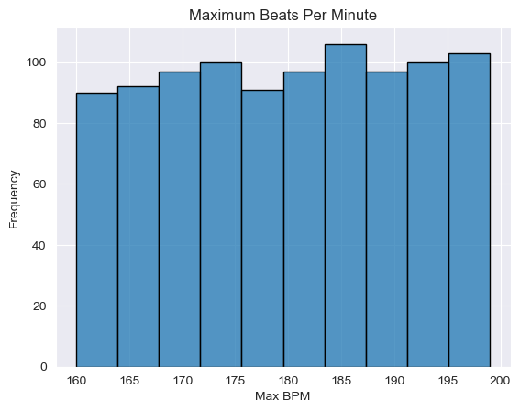
Max_bpm variable

Slide 13
Max_bpm variable

Slide 14
Descriptive statistics

Slide 15
Descriptive statistics - age
Statistic | Value
Mode | 43
Mean | 38.68
Standard Dev. | 12.18
Lower Tail | None (< -3.5)
Upper Tail | None (> 80.5)

Slide 16
Descriptive statistics - gender
Statistic | Value
Mode | Male (0)
Mean | 0.475
Standard Dev. | 0.4996
Lower Tail | (Gender < -1.5)
Upper Tail | (Gender > 2.5)

Slide 17
Descriptive statistics – weight (kg)
Statistic | Value
Mode | 57.7 & 75.6
Mean | 73.85
Standard Dev. | 21.21
Lower Tail | (Weight < 16.25)
Upper Tail | (Weight > 127.85)

Slide 18
Descriptive statistics – session_duration (hours)
Statistic | Value
Mode | 1.03 & 1.13 & 1.37
Mean | 1.26
Standard Dev. | 0.343
Lower Tail | (Session Duration < 0.410)
Upper Tail | (Session Duration > 2.09)

Slide 19
Descriptive statistics – calories_burned
Statistic | Value
Mode | 883.0 & 1025.0
Mean | 905.42
Standard Dev. | 272.64
Lower Tail | (Calories Burned < 186.0)
Upper Tail | (Calories Burned > 1610.0)

Slide 20
Descriptive statistics – workout_type
Statistic | Value
Mode | Strength
Mean | 1.55
Standard Dev. | 1.13
Lower Tail | (Workout Type < -2.0)
Upper Tail | (Workout Type > 6.0)

Slide 21
Descriptive statistics – max_bpm
Statistic | Value
Mode | 198
Mean | 179.88
Standard Dev. | 11.53
Lower Tail | (Max BPM < 140.0)
Upper Tail | (Max BPM > 220.0)

Slide 22
Descriptive statistics – max_bpm
Statistic | Value
Mode | 198
Mean | 179.88
Standard Dev. | 11.53
Lower Tail | (Max BPM < 140.0)
Upper Tail | (Max BPM > 220.0)

Slide 23
Male vs. female

Slide 24
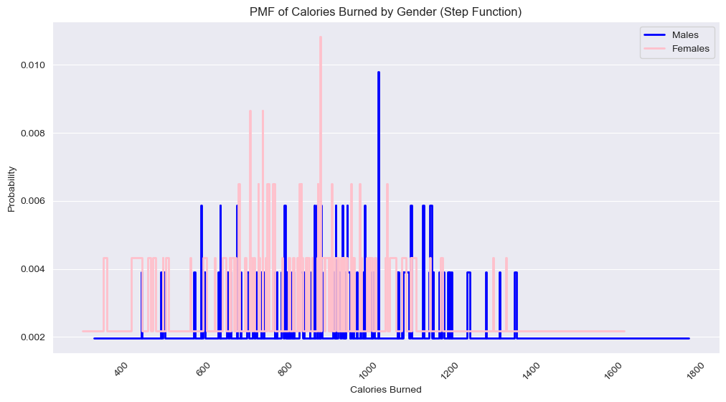
Calories burned by gender
A little under 1% of men burn around 1000 calories.
A little over 1% of females burn over 900 calories.

Slide 25
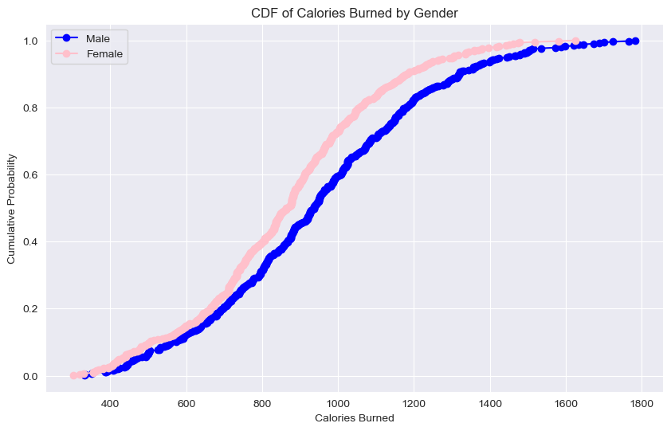
Cdf of calories burned
- More females burn more calories around the 800 – 1400 mark.

Slide 26
Analytical distribution

Slide 27
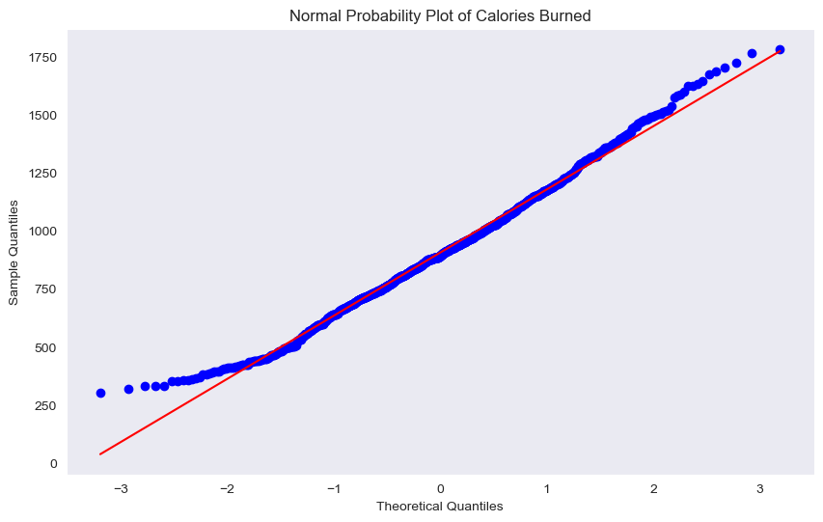
Normal probability – calories_burned
No extreme outliers.
Calories Burned follows a normal distribution.

Slide 28
Scatterplot – calories burned vs session duration

Slide 29
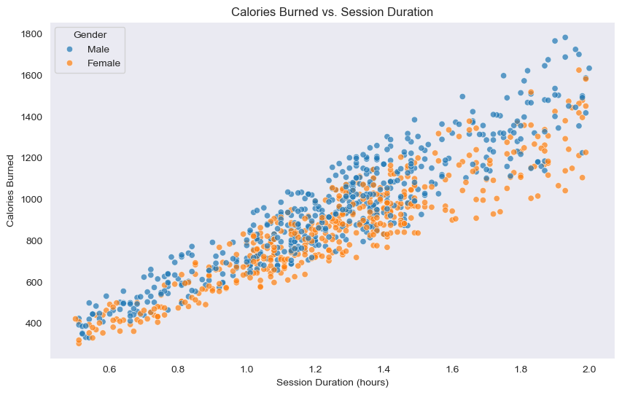
Calories_burned vs. session_duration
Pearson Correlation – 0.91.
Men burn more calories as session duration is longer.

Slide 30
Scatterplot – calories burned vs max bpm

Slide 31
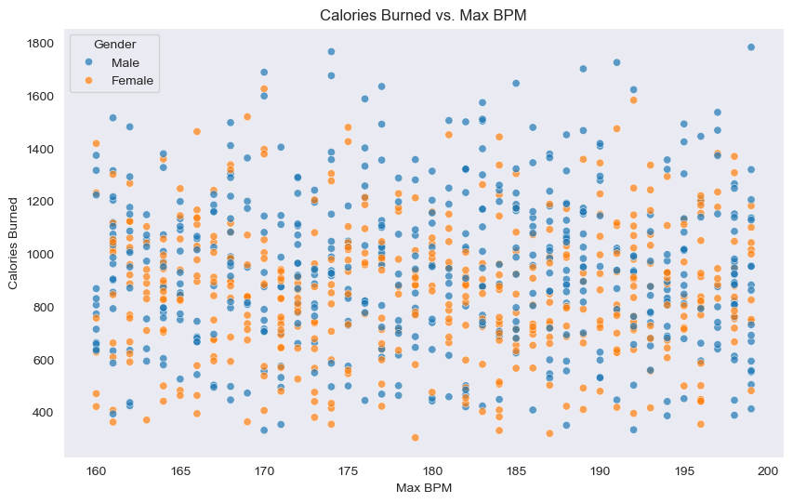
Calories_burned vs. max_bpm
Pearson Correlation – 0.0.
No significance between these two variables.

Slide 32
Scatterplot – calories burned vs workout type by gender

Slide 33
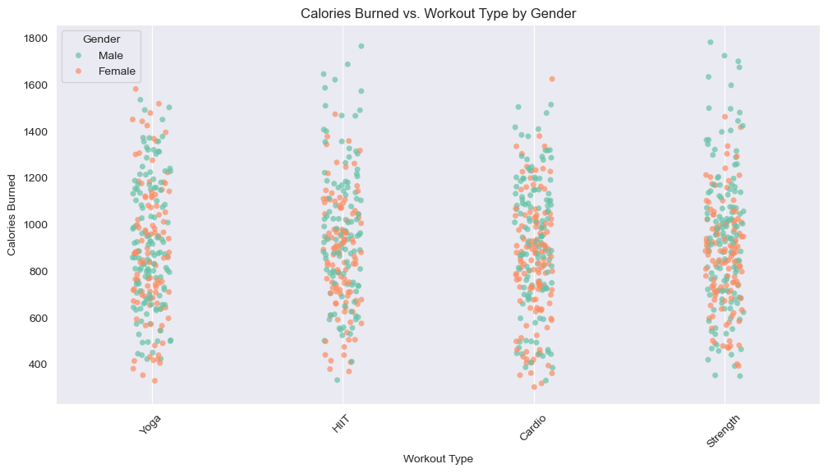
Calories_burned vs. workout_type
Anova: 0.95, P-Value: 0.41.
Shows no signifgance between calories burned and workout type.

Slide 34
Hypothesis test

Slide 35
Hypothesis test & permutation test
Hypothesis Results
Permutation Results
Test Statistic: 0.9881
P-Value: 0.428
Indicates the type of workout nor gender impacts calories burned.
Test Statistic (Yoga): 30.667, P-Value: 0.215
Test Statistic (HIIT): 42.45, P-Value: 0.102
Test Statistic (Cardio): 1.91, P-Value: 0.938
Test Statistic (Strength): 4.34, P-Value: 0.87
Indicates gender doesn’t play a significant role in burning calories for these four workout types.

Slide 36
THANK YOU

