Slide 1
STM32 MCU &
Applications
HCM - 04/10/2020

Slide 2
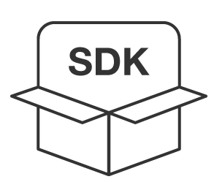

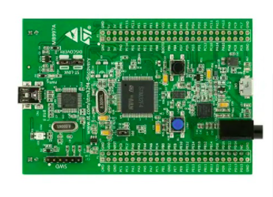
+
WE
LEARN

Slide 3
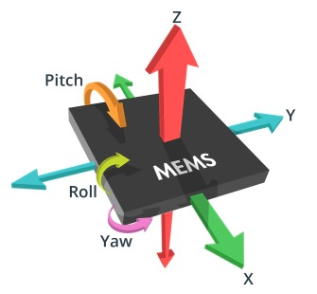
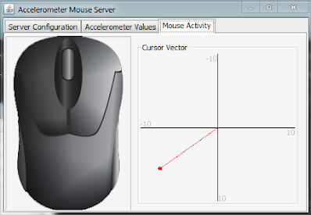
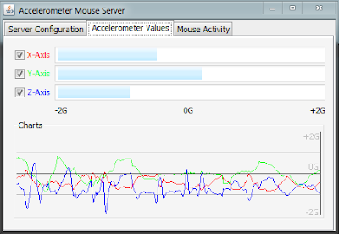
WE BUILD

Slide 4
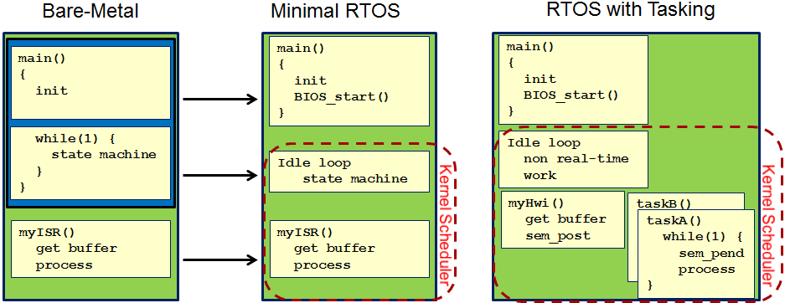
Bare-Metal vs RTOS

Slide 5
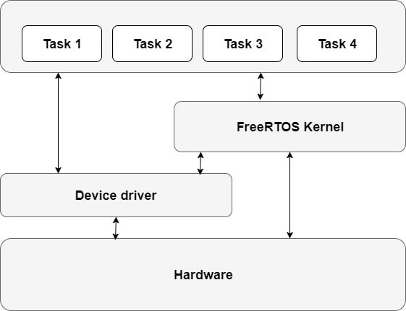
Free-RTOS architecture

Slide 6
Q&A

