Slide 1
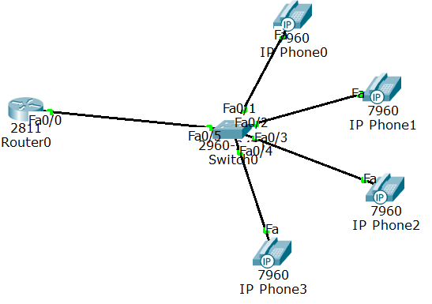
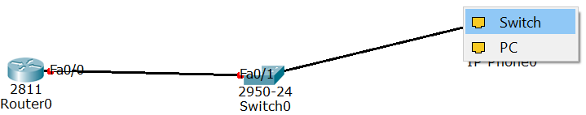
IP Telephony

Slide 2
Router>en
Router#conf t
Router(config)#int fa0/0
Router(config-if)#ip add 192.168.10.1 255.255.255.0
Router(config-if)#no shut
Router(config-if)#exit
Router(config)#ip dhcp pool VOICE
% Create DHCP pool named VOICE
Router(dhcp-config)#network 192.168.10.0 255.255.255.0
Router(dhcp-config)#default-router 192.168.10.1
Router(dhcp-config)#option 150 ip 192.168.10.1
% Mandatory for voip configuration
Router(dhcp-config)#exit

Slide 3
Router(config)#telephony-service
Router(config-telephony)#max-dn 4
Router(config-telephony)#max-ephone 10
Router(config-telephony)#ip source-address 192.168.10.1 port 2000
%TCP port number is 2000
Router(config-telephony)#auto assign 1 to 5

Slide 4
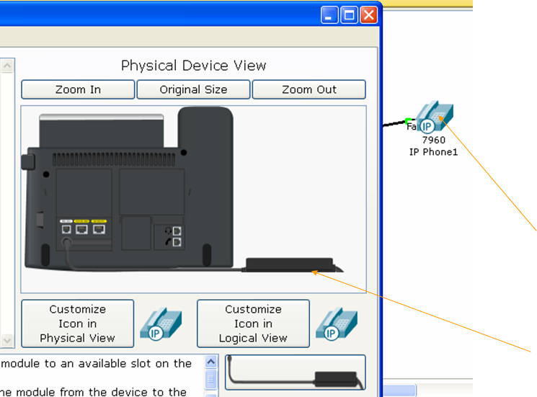
Plug in all the telephones.

Slide 5
Configure switch
Switch>en
Switch#conf t
Switch(config)#int range fa0/1-10 % since max-ephone 10
Switch(config-if-range)#switchport mode access
Switch(config-if-range)#switchport voice vlan 1

Slide 6
Configure router again
Router(config-telephony)#exit
Router(config)#ephone-dn 1 % Defining the first directory entry for phone -1
Router(config-ephone-dn)#number 5401 % Assign the phone number to this entry
Router(config-ephone-dn)#exit
Router(config)#ephone-dn 2 %Defining the first directory entry for phone -2
Router(config-ephone-dn)#number 5402 % Assign the phone number to this entry
Router(config-ephone-dn)#exit
Router(config)#ephone-dn 3
Router(config-ephone-dn)#number 5403
Router(config-ephone-dn)#exit
Router(config)#ephone-dn 4
Router(config-ephone-dn)#number 5404
Router(config-ephone-dn)#

Slide 7
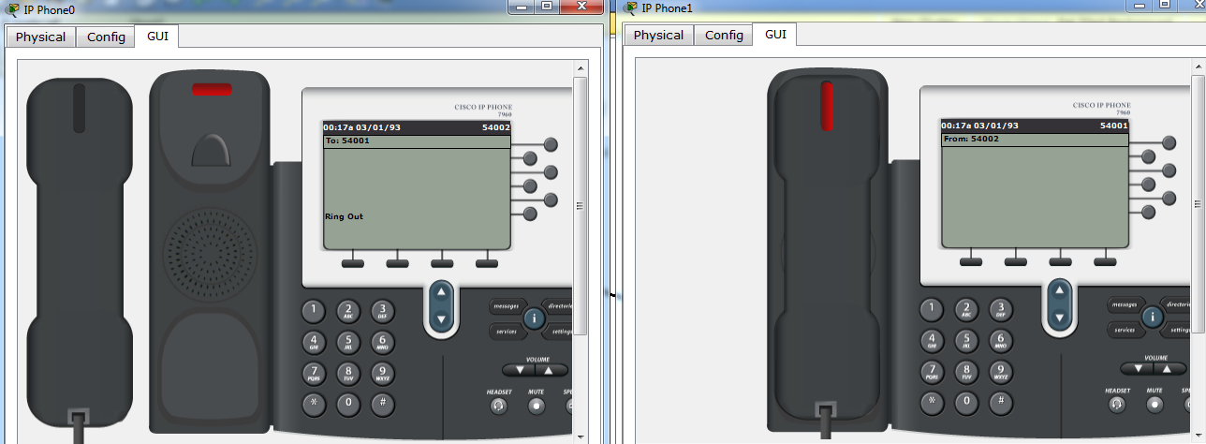
Verify the circuit with dialing.

