Slide 1
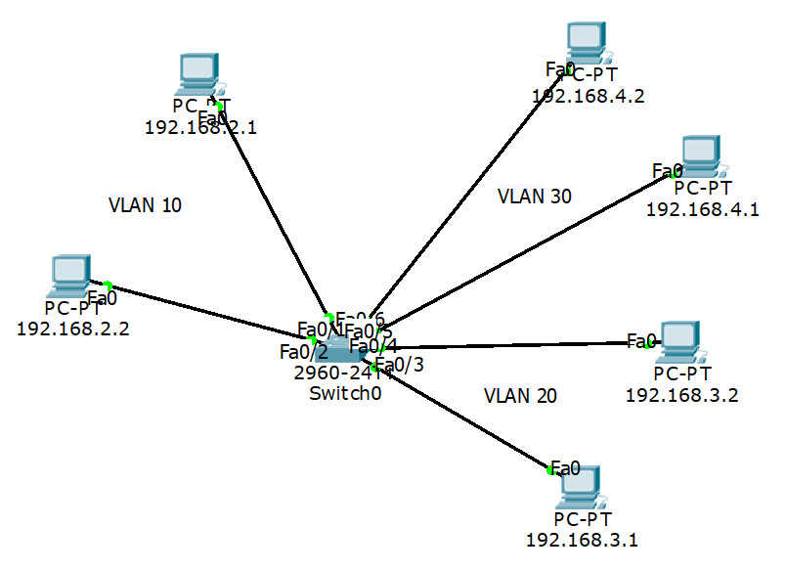
VLAN Configuration with Layer 3 Switch and Router
 | Name | IP of PCs | Interface
VLAN 10 | A | 192.168.2.1 192.168.2.2 | Fa0/1, Fa0/2
VLAN 20 | B | 192.168.3.1 192.168.3.2 | Fa0/3, Fa0/4
NLAN 30 | C | 192.168.4.1 192.168.4.2 | Fa0/5, Fa0/6

Slide 2
Switch>en
Switch# vlan database
Switch(vlan)# vlan 10 name A
Switch(vlan)# vlan 20 name B
Switch(vlan)# vlan 30 name C
Switch(vlan)# exit
Switch#
Switch# conf t
Switch(config)# int fa0/1
Switch(config-if)# switchport mode access
Switch(config-if)# switchport access vlan 10

Slide 3
Switch(config-if)# int fa0/2
Switch(config-if)# switchport mode access
Switch(config-if)# switchport access vlan 10
Switch(config-if)# int fa0/3
Switch(config-if)# switchport mode access
Switch(config-if)# switchport access vlan 20
Switch(config-if)# int fa0/4
Switch(config-if)# switchport mode access
Switch(config-if)# switchport access vlan 20
Switch(config-if)# int fa0/5
Switch(config-if)# switchport mode access
Switch(config-if)# switchport access vlan 30
Switch(config-if)# int fa0/6
Switch(config-if)# switchport mode access
Switch(config-if)# switchport access vlan 30
Switch(config-if)#end
Switch#

Slide 4
Switch#sh vlan brief
VLAN Name Status Ports
---- -------------------------------- --------- -------------------------------
1 default active Fa0/7, Fa0/8, Fa0/9, Fa0/10
Fa0/11, Fa0/12, Fa0/13, Fa0/14
Fa0/15, Fa0/16, Fa0/17, Fa0/18
Fa0/19, Fa0/20, Fa0/21, Fa0/22
Fa0/23, Fa0/24, Gig1/1, Gig1/2
10 A active Fa0/1, Fa0/2
20 B active Fa0/3, Fa0/4
30 C active Fa0/5, Fa0/6
1002 fddi-default active
1003 token-ring-default active
1004 fddinet-default active
1005 trnet-default active

Slide 5
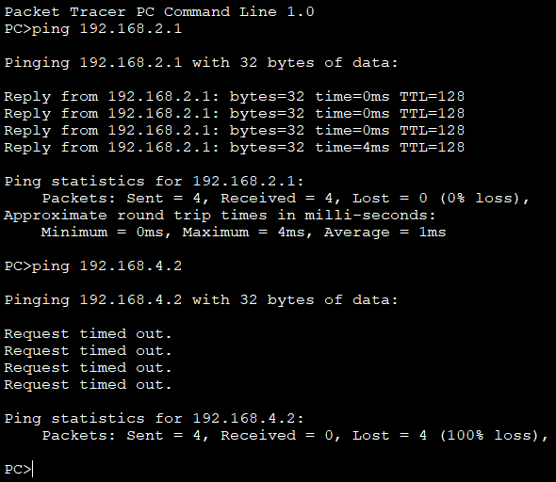
Now apply pink on PC of IP 192.168.2.2 to PC 192.168.2.2 of same VLAN 10 will be success. But to the PC 192.168.4.2 of different VLAN, the ping will be fail as shown below. Similarly you can verify the ICMP packet under simulation mode.

Slide 6
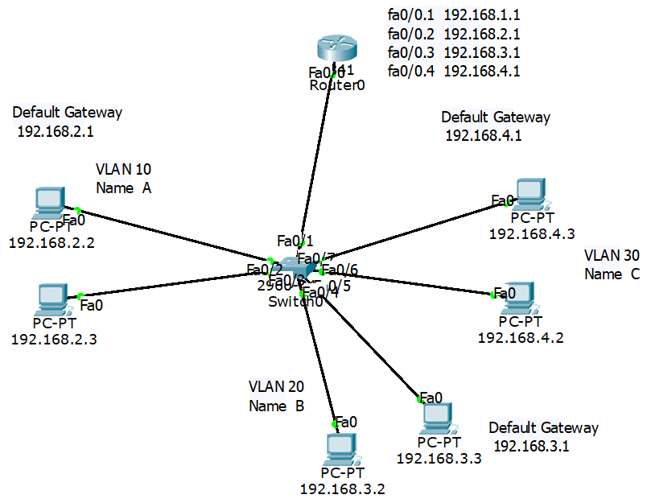

Slide 7
 | Name | IP of PCs | Default Gateway | Interface
VLAN 10 | A | 192.168.2.2 192.168.2.3 | 192.168.2.1 | Fa0/2, Fa0/3
VLAN 20 | B | 192.168.3.2 192.168.3.4 | 192.168.3.1 | Fa0/4, Fa0/5
VLAN 30 | C | 192.168.4.2 192.168.4.3 | 192.168.4.1 | Fa0/6, Fa0/7
VLAN 1 | Default VLAN Router itself | 192.168.1.1 |  | The interface of the router Fa0/0

Slide 8
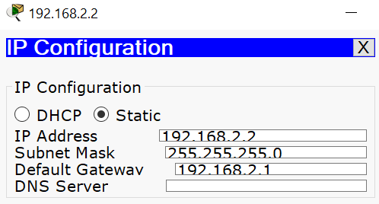
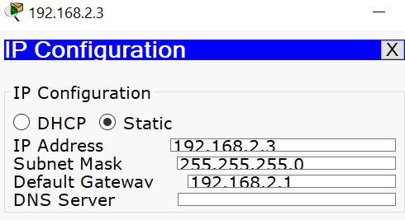
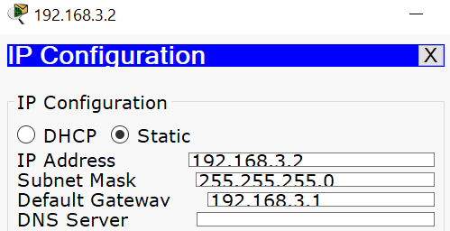
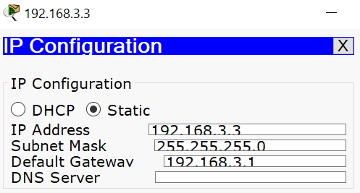

Slide 9
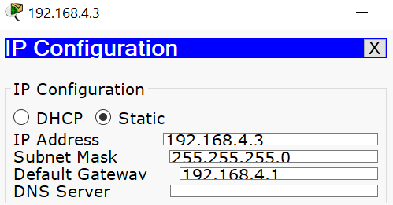


Slide 10
The router has to be configured such that each default gateway IP address (for a VLAN) is referred to a sub-interface of the router. For example interface fa0/0 has four sub-interfaces of fa0/0.1, fa0/0.2, fa0/0.3 and fa0.4. The sub-interfaces are provided IP address of 192.168.1.1 (for default vlan 1), IP 192.168.2.1 (for vlan 10), IP 192.168.3.1 (for vlan 20) and IP 192.168.4.1 (for vlan 30) respectively ass shown in fig.2.

Slide 11
Every port of the switch towards the PCs are in access mode where the port or interface of the switch towards the router is in trunk mode. During packet delivery, the router encapsulates a packet under IEEE 802.1q protocol where IEEE 802.1q header is added with each frame using the command ‘encapsulation dot1q’ and sends it to the appropriate port number.

Slide 12
Switch>en
Switch#vlan database
Switch(vlan)#vlan 10 name A
VLAN 10 added:
Name: A
Switch(vlan)#vlan 20 name B
VLAN 20 added:
Name: B
Switch(vlan)#vlan 30 name C
VLAN 30 added:
Name: C
Switch(vlan)#exit

Slide 13
Switch#conf t
Switch(config)#int fa0/2
Switch(config-if)#switchport mode access
Switch(config-if)#switchport access vlan 10
Switch(config-if)#int fa0/3
Switch(config-if)#switchport mode access
Switch(config-if)#switchport access vlan 10
Switch(config-if)#int fa0/4
Switch(config-if)#switchport mode access
Switch(config-if)#switchport access vlan 20
Switch(config-if)#int fa0/5

Slide 14
Switch(config-if)#switchport mode access
Switch(config-if)#switchport access vlan 20
Switch(config-if)#int fa0/6
Switch(config-if)#switchport mode access
Switch(config-if)#switchport access vlan 30
Switch(config-if)#int fa0/7
Switch(config-if)#switchport mode access
Switch(config-if)#switchport access vlan 30
Switch(config-if)#int fa0/1
Switch(config-if)#switchport mode trunk
Switch(config-if)#end
Switch#
Switch#sh vlan brief

Slide 15
 | Name | IP of PCs | Sub Interface
VLAN 10 | A | 192.168.2.1 | Fa0/0.2
VLAN 20 | B | 192.168.3.1 | Fa0/0.3
VLAN 30 | C | 192.168.4.1 | Fa0/0.3
VLAN 1 | Default VLAN Router itself | 192.168.1.1 | Fa0/0.1

Slide 16
Router>en
Router#conf t
Router(config)#int fa0/0
Router(config-if)#no shut
Router(config-if)#
Router(config-if)#int fa0/0.1
Router(config-subif)#
Router(config-subif)#encapsulation dot1q 1
Router(config-subif)#ip add 192.168.1.1 255.255.255.0

Slide 17
Router(config-subif)#int fa0/0.2
Router(config-subif)#encapsulation dot1q 10
Router(config-subif)#ip add 192.168.2.1 255.255.255.0
Router(config-subif)#int fa0/0.3
Router(config-subif)#encapsulation dot1q 20
Router(config-subif)#ip add 192.168.3.1 255.255.255.0
Router(config-subif)#int fa0/0.4
Router(config-subif)#encapsulation dot1q 30
Router(config-subif)#ip add 192.168.4.1 255.255.255.0
Router(config-subif)#end
Router>
Router>sh ip route

