Slide 1
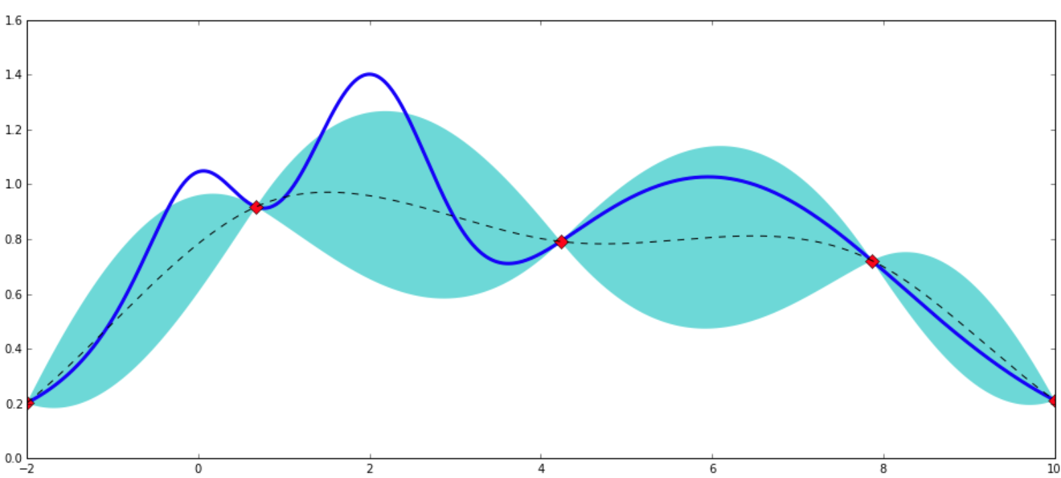
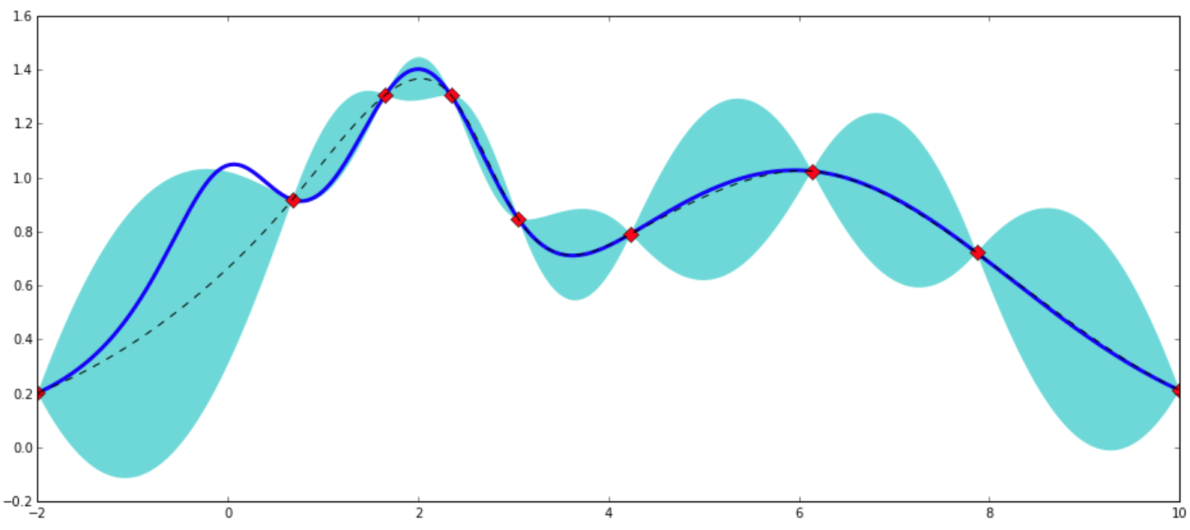
lc
rc
lr
lc
lr
…
lc
rc
lr*lc
Gradient Boosting Regressor
lc*rc
lr*rc
lr*lc+lc*rc
lr*lc*rc
Bayesian Optimization
Model data generation
Feature extraction
Modeling

