Slide 1
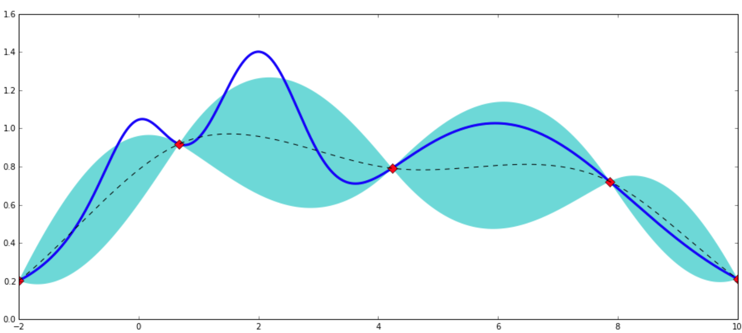
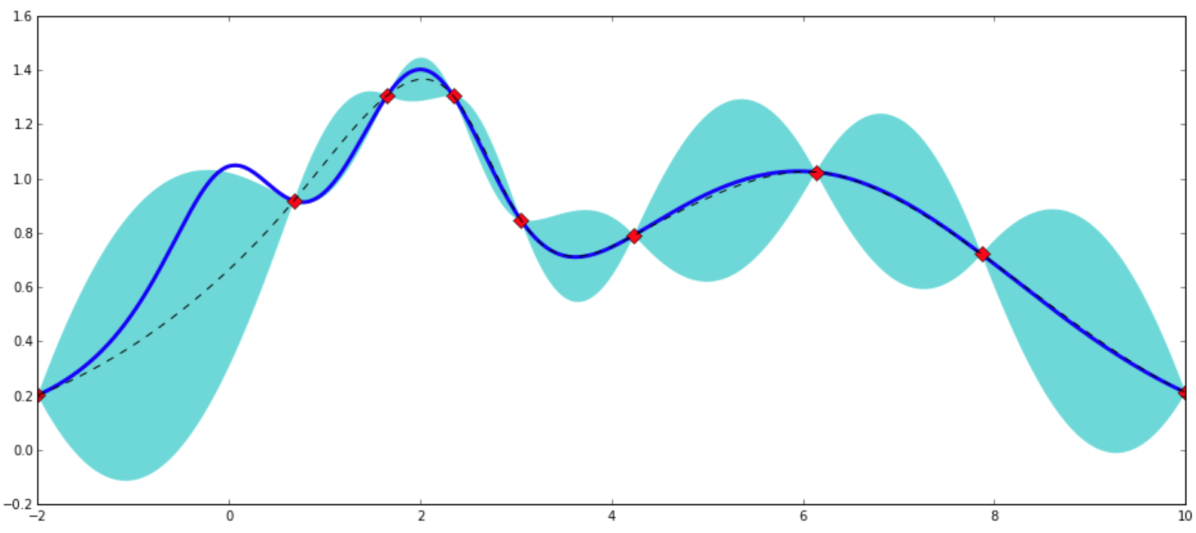
k
m
n
k
n
…
k
m
Gradient Boosting Regressor
n*k
k*m
n*m
n*k*m
Bayesian Optimization
Model data generation
Feature extraction
Modeling

