Slide 1
CIS202 Term Project
Adam Thomas, Kurt Mueller, Huseen Muyne

Slide 2


Introduction
Taylor
Robin
Two best friends, Robin and Taylor, see an opportunity to open up a bookstore named The Literary Oasis in their town.
They see an untapped market for a high quality, service-oriented bookstore that they can be successful in.
The challenge they face is the need of a computer-based information system in order to accomplish their goal that our team has been hired to design and implement.
Using our system they will be able to:
Look up books via title, author and ISBN​
Keep track of sales history ​
Easily order books based off sales history ​
Maintain several databases including :​
Customer information file,​
Book information file, ​
Sale history file​
Customer order file​
Purchase order file

Slide 3
Requirements
Functional

Slide 4
Processes
# | Functional Requirement
1 | The system must be able to look up books.
2 | The system must collect customer orders for out of stock books.
3 | The system must collect new customer information.
4 | The system must update files at point of sale.
5 | The system must generate purchase orders.
6 | The system must generate shipping labels..
7 | The system must be able to purge records.

Slide 5
Information Requirements
# | Functional Requirement
8 | The system must retain customer's names, addresses, phone numbers, reading interests, and a unique customer number of anyone who has purchased a book
9 | The system must retain sales order history to determine reorder quantities.
10 | The system must retain the publisher name, ISBN, title, author, category, specific location in book stacks, and price for each book.
11 | The system must retain the orders purchased from the distributor.
12 | The system must retain orders for books not in stock.

Slide 6
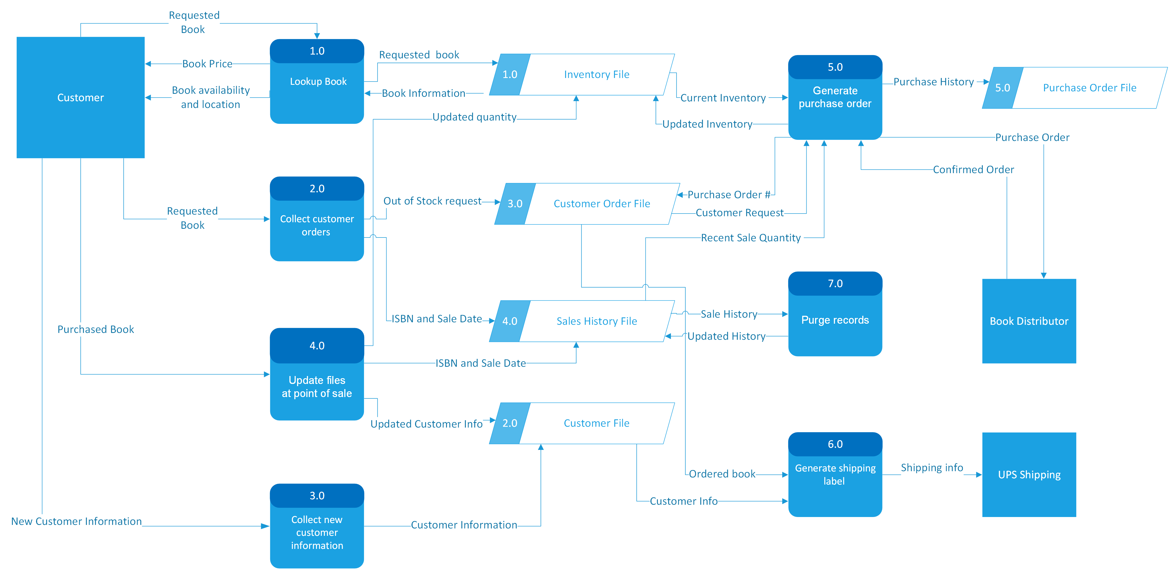
Data Flow Diagram

Slide 7
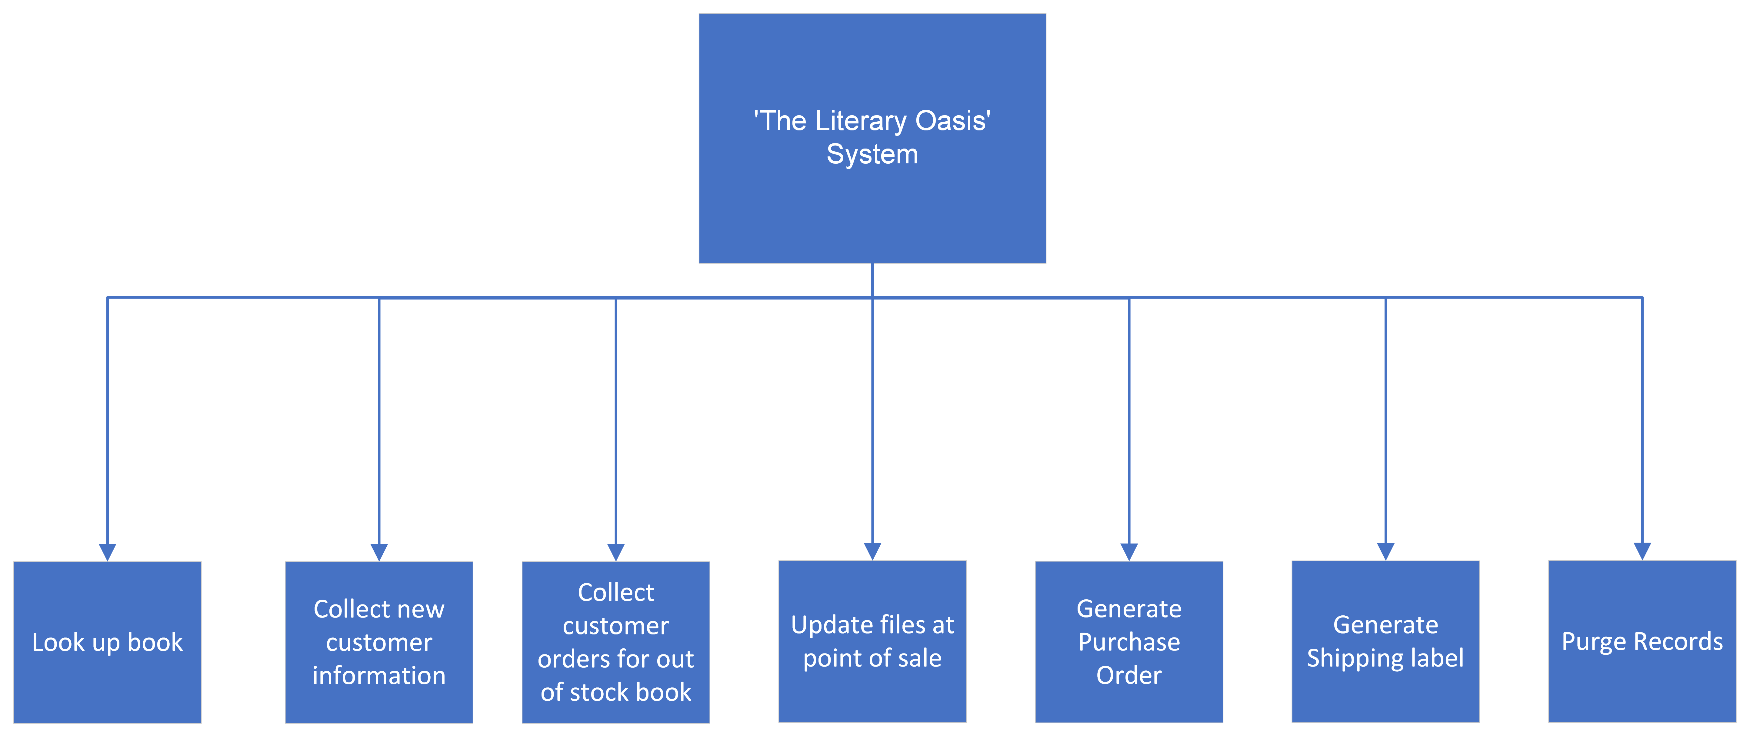
Structure Chart

Slide 8
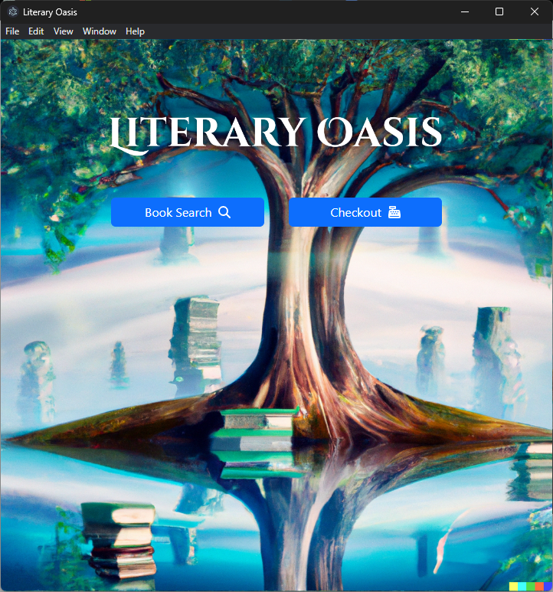
Interface Layouts

Slide 9
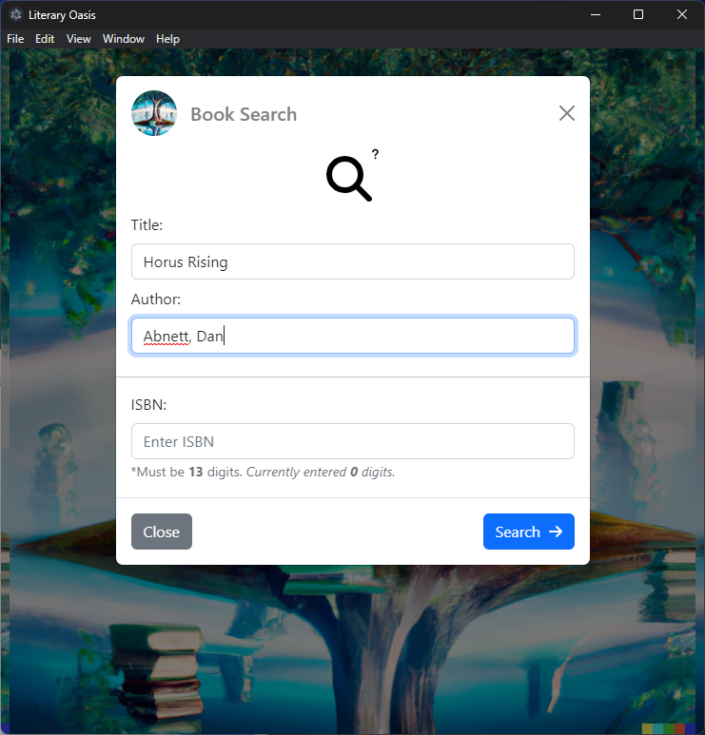
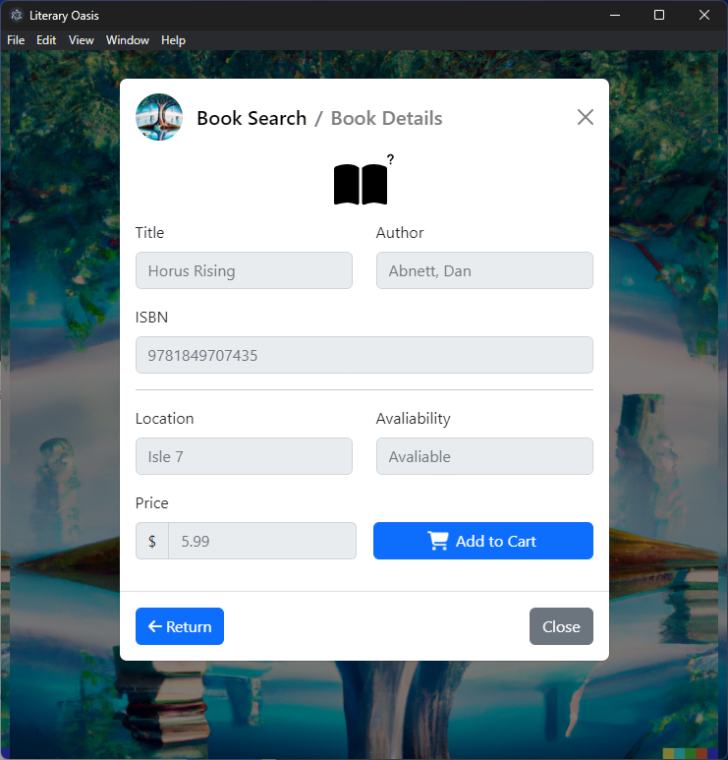

Slide 10
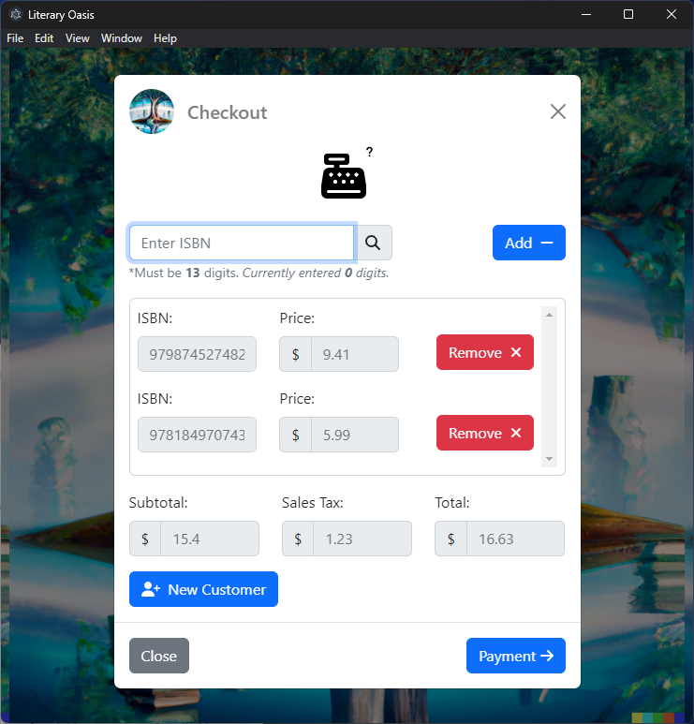

Slide 11
Thank you

