Slide 1

Project Title
ECE 210 Project Presentation
May 10, 2017
  Team Members: Brendan Smick, Jared Merkel, Kevin Mui, Micah DeRusha

Slide 2
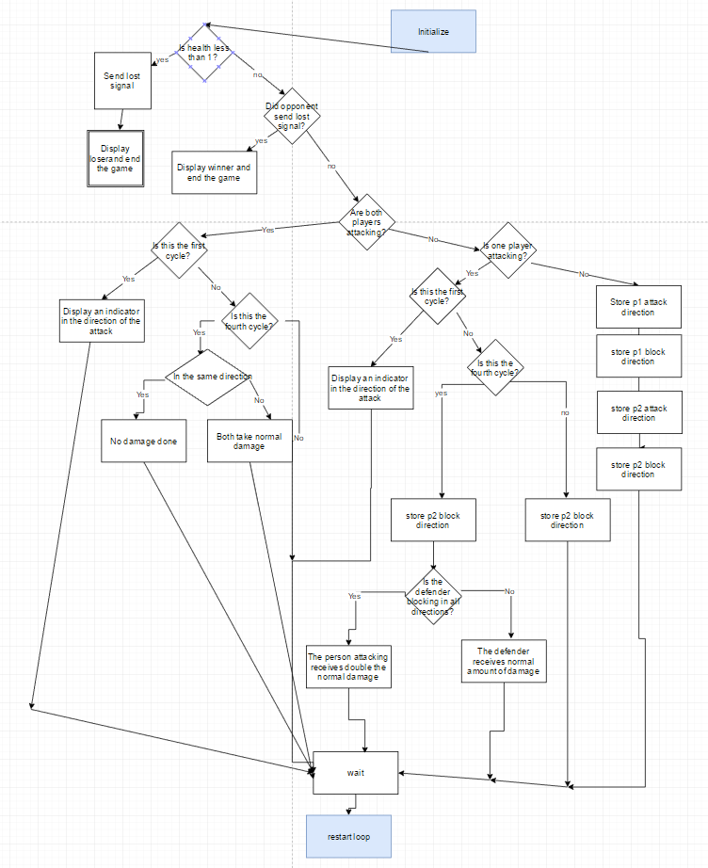
Flowchart

Slide 3
Results
  Video Demo:
  https://drive.google.com/file/d/0BwAenWjaeKh5NnYzYjBZbnBTSEE/view
  (Use Firefox or Edge)

Slide 4
Conclusions
  We learned how to use API’s and C programming. We even dabbled with definitions versus declarations. We had a rough time linking together the multiple files but everything came together without errors in the end.

