Slide 1
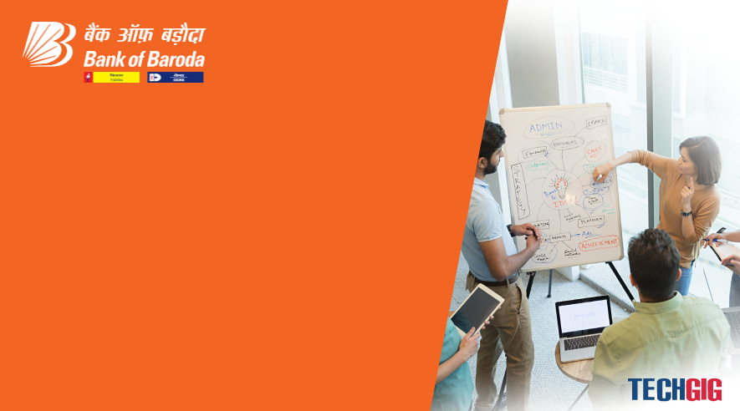

Bank of Baroda Hackathon - 2022
Technology Partner
Your Team Name : Star Rocks
Your team bio :A team with individual.
Date :21-08-22

Slide 2
Problem Statement?
Why did you decide to solve this Problem statement?
Actually this is a unique idea /event that urges me to solve this kind of problem statement.
More over, just trying also to verify my knowledge against this kind of challenge.

Slide 3
User Segment & Pain Points
Which user /advertiser segment would be early adopter of your product & why?
Microsoft has their own products and spreaded their services/products all over the world on many
latest technologies.So,just to say,that I want to use Microsoft products for such kind of problem to solve over the cloud service.

Slide 4
Pre-Requisite
What are the alternatives/competitive products for the problem you are solving?
I need an programming language to support and Azure IOT /sensors to send the data captured to IOT
Hub and returned back data to devices / sensors.

Slide 5
Azure tools or resources
Azure tools or resources which are likely to be used by you for the prototype, if your idea gets selected Visual studio code ,PASS/IAS/SAS cloud services also we need.IOT telemetry message services ,IOT hub as a gateway/security ,IOT sphere etc we need to implement. Also I prefer to use C# as a programming language. Git as a repository. As back end ,sql/Cosmos Database.

Slide 6
Any Supporting Functional Documents
Present your solution, talk about methodology, architecture & scalability
When customers enter /leave the bank branch ,at the door will be operated with counting sensors with video
Previleges and data would be stored into the cloud database via cloud IOT services.
Also .no need to stand in queue,they can sit at chair and as per the first come person will receive a token no in their registerd mobile no.
Also, no of customers will be tract via door sensors.
More over mobile application at bank also existing to the customers in a friendly way.
The process is similar to the ATM services also.

Slide 7
Key Differentiators & Adoption Plan
How is your solution better than alternatives and how do you plan to build adoption?
This solution is different from others because this is being used digitally and will help the customers
tackling hastle free way.
Also this is low cost product but effective.

Slide 8
GitHub Repository Link & supporting diagrams, screenshots, if any
How far it can go?

Slide 9
Thank You
Team member names: Me only.Kiranmay Mukherjee

