Slide 1
Intermediate Quantitative Methods III. Multiple regression (weeks 4-5)
Filip Kostelka & Arnout van de Rijt
EUI SPS Department 2024

Slide 2
Agenda
DONE:
Week 1. I Inference and hypothesis testing
normal distribution, inference, hypothesis testing
Week 2. II Bivariate regression
regression anatomy, part 1: explained variance
connecting the dots: regression by hand (part 1)
Week 3 regression anatomy part 2: uncertainty
connecting the dots: regression by hand (part 2)
TODAY:
Week 4: III Multiple regression
omitted variable problem
regression assumptions & diagnostics

Slide 3
“Correlation without causation”
Why are birth rates higher in areas with many storks?
Why is ice cream consumption related to swimming pool accidents?
Why does the extent of fire damage increase with the number of fire trucks dispatched?
Why do the children of mothers who drank champagne during pregnancy live longer than those with mothers who drank beer?

Slide 4
Spurious association
Mother drinks champagne
+
Mother is rich
+
+
Child lives longer

Slide 5
Spurious association
Education
+
Parents’ SES
+
+
Income

Slide 6
Exercise: Make it spurious
Bivariate analysis:
 | High income | Low income
High edu | 250 | 200
Low edu | 200 | 250
Multiple analysis:
High class | High income | Low income | Low class | High income | Low income
High edu | ? | ? | High edu | ? | ?
Low edu | ? | ? | Low edu | ? | ?

Slide 7
Spurious association
Bivariate analysis:
 | High income | Low income
High edu | 250 | 200
Low edu | 200 | 250
Multivariate analysis:
High class | High income | Low income | Low class | High income | Low income
High edu | 200 | 100 | High edu | 50 | 100
Low edu | 100 | 50 | Low edu | 100 | 200

Slide 8
Regression of a (fake) class society
→ inc
200
250
100
200
high
100
50
High class
Low class
250
200
low
50
100
200
100
low
high
→ edu

Slide 9
Regression of a (fake) class society
. reg inc edu
Source | SS df MS Number of obs = 900
-------------+---------------------------------- F(1, 898) = 11.22
Model | 2.77777778 1 2.77777778 Prob > F = 0.0008
Residual | 222.222222 898 .247463499 R-squared = 0.0123
-------------+---------------------------------- Adj R-squared = 0.0112
Total | 225 899 .250278087 Root MSE = .49746
------------------------------------------------------------------------------
inc | Coef. Std. Err. t P>|t| [95% Conf. Interval]
-------------+----------------------------------------------------------------
edu | .1111111 .0331638 3.35 0.001 .0460235 .1761987
_cons | .4444444 .0234503 18.95 0.000 .3984206 .4904683
------------------------------------------------------------------------------
. reg inc edu ses
Source | SS df MS Number of obs = 900
-------------+---------------------------------- F(2, 897) = 56.06
Model | 25 2 12.5 Prob > F = 0.0000
Residual | 200 897 .22296544 R-squared = 0.1111
-------------+---------------------------------- Adj R-squared = 0.1091
Total | 225 899 .250278087 Root MSE = .47219
------------------------------------------------------------------------------
inc | Coef. Std. Err. t P>|t| [95% Conf. Interval]
-------------+----------------------------------------------------------------
edu | 1.48e-17 .033389 0.00 1.000 -.0655297 .0655297
ses | .3333333 .033389 9.98 0.000 .2678036 .398863
_cons | .3333333 .0248867 13.39 0.000 .2844904 .3821763
------------------------------------------------------------------------------

Slide 10
Regression anatomy: What is different in multiple regression?
. reg edu inc
Source | SS df MS Number of obs = 900
-------------+---------------------------------- F(1, 898) = 11.22
Model | 2.77777778 1 2.77777778 Prob > F = 0.0008
Residual | 222.222222 898 .247463499 R-squared = 0.0123
-------------+---------------------------------- Adj R-squared = 0.0112
Total | 225 899 .250278087 Root MSE = .49746
------------------------------------------------------------------------------
inc | Coef. Std. Err. t P>|t| [95% Conf. Interval]
-------------+----------------------------------------------------------------
edu | .1111111 .0331638 3.35 0.001 .0460235 .1761987
_cons | .4444444 .0234503 18.95 0.000 .3984206 .4904683
------------------------------------------------------------------------------
. reg edu inc ses
Source | SS df MS Number of obs = 900
-------------+---------------------------------- F(2, 897) = 56.06
Model | 25 2 12.5 Prob > F = 0.0000
Residual | 200 897 .22296544 R-squared = 0.1111
-------------+---------------------------------- Adj R-squared = 0.1091
Total | 225 899 .250278087 Root MSE = .47219
------------------------------------------------------------------------------
inc | Coef. Std. Err. t P>|t| [95% Conf. Interval]
-------------+----------------------------------------------------------------
edu | 1.48e-17 .033389 0.00 1.000 -.0655297 .0655297
class | .3333333 .033389 9.98 0.000 .2678036 .398863
_cons | .3333333 .0248867 13.39 0.000 .2844904 .3821763
------------------------------------------------------------------------------
Model df: More than 1 degree of freedom used up by model → F no longer equal to t squared
R² now based on 2 predictors, so square root no longer equal to correlation r, stand reg coefficient
Calculation of coefficients and standard errors is more complex

Slide 11
Suppressor variables
Education
+
Age
-
-
Income

Slide 12
Exercise: Un-suppress it
Bivariate analysis:
 | High income | Low income
High edu | 250 | 250
Low edu | 250 | 250
Multivariate analysis:
Old | High income | Low income | Young | High income | Low income
High edu | ? | ? | High edu | ? | ?
Low edu | ? | ? | Low edu | ? | ?

Slide 13
Suppressor variable
Bivariate analysis:
 | High income | Low income
High edu | 250 | 250
Low edu | 250 | 250
Multivariate analysis:
Old | High income | Low income | Young | High income | Low income
High edu | 125 | 25 | High edu | 125 | 225
Low edu | 225 | 125 | Low edu | 25 | 125

Slide 14
Older people earn more but less edu
→ inc
250
250
225
125
high
25
125
Old
Young
250
250
low
125
25
125
225
low
high
→ edu

Slide 15
Older people earn more but less edu
. regress inc edu
Source | SS df MS Number of obs = 1,000
-------------+---------------------------------- F(1, 998) = 0.00
Model | 0 1 0 Prob > F = 1.0000
Residual | 250 998 .250501002 R-squared = 0.0000
-------------+---------------------------------- Adj R-squared = -0.0010
Total | 250 999 .25025025 Root MSE = .5005
------------------------------------------------------------------------------
inc | Coef. Std. Err. t P>|t| [95% Conf. Interval]
-------------+----------------------------------------------------------------
edu | 0 .0316544 0.00 1.000 -.0621169 .0621169
_cons | .5 .0223831 22.34 0.000 .4560767 .5439233
------------------------------------------------------------------------------
. regress inc edu old
Source | SS df MS Number of obs = 1,000
-------------+---------------------------------- F(2, 997) = 117.29
Model | 47.6190476 2 23.8095238 Prob > F = 0.0000
Residual | 202.380952 997 .202989922 R-squared = 0.1905
-------------+---------------------------------- Adj R-squared = 0.1889
Total | 250 999 .25025025 Root MSE = .45054
------------------------------------------------------------------------------
inc | Coef. Std. Err. t P>|t| [95% Conf. Interval]
-------------+----------------------------------------------------------------
edu | .1904762 .0310905 6.13 0.000 .1294659 .2514865
old | .4761905 .0310905 15.32 0.000 .4151802 .5372008
_cons | .1666667 .0296584 5.62 0.000 .1084665 .2248668
------------------------------------------------------------------------------

Slide 16
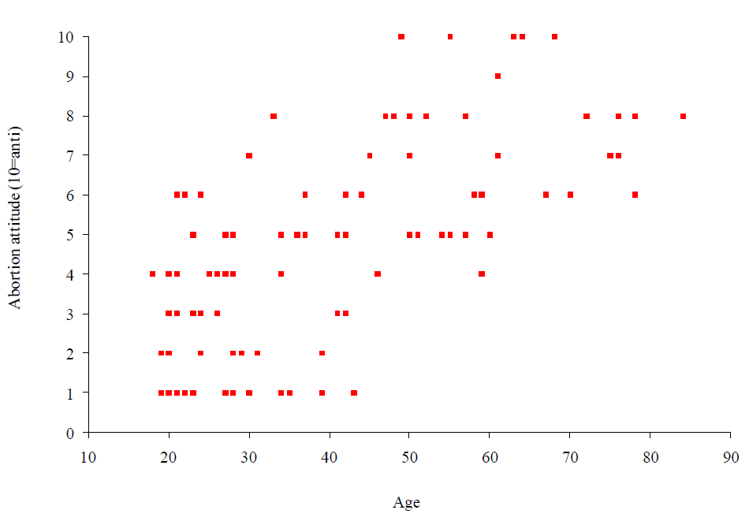
A bivariate association

Slide 17
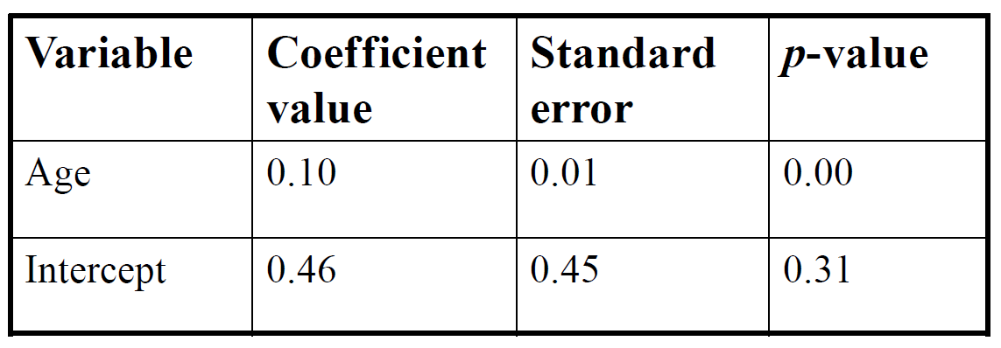
Bivariate regression finds an effect
Abortion attitude = $β_{0}$ + $β_{1}$Age

Slide 18
A bivariate association
How could it be spurious? What lurking variables?

Slide 19
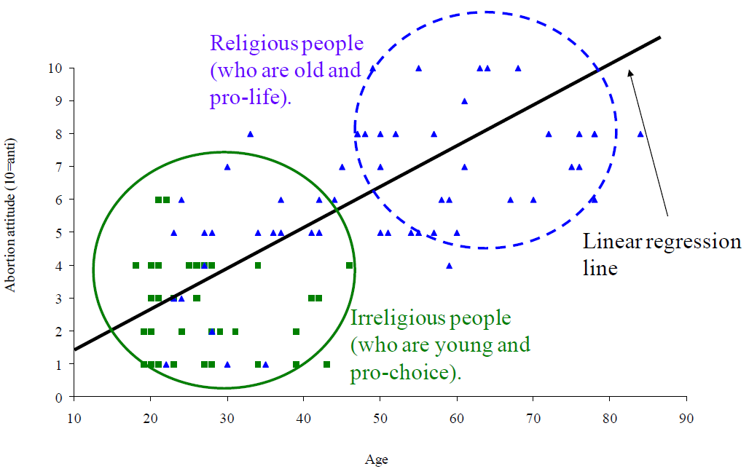
Multiple regression takes lurking variable into account
Again, we try to minimize the sum of squared deviations RSS.
But because we have three variables now (Y, X₁, and X₂),
we are fitting a plane in 3D space rather than 1 line in 2D space.

Slide 20
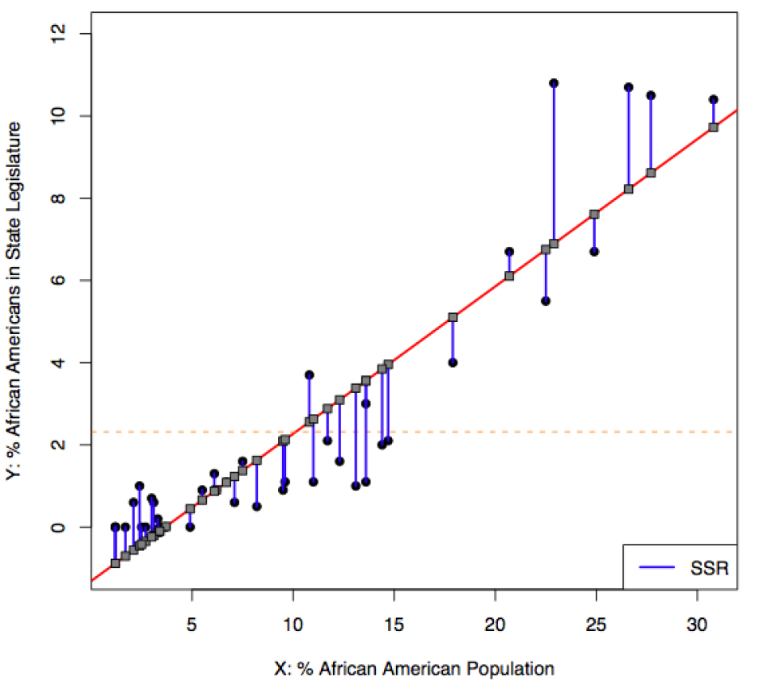
Last week we asked: What is the best fitting line?
"Least squares" solution:
The line that minimizes the RSS
RSS

Slide 21
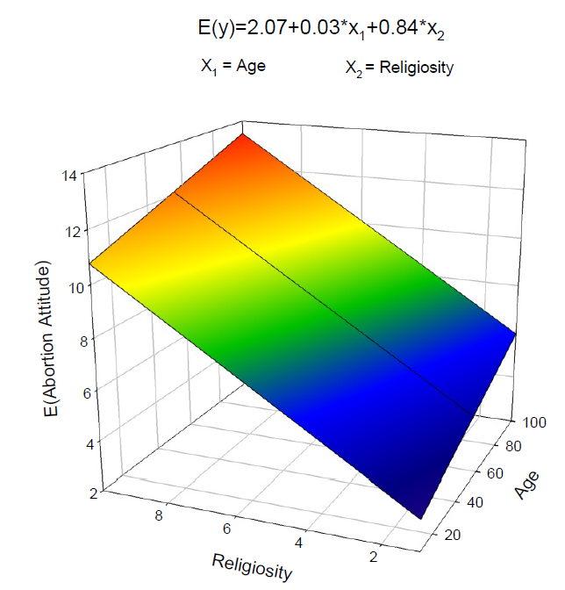
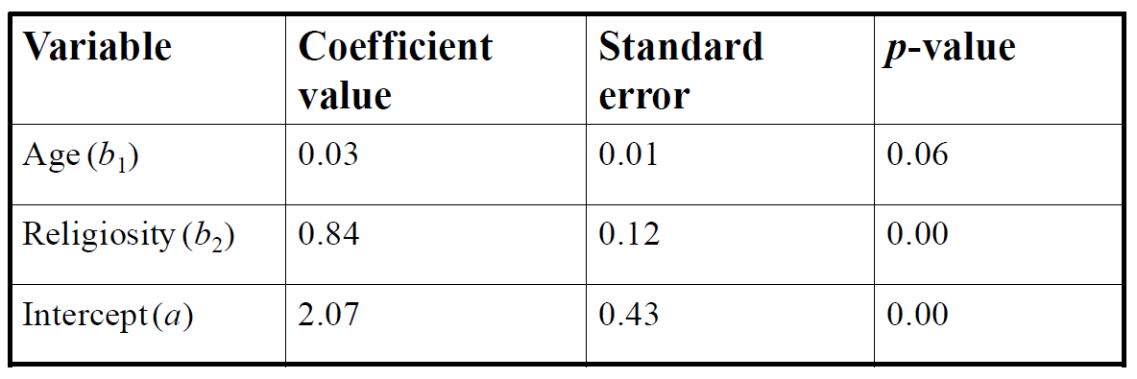
Plane that minimizes the RSS
Abortion attitude = $β_{0}$ + $β_{1}$Age + $β_{2}$Religosity

Slide 22
Final example: Controlling through multiple regression
Data on 157 countries from Fish (2002): Islam and Authoritarianism. World Politics, 55:4-37.
How does the income of a country explain its level of democracy?

Slide 23
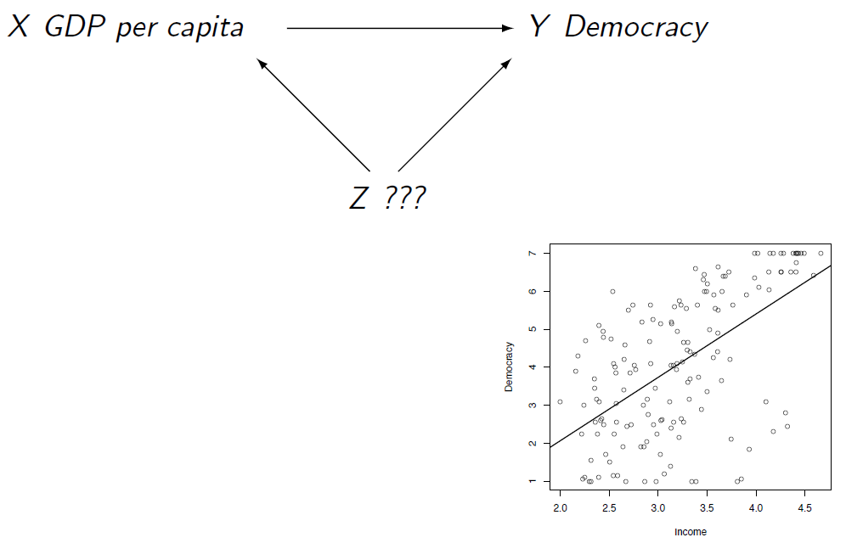
What Z may be lurking?
Perhaps “Colony”: whether a country was a British colony (1 = yes, 0 = no).
Democracy = $β_{0}$ + $β_{1}log(GDP)$ + $β_{2}$Colony

Slide 24
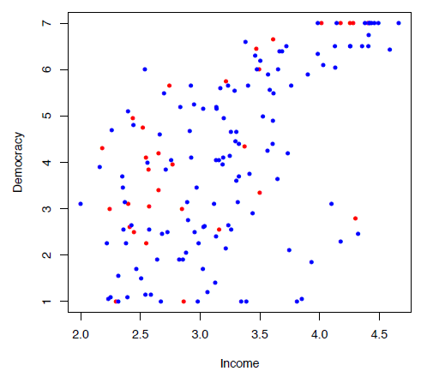
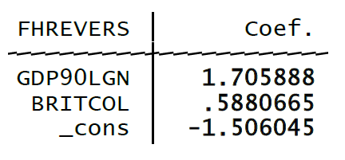
Estimated coefficients

Slide 25
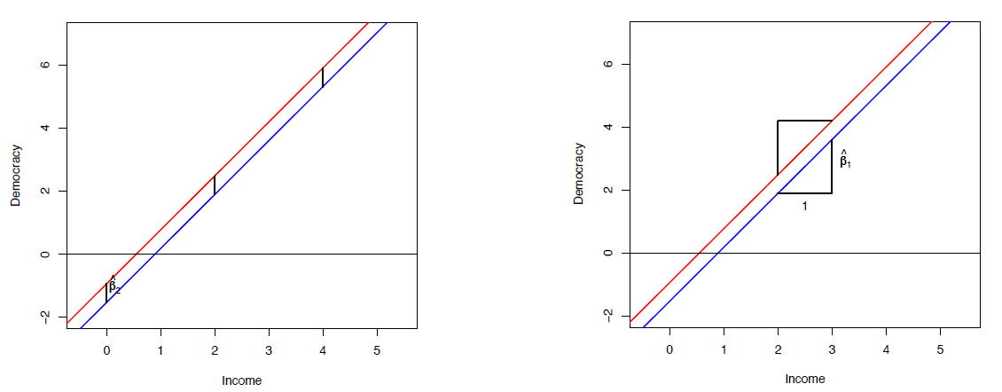
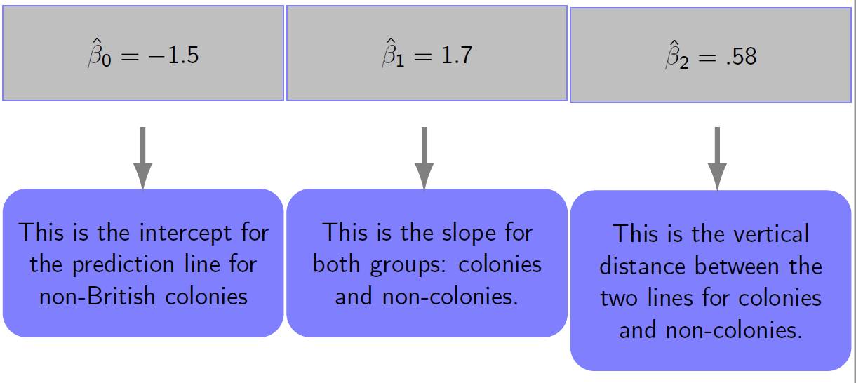
Democracy = $β_{0}$ + $β_{1}log(GDP)$ + $β_{2}$Colony

Slide 26
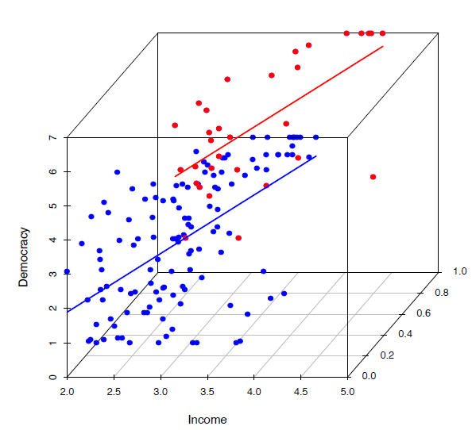
3D representation

Slide 27
Interpretation
Was it important to control for British colony?

Slide 28
Omitted variable problem: There are countless other omitted variables
One solution is to “un-correlate” X₁ from any other variable.
This can be done through randomization.
Experiments implement randomization. Randomly decide who gets the real pill and who get the placebo. This way what pill is taken is not related to any feature X₂ of the patient. It creates an apple-to-apple comparison. No need for multiple regression!

Slide 29

Other (partial) fixes
In Spring:
Causal inference
by Prof. Dinas
Lotteries (green card lottery, allocation of students to dorm rooms, admission to programs with limited # spots)
Regression discontinuity (vote share and winning an election, test score and passing a test, birth day (dec 31 vs. jan 1) and school grade / sport league, evaluation score and receiving a grant). Logic: Those very close to the cut-off are near-identical in performance but very different in resources obtained. Allows estimation of performance effect.
Longitudinal data (later in course). Many omitted variables are time-constant (gender, race, country of birth, SES, country characteristics). These variables can all be controlled by comparing units with themselves over time! Also: "fixed effects" or "within design"

Slide 30

Coffee break

Slide 31
Regression assumptions and diagnostics
OLS makes a number of assumptions.
Some assumptions are necessary for estimates to be unbiased, others are needed for standard errors to be correctly estimated.
One can look if these assumptions appear to hold or are violated → “regression diagnostics.”

Slide 32
OLS assumptions
Zero conditional mean: The expected value of the error term is zero conditional on the explanatory variables
Random sampling: The observed data represent a random sample from the population to which we aim to generalize
No perfect collinearity: There is variation in the explanatory variables
Homoskedasticity: The error term has constant variance, i.e. the same variance regardless of the value of X
Normality: The error term follows a normal distribution
Linearity: The population regression model is linear in its parameters.

Slide 33
Zero conditional mean
The expected value of the error term does not depend on the explanatory variables:
Exp(U|X) = Exp(U) = 0
This is a problem social scientists obsess over. It is very commonly violated, namely whenever a relevant variable is omitted that is imperfectly correlated with the predictors (all examples before the coffee break).

Slide 34
Zero conditional mean
Example of a violation:
We are regressing wage on education: Wages_{i} = β₀ + β₁ Educ_{i} + u_{i}
But an important wage determinant is ability (skills, intelligence etc.), which we cannot observe, so it is captured by u_{i}
The conditional mean assumption is: Exp(U|X) = Exp(U) = 0.
Therefore it is assumed that Exp(ability|8) = Exp(ability|16)
This will not hold, as more able people tend to be educated.

Slide 35
Fixing non-zero conditional mean
Often impossible in observational data, as it may amount to solving the omitted variable problem from before.
See → “Causal inference” course in Spring

Slide 36
OLS assumptions
Zero conditional mean: The expected value of the error term is zero conditional on the explanatory variables
Random sampling: The observed data represent a random sample from the population to which we aim to generalize
No perfect collinearity: There is variation in the explanatory variables
Homoskedasticity: The error term has constant variance, i.e. the same variance regardless of the value of X
Normality: The error term follows a normal distribution
Linearity: The population regression model is linear in its parameters.

Slide 37
The random sampling assumption
Each unit of the population had an equal chance of being in your dataset
Examples of non-random samples:
Convenience samples: Sample those nearby, available
Snowball / respondent-driven samples: Subjects recruit other subjects (e.g. when sampling from hidden populations: injection drug users, jazz musicians, homeless)

Slide 38
Problem with non-random samples
Examples
Biased constant: If you oversample men, who tend to be taller, then estimate of average height is upwardly biased.
Biased slope: If you oversample tall women, then your estimate of male effect on height is downwardly biased.

Slide 39
OLS assumptions
Zero conditional mean: The expected value of the error term is zero conditional on the explanatory variables
Random sampling: The observed data represent a random sample from the population to which we aim to generalize
No perfect collinearity: There is variation in the explanatory variables
Homoskedasticity: The error term has constant variance, i.e. the same variance regardless of the value of X
Normality: The error term follows a normal distribution
Linearity: The population regression model is linear in its parameters.

Slide 40
No perfect collinearity
The observations x_{i} for i = 1,…, n are not all the same value, so var(X) > 0.
(“no multicollinearity”:) One predictor is not an exact linear combination of the other predictors.
Examples of perfect collinearity:
You regress Americans’ weights on average height
You regress Americans’ weights on both their height in inches and their height in centimeters
You regress democratization on both (log) GDP in euros and (log) GDP in dollars.
You regress earnings on (a) mother’s earnings, (b) father’s earnings, and (c) mother’s minus father’s earnings

Slide 41
Example 1
I = own income
IM = income mother
IF = income father
I = β₀ + β₁ IM + β₂ IF + β₃ (IM - IF)
I = β₀ + (β₁+ β₃) IM + (β₂- β₃) IF
We can choose any value of β₃ and accommodate it. So we cannot estimate it. This is a case of perfect multicollinearity.

Slide 42
Example 2
I = income
I = β₀ + β₁ age + β₂ period + β₃ cohort
I = β₀ + β₁ age + β₂ period + β₃ (period – age)
I = β₀ + (β₁ - β₃) age + (β₂ + β₃) period
We can choose any value of β₃ and accommodate it. So we cannot estimate it. This is a case of perfect multicollinearity.

Slide 43
(Imperfect) multicollinearity
Even if one predictor (e.g. X) is not an exact linear combination of other predictors (e.g. Z), it may happen that X and Z are highly related.
Example of imperfect multicollinearity:
You regress something on a set of measures that capture the same latent concept and have a high Cronbach’s alpha.

Slide 44
Dealing with imperfect multicollinearity
Inspect the correlation table and find predictors that are highly correlated
Calculate the Variance Inflation Factor (VIF) of each predictor in the model = indicator for size of the problem
VIF = 1 / (1 – R²_{j}) where R²_{j} is from regressing X on other predictors
Estimate models that exclude some of the high-VIF predictors, e.g. those without which similar R² is achieved or those that are theoretically near-equivalent to included predictors

Slide 45
OLS assumptions
Zero conditional mean: The expected value of the error term is zero conditional on the explanatory variables
Random sampling: The observed data represent a random sample from the population to which we aim to generalize
No perfect collinearity: There is variation in the explanatory variables
Homoskedasticity: The error term has constant variance, i.e. the same variance regardless of the value of X
Normality: The error term follows a normal distribution
Linearity: The population regression model is linear in its parameters.

Slide 46
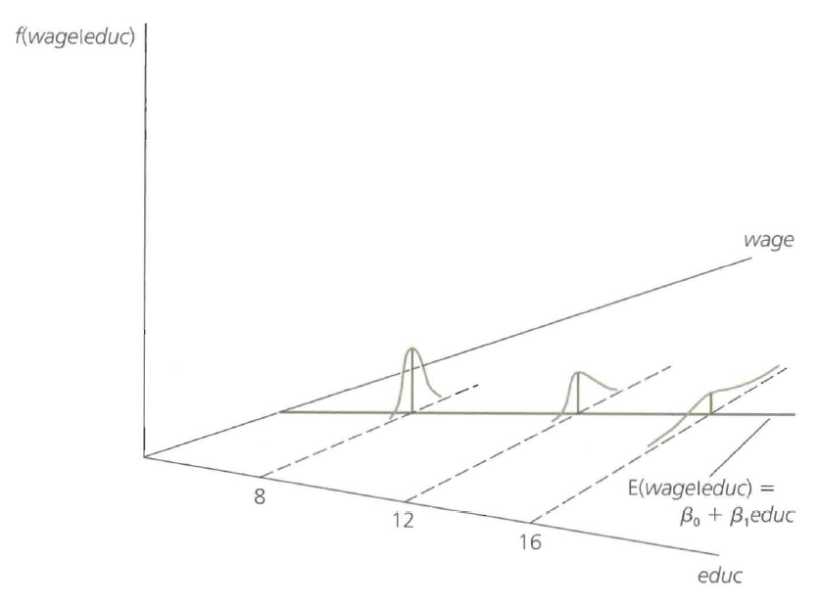
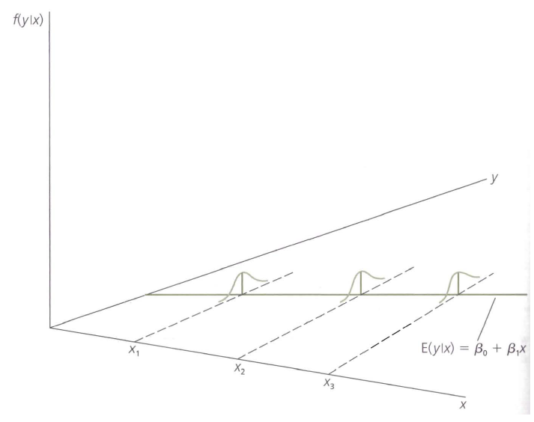
Homoskedasticity
The error term has constant variance, i.e. the same variance regardless of the value of X
Homoskedastic Heteroskedastic

Slide 47
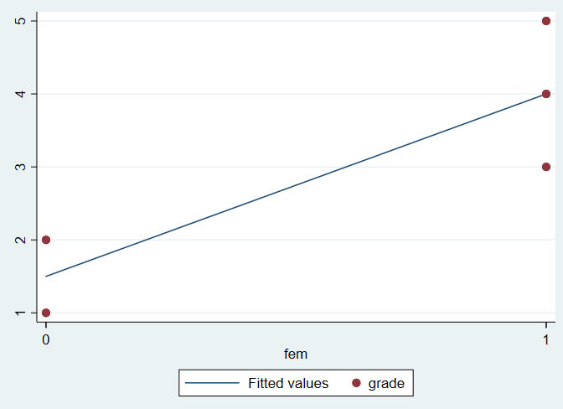
Heteroskedasticity in our toy data

Slide 48
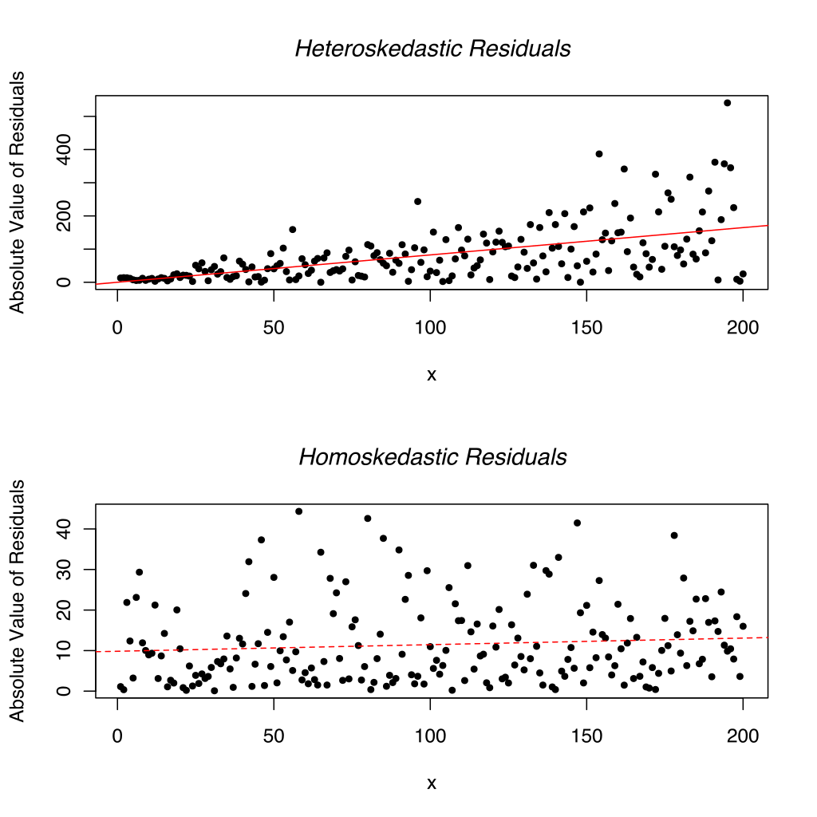
Heteroskedasticity

Slide 49
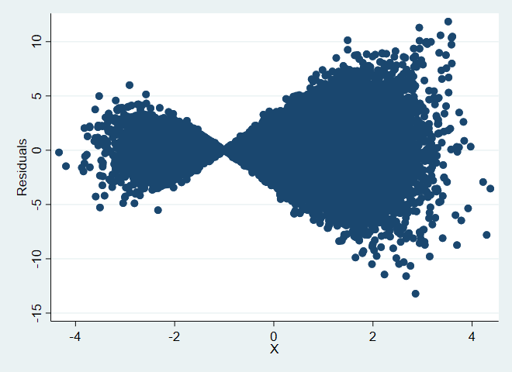
Addressing heteroskedasticity
Heteroskedasticity in residuals can mean 2 things:
(1) The model is correct but has heteroskedastic errors
Calculate heteroskedasticity-consistent (a.k.a. “robust”) standard errors.
(option robust in STATA’s regress command)
This is probably often a good idea. Some (=Arnout & Filip) pretty much always calculate robust standard errors, as a default.
(2) The heteroskedasticity is caused by model misspecification.
For example, if the true model is Y = X + Z + X * Z + error, but you estimate Y = X + error, then you will see this relationship between X and residuals:
You need to change the model.
Adjusting standard errors does not solve the deeper problem!

Slide 50
OLS assumptions
Zero conditional mean: The expected value of the error term is zero conditional on the explanatory variables
Random sampling: The observed data represent a random sample from the population to which we aim to generalize
No perfect collinearity: There is variation in the explanatory variables
Homoskedasticity: The error term has constant variance, i.e. the same variance regardless of the value of X
Normality: The error term follows a normal distribution
Linearity: The population regression model is linear in its parameters.

Slide 51
Normality
The error term follows a normal distribution.
How to evaluate:
- inspect residual plot and see if errors are bell-shaped (symmetric, one mode, small errors are more common than large errors)

Slide 52
Fixing non-normality
Work with a large sample (central limit theorem)
Use an alternative method for assessing confidence

Slide 53
OLS assumptions
Zero conditional mean: The expected value of the error term is zero conditional on the explanatory variables
Random sampling: The observed data represent a random sample from the population to which we aim to generalize
No perfect collinearity: There is variation in the explanatory variables
Homoskedasticity: The error term has constant variance, i.e. the same variance regardless of the value of X
Normality: The error term follows a normal distribution
Linearity: The population regression model is linear in its parameters.

Slide 54
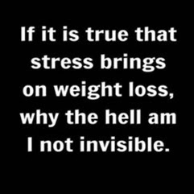
The linearity assumption

Slide 55



Non-linear in variables
Linear in variables and parameters:
Non-linear in parameters:
Non-linear in variables:

Slide 56
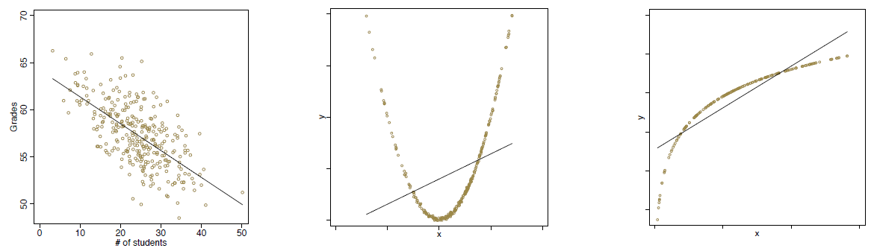
The linearity assumption
How to evaluate?
→ Plot the data points and see if they follow a straight line.
Only in the left figure does the linearity assumption hold. In the middle and right figure it is violated.

