Slide 1
Developing Leadership Skills through Assessment
ACBSP Region 2 Conference Edmund Matecki¹ Kentaro Murayama²

Slide 2
Motivation: Why Care about Leadership?
Employer Survey
Initial Assessment

Slide 3
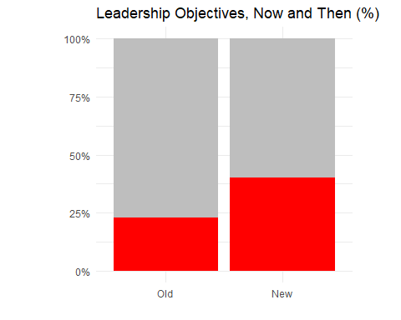
The Change

Slide 4
Assessing Leadership: Business Core
LO7: Discern ethical choices and critically evaluate the ethical choices of others.
Internal: BUS 499 International ethics case Rows PLO7 a,b,c
External: Peregrine Ethics
LO8: Evaluate socio-cultural and international diversity variables in decision making.
Internal: BUS 499 International ethics case Rows PLO8 a,b,c
External: Peregrine HR
LO9: Work collaboratively with and provide feedback to others in a team setting.
Internal: Team Simulation Peer Feedback #2 overall score from rubric in D2L
External: Peregrine Org Behavior
LO10: Reflect on personal leadership growth and potential.
Internal: Final reflection paper. BUS 499 Reflection and Development Plan Rows 1 and 2
External: Peregrine Leadership

Slide 5
Multi-pronged Assessment Regime
Course-embedded summative assessments
Peregrine Exit Exam
Aligned CPC Topic
Course-embedded Formative Assessments
Learning Objective
Student Exit Survey Aligned Question
External Stakeholder
Survey Aligned Question

Slide 6
Automation of Data Collection & Analysis
A
A
A
Peregrine
Data
Summative
D2L Rubrics
Data Visualizations
Assessment
Reports
IT Support
Downloads Rubric Data
Proprietary R code
Forms Survey
Formative
D2L Rubrics
Employer
Survey
A
A
A

Slide 7
Demonstration: Business Core LO 8
Re-define Learning Objectives
Re-design Assessment Tools
Implement Standardized Assessment Mechanisms
Automate Data Collection and Processing
Communicate Feedback

Slide 8
1. Re-define Learning Objectives
Learning Objective: Evaluate socio-cultural and international diversity variables in decision making.

Slide 9
2. Re-design Assessment Tools
External Tool: Peregrine CPC Exam
Internal Tool: Project Assignment “Ethics Case”

Slide 10
3. Implement Standardized Assessment Mechanisms
(Sereis of Screenshots)

Slide 11
4. Automate Data Collection and Processing
Challenges
Inconsistency in rubrics (e.g. word choices, typos, etc.)
Variations in the data sources (e.g. external/internal, rubric/exam, etc.)
Timely responses for feedback
Solutions
Literal programming for reproducible analysis
Iterative data processing

Slide 12
5. Communicate Feedback
Annual Department Retreat
Assessment outcomes for core objectives
Assessment outcomes for each program
Strategy development

Slide 13
Complementary Design in Action
Challenge: Internal and external assessment outcomes are not directly comparable
Track the changes over time
Two-dimensional dynamics
Possible calibration

Slide 14
Single Measures
Graphs

Slide 15
Combined Measures
Graph

Slide 16
Feedback & Strategy Development
Annual Meeting & Strategy Development
Data analysis provided
Discuss the findings with additional qualitative information from discutants
Review the existing assessment tools in light of learning objectives
Propose changes in assessment tools (and/or learning objectives)
Continuous Feedback
Assessment Committee
Curriculum Development Committee
Individual faculty members (both regular and temporary)

Slide 17
Notes
1. Associate Professor of Economic, California University
2. Visiting Assisstant Professor of Economics, California University

