Slide 1
Socket Programming
CSCE 3530

Slide 2
What are ports?
Ports could be described as the points of entry or exit for packets in communication.
There are 65536 ports to be used by the transport layer [0-65535].
Note : Some of them are registered (Ex: 8080 is used for HTTP communication).
You could use “ netstat –an “ for a list of all ports that are currently being used.

Slide 3
Sockets
Sockets are an operating system abstraction for dealing with networking protocols.
Two Kinds:
Stream sockets:
Dedicated & point-to-point channel between server and client.
Use TCP protocol for data transmission.
Reliable and Lossless.
Data sent/received in the similar order.
Long time for recovering lost/mistaken data

Slide 4
Sockets
Datagram packets:
No dedicated & point-to-point channel between server and client.
Use UDP for data transmission.
Not 100% reliable and may lose data.
Data sent/received order might not be the same.
Don't care for rapid recovering lost/mistaken data.

Slide 5
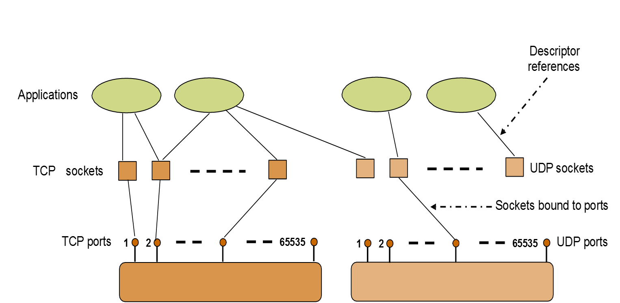
Sockets

Slide 6
Client-Server communication
CSCE 3530

Slide 7
Client-Server communication
Server
Client
Listens for requests on the appropriate port.
Receives the request.
Processes the request
Sends the response.
Ex: The web server accepts the form, retrieves the data from the database and sends the data in the form of a web page.
Submits a request for service.
Receives the response from the server.
Ex: The request for student records is submitted through a form in HTML.

Slide 8
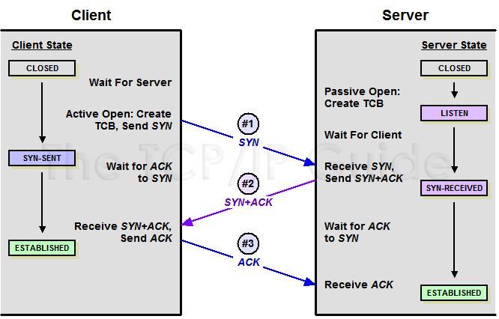
The 3-Way Handshake

Slide 9
Socket Procedures
Server
Client
Create a socket with the socket() function;
Bind the socket to an address using the bind() function;
Listen for connections with the listen() function;
Accept a connection with the accept() function system call. This call typically blocks until a client connects with the server.
Send and receive data by means of send() and receive().
Create a socket using the socket() function;
Connect the socket to the address of the server using the connect() function;
Send and receive data by means of the read() and write() functions.

Slide 10
Creating a socket
int sockid = socket(family, type, protocol);
sockid: socket descriptor, an integer (like a file-handle)
family: integer, communication domain, e.g.,
AF_INET, IPv4 protocols, Internet addresses (typically used)
AF_UNIX, Local communication.
type: communication type
SOCK_STREAM - reliable, 2-way, connection-based service
SOCK_DGRAM - unreliable, connectionless, messages of maximum length
protocol: specifies protocol
Either TCP or UDP
usually set to 0 (i.e., use default protocol)
upon failure returns -1
NOTE: Socket() does not specify where data will be coming from,
nor where it will be going to – it just creates the interface!

Slide 11
Specifying addresses
Particular form of the sockaddr used for TCP/IP addresses:
These structures and macros are defined in netinet/in.h
struct sockaddr_in {
unsigned short sin_family; /* Internet protocol (AF_INET) */
unsigned short sin_port; /* Address port (16 bits) */ struct in_addr sin_addr; /* Internet address (32 bits) */
}
struct in_addr {
unsigned long s_addr; /* Internet address (32 bits) */
}

