Slide 1



Elementary Afterschool Programs Management Database
Database Presentation
Group 10, BMGT402 Section 0101
Mackenzie Bookchin, Olivia Phillips, Kemal Mussa,
Lixuan Lin, Akmal Mustofa, Shivani Madhusudhan

Slide 2

Mission Statement
The purpose of the Afterschool Program database is to track student enrollment in various afterschool programs to ensure best utilization of school and faculty resources.

Slide 3
Objectives
To maintain, create, read, update, and delete data on students
To track which department’s programs are most in demand by students
To identify programs that do not have enough students enrolled
To ensure that programs are properly staffed and funded
To track which building and room each program is being held in
To maintain a point of contact for each student to their parent/guardian

Slide 4

Business Rules
R1: A student can only be enrolled in one afterschool program per semester. All programs must have at least one student in order to run.
R2: If a student leaves or is expelled from school, the contact information associated with that student should be deleted.
R3: Each program only requires one faculty advisor to oversee it, and a faculty advisor can only oversee one program.
R4: If a program’s faculty advisor is fired, a substitute faculty member will oversee the program until a new faculty advisor is assigned.
R5: If the faculty’s information is updated, the program that the faculty advisor associated with will be updated as well.
R6: Each afterschool program has to have a unique name, but each student and faculty member do not.
R7: If a program is cancelled, students will have no program enrollment until they select a new one and the room will be unused unless reassigned.
R8: If a program is updated, the information for its room and student(s) will also be updated.
R9: Students, guardians, faculty members, programs, and departments all must have their own unique ID or number.
R10: Each student has to have at least one parent/guardian listed in the system. A parent/guardian can be in the system for more than one child if they have multiple children attending the school.

Slide 5
Business Rules (Cont’d)
R11: A guardian may not be removed from the system if there is a student in the system associated with that guardian.
R12: Each department can run one or many programs, but a program can belong to only one department.
R13: Each department can have one or many faculty members, but a faculty must belong to only one department.
R14: A department may not be removed from the school if it employs any faculty members.
R15: A department can not be removed if it currently runs any programs
R16: A department’s information can not be updated if it currently runs any programs
R17: If a department’s information is updated, all faculty information must be updated as well.
R18: A building number, and a room number in a building, may not be repeated twice.
R19: If a building is no longer in use by the school, all rooms in the building should be removed from the system.
R20: If a building number is changed, all rooms associated with the building should also be updated.
R21: Each program needs at least one room to operate, and each room can only host one afterschool program.
R22: A building has many rooms, but a room only belongs to one building.
R23: All school activities must start at 4PM and end before or by 6PM.

Slide 6
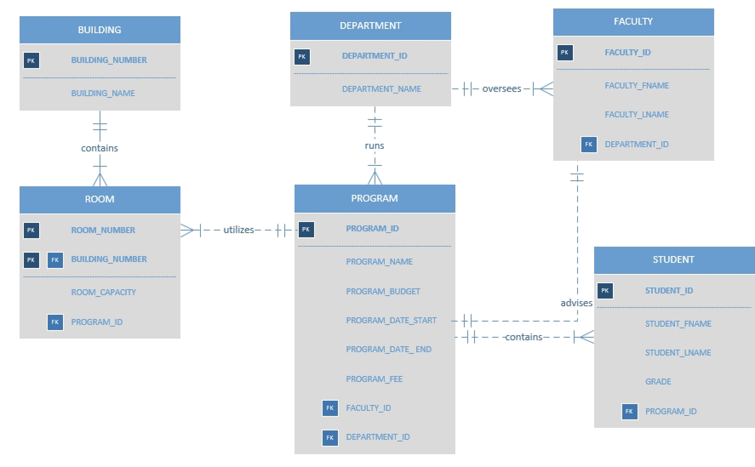
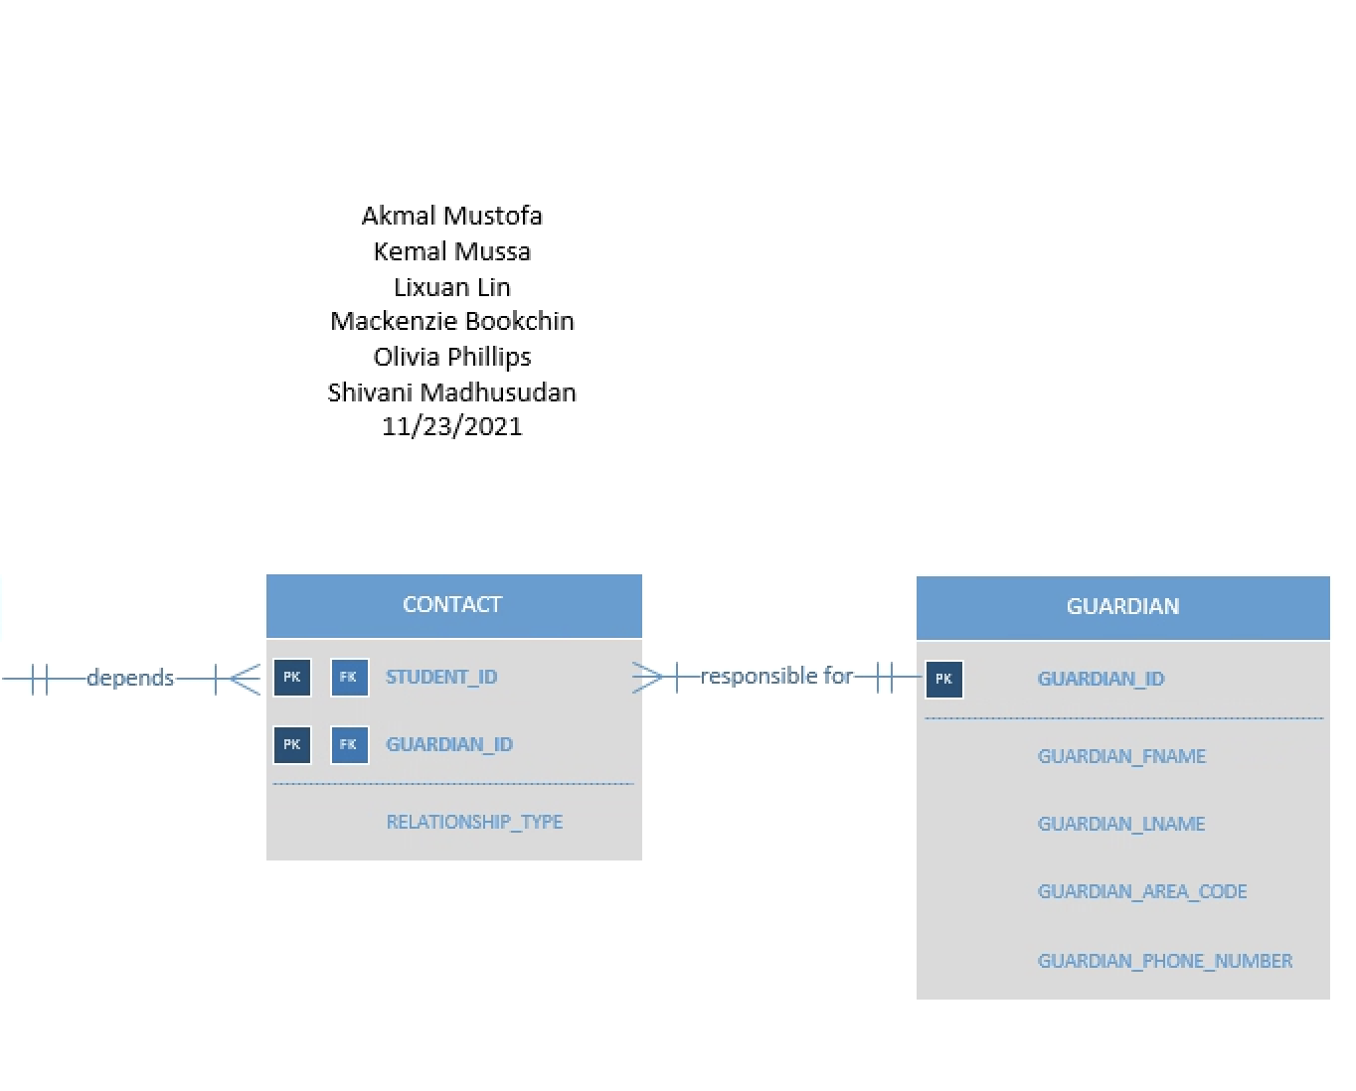
Entity Relationship Diagram (ERD)
Notes:
(Suzie)

Slide 7
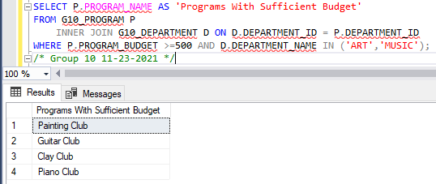
Query A: High Budget Arts Programs
This report shows the more expensive art and music clubs, whose budgets are greater than or equal to $500.This can help directors determine what the application fee should be or if the budget should be decreased.
Mission Objective:
To ensure that programs are properly funded

Slide 8
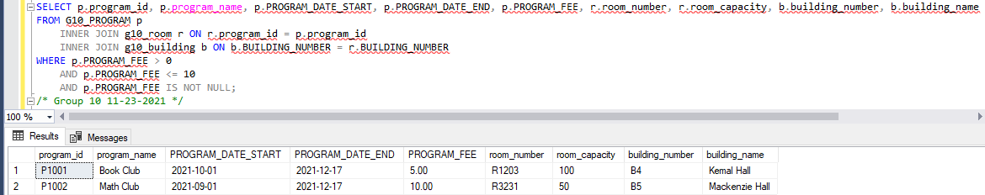
Query B: Low Cost Program Information for Students
This report will help the school inform students of the inexpensive clubs offered. This is for students that are seeking an afterschool program with a fee less than $10, but not one of the free programs. Additionally, this query accounts for those programs which have already reached capacity.
Mission Objective: Identify programs that do not have enough students enrolled

Slide 9
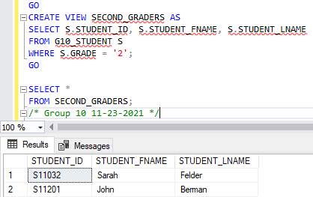
Query C: PTA Pizza Party Student List
The school’s PTA president is planning a pizza party for the schools second graders. In order to do so, they need to see a list of all of the second graders currently enrolled in the school, in order to know how much food to order and customize gifts for the students. They will only receive limited access to information encompassed in this custom view to provide as little access to the database as possible.
Mission Objective:
To read data on students

Slide 10
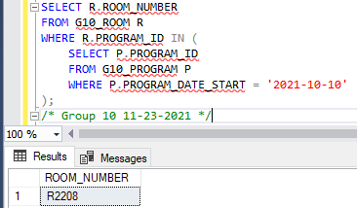
Query D: Program Start Date Information for Room Prep
In order to have all rooms ready for their respective programs, the janitorial staff need to know what dates there are programs and which rooms they are in. Some programs begin later in the semester on October 10th, so this query provides a list of which rooms will need to be ready for use by this start date.
Mission Objective:
To track which building and room each program is being held in

Slide 11
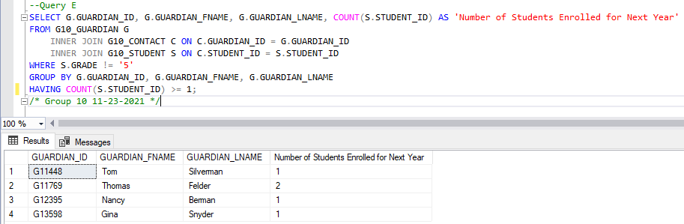
Query E: Next Year’s Program Registration
At the end of each school year, the school will send out information by email regarding after-school programs that can be signed up for for the following school year. Because some guardians have multiple students in the same household, they do not need to be sent this information multiple times. This query will provide a list of guardians who need to be sent next year’s program information.
Mission Objective:
To maintain a point of contact for each student to their parent/guardian

Slide 12
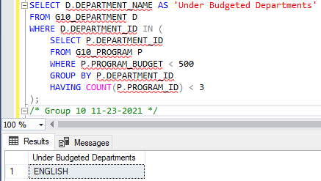
Query F1: Finding Underfunded Departments
The elementary school wants to determine which departments are underfunded and could potentially use more funding and more programs. Running this query will determine which departments have less than three programs, and which have programs that are considered low budget (less than a budget of $500).
Mission Objective:
To manage the development of departments and their respective programs.

Slide 13
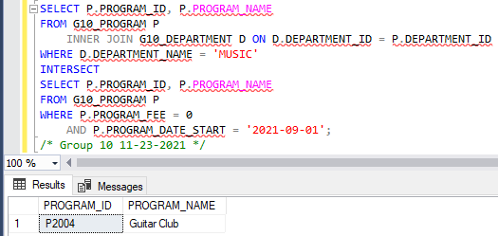
Query F2: Which Programs Will Fill Up First?
The school would like to know which programs to expect to fill up first. In the past, programs running for the entirety of the semester (Sept-Dec) were strongly desired, and there has been a high demand for programs in the music department. Additionally, the school expects that programs with no enrollment fee will be filled before those with a cost. Therefore, this query will show a list of programs run by the music department, beginning in September, and having no fee to enroll.
Mission Objective:
To track which department’s programs are most in demand by students

Slide 14
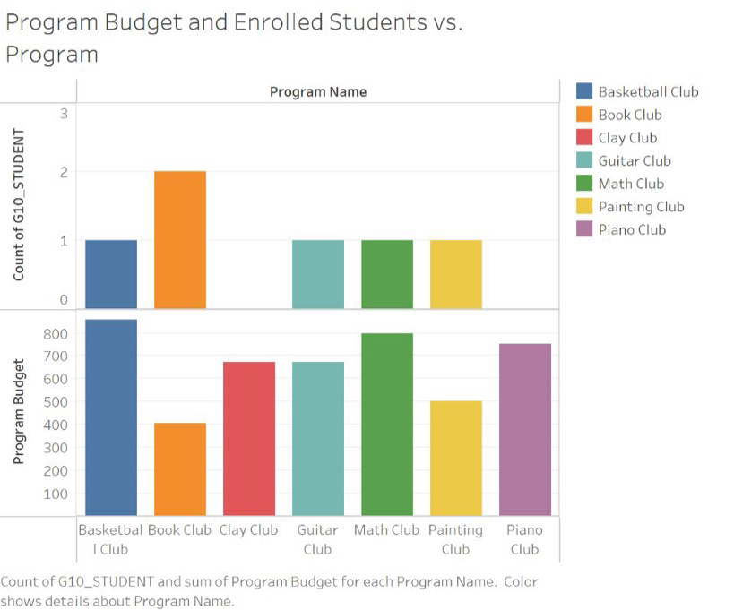
Which programs need less or more funding?
The school would like to better utilize resources for after-school programs in order to allocate budget according to number of enrolled students per program.
Tableau can aid in the decision making process for which programs need more or less funding.
Mission Objectives:
- To identify programs that do not have enough students enrolled
- To ensure that programs are properly staffed and funded

Slide 15

Thank you!
Any Questions?
We pledge on our honor that we have not given or received any unauthorized assistance on this assignment
Mackenzie Bookchin, Olivia Phillips, Kemal Mussa, Lixuan Lin, Akmal Mustofa, Shivani Madhusudhan

