Slide 2
Goal: Recruit people to women in tech gala
Specifically: Choose the best stations to collect emails at
Our approach:
Define target audience
Identify stations used by target audience
Choose highest traffic stations of interest

Slide 3
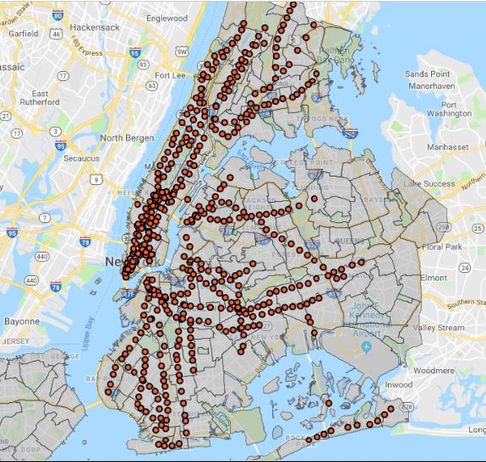
Define target audience
Women in technology fields
Women working in other fields
Other genders in technology fields
Students
NTA demographic data
NTA demographic data
Map data
Maps titled “NTA Map” & “Subway Stations” are available on NYC Open Data

Slide 4
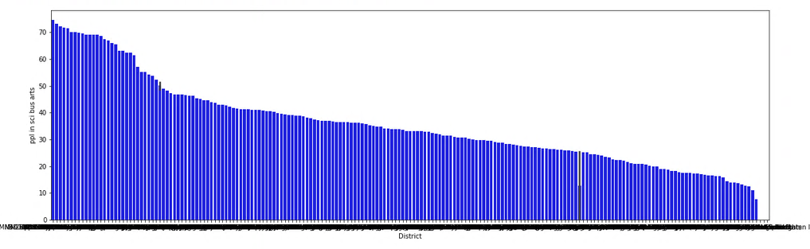
Filter – neighborhoods with most tech workers
% of people working in business, management,
science, and art – by neighborhood
* Neighborhood tabulation area data was collected in 2012 by the City of New York and available at: https://data.cityofnewyork.us/City-Government/Demographics-and-profiles-at-the-Neighborhood-Tabu/hyuz-tij8

Slide 5
Filter – neighborhoods with most employed women
(ANOTHER GRAPH LIKE THE PREV)
(this slide should be fast to explain since it will look nearly identical to the prev)

Slide 6
Which stations (of our filtered stations) have the most traffic?

Slide 7
Appendix

