Slide 1
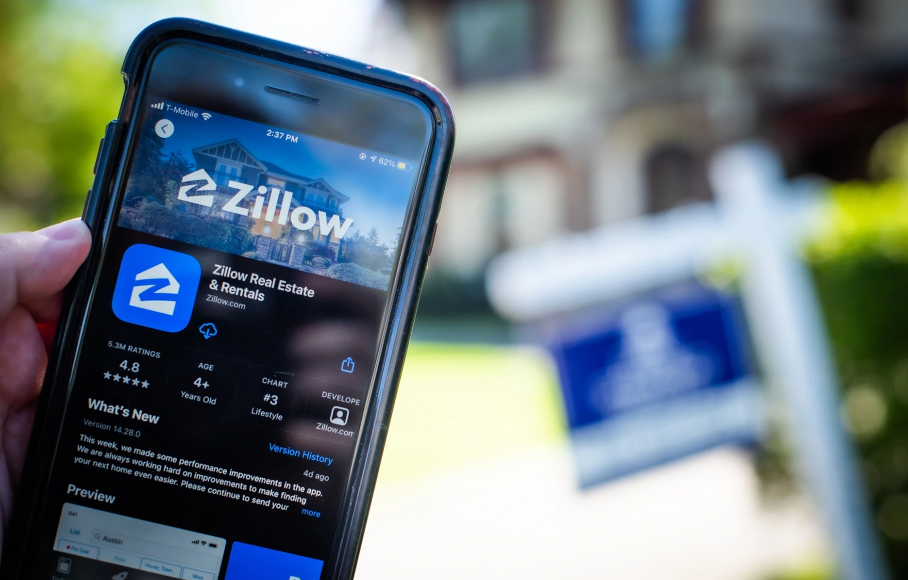
Insight into Zillow
Buying Properties in
Specific Neighborhoods
Team Members: Karl Eirich, Kasha Muzila, Joe Damisch

Slide 2
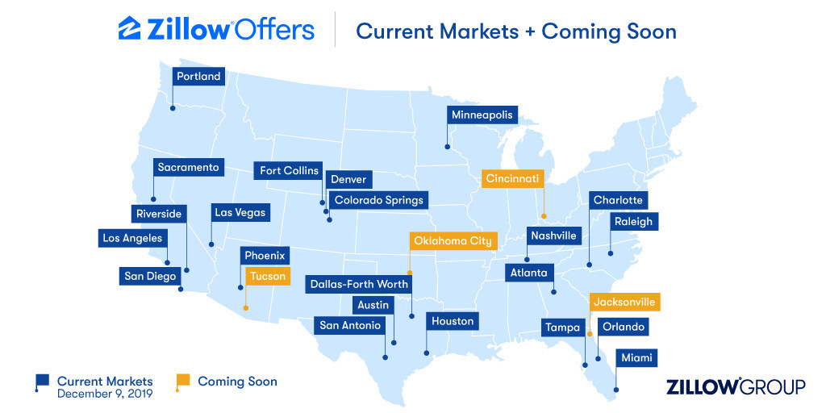
Overview

Slide 3
Project Objective:
Create a pipeline that can show a correlation between Yelp data and Zillow-owned homes within that neighborhood.

Slide 4



Pipeline Overview
Docker &
Docker Compose
Open source containerization platform and tool
Helps create a remote cloud environment for streaming
Kafka
Open source event streaming platform capable of handling trillions of events a day
Topics: events
Flask
Lightweight web application framework
API Calls:
summary
zipcode
refresh
Apache Bench
Generates test data
Item 1
Spark
Filters our data
Cloudera
HDFS - storage
Presto
Query data

Slide 5
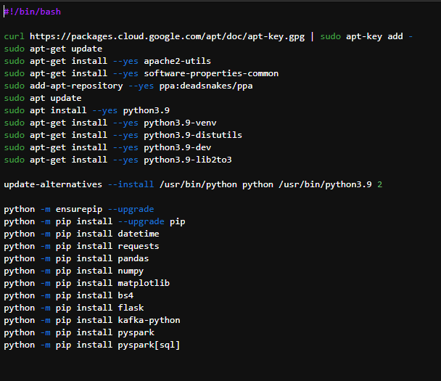
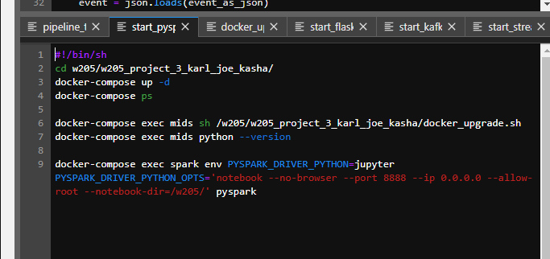
Docker and Docker Compose

Slide 6
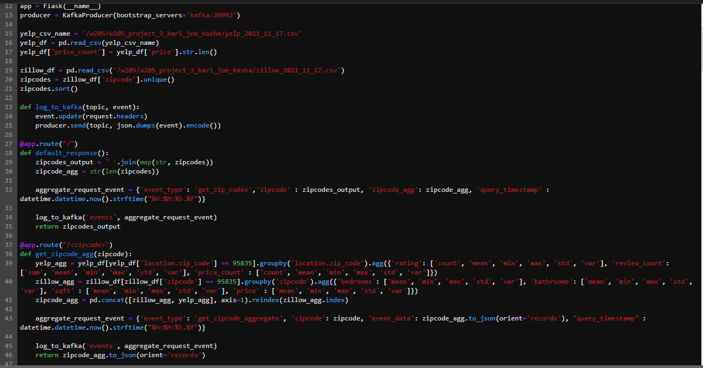
Kafka

Slide 7
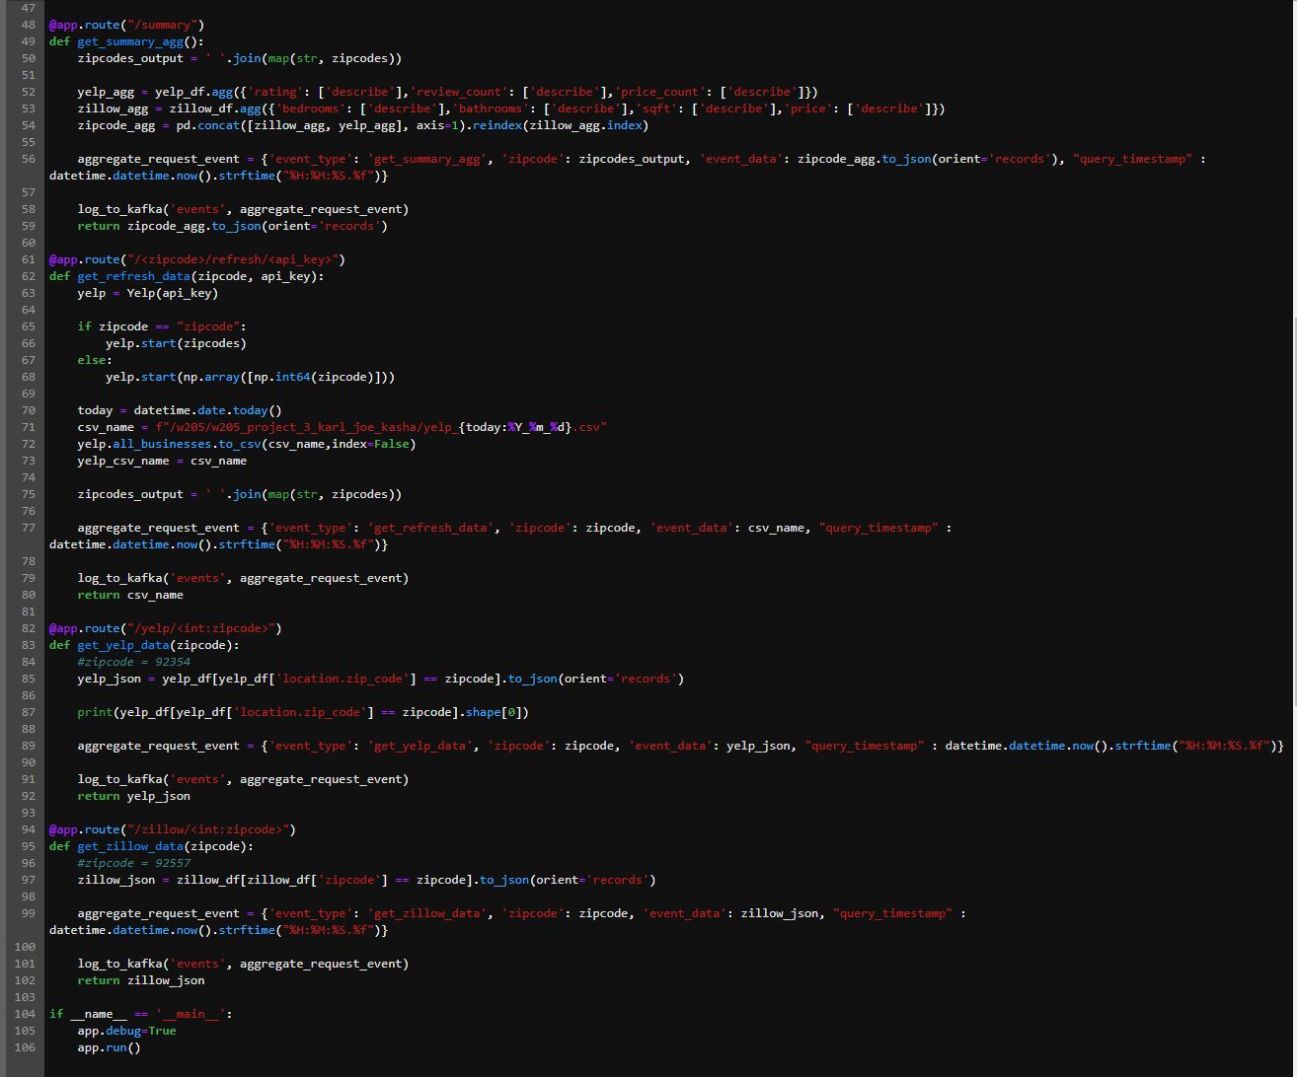
Flask

Slide 8
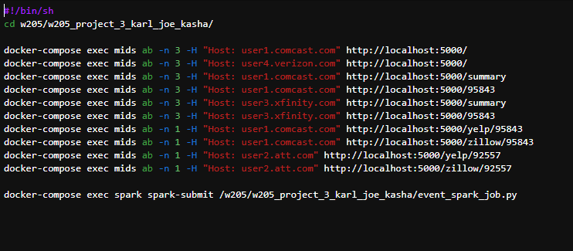
Apache Bench

Slide 9
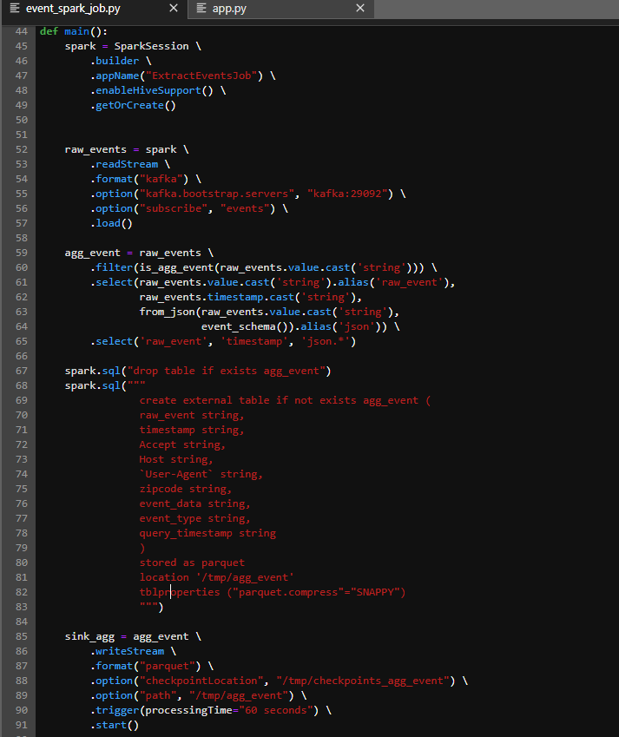
Spark

Slide 10
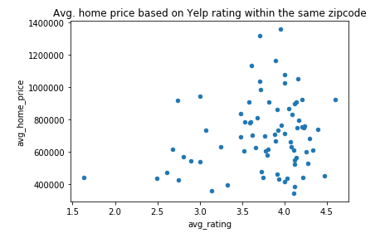
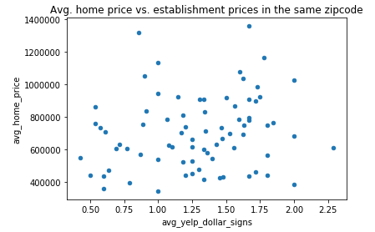
Analytics

Slide 11
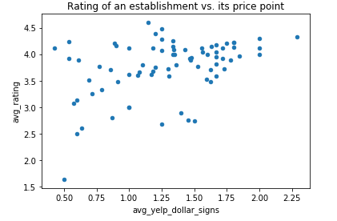
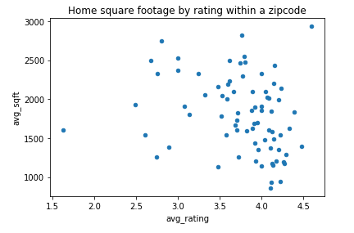
Analytics Cont.

Slide 12
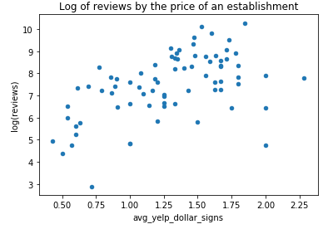
Analytics Cont.

Slide 13
Thank you!
Questions?

